Slide 1

ChatBot Weekly Report(0321-0328)
Alex Chuang
d05921017@ntu.edu.tw
Department of Electrical Engineering, National Taiwan University

Slide 2
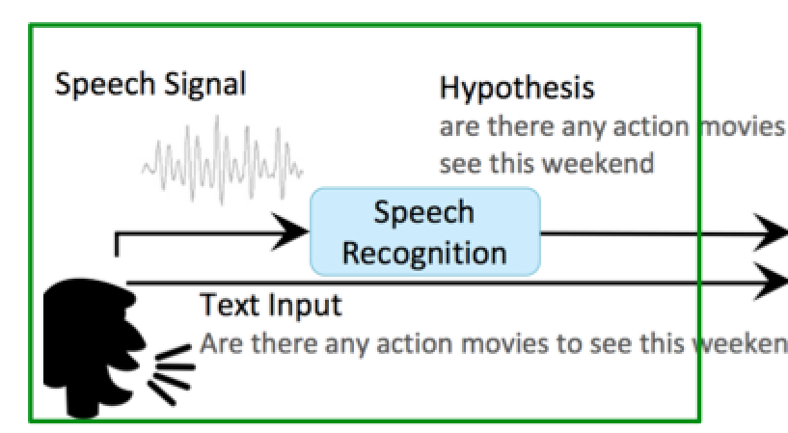

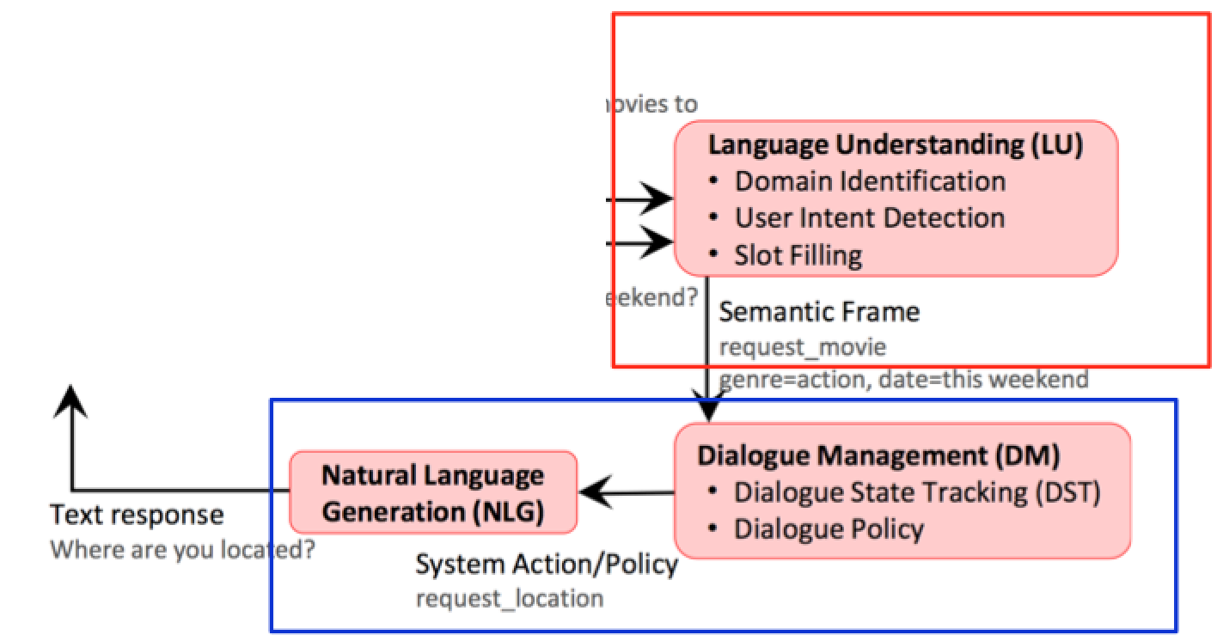
Not found
Onlineshoppingbot architecture
Rule base system
Found intent and slots
_{Found intent}s and slots
Learning base system

Slide 3
Learning based system
python api_service.py --data_dir data/ --train_dir model_tmp --max_sequence_length 50 --task joint --bidirectional_rnn True

