Slide 1

IoT Analytics, ML , and Amazon SageMaker
主講人: 謝旻軒
日期: 2021/9/16

Slide 2
Agenda
Introduction of IoT Analytics
Brief introduction of Machine Learning
Machine Learning with Amazon SageMaker

Slide 3
Introduction of IoT Analytics

Slide 4




What is IoT Analytics?
Amazon SageMaker
Analytics / Machine Learning
Ingest IoT Data
Notebook
Reports / Dashboards
AWS IoT Analytics
Amazon QuickSight
Automate steps to gather data for data analytics or ML
Auto data transformation, cleaning, query
Fully integrated with AWS IoT Core

Slide 5




Under the Hood of IoT Analytics
AWS IoT Analytics
Channel
Pipeline
Data store
Dataset
Raw Data
Transformation
Processed Data
Query Data
4 components
Multiple pipelines can connect to a single channel and data store
Datasets can be formed from a single data store

Slide 6
Under the Hood of IoT Analytics
AWS IoT Analytics
Dataset
Pipeline
Data store
Dataset
Channel
Pipeline
Data store
Dataset
Pipeline
Dataset
4 components
Multiple pipelines can connect to a single channel and data store
Datasets can be formed from a single data store

Slide 7

Channel
Channel
Amazon S3
AWS managed or customer managed
Entry of IoT Analytics
Stores raw data
Data is stored in S3, and can be configured to be AWS Managed or customer managed

Slide 8
Pipeline
Pipeline
Responsible for data transformation
Consumes messages from the channel
Sends processed messages to a data store

Slide 9
Pipeline
Message transform activities such as:
Remove attribute
Add attribute
Select attribute
Calculate attribute
Transform using Lambda
Filter messages
Append Device Registry Info
Append Device Shadow Info
Pipeline
Responsible for data transformation
Consumes messages from the channel
Sends processed messages to a data store

Slide 10
Data store
Data store
Amazon S3
AWS managed or customer managed
Responsible for storing processed data
JSON/PARQUET format
Data is stored in S3, and can be configured to be AWS Managed or customer managed

Slide 11
Dataset
A materialized view from a data store.
Used for reporting or ML purposes.
SQL Dataset
Automates custom analysis with a container image with a desired schedule.
Dataset
Container Dataset
Queries data from data store
Can create multiple datasets from the same data store
SQL Dataset / Container Dataset

Slide 12

More about SQL Data set
SQL operations
Configure to send data to S3
S3 Bucket
Data store
SQL Dataset
Use the same SQL queries, functions and operators as Amazon Athena
Schedule data refresh
Configure data retention period
Configure destination to S3/IoT Events

Slide 13






IoT Analytics and Kinesis Firehose
Device
S3 Bucket
Amazon Kinesis Data Firehose
AWS Glue
Amazon Athena
Lambda function
IoT Analytics
MQTT Messages
IoT topic
IoT rule
Channel
Pipeline
Data store
Dataset
IoT Analytics is a fully-managed IoT analytics service
Data transformation/enrichment
IoT Analytics is best suited for analyzing, visualizing, and do ML on IoT data

Slide 14
Why choose IoT Analytics over Kinesis Firehose?
Device
S3 Bucket
Amazon Kinesis Data Firehose
AWS Glue
Amazon Athena
Lambda function
MQTT Messages
IoT topic
IoT rule
AWS IoT Analytics
To manage the complexities of IoT data
IoT data frequently has corrupted messages and false readings that must be cleaned up before analysis can occur
IoT Analytics can filter, transform, and enrich IoT data before storing it in a data store for analysis

Slide 15
Pricing of IoT Analytics (ap-northeast-1)
Storage price
Raw data: Same as S3
Processed data and data set: 0.04 USD/GB per month
Data processing fees
0.26 USD/GB processed
Query Execution
8.45 USD/TB of data scanned

Slide 16




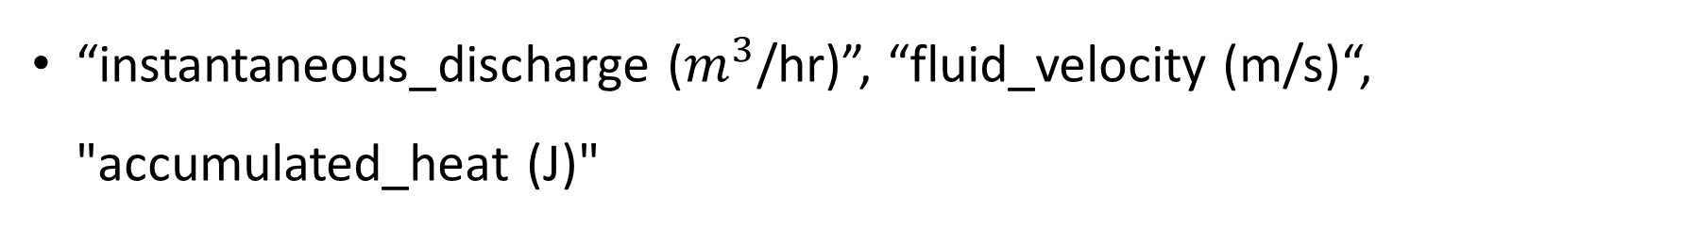
Demo
“instantaneous_discharge ($m^{3}$/hr)”, “fluid_velocity (m/s)“, "accumulated_heat (J)"
Device
AWS Cloud
AWS IoT Greengrass
MQTT Messages
Artifact
Component
IoT topic
IoT rule
Channel
Pipeline
Data store
Dataset
Notebook

Slide 17
Brief introduction of Machine Learning

Slide 18
The Concept of Machine Learning
Machine Learning = Finding a Function
Pictures as input, outputs an object name → Image recognition
Environment state (from sensors) as input, outputs a description
Categories of Machine Learning
Supervised → labeled data, task is pre-defined
Unsupervised → for data exploring, research purposes

Slide 19
The Concept of Machine Learning
Machine Learning = Finding a Function
Pictures as input, outputs an object name → Image recognition
Environment state (from sensors) as input, outputs a description
Categories of Machine Learning
Supervised → labeled data, task is pre-defined
Unsupervised → for data exploring, research purposes

Slide 20
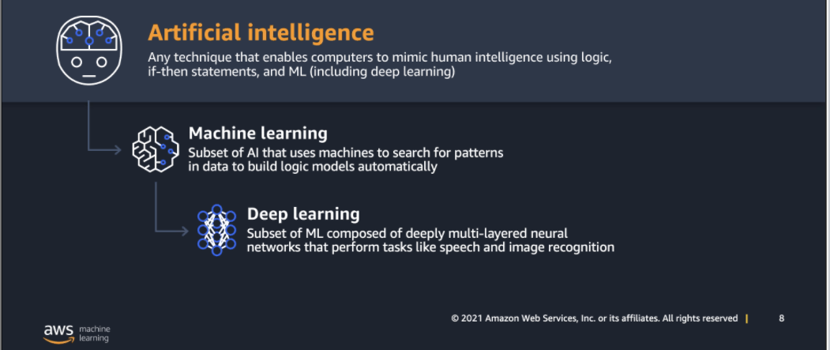
AI, ML, and Deep Learning

Slide 21
Procedure of ML
Define the problem
Regression/Classification/etc.
Data preparation
Labeling data
Dataset partition
Choose algorithm (model), hyperparameters
Common ML models
Train model
Inferencing model

Slide 22
Define the problem
Regression → Objective metric: MSE/RMSE
Forecasting PM2.5
Classification → Objective metric: Accuracy
Email spam filtering bot (yes/no)
Image classification on animals (which animal)
and much more…

Slide 23
Data preparation
The more, the better
Labeling data
Pre-process data
Dataset partition
Training set/Validation set
To avoid overfitting

Slide 24
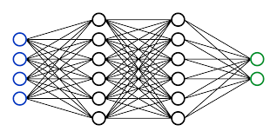
Choose algorithm (model), hyperparameters
Common ML models
Neural Network (e.g. CNN, RNN, DNN)
Decision Tree (e.g. XGBoost)
Support Vector Machine
Hyperparameters
Batch
Epoch
Loss function
Optimizer
…

Slide 25
Train model
How?
By continuously adjusting parameters in model.
Common ML frameworks
PyTorch
TensorFlow
Scikit-learn
Keras
MXNet

Slide 26
Inferencing model
Inference = data asking the model
Batch inference = multiple data doing inference

Slide 27
Machine Learning with Amazon SageMaker

Slide 28
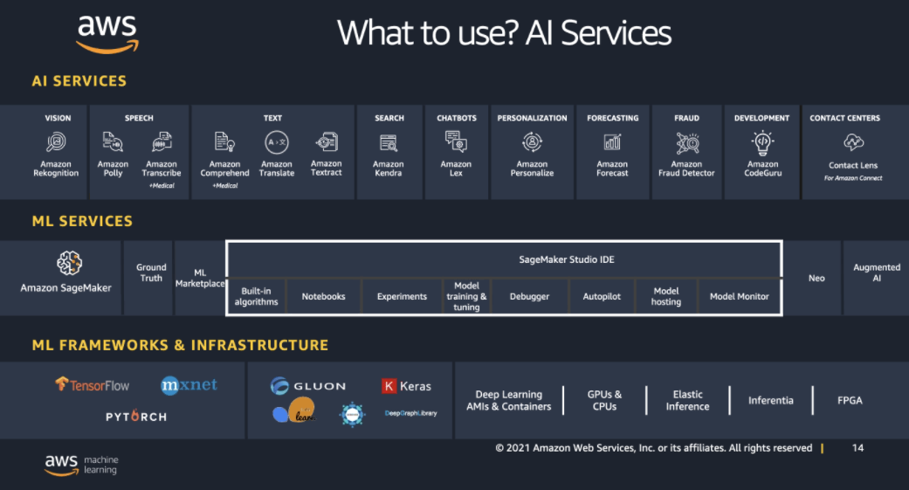
AWS ML Stack

Slide 29
Some SageMaker Features
Ground Truth → Human labeling data
Hyperparameter tuning → Automate hyperparameter tuning job
Autopilot → Automate ML
Model hosting → Use instance to host model for inference
Augmented AI → Human decide when confidence is low
Neo → Compile model to inference on edge device

Slide 30



SageMaker Overview
Prepare
Build (algorithm)
Train & Tune
Deploy for inference
Python SDK
Endpoint
SageMaker Notebook
Train
1-click Deployment
Model
Neo
Amazon SageMaker Ground Truth
Edge
Neo Compiled
Model
SageMaker Autopilot
Hyperparameter
Tuning

Slide 31
Using and Training in SageMaker
Jupyter Notebooks (.ipynb)
SageMaker Notebook instance
Notebook in SageMaker Studio
Training in SageMaker
Training on a separate instance, not in Jupyter Notebook kernel
Data must be in S3
Use SageMaker Python SDK and boto3 to call
Use spot instance

Slide 32
SageMaker Console, SageMaker Studio, and SageMaker Notebook instance
SageMaker Studio
A fully integrated IDE, which means it is a gateway to many tools with single interface
Only charge fees when kernel is running
Share codes with colleges

Slide 33
SageMaker Autopilot
Pros
Automated Machine Learning
Automated Data Exploring & Analyzing
Generates training notebook
Model leaderboard
Cons
Can only work with regression/classification tasks
Cannot use pretrained model
Notes:
Short/long term

Slide 34


SageMaker Neo
Download/
GGV2 Component
S3
S3
Device
Neo compile
Console
CLI
SDK
Model
Compiled
Model
Compiled
Model
Neo
Runtime (dlr)
.tar.gz

Slide 35
Thanks for Listening

