Slide 1
第六組專題報告
電機三 余欣澄、陳思穎、蔡汶玲

Slide 2
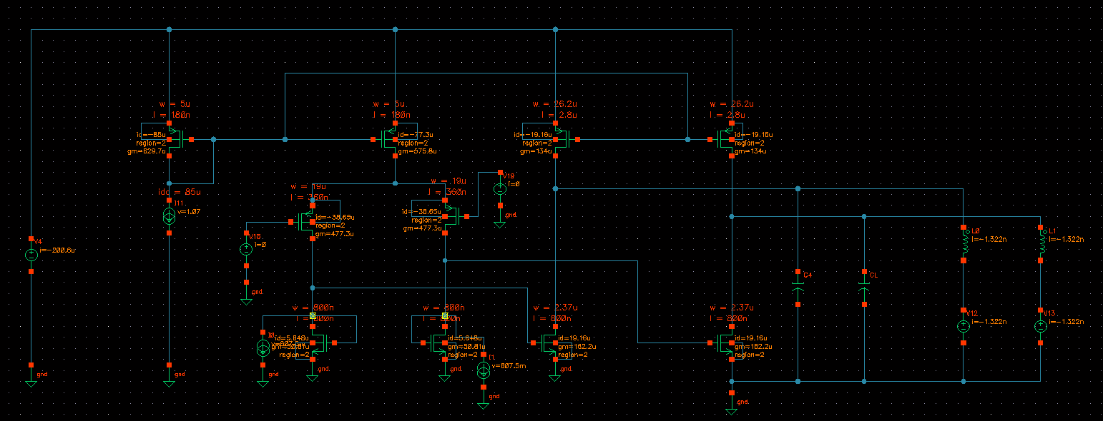
Current-shunt CMOTA

Slide 3
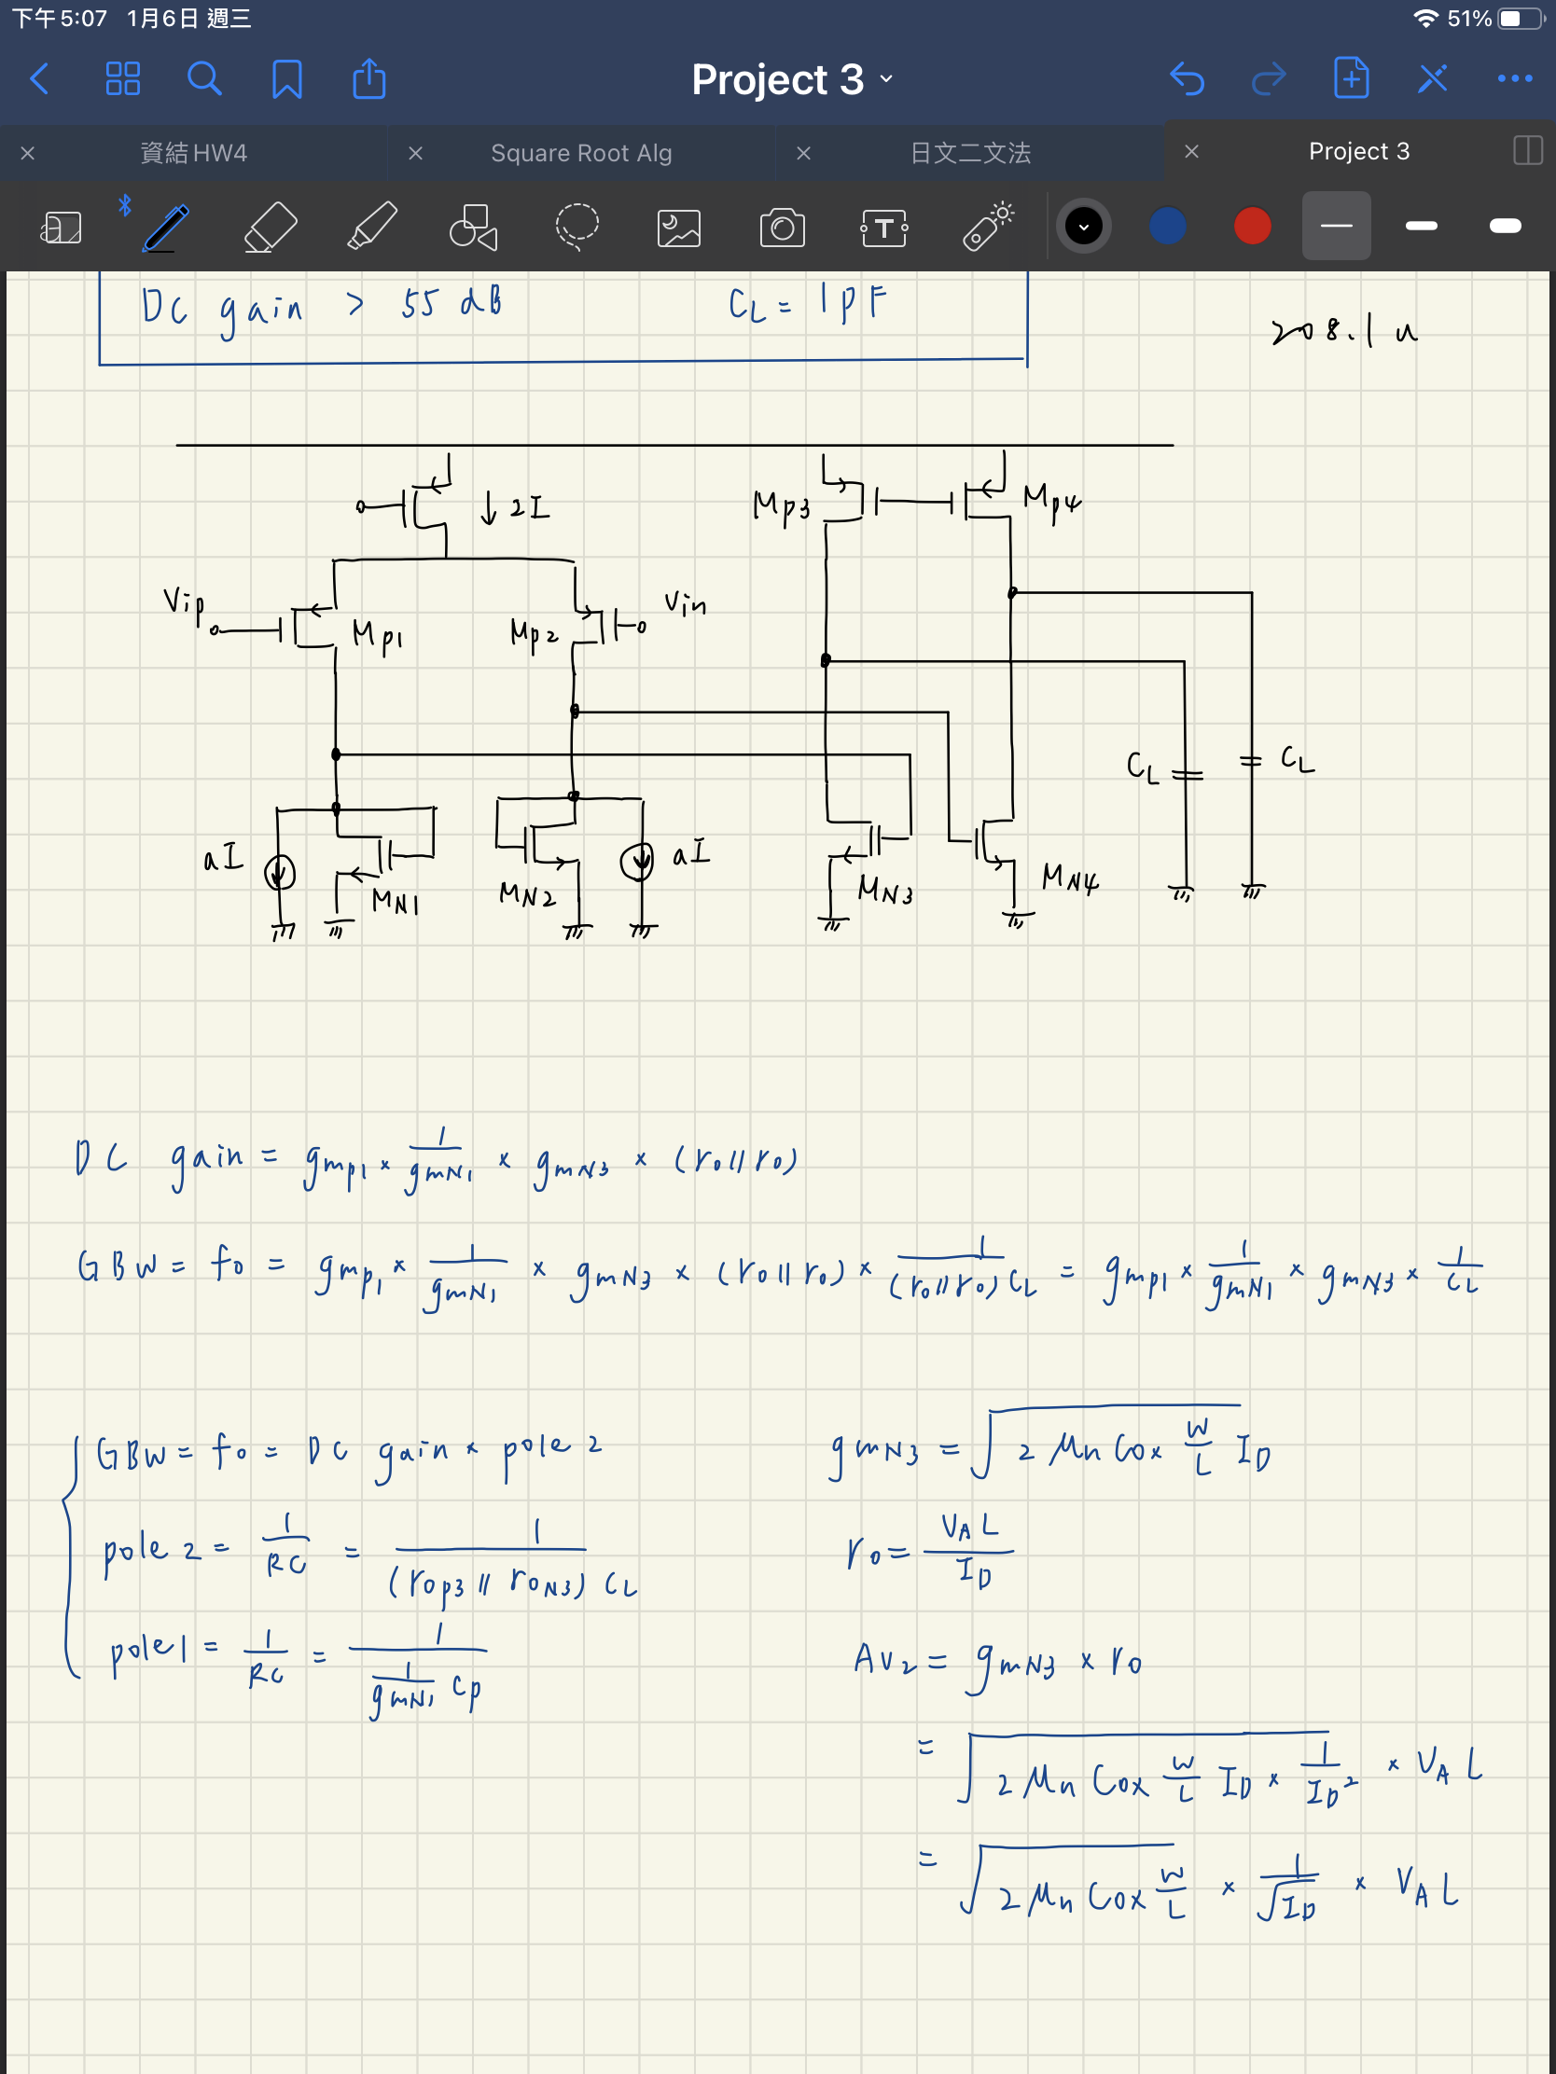

Slide 4
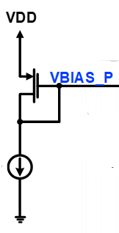
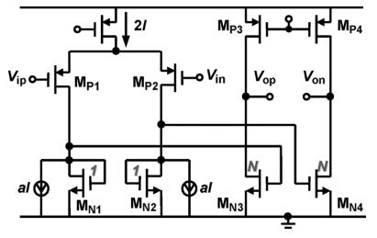
Q1
W=5u
L=180n
Q2
W=5u
L=180n
Q7
W=26.2u
L=2.8u
Q8
W=26.2u
L=2.8u
Transistor | L(m) | W(m)
Q1 | 180n | 5u
Q2 | 180n | 5u
Q3 | 360n | 19u
Q4 | 360n | 19u
Q5 | 800n | 800n
Q6 | 800n | 800n
Q7 | 2.8u | 26.2u
Q8 | 2.8u | 26.2u
Q9 | 800n | 2.37u
Q10 | 800n | 2.37u
Idc=85uA
Q3 Q4
W=19u
L=360n
33uA
33uA
Q5
W=800n
L=800n
Q6
W=800n
L=800n
Q9
W=2.37u
L=800n
Q10
W=2.37u
L=800n

Slide 5
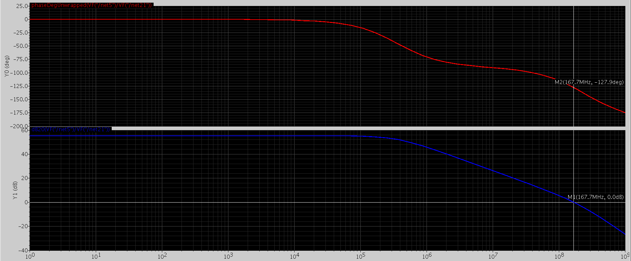
Parameters | Value
DC gain | 55.34dB
PM | 52.2°
GBW | 167.6MHz
Power | 208.1uW
First stage gain | 18.53
Second stage gain | 36.81

Slide 6
Different a
N= 2.9625
2I= 77.3uA
I= 38.65uA
a | aI | DC Gain (dB) | GBW (MHz) | PM | Power (W) | Size of PMOS（second stage）
0.54 | 21u | 48.47 | 175.6 | 61.3° | 339.9u | 76.1u/2.8u
0.85 | 33u | 55.35 | 167.6 | 52.2° | 208.1u | 26.2u/2.8u
0.96 | 37u | 62.06 | 140.9 | 39.4° | 161.6u | 8.58u/2.8u

Slide 7
Different N
N | DC Gain (dB) | GBW (MHz) | PM | Power (W) | Size of NMOS（second stage） | Size of PMOS（second stage）
1.5 | 55.39 | 98.73 | 69.1° | 172.148u | 1.2u/800n | 12.58u/2.8u
2.9625 | 55.35 | 167.6 | 52.2° | 208.1u | 2.37u/800n | 26.2u/2.8u
6 | 55.30 | 239.3 | 34° | 283.9u | 4.8u/800n | 54.88u/2.8u
10 | 55.28 | 278.6 | 23.2 | 384.4u | 8/800n | 92.92/2.8u
Av2=gmN3*ro
=sqrt(2*un*Cox*W/L*Id)*(VA*L/Id)
=sqrt(2*un*Cox*W/L)*1/sqrt(Id)*VA*L

Slide 8
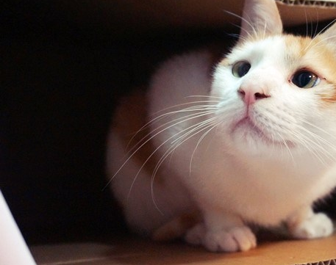
Thank You!

