Slide 1
DICOM Network Services

Slide 2
DICOM 規範之網路傳輸協定
Part 4 Service Class Specifications
  定義DICOM 的傳輸各種功能（Exp. Storage, Query/Retrive, Print ……)
Part 7 Message Exchange
  訂定 DICOM Command Request and Response 的內容
Part 8 Network Communication Support for Message Exchange
  網路連結建立及資料傳輸的方式

Slide 3
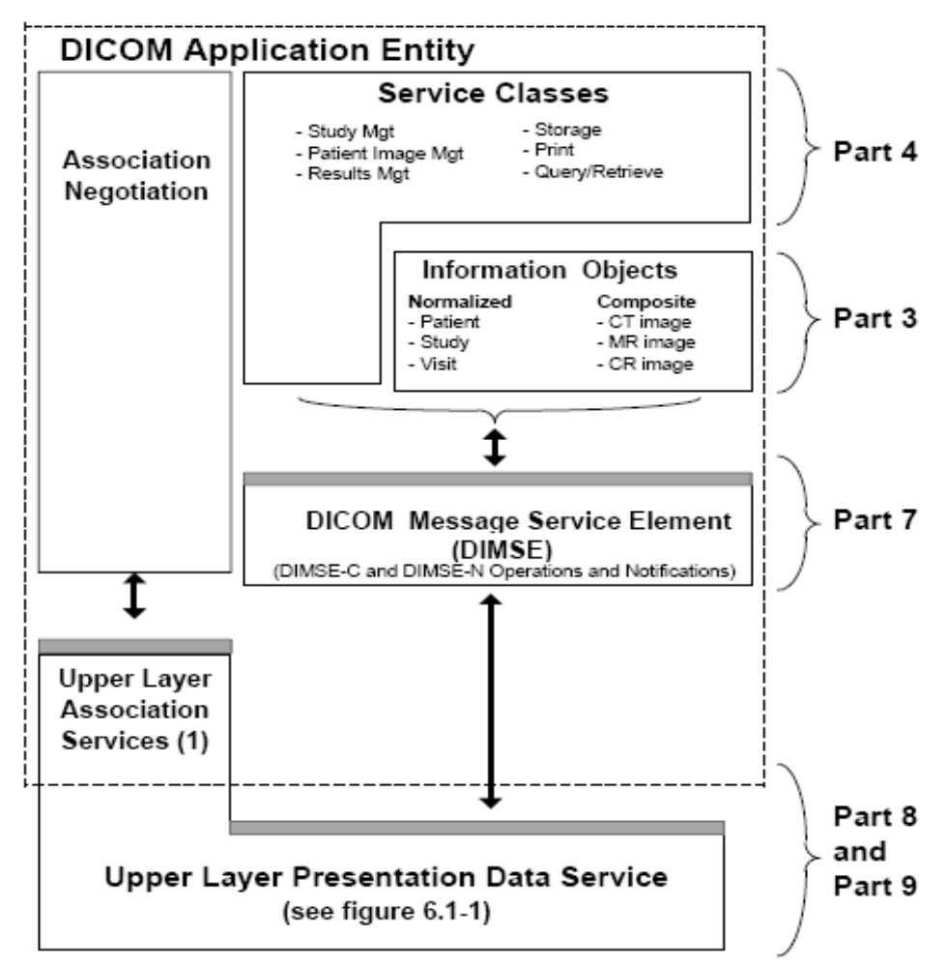

Slide 4
Part 8: Network Communication Support for Message Exchange
網路連結建立及資料傳輸的方式

Slide 5

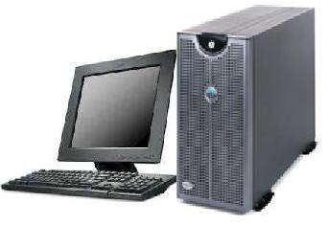
Client-Server Model
Browser is client & HTTP server is server
DICOM SCU (Service Class User) is client and SCP (Service Class Provider) is server
  Server waits for incoming requests
  Client initiates communication
Request
Response
Client
Server

Slide 6
DICOM data exchange base on TCP/IP Socket Link
(1)
TCP/IP Internet/intranet
Client
Call connection
(IP,Port)
Server
Socket port
listening
(2)
Server listening another connection
Socket Link
And Multi-Thread Process
Generate new thread
Pass socket handle to the thread
Server connected
socket
(TCP/IP) Link
Read and sent data
Client connected socket

Slide 7

Multi-Threaded Server
Several requests from multiple clients at any given time
Servers run multiple threads; each handling an individual connection
One Server
Port 104
Multiple Clients

Slide 8
Client /Server的連線流程(TCP)：
Server
client
Server端：
伺服器行程必須先執行
伺服器必須開啟一 socket 來〝聆聽〞用戶端的連線請求 。
Client端：
開啟一 socket用來與伺服器連線
指定 IP, 伺服器行程之 port number
socket()
socket()
bind()
listen()
connect()
accept()
read()
write()
write()
read()

Slide 9
DICOM 網路連結的設定
設定內容
  IP: Server 需有固定 IP，Client 通常亦需固定 IP
    client server 角色在影像傳輸時有時會調換
      如接收影像時，Viewer 為 Server (SCP)
  Port :DICOM 傳輸常用 104 or 10004 Port
  AE Name: Application Entity Name，需設定對方的 AE Name
PACS server 當中設定及管控許多 Client (Modalities and Viewers)
Modalities and Viewers 系統也可設定連結至多個 server

Slide 10
DICOM Association

Slide 11
DICOM Association 作用與內容
檢驗對方系統的權限(Check Application Entity Name)
溝通雙方接能支援的 DICOM 傳輸功能(SOPs)
協商每個傳輸服務資料的編碼方式(Transfer Syntax)
交換雙方資訊(User information)

Slide 12
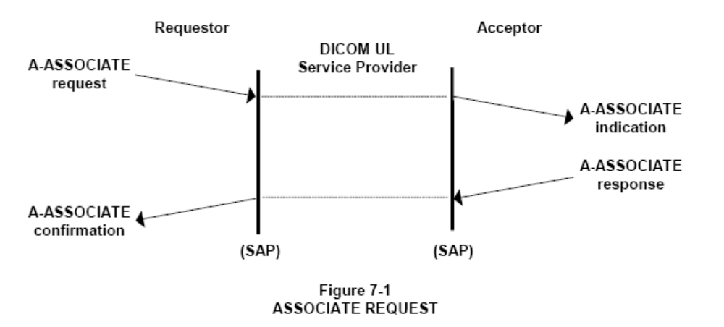
DICOM Associate Request and Response

Slide 13
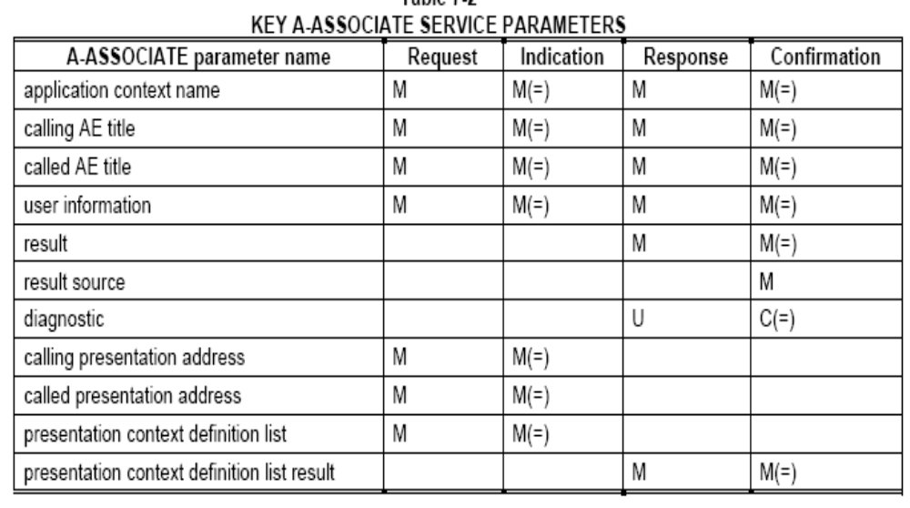
A-ASSOCIATE PARAMETERS

Slide 14
DICOM Association Communication
SCP
SCU
(3)
Server
(Chose SOPS and Trans. Syntexs)
Client (Purpose SOPs and Trans. Syntexs)
Association request
Association response
SCU 端提出希望進行的傳輸服務 (SOP , Exp. Storage, Query ,Retrieve,MWL…)以及每個傳輸服務資料的編碼方式(Transfer Syntex)
SCP 回應能夠提供的傳輸服務及選定資料的編碼方式

Slide 15
DICOM Association Communication
SCP
Association request
SCU
(3)
Association response
Local AEName HISCO_SCP, Remote AEName GE_SCUApplication Context Name 1.2.840.10008.3.1.1.1 (DICOM 3)
Request Presentation Context ID 1
Abstract Syntax Name 1.2.840.10008.1.1 (Verification) Transfer Syntax Name 1.2.840.10008.1.2 (Implicit Little Ending)
Abstract Syntax Name 1.2.840.10008.5.1.4.1.1.2 (CT Storage) Transfer Syntax Name 1.2.840.10008.1.2 .1 (Explicit Little Ending)
Local AE User Informations
Max Sub Length 10000
Implementation Class HISCO DICOM LIB
Implementation Version V 2.0 20001200
Local AEName GE_SCU, Remote AEName HISCO_SCP
Application Context Name 1.2.840.10008.3.1.1.1 (DICOM 3)
Request Presentation Context ID 1 Abstract Syntax Name 1.2.840.10008.1.1 (Verification) Transfer Syntax Name 1.2.840.10008.1.2 (Implicit Little Ending)
Request Presentation Context ID 3
Abstract Syntax Name 1.2.840.10008.5.1.4.1.1.2 (CT Storage) Transfer Syntax Name 1.2.840.10008.1.2 (Implicit Little Ending) Transfer Syntax Name 1.2.840.10008.1.2 .1 (Explicit Little Ending)
Request Presentation Context ID 5 Abstract Syntax Name 1.2.840.10008.5.1.4.1.2.2.1 (S. Root Query) Transfer Syntax Name 1.2.840.10008.1.2 (Implicit Little Ending)
Local AE User Informations
Max Sub Length 16384
Implementation Class 1.2.124.113532.3320
Implementation Version BROKER971.0

Slide 16
Part 7 Message Exchange
訂定 DICOM Command Request and Response 的內容

Slide 17
DICOM Message
DICOM 傳輸會交換 Message 跟 Data
  Message : 定義於 DICOM Part 7，用來觸發及回應各項 DICOM 網路傳輸服務(如影像儲存、影像查詢等)
  Data : 定義於 DICOM Part 3，各式臨床醫療儀器產生的資料
    Message 內容組成 DICOM Command Object (DCO)，Data 組成 DICOM Data Object (DDO)。

Slide 18
DICOM Message
Message 與 Data 編碼後傳輸， Message 編碼方式定義於 Part 7，Data 編碼方式定義於 Part 5，兩者格式類似
Message 當中包含許多 Element，每個Element 包含 Tag、Length、Value 三部份

Slide 19
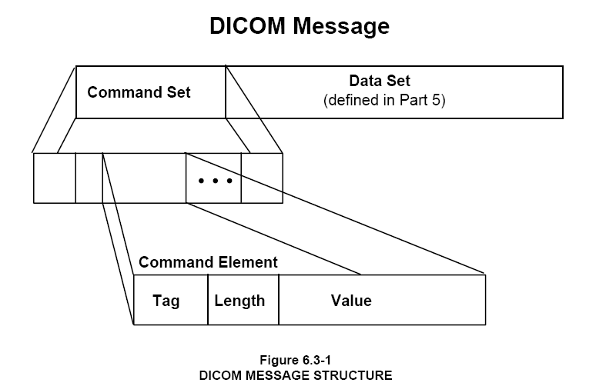
DICOM Message
DICOM 網路傳輸，一定會包含 Message 資訊，某些 Message 之後接著傳輸 Data

Slide 20
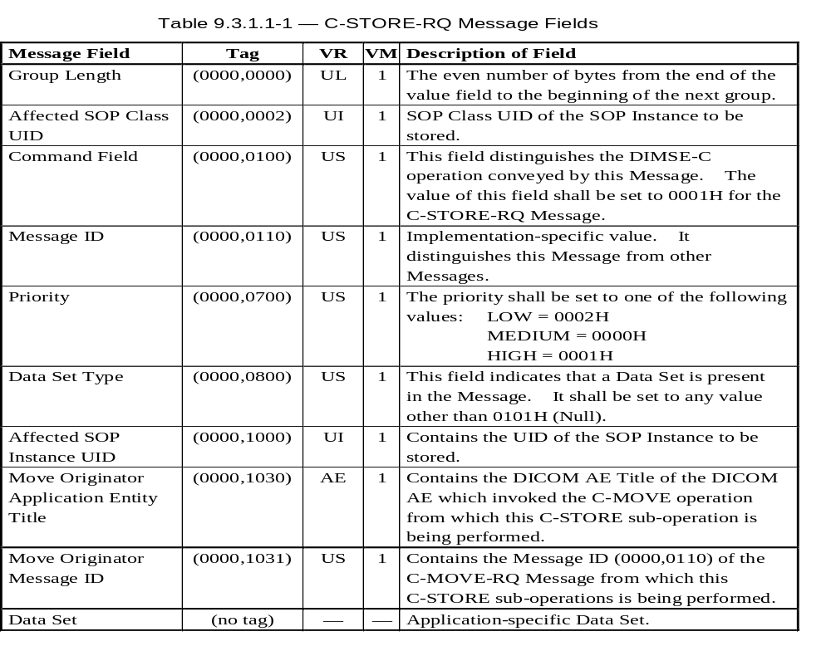
C-Storage Request Command

Slide 21
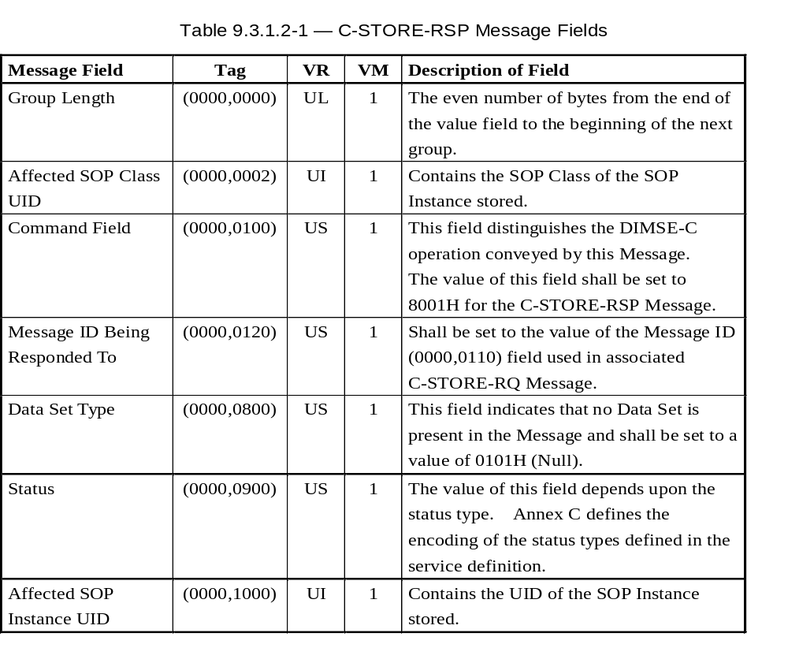
C-Storage Response Command

Slide 22
DICOM Network Service Object Pair
SCP
SCU
(4)
Server
(Perform operation)
SOP Request (DCO+DDO)
Client
(Initiate DICOM operation)
SOP Responses
(DCO+ DDO)
SOP : Service Object Pair(Part 4)
SCU : Service Class User (Part 4)
SCP : Service Class Provider (Part4)
DCO : DICOM Command Object(Part 7)
DDO : DICOM Data Object(Part 3)

Slide 23
Part 4 Service Class Specifications
定義DICOM 的傳輸各種功能

Slide 24
DICOM Part 4 傳輸服務(1)
Normalized DIMSE-N Services
  N-CREATE: to create an information object
  N-DELETE: to delete an information object
  N-GET: to retrieve information object attribute value
  N-SET: to specify information object attribute value
  N-EVENT-REPORT: to notify information object-related event
定義新增、刪除、取得及設定、事件通知等傳輸服務

Slide 25
DICOM Part 4 傳輸服務(2)
Composite DIMSE-C Services
  C-FIND: to inquire information object instance
  C-GET: to transmit an information object instance via third-party application processes
  C-STORE: to transmit an information service-object pair (SOP) instance
  C-ECHO : to verify connection
    Similar to IP Ping
定義資料物件之查詢、取得、儲存、以及網路連結確認

Slide 26
DICOM Services in Clinical Workflow

Slide 27
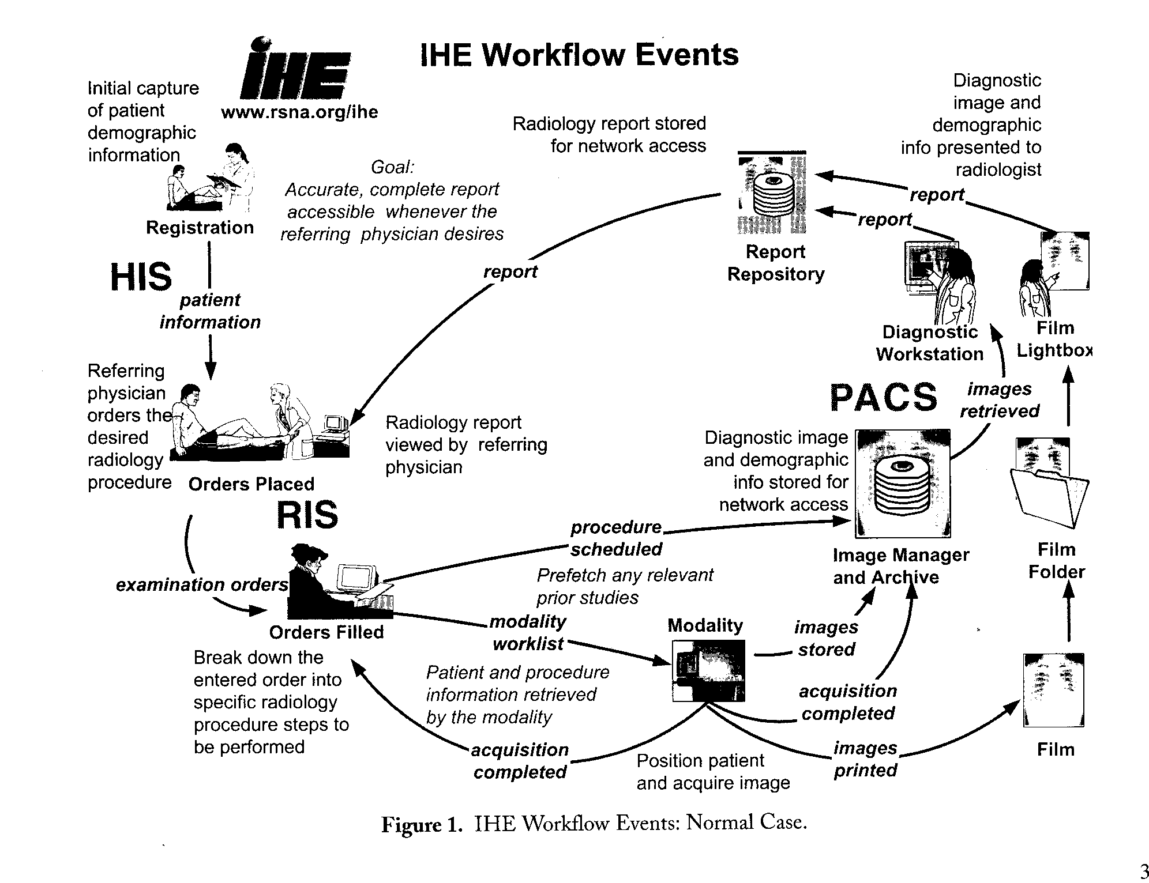
IHE RAD Workflow : Normal Case

Slide 28
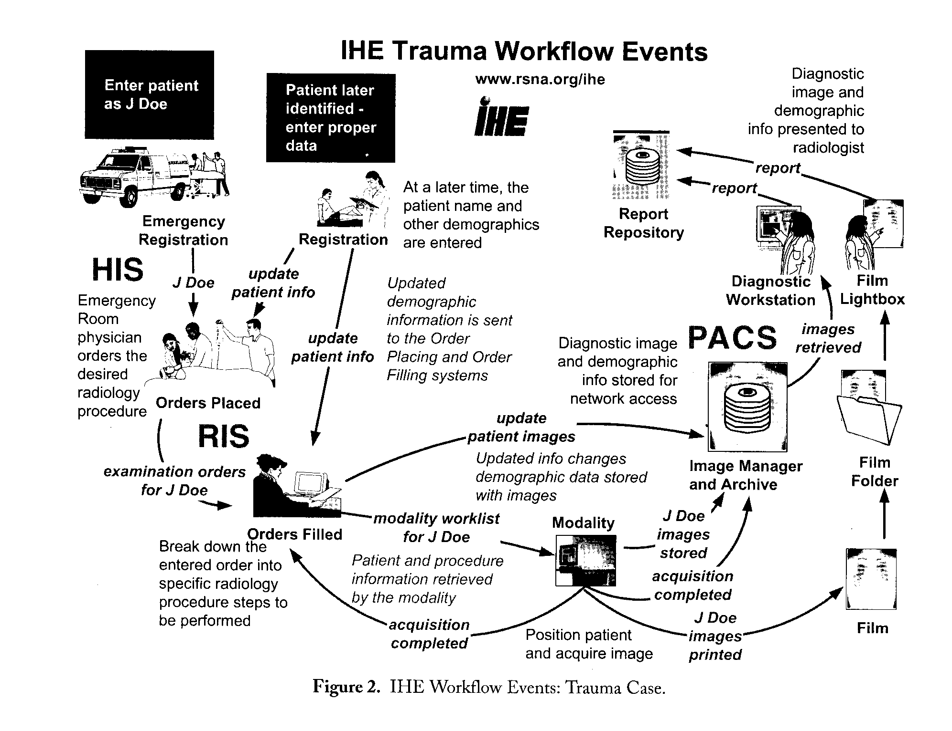
IHE RAD Workflow : Trauma Case

Slide 29
HIS: Hospital Information System
RIS: Radiology Information
PACS: Picture Archiving and Communication System
放射影像檢查流程
掛號系統
影像檢視系統
Patient Registration
Query and Retrieve
Message exchange by HL7 and DICOM standards
HIS
影像儲存管理系統
診間系統
PACS
New Order
Image Store
RIS
放射科管理系統
Modality Worklist
造影儀器
各子系統可能由不同廠商不同平台開發—分散式異質性的環境
各子系統利用 HL7、DICOM 等標準傳輸協定做整合
Notes:
使用之儀器及資訊系統由各專業廠商提供.造影檢查流程中,資訊必須在系統間流通.→ 異質性系統整合.

Slide 30
Simplified RIS Normal Workflow
影像檢視
掛號系統
Patient Registration
Query and Retrieve
影像管理系統
醫令系統
Image Stored
Storage Commitment
New Order
部門排程系統
Modality Worklist
造影儀器
MPPS
( Acquisition Complete)

Slide 31
系統運作流程 (1)
掛號系統
Patient Registration
掛號系統將掛號資料及病人基本資料送到醫令系統及排程系統
HL7 ADT message
影像檢視
Patient Registration
Query and Retrieve
影像管理系統
醫令系統
New Order
將醫師所開立的檢查處方傳送到部門排程系統 HL7 chapter 4 ORM message
SPS (Scheduled Procedures )
Image Stored
Storage Commitment
New Order
部門排程系統
Modality Worklist
造影儀器
MPPS
( Acquisition Complete)

Slide 32
系統運作流程 (2)
掛號系統
影像檢視
Patient Registration
Query and Retrieve
Modality Worklist Query
部門排程系統將病人及醫生處方資料配合排定所要檢查的時間及做檢查的機器名稱後，組成資料表提供造影儀器的查詢
DICOM PS3.4 MWL Service Class
影像管理系統
醫令系統
SPS (Scheduled Procedures )
Image Stored
Storage Commitment
New Order
部門排程系統
Modality Worklist
造影儀器
MPPS
( Acquisition Complete)

Slide 33
系統運作流程 (3)
掛號系統
影像檢視
Image Stored
造影儀器影像物件傳送給影像管理系統。
DICOM PS3.4 Storage Service Class
Storage Commitment
造影儀器確認影像資料是否已儲存在影像管理系統當中。
DICOM PS3.4 Commitment Service Class
Patient Registration
Query and Retrieve
影像管理系統
醫令系統
SPS (Scheduled Procedures )
Image Stored
Storage Commitment
New Order
部門排程系統
Modality Worklist
造影儀器
MPPS
( Acquisition Complete)

Slide 34
系統運作流程 (4)
Query and Retrieve
影像檢視系統查詢影像管理系統當中有哪些影像資料(Query)，及抓取所要的影像(Retrieve)。
DICOM PS3.4 Query/Retrieve Service Class
影像檢視
掛號系統
Patient Registration
Query and Retrieve
影像管理系統
醫令系統
Image Stored
Storage Commitment
New Order
部門排程系統
Modality Worklist
造影儀器
MPPS
( Acquisition Complete)

Slide 35
傳輸交易作用介紹(1)
Modality Worklist Query
MWL 的用途
造影儀器利用 MWL 查詢取得病人及處方的相關資料，操作人員可在儀器上直接選取病人的相關資料轉入系統當中，避免操作人員再次輸入資料的負擔及錯誤發生。
檢查完成後，利用 MWL 轉入之病人及處方的資料配合病人檢查所得的影像資料組合成影像物件(DICOM image object)， 再將影像物件傳送給影像管理系統，使得影像物件能夠包含病人、處方等相關資料。

Slide 36
傳輸交易作用介紹(2)
Image Stored and Storage Commitment
Image Stored
造影儀器將影像物件傳送給影像管理系統
Storage Commitment
造影儀器在消除本身系統當中的的影像資料之前，可利用Storage Commitment確認這些影像是否已傳送到影像管理系統而且網路傳送及影像儲存過程皆沒有問題，影像已存放妥善。

Slide 37
傳輸交易作用介紹(3)
Query/Retrieve
影像檢視系統查詢本身系統當中有哪些影像資料(Query)，及抓取所要的影像(Retrieve)。
依IHE RIS 架構運作，影像物件當中包含了產生此影像的病人(Patient)、檢查處方(Study)、造影儀器(Series)、影像(Image) 的相關資訊。
影像管理系統管理到每一個病人、每次就診、所有檢查儀器產生的影像。
利用功能強大的 DICOM 查詢，影像檢視系統可以用各種不同的方式來檢閱影像管理系統當中儲存的影像內容。

Slide 38
影像管理系統需具備之 DICOM 傳輸協定
  Image Stored
    Modality Image Stored : IHE Rad. 8,
      Referenced Standards :DICOM 2003 PS 3.4: Storage Service Class.
    Creator Image Stored: IHE Rad. 18
      Referenced Standards : DICOM 2003 PS 3.4: Storage Service Class.
  Storage Commitment
    IHE Rad. 10
      DICOM 2003 PS 3.4: Storage Commitment Push Model SOP Class.
  Query/Retrieve
    Image Query: Rad. 14
      Referenced Standards : DICOM 2003 PS 3.4: Query/Retrieve Service Class
    Image Retrieve:Rad.16
      Referenced Standards : DICOM 2003 PS 3.4: Query/Retrieve Service Class

Slide 39
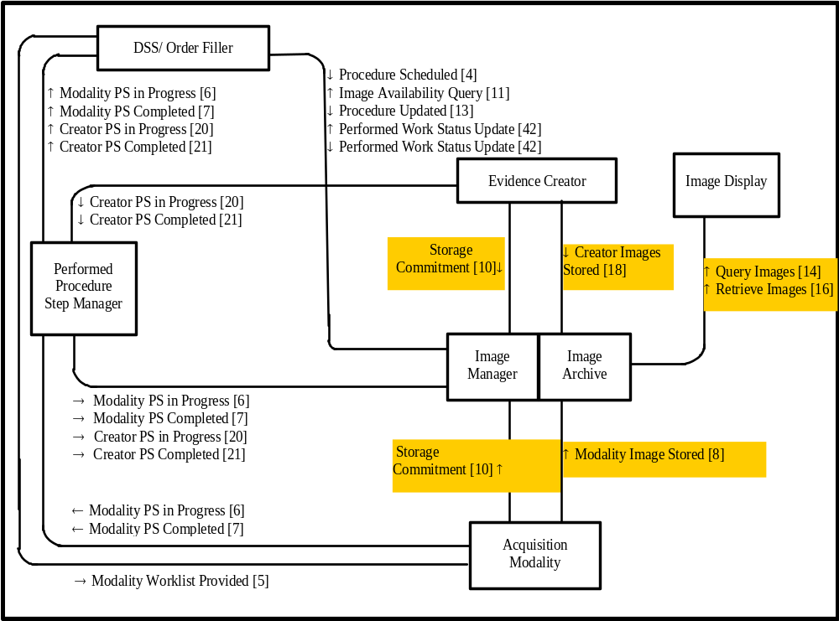
Image Management and Display
DICOM:
Image Storage
Storage Commitment
Query/Retrieve

Slide 40
PACS 各子系統功能
Modalities (CT,MR,US,CR…)
  Imaging (造影成像)
  DICOM store SCU (Service Class User)
DICOM Server
  Image archiver and manager(影像儲存管理)
  DICOM store SCP (Service Class Provider)、 DICOM Query/Retrieve SCP
DICOM Viewer
  Viewing images(影像顯示)
  DICOM Query/Retrieve SCU

Slide 41
DICOM C-Store通訊
例一：CT Scanner 傳送一系列影像至PACS Archiving Sever
  Service：C-STORE (Composite Service)
    SCU：CT Scanner
    SCP：PACS Server
CT Scanner
PACS Controller
Images
SCU
SCP
Service：Store CT Images

Slide 42
CLIENT
CT SCANNER
(C-STORE SCU)
Requests for
establishing association
Requests for
C-STORE service
Sends image data
(1) - (7)
Sends image data
Requests for
dropping association
SERVER
PACS Server
(C-STORE SCP)
Association Request
Association Response
C-STORE Request
C-STORE Response
First Data Packet
Confirmation
(0)
(0)
(1) (2)
(2)
(3) (4)
(5)
(7)
(9)
(9)
Association granted
C-STORE
Service granted
Receives image data
Receives image data
Drops association
Multiple image Retrieval
service Loop
…
(7)
Last Data Packet
Confirmation
Dropping Association Request
Dropping Association Response
(8)
DICOM send and receive operations. Numerals designate steps described in text.

Slide 43
Image Stored(影像儲存)
用途
  造影儀器將影像物件傳送給影像管理系統。
  影像後處理系統將處理後的影像物件傳送給影像管理系統。
支援標準
  DICOM PS3.4 Storage Service Class
說明
  造影後，儀器將病人基本資料、看診檢查、以及造影資料合併成影像物件，在利用 Image Stored 協定傳給影像管理系統。

Slide 44
DICOM Server Operations for Storage and Query/Retrieve
DICOM Server
(6)
(5)
Query
Process
SQL
DICOM
Viewer
Query and Retrieve
Query Request (DCO+DDO)
(3)
(1)
TCP\IP
Result table
Tags & File Index
DDO
Input
Process
Storage Request (DCO+DDO)
Modality
Make DICOM date object (DDO)
Database
Query Responses
(DCO+DDO)
(8)
TCP\IP
SQL
Storage Responses
(DCO)
Retri-eve
Process
(7)
Retrieve Request (DCO+DDO)
File Index
TCP\IP
(9)
(2)
Retrieve Responses
(DCO+DDO)
File Index
DICOM Files
Storage
System
(4)
DICOM Files median
DICOM Files
DICOM Files
Server User Interface

Slide 45
DICOM Server Operations for Storage and Query/Retrieve
DICOM Server
DICOM 影像物件轉入 DICOM server 的方式
Modality 或 DICOM Gateway 將影像轉成 DICOM Data Object(DDO) 後可利用 DICOM C-Storage SOP 此網路傳輸功能將影像傳送到 DICOM Server。
Modality 產生的影像亦可複製到儲存媒體CD-R、MO..，Server 讀取媒體中的影像物件
Server 中的 DDO Input Process 解出影像物件的每個 Tags，將這些 Tags 以及影像物件存檔的路徑及檔名寫入資料庫當中
影像物件存入 Server 中的 DICOM file storage system
(6)
(5)
Query
Process
SQL
DICOM
Viewer
Query and Retrieve
Query Request (DCO+DDO)
(3)
(1)
TCP\IP
Result table
Tags & File Index
DDO
Input
Process
Storage Request (DCO+DDO)
Modality
Make DICOM date object (DDO)
Database
Query Responses
(DCO+DDO)
(8)
TCP\IP
SQL
Storage Responses
(DCO)
Retri-eve
Process
(7)
Retrieve Request (DCO+DDO)
File Index
TCP\IP
(9)
(2)
Retrieve Responses
(DCO+DDO)
File Index
DICOM Files
Storage
System
(4)
DICOM Files median
DICOM Files
DICOM Files
Server User Interface

Slide 46
DICOM通訊
例二：影像工作站（Image Workstation）向PACS Controller查詢影像，並與新產生的影像比較
  Services: C-FIND, C-MOVE, C-STORE
  Query/Retrieve
    SCU: Image Workstation; SCP: PACS Controller
  C-STORE
    SCU: PACS controller; SCP: Image Workstation

Slide 47
Workstation
PACS Controller
C-Find / Move
C-Store
Images
Workstation
SCU： C-find, C-Move
SCP： C-Store
PACS Controller
SCP： C-find, C-Move
SCU： C-Store
Services : C-Find：尋找影像 (自PACS Controller中)
C-Move：移動影像 (從PACS Controller至workstation)
C-Store：儲存影像至monitor(顯示影像)

Slide 48
WORKSTATION
(Q/R SCU)
Requests for
establishing association
Selects image
from the table
for retrieval
Requests for
C- MOVE service
PACS CONTROLLER
(Q/R SCP)
Association Request
Association Response
C-FIND Request
C-FIND Response
C-MOVE Request
C-MOVE Response
Association granted
(2a) C-FIND
(2c) Service granted
(2b)
Perform C-FIND
to look for
studies,series,
and images
(5a) C-MOVE
Service granted
Requests for
C-FIND service
Multiple image Retrieval
service Loop
(1)
(3)
receive a
table with all
requests
(4a)
(4b)
(5b) (6)
Dropping Association Request
Dropping Association Response
Invokes C-STORE SCU Retrieve
images
from
archive
Drops
association
(9)
(8)
(8)
C-STORE
SOP SERVICE*
(7) Sends images
WORKSTATION
(C-STORE SCP)
PACS CONTROLLER
(C-STORE SCU)
(*Refer to Figure 7.5, “DICOM send and receive operations)
DICOM query/retrieve operation.Numerals designate steps described in text.

Slide 49
DICOM Query/Retrieve
Query/Retrieve
影像檢視系統查詢本身系統當中有哪些影像資料(Query)，及抓取所要的影像(Retrieve)。
依IHE SWF 架構運作，影像物件當中包含了產生此影像的病人(Patient)、檢查處方(Study)、造影儀器(Series)、影像(Image) 的相關資訊。
影像管理系統管理到每一個病人、每次就診、所有檢查儀器產生的影像。
利用功能強大的 DICOM 查詢，影像檢視系統可以用各種不同的方式來檢閱影像管理系統當中儲存的影像內容。

Slide 50
DICOM Server Operations for Storage and Query/Retrieve
DICOM Server
DICOM Query 運作方式
5.Viewer 將查詢條件包成 DDO 查詢物件傳給 Server
6.Server 中的 Query Process 將收到的查詢物件轉成 SQL 查詢，以此向資料庫查詢，由此得到查詢後的 Result Table。
5.Query Process 將 Result Table 中每一筆資料再轉成一個 DDO 物件回傳給 Viewer。Viewer 解開這些物件，檢視查詢的結果。
(6)
(5)
Query
Process
SQL
DICOM
Viewer
Query and Retrieve
Query Request (DCO+DDO)
(3)
(1)
TCP\IP
Result table
Tags & File Index
DDO
Input
Process
Storage Request (DCO+DDO)
Modality
Make DICOM date object (DDO)
Database
Query Responses
(DCO+DDO)
(8)
TCP\IP
SQL
Storage Responses
(DCO)
Retri-eve
Process
(7)
Retrieve Request (DCO+DDO)
File Index
TCP\IP
(9)
(2)
Retrieve Responses
(DCO+DDO)
File Index
DICOM Files
Storage
System
(4)
DICOM Files median
DICOM Files
DICOM Files
Server User Interface

Slide 51
DICOM Server Operations for Storage and Query/Retrieve
DICOM Server
DICOM Retrieve 運作方式
7.Viewer 利用先前 Query 的結果得到將 PatientID或 StudyInstanceUID 或 SeriesaInstanceUID 或 SOPInstanceUID 的值轉成 DDO 物件，將此Retrieve Key 的 DDO 物件傳至 Server。
8.Retrieve Process 將DDO 傳入的 Key value 及要 Retrieve 的 Level(Patient or Study or Series or Image) 再轉成 SQL 向資料庫查詢。此查詢會回應與此 Key value 相同所有影像物件的存檔路徑及檔名。 Retrieve Process 依據存檔路徑及檔名找到 DICOM File Storage system中這些影像檔。
9.Retrieve Process 將取的每個影像檔利用 DICOM 傳輸回傳給 Viewer。
(6)
(5)
Query
Process
SQL
DICOM
Viewer
Query and Retrieve
Query Request (DCO+DDO)
(3)
(1)
TCP\IP
Result table
Tags & File Index
DDO
Input
Process
Storage Request (DCO+DDO)
Modality
Make DICOM date object (DDO)
Database
Query Responses
(DCO+DDO)
(8)
TCP\IP
SQL
Storage Responses
(DCO)
Retri-eve
Process
(7)
Retrieve Request (DCO+DDO)
File Index
TCP\IP
(9)
(2)
Retrieve Responses
(DCO+DDO)
File Index
DICOM Files
Storage
System
(4)
DICOM Files median
DICOM Files
DICOM Files
Server User Interface

