Slide 1
DICOM MWL

Slide 2
DICOM MWL and Query
查詢條件
  Single Value Matching
  List of UID Matching
  Wild Card Matching
  Range Matching
  Sequence Matching
依據標準規範 Server 端提供多樣條件，方便client 端依據需求查詢
  過程中不需修改資料庫及程式

Slide 3
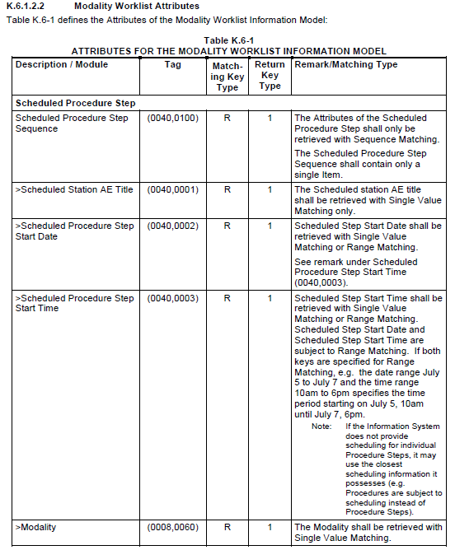


Slide 4
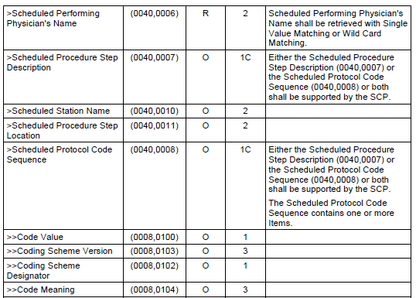

Slide 5
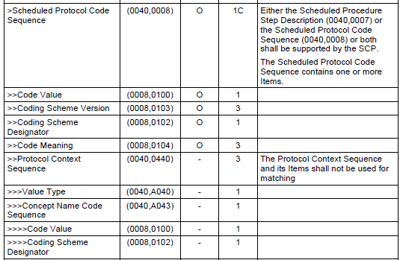

Slide 6
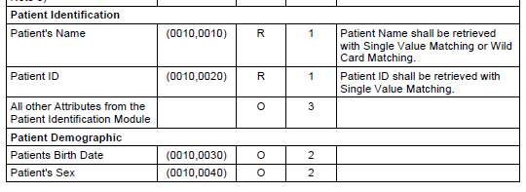

Slide 7
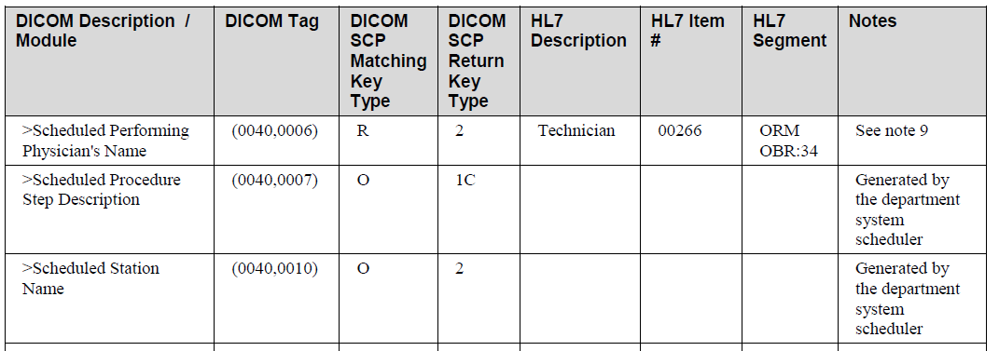
IHE Rad. TF VOL 2
Table B-1. HL7 Order Mapping to DICOM MWL

Slide 8
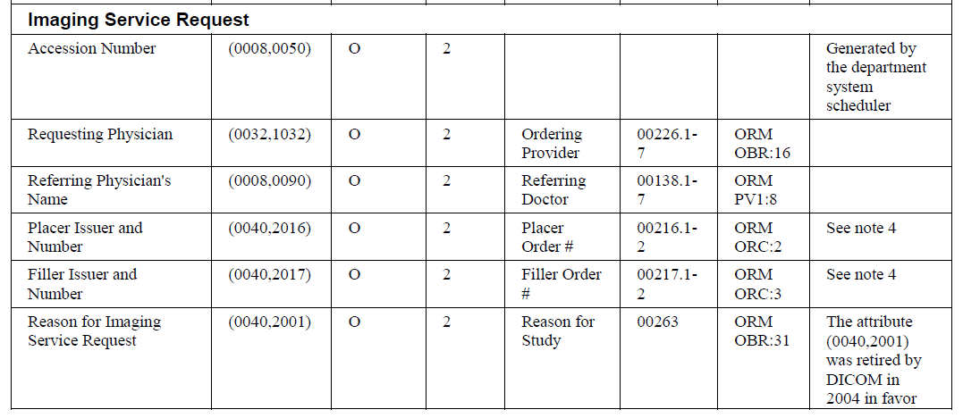

Slide 9
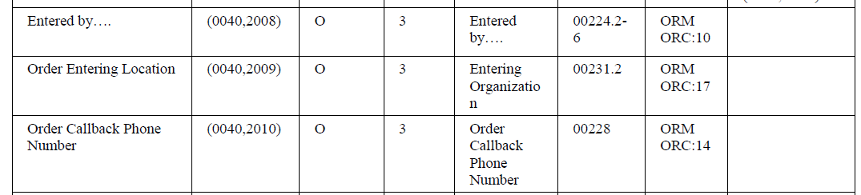

Slide 10
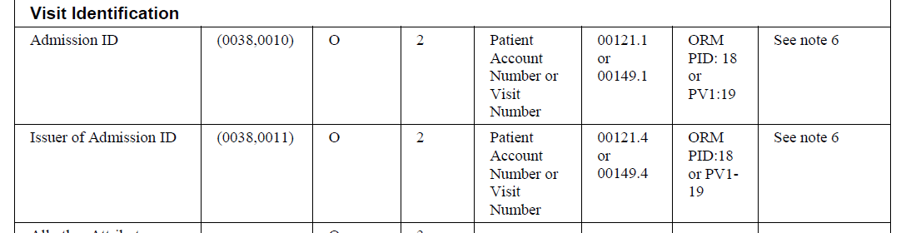

Slide 11
傳輸交易作用介紹(1)
Modality Worklist Query
MWL 的用途
造影儀器利用 MWL 查詢取得病人及處方的相關資料，操作人員可在儀器上直接選取病人的相關資料轉入系統當中，避免操作人員再次輸入資料的負擔及錯誤發生。
檢查完成後，利用 MWL 轉入之病人及處方的資料配合病人檢查所得的影像資料組合成影像物件(DICOM image object)， 再將影像物件傳送給影像管理系統，使得影像物件能夠包含病人、處方等相關資料。

Slide 12
系統運作流程 (2)
掛號系統
影像檢視
Patient Registration
Query and Retrieve
影像管理系統
醫令系統
SPS (Scheduled Procedures )
Image Stored
Storage Commitment
New Order
部門排程系統
Modality Worklist
造影儀器
Modality Worklist Query
部門排程系統將病人及醫生處方資料配合排定所要檢查的時間及做檢查的機器名稱後，組成資料表提供造影儀器的查詢
DICOM PS3.4 MWL Service Class
MPPS
( Acquisition Complete)

Slide 13
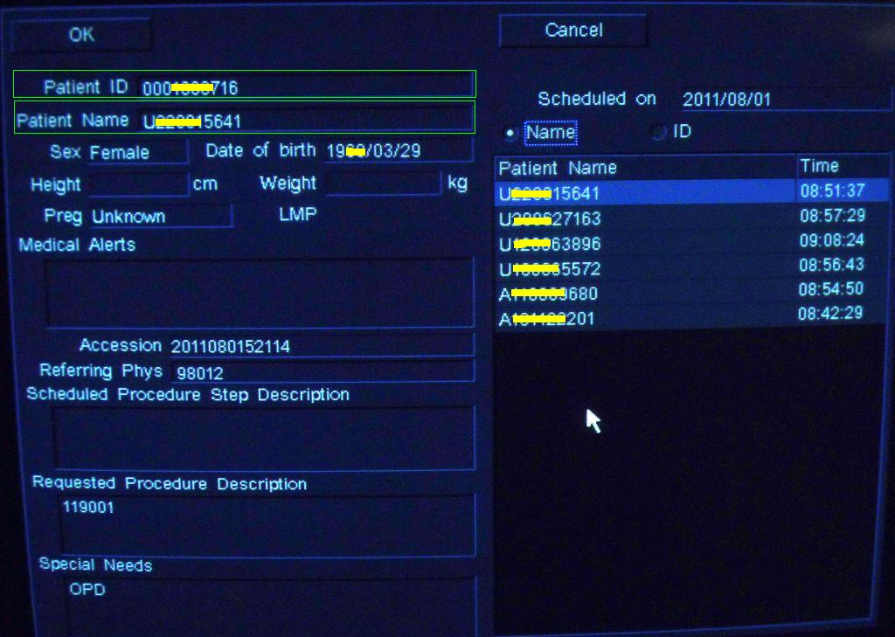
Worklist interface of a Ultrasound modality used in one Hospital in Taiwan
Patient Name usually be replaced by other identify data( ID card number:身分證號 in this case, or English name in some of other hospitals.)
Phys name, procedure descriptions can not have Chinese also.

Slide 14
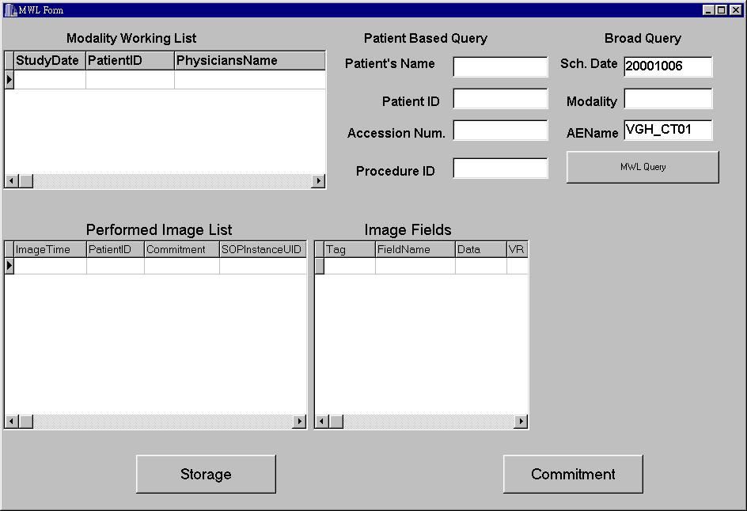

Slide 15
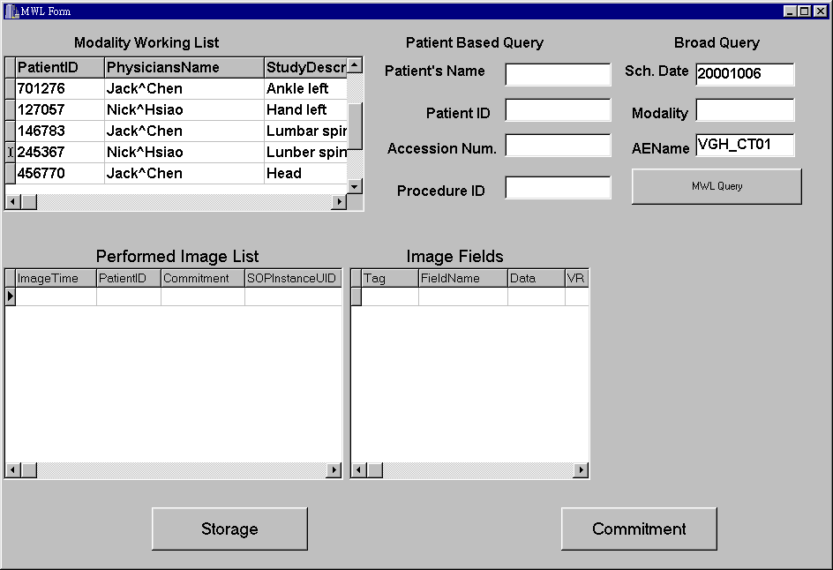

Slide 16
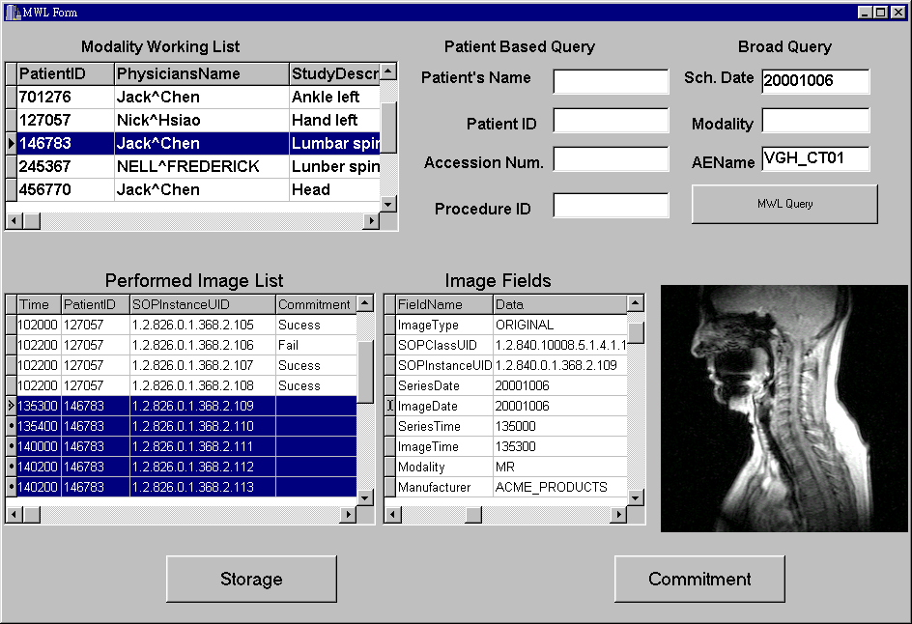

Slide 17
MWL 定義的欄位(1)
Patient Identification
Patient's Name (0010,0010), Patient ID (0010,0020), Patient ID’s (0010,1000)
Patient Demographic
Patients Birth Date (0010,0030) , Patient's Sex (0010,0040),Ethnic Group (0010,2160),Patient Comment (0010,4000)
Patient Medical
Pregnancy Status (0010,21C0), Medical Alerts (0010,2000), Additional Patient History (0010,21B0),Contrast Allergies (0010,2110), Patient Weight (0010,1030), Special Needs (0038,0050)
Imaging Service Request
Imaging Service Request Comments(0040,2400), Accession Number (0008,0050),Requesting Physician (0032,1032),Requesting Service (0032,1033), Referring Physician's Name (0008,0090), Current Patient Location (0038,0300)

Slide 18
MWL 定義的欄位(2)
Requested Procedure
Requested Procedure Comments (0040,1400) ,Requested Procedure Description (0032,1060), Requested Procedure Code Sequence (0032,1064), Code Value (0008,0100), Coding Scheme Version (0008,0103), Coding Scheme Designator (0008,0102), Code Meaning (0008,0104), Requested Procedure ID (0040,1001) , Names of Intended recipients of results (0040,1010) , Study Instance UID (0020,000D), Referenced Study Sequence (0008,1110) , Referenced SOP Class UID (0008,1150), Referenced SOP Instance UID (0008,1155)
Scheduled Procedure Step
Scheduled Procedure Step Sequence(0040,0100) ,Scheduled Station AE Title (0040,0001),Scheduled Procedure Step Start Date(0040,0002) ,Scheduled Procedure Step Start Time(0040,0003) , Scheduled Procedure Step Location (0040,0011),Modality (0008,0060) ,Scheduled Performing Physician's Name(0040,0006),Scheduled Procedure Step ID (0040,0009),Scheduled Action Item Code Sequence(0040,0008),Code Value (0008,0100), Coding Scheme Version (0008,0103),Coding Scheme Designator (0080,0102),Code Meaning (0080,0104), Scheduled Procedure Step Description(0040,0007)

Slide 19
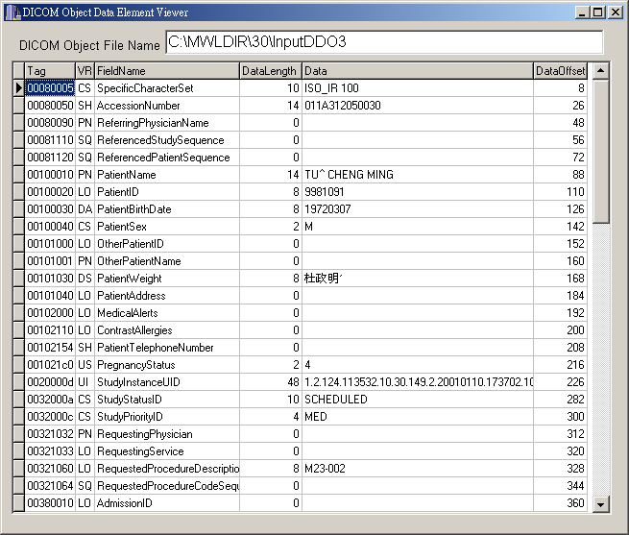
台灣某醫院新建 PACS 系統 MWL 的欄位內容(1)

Slide 20
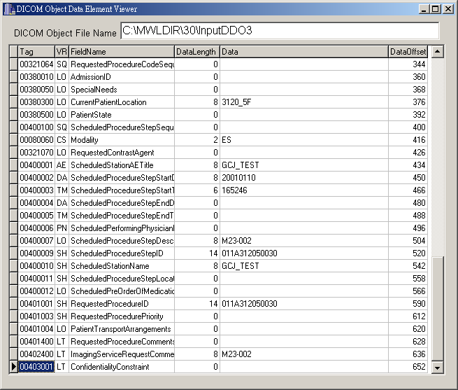
台灣某醫院新建 PACS 系統 MWL 的欄位內容(2)

Slide 21
HL7-DICOM MWL 轉換參考資訊
IHE Radiology Technical Framework Volume I
  3 Scheduled Workflow (SWF)
IHE Radiology Technical Framework Volume II
  4.5 Query Modality Worklist
  Appendix B: HL7 Order Mapping to DICOM MWL

