Slide 1
DICOM Network Services

Slide 2
DICOM Network protocols and services (網路傳輸功能)
Part 4 Service Class Specifications
  Functionalities of DICOM network services （Exp. Storage, Query/Retrive, Print ……) 定義DICOM 網路互動的各種功能
Part 7 Message Exchange
  Message type and format (訂定 DICOM Command Rrequest and Response 的內容 )
Part 8 Network Communication Support for Message Exchange
  Lower layer network(TCP/IP) requirements 網路傳出底層支援。
Part 9 Point-to-Point Communication Support for Message Exchange
  Retired: 點對點資料交換（Retried 因此實際上並無 Part 9 ）

Slide 3


Communication Client-Server Model
Client initiate service request with parameters
And server response corresponding results
For example web browser and server:
  Browser initiate HTTP request with URL and parameters
  Web server response corresponding HTML web page( result)
Request
Response
Client
Server

Slide 4
Communication Client-Server Model
DICOM SCU (Service Class User) is client and SCP (Service Class Provider) is server
  Server waits for incoming requests
  Client initiates communication
Request
Response
Client(SCU)
Server(SCP)

Slide 5
Majority DICOM Service Classes (defined in DICOM Part 4)
Verification
  Like TCP/IP ping, every DICOM applications should support verification service
Storage
  Store DICOM object to remote system. Exp: modalities store images to PACS server
Query/Retrieve
  Query(search) by information of patient, study, series to find images related and retrieve the specific images. Exp: Viewer query and retrieve images from PACS server

Slide 6
Function of PACS systems
Modalities (CT,MR,US,CR…)
  Imaging (造影成像)
  DICOM store SCU (Service Class User)
DICOM Server
  Image archiver and manager(影像儲存管理)
  DICOM store SCP (Service Class Provider)、 DICOM Query/Retrieve SCP
DICOM Viewer
  Viewing images(影像顯示)
  DICOM Query/Retrieve SCU

Slide 7
DICOM Query/Retrieve
Viewer
PACS Server
Query /Retrieve
Storage
Images
orkstation
SCU：Q/R
SCP： Storage
PACS Server
SCP： Q/R
SCU：Storage
Services : Query : find images (requested by viewer)
Retrieve: move images (requested by viewer)
Storage：store images (requested by PACS server)
Storage is a sub-service in DICOM retrieve.

Slide 8
Communication Client-Server Model
Not only PACS server should play the role as SCP, Viewer also would be SCP in DICOM communication, Exp
  Viewer(SCU) queries PACS server(SCP)
  PACS server(SCU) stores images to Viewer (SCP)
Request
Response
Client
Server

Slide 9
Network setting for DICOM Application Entity
Application Entity a system or modality
Settings (設定內容)
  AE Name: Application Entity Name，require to set system it self AE Name and remote systems AE names.
  IP: All system require fixed IP
  Port :DICOM 傳輸常用 104 or 10004 Port
A PACS server may set a list of Modalities and Viewers
Modality and Viewer also can connect to multiple servers

Slide 10
First step of DICOM communication
Association negotiation
DICOM AE need to agree on certain things before they operate with one another (open a association).
  The services that can be performed.
  The transfer syntax.
    Specify DICOM object encoding format

Slide 11
傳輸交易作用介紹(3)
Query/Retrieve
影像檢視系統查詢本身系統當中有哪些影像資料(Query)，及抓取所要的影像(Retrieve)。
依IHE RIS 架構運作，影像物件當中包含了產生此影像的病人(Patient)、檢查處方(Study)、造影儀器(Series)、影像(Image) 的相關資訊。
影像管理系統管理到每一個病人、每次就診、所有檢查儀器產生的影像。
利用功能強大的 DICOM 查詢，影像檢視系統可以用各種不同的方式來檢閱影像管理系統當中儲存的影像內容。

Slide 12
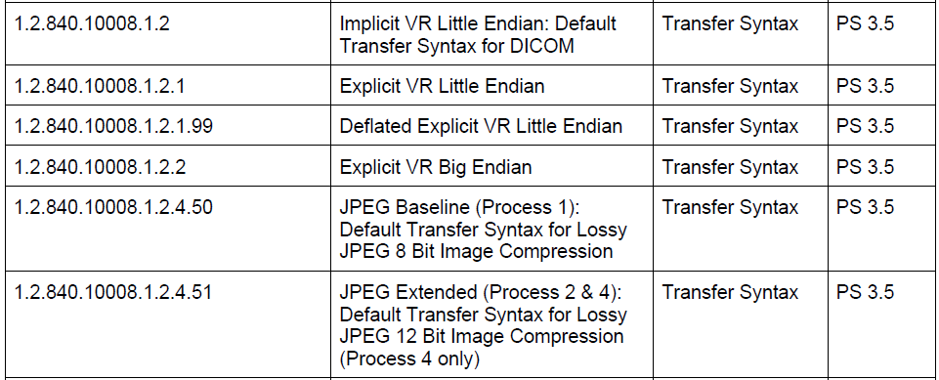

Example of transfer syntax

Slide 13
First step of DICOM communication
Association negotiation
Information could be exchanged in association
  Exchange Application Entity name for mutual accessibility
  Negotiate network services that both supported.
  Negotiate network transfer syntax that both supported.
  Exchange other user information

Slide 14
DICOM communication demonstration

Slide 15
AE Name and IP setting examples
DICOM
  Conquest
  http://www.santesoft.com/howto/network.html
HL7 IHE gazelle
  http://gazelle.ihe.net/DDS/home.seam

Slide 16
DICOM command messages
Once an association is established, service are performed by AE’s through the exchange of DICOM Messages.
A message is the combination of a DICOM command request or response and its associated object instance.

Slide 17
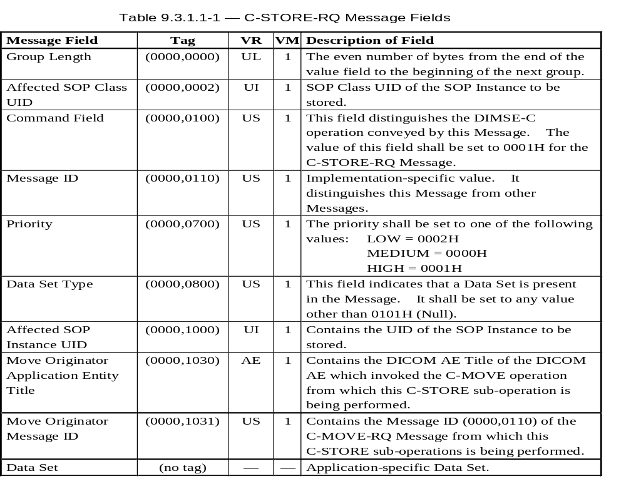
C-Storage Request Command

Slide 18
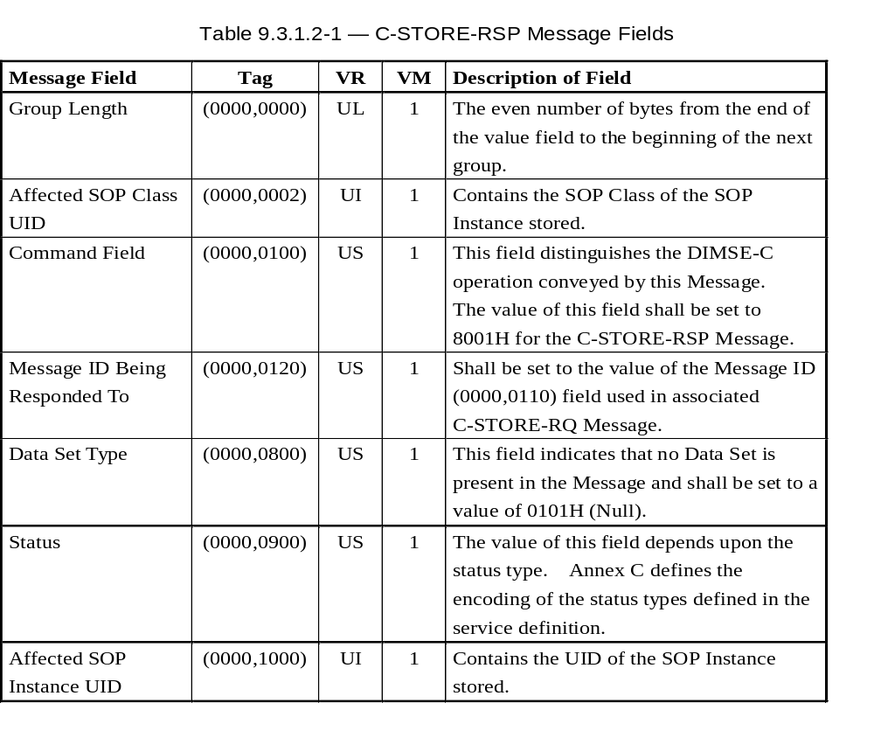
C-Storage Response Command

Slide 19
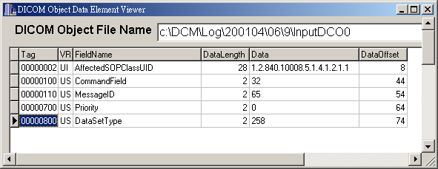
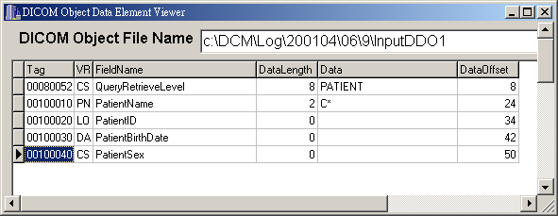
DICOM Patient Root Query Request

Slide 20
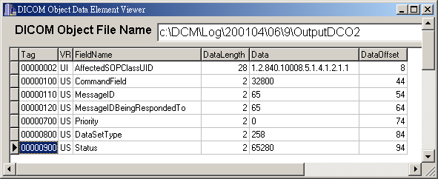
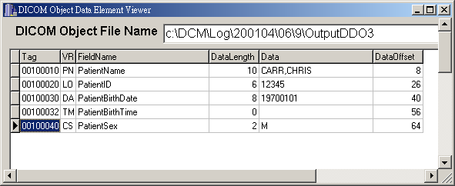
DICOM Patient Root Query Response

Slide 21
DICOM Query Matching
Single Value Matching
List of UID Matching
Universal Matching
  Match Key Attribute in a request is zero length, then all entities shall match.
Wild Card Matching
  Match Key contains “*” or a “?”, then “*” shall match any sequence of characters and “?” shall match any single character.
Range Matching

Slide 22
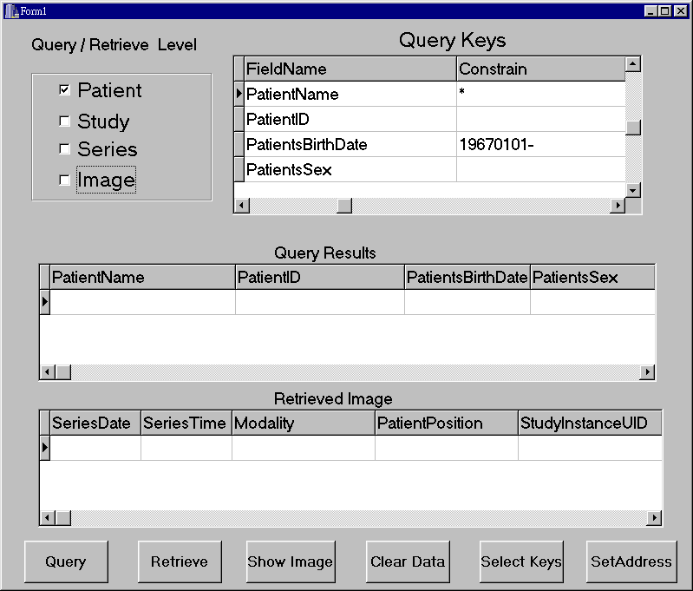

Slide 23
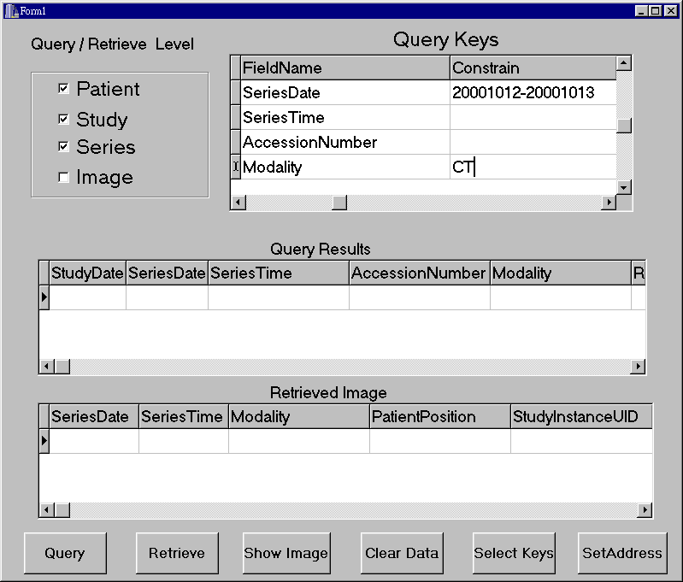

Slide 24
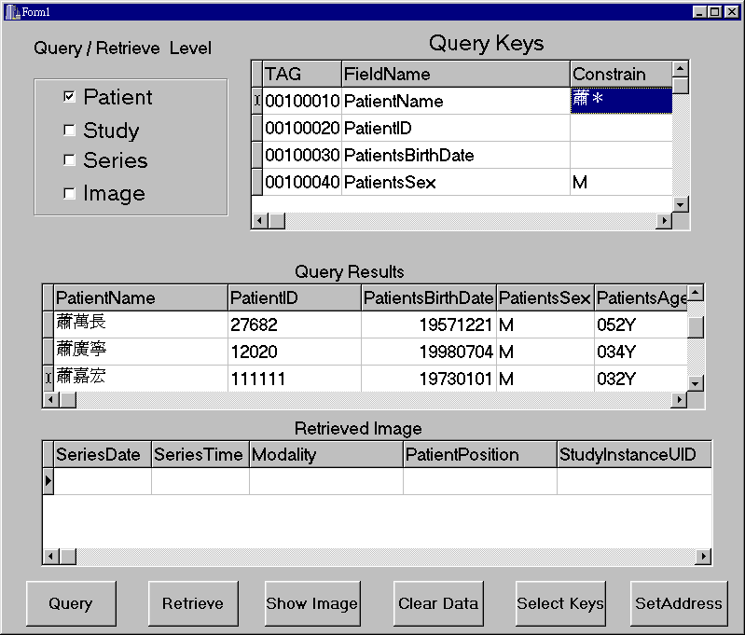

Slide 25
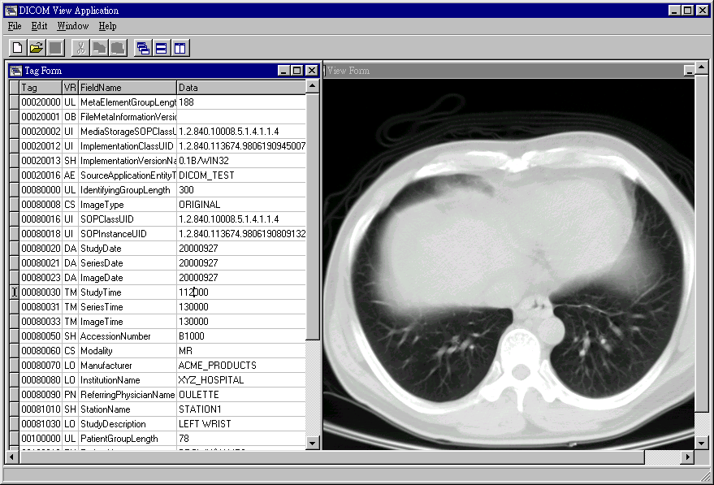

Slide 26
