Slide 1
醫學影像管理系統
Image manager

Slide 2
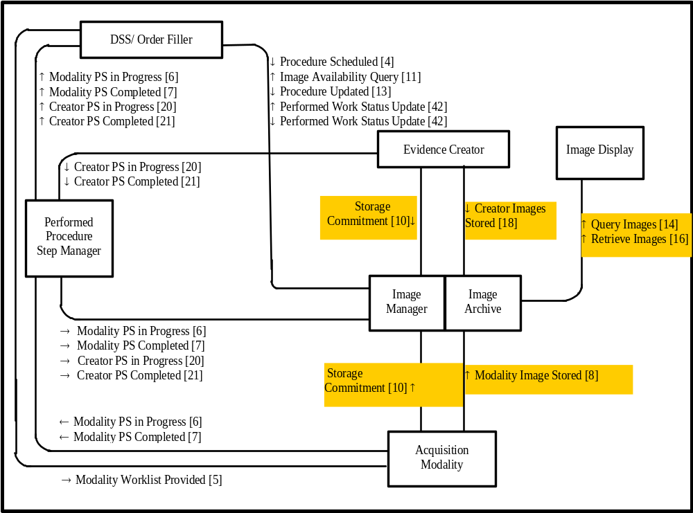
Image Management and Display
DICOM:
Image Storage
Storage Commitment
Query/Retrieve

Slide 3
Question : 影像管理系統需具備哪些功能
具備哪些功能項目
具備哪些整合介面及資料傳輸功能
資料庫需包含哪些資料表格
系統架構

Slide 4
影像管理系統需具備之 DICOM 傳輸協定
  Image Stored
    Modality Image Stored : IHE Rad. 8,
      Referenced Standards :DICOM 2003 PS 3.4: Storage Service Class.
    Creator Image Stored: IHE Rad. 18
      Referenced Standards : DICOM 2003 PS 3.4: Storage Service Class.
  Storage Commitment
    IHE Rad. 10
      DICOM 2003 PS 3.4: Storage Commitment Push Model SOP Class.
  Query/Retrieve
    Image Query: Rad. 14
      Referenced Standards : DICOM 2003 PS 3.4: Query/Retrieve Service Class
    Image Retrieve:Rad.16
      Referenced Standards : DICOM 2003 PS 3.4: Query/Retrieve Service Class

Slide 5
Image Stored(影像儲存)
用途
  造影儀器將影像物件傳送給影像管理系統。
  影像後處理系統將處理後的影像物件傳送給影像管理系統。
支援標準
  DICOM PS3.4 Storage Service Class
說明
  造影後，儀器將病人基本資料、看診檢查、以及造影資料合併成影像物件，在利用 Image Stored 協定傳給影像管理系統。

Slide 6
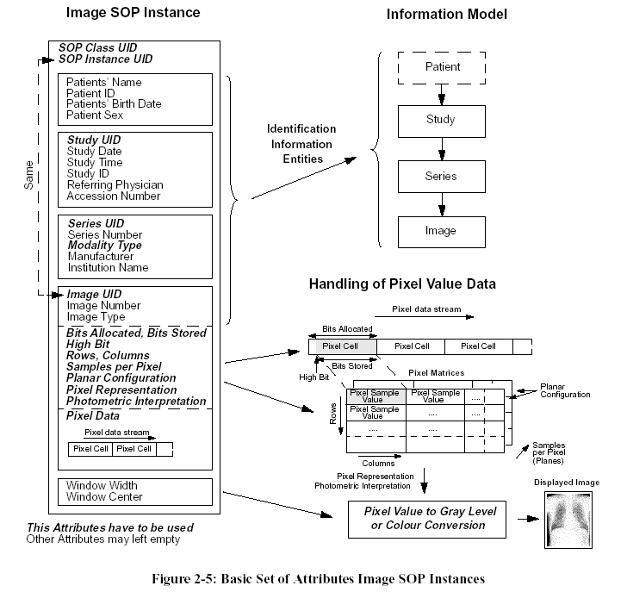
Package all related information in a image persistent object
—影像物件包含:影像格式、像素值、病人及造影過程的資訊

Slide 7
DICOM Server Operations for Storage and Query/Retrieve
DICOM Server
(6)
(5)
Query
Process
SQL
DICOM
Viewer
Query and Retrieve
Query Request (DCO+DDO)
(3)
(1)
TCP\IP
Result table
Tags & File Index
DDO
Input
Process
Storage Request (DCO+DDO)
Modality
Make DICOM date object (DDO)
Database
Query Responses
(DCO+DDO)
(8)
TCP\IP
SQL
Storage Responses
(DCO)
Retri-eve
Process
(7)
Retrieve Request (DCO+DDO)
File Index
TCP\IP
(9)
(2)
Retrieve Responses
(DCO+DDO)
File Index
DICOM Files
Storage
System
(4)
DICOM Files median
DICOM Files
DICOM Files
Server User Interface

Slide 8
DICOM Server Operations for Storage and Query/Retrieve
DICOM Server
DICOM 影像物件轉入 DICOM server 的方式
Modality 或 DICOM Gateway 將影像轉成 DICOM Data Object(DDO) 後可利用 DICOM C-Storage SOP 此網路傳輸功能將影像傳送到 DICOM Server。
Modality 產生的影像亦可複製到儲存媒體CD-R、MO..，Server 讀取媒體中的影像物件
Server 中的 DDO Input Process 解出影像物件的每個 Tags，將這些 Tags 以及影像物件存檔的路徑及檔名寫入資料庫當中
影像物件存入 Server 中的 DICOM file storage system
(6)
(5)
Query
Process
SQL
DICOM
Viewer
Query and Retrieve
Query Request (DCO+DDO)
(3)
(1)
TCP\IP
Result table
Tags & File Index
DDO
Input
Process
Storage Request (DCO+DDO)
Modality
Make DICOM date object (DDO)
Database
Query Responses
(DCO+DDO)
(8)
TCP\IP
SQL
Storage Responses
(DCO)
Retri-eve
Process
(7)
Retrieve Request (DCO+DDO)
File Index
TCP\IP
(9)
(2)
Retrieve Responses
(DCO+DDO)
File Index
DICOM Files
Storage
System
(4)
DICOM Files median
DICOM Files
DICOM Files
Server User Interface

