Slide 1
Web Solutions for Healthcare

Slide 2
臨床醫療資訊化現況
醫療資訊分散儲存於各系統
  文字病歷-HIS (Hospital Information System)
  醫學影像-PACS (Picture Archiving and Communication System)
醫學資訊有其專屬的格式及要求
  HL7(Health Level 7)
  DICOM (Digital Imaging and COmmunication in Medicine)
  各醫院及部門有許多專屬非標準之資訊系統
目前臨床資訊要交換整合並不容易
  依據現有之標準規範修改工程浩大
  目前之 HL7 及 DICOM 規範，與 IT 主流技術及規範有出入

Slide 3
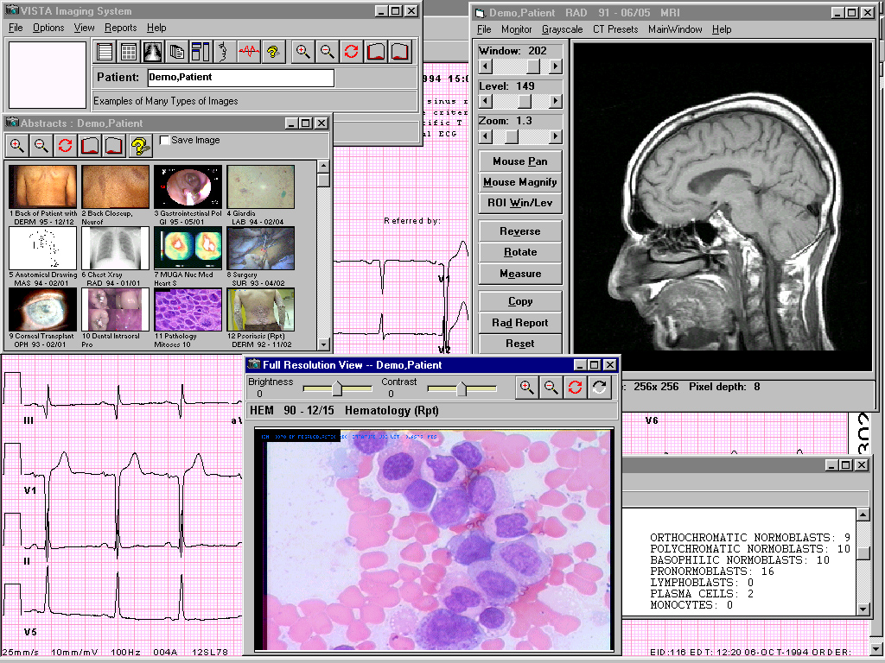
Wide Variety of Images Integrated with Patient Record
Cardiology
Bronchoscopy
Gastrointestinal Endoscopy
Hematology
Pathology
Surgery
Nuclear Medicine
Dental
Radiology
Dermatology
Ophthalmology
Podiatry
Vascular
Urology
Nursing
Electrocardiography
Scanned Documents
Notes:
內容建構是網路學習推行的關鍵
臨床醫療會產生豐富的多媒體資料, 很有潛力應用於 E-Learning

Slide 4
現行醫學影像資訊標準的瓶頸
DICOM 是目前推行最成功的醫學資訊標準，但是:
  使用專屬的資料格式及傳輸協定
    一般資訊人員無法處理
    不易與資訊主流技術結合
  規範之報告物件及影像標記格式複雜
  以放射醫學影像為主，對其他多媒體格式支援不完整

Slide 5
Multimedia clinical contents display and integration solutions
2D images
Very Difficult!!
3D images
DICOM
Objects
DICOM Viewer
Video
Display, Measurements, and Annotations
Audio
HTML,XML, Web multi-medias
Browser
Wave form
Suitable.
Structure
Reports
Lots of works should be done for developing a viewer to handle multimedia contents. Web solutions are available and been used in lots of domains. Using browser to handle clinical content, can reduce many technical overheads.

Slide 6
醫療資訊標準的新發展
HL7 : HL7 V3 CDA (Clinical Document Architecture)
  XML formatted clinical documents
DICOM : part 18 WADO (Web Access to DICOM objects)
IHE
  RID (Retrieve Information for Display), XDS (Cross-enterprise Document Sharing)

Slide 7
DICOM Parts 18 : WADO – Web Access to DICOM persistent Objects
Scope of the Standard
New web-based service for accessing and presenting DICOM persistent objects
Simple mechanism for accessing a DICOM persistent object from HTML pages or XML documents, through HTTP/HTTPs protocol, using the DICOM UIDs (study, series, instance)

Slide 8
Examples of implementation
Web Client System
Web Access to Dicom Persistent Objects
Direct
Interface
Web Access to Dicom Persistent Objects
Web Gateway
Gateway
DICOM Q/R
DICOM Interface
Web Interface
DICOM Q/R
DICOM Interface
DICOM Objects Database
DICOM Objects Database
Flexibility for the client
to be implemented either
as new system
or on existing system

Slide 9
WADO Interaction Diagram
Web Client
System
Web Enabled DICOM Server
Object(s) request (HTTP GET)
Object(s) send
(HTTP response header and body)

Slide 10
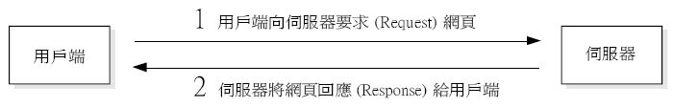
WWW 與 HTTP 協定
WWW 是一種主從式的架構, 由用戶端 (瀏覽器) 主動提出服務要求, 伺服器收到要求之後, 才將資料回應給用戶端：

Slide 11
WWW 與 HTTP 協定
WWW 伺服器與用戶端之間使用 HTTP (HyperText Transfer Protocol) 協定進行連線與傳送資料, HTTP 是一種跨平台的通訊協定, 它定義了伺服器與用戶端之間資料傳輸方式。

Slide 12
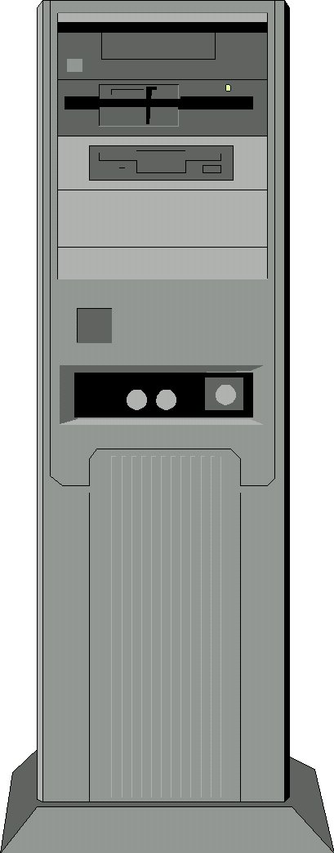
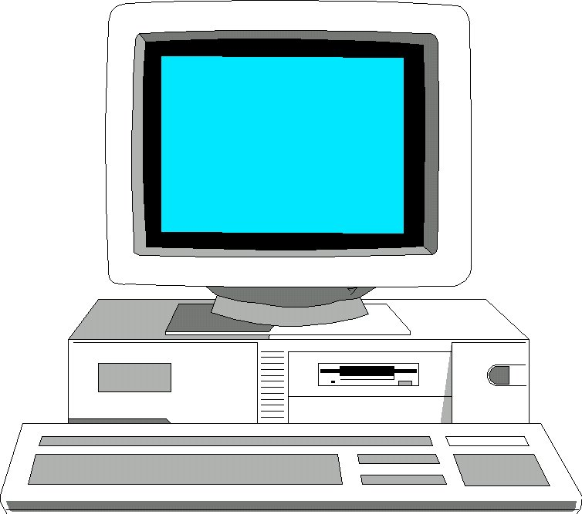
HTML網頁運作原理
網站伺服器
HTTP request
(http://website/test.htm)
HTTP response
<html>
<b>大家好</b>
</html>
網站伺服器負責依據 HTTP 請求提供對應的 HTML網頁
客戶端(瀏覽器)
大家好
瀏覽器負責解譯HTML並產生網頁

Slide 13
HTTP Request and Response
Browser 與 server 透過 HTTP request and response 做資料傳遞
  HTTP request 資料傳遞方式
    POST及GET兩種方式。
      GET ：與 url傳送的方式一樣，透過 url 來傳送， 有資料量的限制。
      POST：不經由 url 傳送，直接將大量的資料傳送給指定的程式，沒有資料量的限制。
  Response 回應 HTML,XML, …等資訊

Slide 14
Syntax of the WADO HTTP GET method
Syntax defined by the RFC2396 (URI)
http://<authority><path>?<query>
e.g:
    http://www.hosp.fr/dicom/wado.asp?studyUID=1…
Path of the Web Enabled DICOM Server
WADO Parameter(s)

Slide 15
WADO Selection Parameters
studyUID&seriesUID&objectUID
[&frameNumber]
  studyUID => UID of the study containing the object(s)
  seriesUID => UID of the series containing the object(s)
  objectUID => UID of the single object (Service Object Pair SOP)
  frameNumber => number of the selected frame (multiframe image objects) – if NOT retrieved as application/dicom

Slide 16
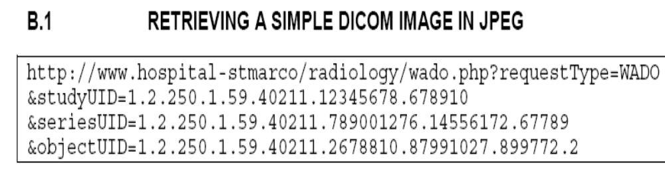

Slide 17
WADO MIME type of return object
The MIME type of the object contained in the contentType parameter, compatible the <accept> parameter of the GET method
application/dicom for all objects, or a different MIME type for converting the DICOM object, depending of the nature of the object:
  image/jpeg for still image object
  text/html or text/plain for text object, or
  other optional formats

Slide 18
MIME (Multipurpose Internet Mail Extensions) Types
Client: HTTP request 指定 MIME type
Server: 依據 MIME type 指定之文件格勢 response 文件回 client

Slide 19
Parameters when the object is return as image/xxx (2)
[region][rows][columns][annotation]
  region => part of the image to be displayed, in relative coordinates (top left hand corner and bottom right hand extent)
  rows => maximum number of pixels (vertical)
  columns => maximum number of pixels (horizontal)
  annotation => text to be superimposed of the image (“patient” and / or “technique” for demographic information and technical information, respectively)

Slide 20
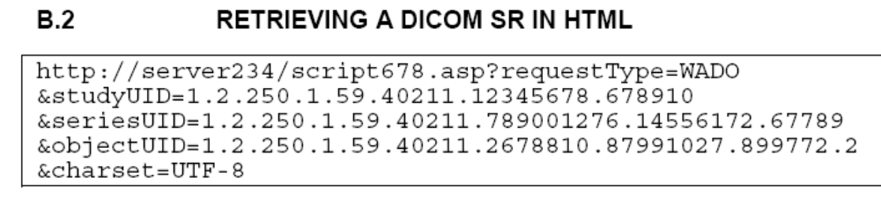
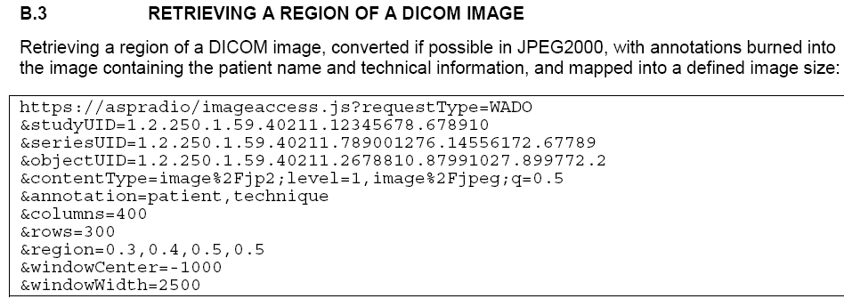

Slide 21
Client flexibility
The WADO functionality supports access to
  Native (un-rendered) DICOM data
  Associated rendering data e.g. Gray Scale Presentation State
  “Rendered” information e.g. JPEG image
So client design can be
  Simple, relying on basic features of the web browser
  Complex, providing advanced functionalities by taking ‘raw’ DICOM data and deciding the processing and rendering to be applied

Slide 22
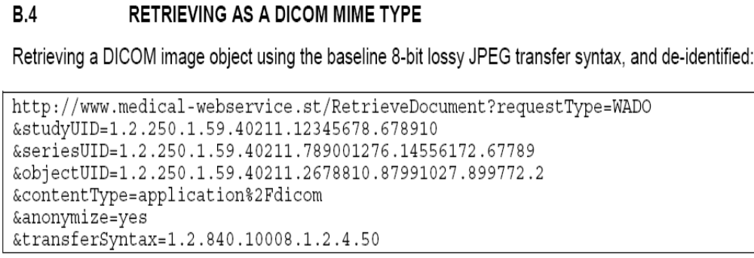

Slide 23
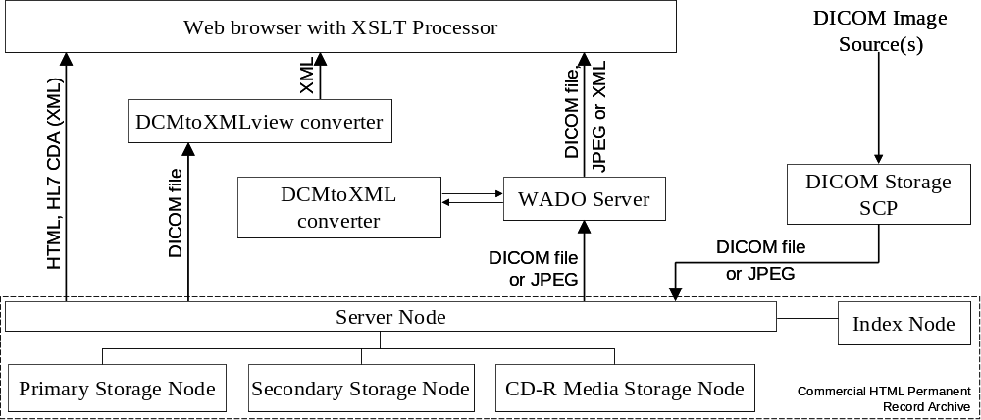
WADO Implementation diagram

Slide 24
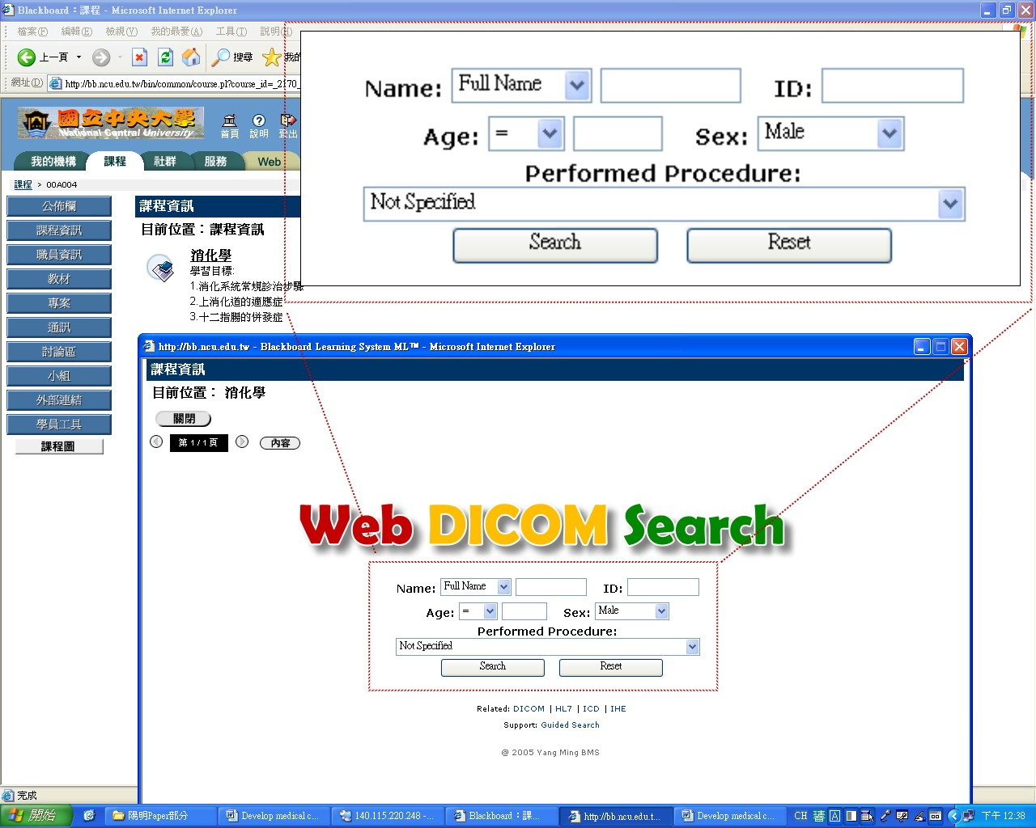

Slide 25
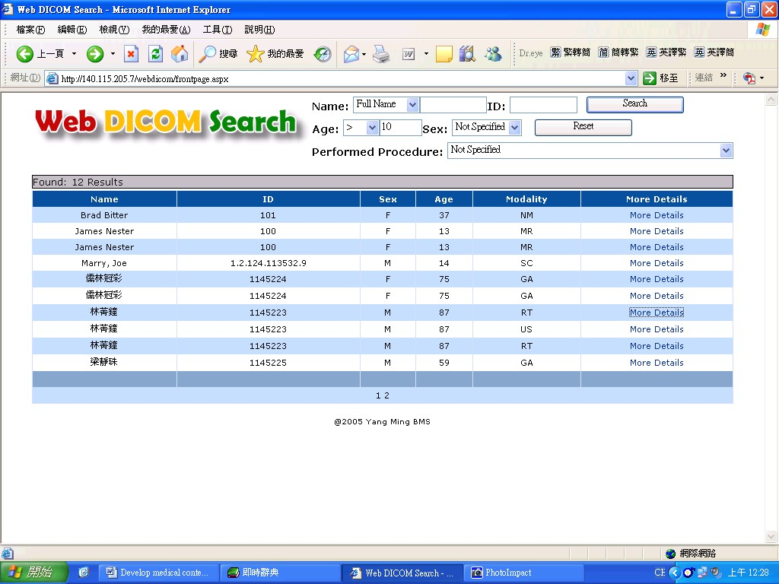
The matching result list

Slide 26
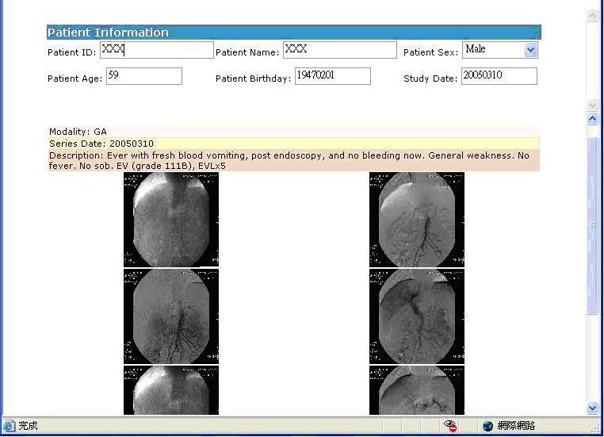
Patient information and a series of his/her medical images.

Slide 27
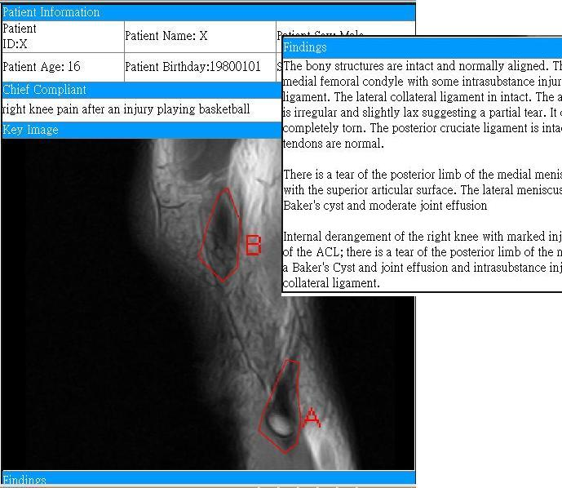
Annotated image with HTML report
Figure 7. A learning asset in our content repository.

Slide 28

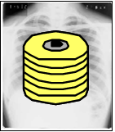

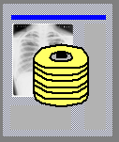

IHE : Web accessing of clinical document
R I S
Images
Store
Images
Retrieve
Interpretation
Acquisition
Modality
Image Manager
& Archive
Reference
to images
Report
Store
Images Store
DICOM
Q/R
Web Access to Persistent Object
Report
Export
Report
Repository
Clinical Document
Consultation
L I S
C I S
:
:
Report
Export
Clinical Documents
Repository
Clinical depts

Slide 29
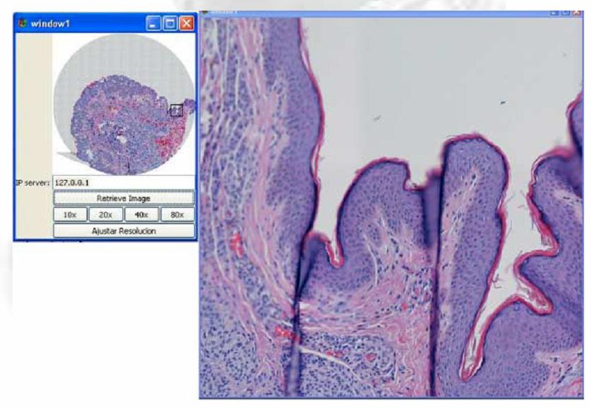


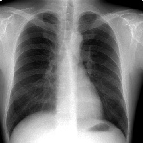
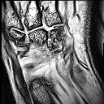
初步構想
Virtual Slide Pathology System
H
I
S
Browser
建構病理及其他非 DICOM
影像之 ＷＡＤＯ 介面
Web
Server
With
WADO
Image acquisition、Compression、Image Store、Decompression
WADO
MWL
PACS
Server
內容製作工具及學習平台利用 ＷＡＤＯ 介面 整合醫學多媒體數位內容
RIS
Modalities
Image
Store
放射醫學影像 WADO (Web Access to DICOM Persistent Objects) 介面，提供影像在 Web 上調整檢視

Slide 30
目前網路應用發展的趨勢
Web solutions
Application
  Web applications
Contents
  HTML, XML
Integration
  HTTP protocols (HTTP request/response, web services, Ajax)
Workflow management
  SOA( Service Oriented Architecture ),BPM( Business Process Management)
Access control
  SSO (Single Sign On) portal

Slide 31
臨床資訊系統 web 化的優點
整合容易
  使用 HTTP 連結做整合
  統一使用 Browser 檢視及處理
  全球通用之可攜式病歷
易於調整
  調整網頁改變呈現方式
  調整 server 端程式改變 web功能及流程
    傳統 DICOM 需兩方(或多方)配合一起修改
技術障礙最低
  目前大家最熟悉的技術
  容易與 web 新的技術及應用結合

Slide 32
Web 化臨床資訊系統需處理的問題
資訊安全及隱私保護
資料及流程重新設計
  以 XML 格式規範臨床文件(Exp : HL7 V3)
  以Web 方面新的技術及概念，重新規範資訊整合架構及流程
專業之醫療多媒體資訊之呈現

