Slide 1
Web vibration FFT analysis
09.23.2020

Slide 2
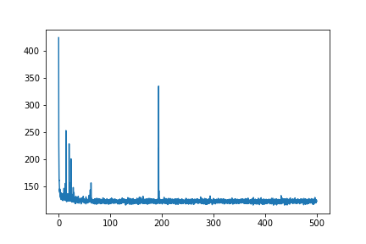
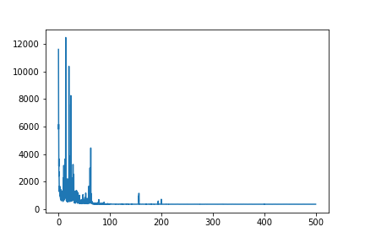
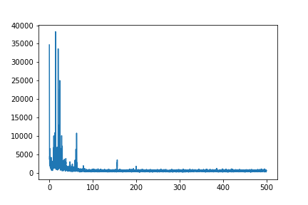
web_200hz-009_fft
Clustering
Web masking: threshold =20
Cluster 0
Cluster 2

Slide 3
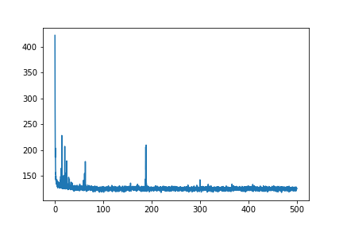
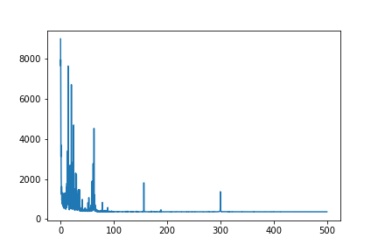
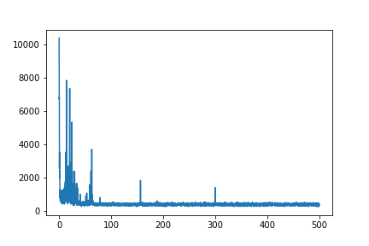
web_300hz-007_fft
Clustering
Web masking: threshold =20
Cluster 0
Cluster 2

Slide 4
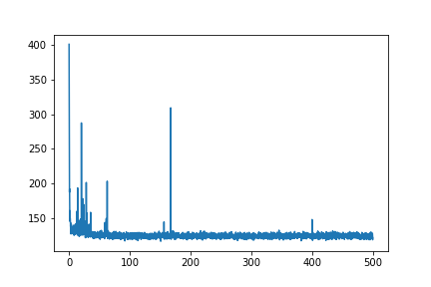
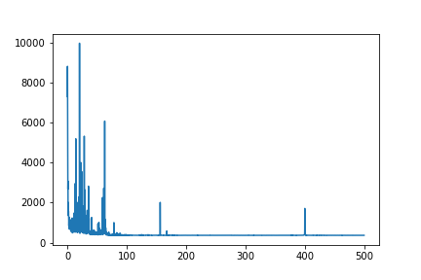
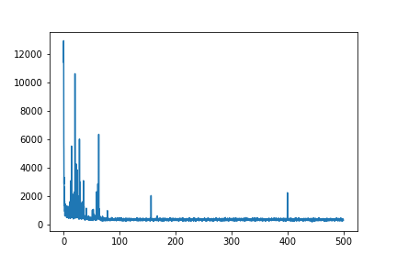
web_400hz-003_fft
Clustering
Web masking: threshold =20
Cluster 0
Cluster 2

Slide 5

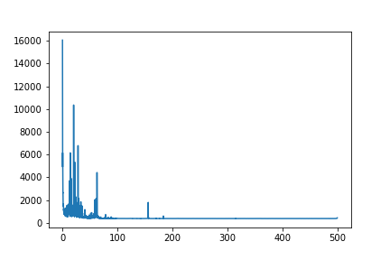
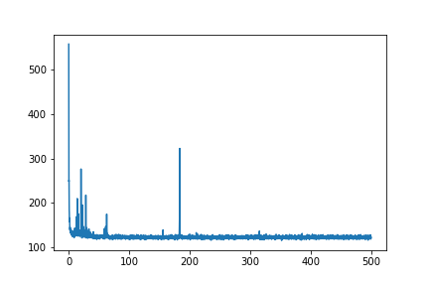
web_500hz-008_fft
Clustering
Web masking: threshold =20
Cluster 0
Cluster 2

