Slide 1
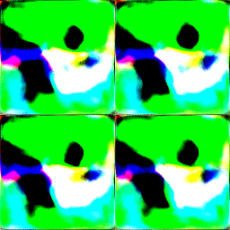

Invert
G

Slide 2



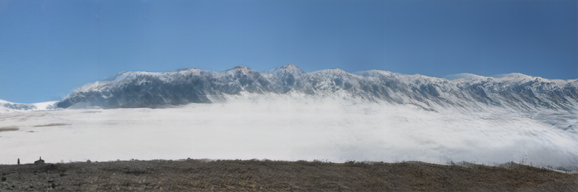

Slide 3
Input
Extend 5 times
Output

Slide 4


c
c
c
c
c
real fake
y₁₀
y₀₀
c
y₁₁
y₀₁
Syn
z_{i}
z_{j}
z_{opt}
z_{k}
z_{opt}
G
D
Gen

Slide 5
Syn
Coord.
MLP

Slide 6
Coord.
Coord.

