Slide 1

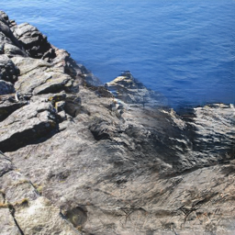
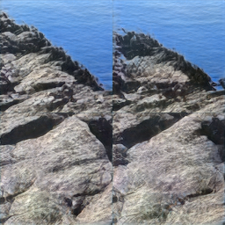
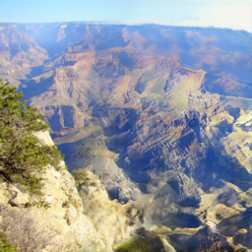
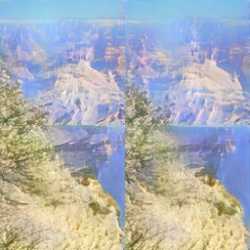

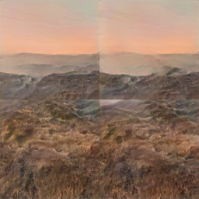
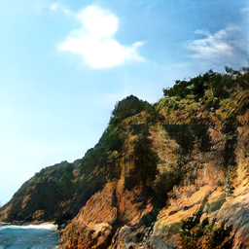
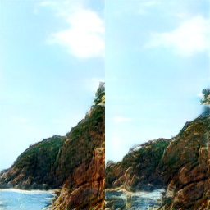
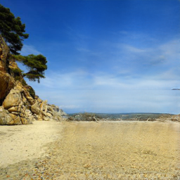
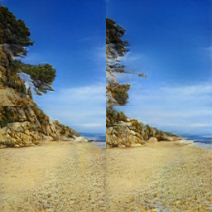


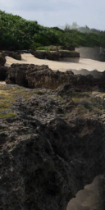
w/o
w/

Slide 2




Input
w/o
$$ℒ_{prior}$$
with
$$ℒ_{prior}$$
Input
w/o
$$ℒ_{prior}$$
with
$$ℒ_{prior}$$

Slide 3
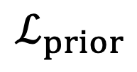
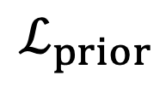
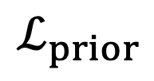
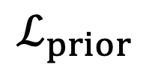
Input
w/o
$$ℒ_{prior}$$
w/
$$ℒ_{prior}$$
Input
w/o
$$ℒ_{prior}$$
w/
$$ℒ_{prior}$$

Slide 4
Input
w/o
$$ℒ_{prior}$$
w/
$$ℒ_{prior}$$

Slide 5
Input
w/o
$$ℒ_{prior}$$
with
$$ℒ_{prior}$$
Input
w/o
$$ℒ_{prior}$$
with
$$ℒ_{prior}$$

