Slide 1
Evaluating the Impact of Robotic Process Automation on Earnings Management
Presenter: Hsing Kuang, Lai
Advisor: Sheng Feng, Hsieh
Department and Graduate Institute of Accounting
College of Management
National Taiwan University
Notes:
Good morning, every one. My name is 賴星光. I will be presenting my research on the impact of Robotic Process Automation (RPA) on earnings management.

Slide 2
Contents
01
02
03
Literature Review & Hypothesis Development
Sample Selection & Research Design
Introduction (Motivation)
04
05
Results
Conclusion
Notes:
My presentation will follow the sequence: introduction, hypothesis, empirical model design and results, and finally, conclusion.

Slide 3



Motivation
Disruptive technologies like ERP, AI, ML, cloud computing, blockchain, and RPA are reshaping finance and accounting.
Notes:
The reason for conducting this research is closely linked to the emergence of new technologies, particularly RPA.
Recently, technologies like ERP, AI, and RPA have been reshaping the finance and accounting area.

Slide 4


Motivation
One of the instance, revolution in financial operations through ERPs with abundant empirical evidences on ERP benefits
Hayes et al. (2001)
Morris and Laksmana (2010)
Notes:
For instance, ERP has been shown to influence financial operations in several accounting studies.
Hayes et al. found a positive market response post-ERP implementation.
Additionally, Morris and Laksmana's research indicates that financial reporting quality improves after ERP adoption.

Slide 5
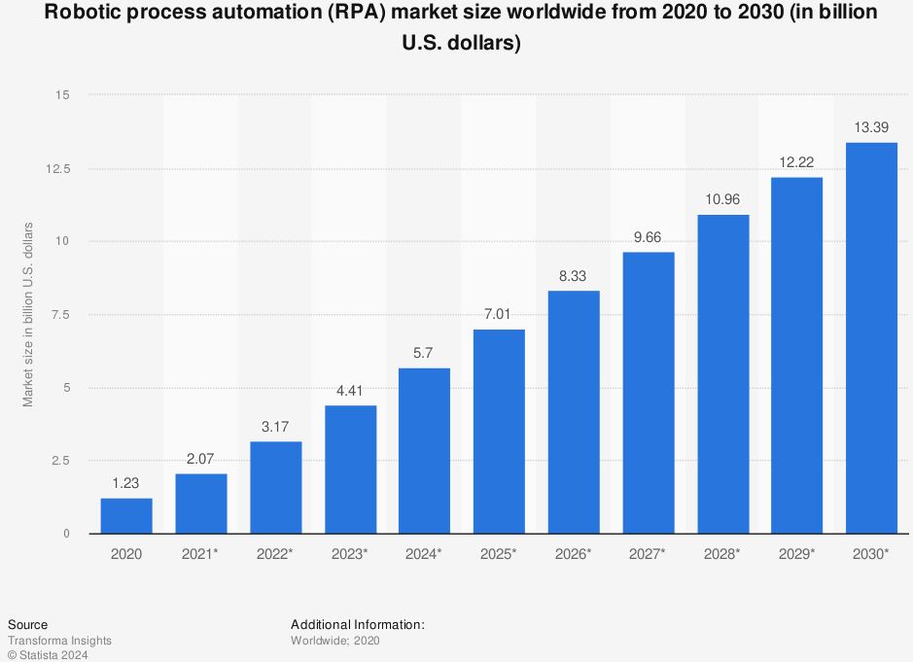
Motivation
Rapid growth of RPA after Covid-19 pandemic.
Theoretical and qualitative insights on RPA adoption while empirical studies on RPA’s impact on the accounting profession are rare.
Notes:
RPA, a relatively new technology, has grown rapidly, especially since COVID-19.
Despite its recent emergence, most RPA researches are qualitative or theoretical.
Quantitative studies on RPA in accounting are still quite rare.

Slide 6
Motivation
There are ample of empirical studies exploring technology and earnings management.
Technology
Earnings Management
Brazel and Dang (2008)
Morris and Laksmana (2010)
Paredes and Wheatley (2017)
Notes:
In classic accounting research, there are many papers linking earnings management to technologies like ERP.
Given the recent emergence of RPA and the abundant literature discussing the relation between earnings management and technology, we conducted this study to evaluate the impact of RPA on earnings management.

Slide 7
02 Literature Review & Hypothesis Development
Earnings Management
Automation Tools: from ERP to RPA
Earnings Management with Automation Tools
Accrual-Based Earnings Management & Hypothesis 1
Real Activities Manipulation & Hypothesis 2
Notes:
The second part is literature review and hypothesis development.

Slide 8
Earnings Management
Earnings Management (EM)
Healy and Wahlen (1999) | Accrual based earnings management (AM) | Real activities manipulation (RM)
Definition | Altering financial statements through accounting choices | Deviating from usual business operations to influence reported earnings
Techniques | e.g., Depreciation methods, and bad debt estimations | For instance: Excessive price discounts and overproduction Reduction of discretionary expenses
Notes:
Based on Healy and Wahlen, earnings management can be divided into two categories: accrual-based management and real activities manipulation.
Accrual-based management involves manipulating financial statements through accounting principle choices, such as changing the depreciation method.
Real activities manipulation involves unusual operations to alter reported earnings.
For example, a company might reduce its cost of goods sold through overproduction.

Slide 9

Automation Tools: from ERP to RPA
 | ERP | RPA
Purpose | Integrate various functions and centralize system control | Mimic human actions to automate repetitive tasks
Inter-company | Capital intensive industry (e.g. manufacturing) | Banking (financial industry)
Intra-company | Accounting | Accounting
Properties | Centralized data processing Track of accounting transactions | Bridge the gap between different applications High adaptability
Notes:
The first wave of automation, Enterprise Resource Planning (ERP) systems, integrates various functions within a firm, centralizing system control.
Initially adopted by manufacturing companies, ERP technology gradually expanded to other industries.
In accounting functions, ERPs assist in data processing and tracking complex transactions, leading to automated generation of financial reports through predefined processes.
The next generation of automation is Robotic Process Automation (RPA).
RPA, or robots, mimic human actions to complete repetitive tasks and have become widely used in the financial industry.
In accounting functions, RPA handles rule-based tasks and interacts with diverse systems, bridging gaps left by ERP.
Thus, RPA complements ERP as an auxiliary tool.

Slide 10

Exploring the Potential Relation Between RPA and EM via ERP Insights
No direct empirical research linking RPA with EM so far.
Both ERP and RPA technologies aim to elevate operational efficiency and data accuracy within organizations, which are critically relevant to the quality of financial reporting.
RPA serves as an analogy role to ERP and influence of ERP on EM may closely mirror that of RPA on EM.
Notes:
Before discussing how RPA influences earnings management, it's important to note the lack of empirical research on this relationship.
However, both RPA and ERP technologies improve operational efficiency and data accuracy, which are crucial for reporting quality.
Given their similarities, we will review ERP research on earnings management, assuming that RPA's impact will mirror that of ERP.

Slide 11
AM with Automation Tools
Mixed Results
 | Brazel and Dang (2008) | Morris and Laksmana (2010)
ERP Adoption | Increase AM | Decrease AM
Control firms | Excluded | Included
Sample Period | Pre-SOX | Post-SOX sample included
Adoption Motivation | Cost reduction and productivity gains (Shehab et al. 2004) | Compliance with new financial reporting standards post-SOX
 | Weaken auditor assessments and internal controls Question about IT auditors' competency Aid managerial decisions | Improve transparency Enhance internal control
Regulatory
Context Matters
Notes:
Braze and Dang indicate that earnings management increases after ERP adoption, explaining that real-time information aids managerial decisions and that ERP implementation negatively impacts audit quality. Additionally, the competency of external IT audits is questioned.
Conversely, Morris and Laksmana find a significant drop in accrual-based earnings management post-ERP, attributing it to increased transparency deterring earnings management. Their empirical study, including control firms, also shows improved internal control after ERP implementation.
The mixed results may stem from different sample periods. Morris and Laksmana's study includes the early SOX period, while Braze and Dang's study is pre-SOX. This difference highlights varying motivations for ERP adoption: operational advantages pre-SOX versus regulatory compliance post-SOX. Regulatory issues thus play a significant role in ERP adoption and its impact on earnings management.

Slide 12
AM with Automation Tools
Hong et al. (2023):
No singular framework effectively covers all aspects of RPA risk management.
Underdeveloped frameworks for RPA-specific risk management and control.
Implications for Earnings Management
Similarity to situation of Brazel and Dang (2008) due to lack of comprehensive control frameworks
Potential for firms to exploit RPA tools for AM practices.
Hypothesis 1: The implementation of RPA is positively associated with earnings management through discretionary accruals.
Notes:
After reviewing ERP studies, we assess the RPA control framework to propose our hypothesis.
According to Hong, while RPA can apply the ERP control framework due to similarities, it remains insufficient for comprehensive RPA risk management.
This underdeveloped framework may lead to scenarios similar to Braze and Dang's findings, where comprehensive controls are needed.
Thus, companies might use RPA to assist in earnings management.
Therefore, our hypothesis is that RPA implementation is positively associated with earnings management through discretionary accruals.

Slide 13
RM with Automation Tools
Paredes and Wheatley (2017)
RM drop in post-ERP implementation period.
Morris (2011)
Lenard et al. (2016)
ERP adopted firms less prone to reporting internal control weaknesses (ICW).
Firms disclosing internal control weaknesses more likely to engage in RM.
Notes:
Building on the interplay between RPA implementation and earnings management through accruals, we also examine real activities manipulation (RM).
Paredes and Wheatley (2017) found that firms are less likely to engage in RM post-ERP implementation due to improved integration and monitoring.
Morris (2011) observed fewer internal control weaknesses (ICWs) in ERP firms, indicating strengthened internal controls.
Lenard et al. (2016) found that companies with ICWs were more likely to engage in RM.
Thus, ERP integration appears to reduce RM likelihood through enhanced internal controls and monitoring.

Slide 14
RM with Automation Tools
Hypothesis 2:
The implementation of RPA is positively associated with earnings management through real activities manipulation.
Regulation Factors
Motivation of Adoption
Lack of control framework
Parallels with Hypothesis 1
Notes:
However, Morris (2011), also referencing Brazel and Dang (2008), highlights the different situations between two studies.
This parallels with hypothesis 1. Similarly, we suggest that RPA implementation can allow firms to use automation for RM without a strong control framework.

Slide 15
03 Sample Selection & Research Design
Main Interest: RPA Implementation Indicator
Sample in this Research
Proxies for
Accrual-Based Earnings Management
Real Activities Manipulation
Empirical Models
Notes:
The following section is for sample selection and research design

Slide 16
Main Interest Variable: RPA Implementation Indicator
Target: RPA technology adoption, using Paredes and Wheatley (2018) 's document analysis method for ERP implementations.
Systematic keyword search in TWSE and TPEx firms' digital annual reports.
Keywords: “Robotic Process Automation,” “RPA,” and their Taiwanese Mandarin equivalents.
Verify RPA adoption through keyword analysis of documents. (Including RPA / implementation/education/ training, etc.)
Assume continuity of RPA initiatives if mentioned once, marking ongoing engagement in following years.
Notes:
Our study on RPA technology adoption uses a document analysis strategy same as Paredes and Wheatley.
We conduct a systematic keyword search in the digital annual reports of listed firms to compile a comprehensive dataset on RPA implementation.

Slide 17
Sample Selection
Sample Period: 2017 ~ 2022
Before 2017, there are no annual reports recorded RPA related disclosure.
Exclude firms from the financial industry, which is anecdotally known for having widespread RPA adoption.
Table 1 Panel A: Selection Procedure
Unique firms with searched keyword in annual reports within the sample period | 128
Less:
Remove the content unrelated to RPA after manual examine each annual report | (9)
Financial institutions (TSE code: M2800) | (21)
Missing value for variables calculation OR Not satisfied with minimum industry-year observations for calculation of EM proxies | (12)
Total | 86
Notes:
Our sample period begins in 2017, as no company disclosed RPA utilization before that year.
For the earnings management analysis, we exclude financial companies, following common research practice.
Companies with missing data for variable calculation are also excluded.
Ultimately, our sample includes 86 firms that have adopted RPA.

Slide 18
TSE Code | Industry Name | Number of Firms
M1300 | Plastics | 3
M1400 | Textiles | 9
M1500 | Electric machinery | 5
M1721 | Chemical | 2
M1722 | Biotechnology and medical care | 3
M2200 | Automobile | 1
M2324 | Semiconductor | 6
M2325 | Computer and peripheral equipment | 8
M2326 | Optoelectronic | 7
M2327 | Communications and internet | 7
M2328 | Electronic parts/components | 7
M2329 | Electronic products distribution | 2
M2330 | Information service | 10
M2331 | other electronic | 2
M2500 | Building material and construction | 1
M2600 | Shipping and transportation | 4
M2700 | Tourism and hospitality | 2
M2900 | Trading and consumers’ goods industry | 1
M3700 | Sports and leisure | 2
M3800 | Household | 1
M9900 | Others | 3
Total |  | 86
Distribution of RPA Adoptions by Industry/ Starting Year
Adoption Year | Number of Firms
2017 | 1
2018 | 14
2019 | 12
2020 | 22
2021 | 21
2022 | 16
Total | 86
Notes:
The tables above show the distribution of industries among our RPA-adopting firms and the years they began adoption.

Slide 19
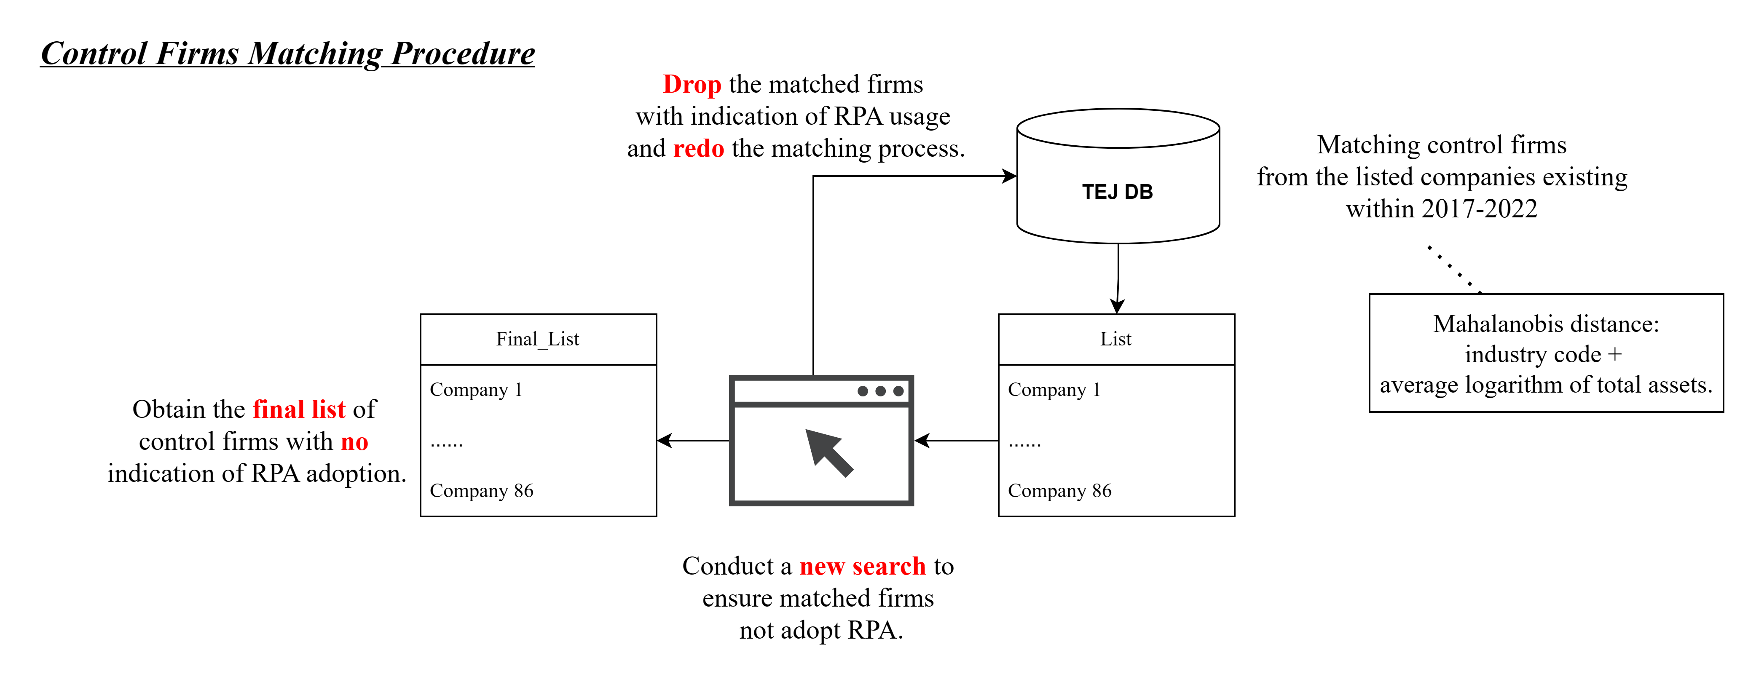
Sample Selection
Notes:
Similar to previous studies, we match 86 comparable firms without RPA implementation as a control group.
After initial pairing, we check if control firms might be using RPA through news search.
If we find any indications, we exclude those firms and repeat the matching process.
This is done until we have a set of control firms with no RPA adoption news.

Slide 20
Proxies for Accrual-based Earnings Management & Real Activities Manipulation
ABSDA
AM
Absolute discretionary accruals, estimated using the modified Jones model (Jones 1991; Becker et al. 2010), capture upward and downward earnings manipulation, indicating comprehensive AM activities.
Discretionary component of accruals quality, influenced by management's accounting decisions and estimates, reflecting manipulation potential (Francis et al. 2005).
DAQ
(For additional analysis section)
Proxy calculation: Appendix A
Notes:
For the earnings management proxy, we use the absolute value of discretionary accruals calculated from the modified Jones model to detect manipulation via accruals.
In the additional analysis section, we use another proxy called the discretionary component of accruals quality following Francis et al.'s study.

Slide 21
Proxies for Accrual-based Earnings Management & Real Activities Manipulation
ABEXP
RM
Combined
Abnormal discretionary expenses, higher the values, the greater amount of dicretionary expenses cut by firms
Aggregation of ABEXP and ABPROD
Abnormal production cost, higher the value, the larger amount of inventory overproduction to reduce COGS
ABPROD
Proxy calculation: Appendix A
Notes:
For another form of earnings management, we follow Zang’s research, using abnormal discretionary expenses, abnormal production costs, and their aggregation to detect real activities manipulation. The larger these proxies are, the more likely a firm is engaging in RM.

Slide 22
Main Interest Variables
01
02
03
POST
RPA
POST*RPA
1 for the firm-year observations during/ after implementation of RPA
1 for the treatment group
Product of POST and RPA
For the models with matched control group
Notes:
Our main variables of interest are POST and RPA.
POST is set to 1 for firm-year observations within or after RPA adoption,
and RPA is set to 1 for observations in the treatment group.
The product of these two indicators is used in the matched regression analysis.

Slide 23
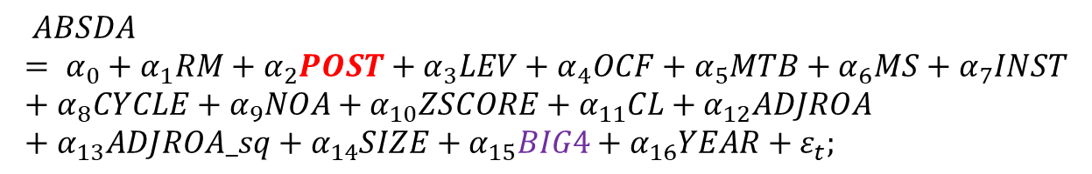
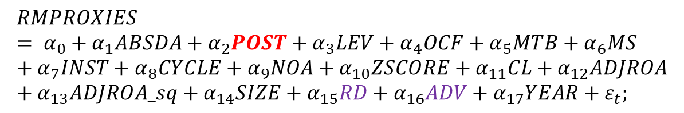
Empirical Models-Within Treatment Group
$$ABSDA= α_{0}+α_{1}RM+α_{2}POST+α_{3}LEV+α_{4}OCF+α_{5}MTB+α_{6}MS+α_{7}INST+α_{8}CYCLE+α_{9}NOA+α_{10}ZSCORE+α_{11}CL+α_{12}ADJROA+α_{13}ADJROA_sq+α_{14}SIZE+α_{15}BIG4+α_{16}YEAR+ε_{t};$$
$$RMPROXIES= α_{0}+α_{1}ABSDA+α_{2}POST+α_{3}LEV+α_{4}OCF+α_{5}MTB+α_{6}MS+α_{7}INST+α_{8}CYCLE+α_{9}NOA+α_{10}ZSCORE+α_{11}CL+α_{12}ADJROA+α_{13}ADJROA_sq+α_{14}SIZE+α_{15}RD+α_{16}ADV+α_{17}YEAR+ε_{t};$$
where RMPROXIES are ABEXP, ABPROD, and RM.
Notes:
For the empirical models, we follow Chen et al. and Zang’s studies to distinguish AM regression and RM regressions in a simultaneous equation framework.
Control variables are included based on prior research. Big4 is a control variable specifically for AM equations, while R&D intensity and advertising intensity are included in the RM equation.
Our main focus is the coefficient of POST.

Slide 24
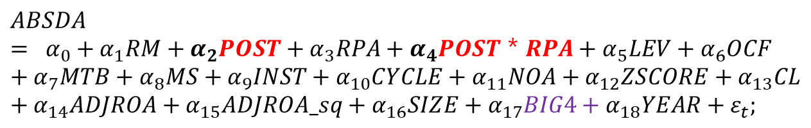
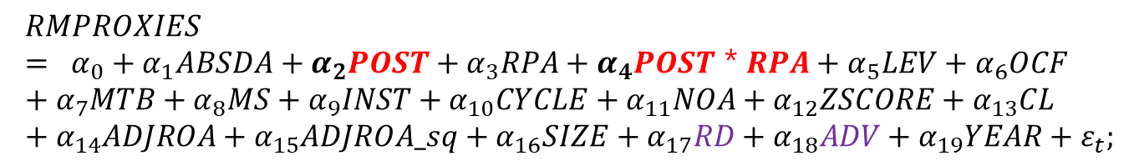
Empirical Models-Matched Control Group
$$ABSDA= α_{0}+α_{1}RM+α_{2}POST+α_{3}RPA+α_{4}POST＊RPA+α_{5}LEV+α_{6}OCF+α_{7}MTB+α_{8}MS+α_{9}INST+α_{10}CYCLE+α_{11}NOA+α_{12}ZSCORE+α_{13}CL+α_{14}ADJROA+α_{15}ADJROA_sq+α_{16}SIZE+α_{17}BIG4+α_{18}YEAR+ε_{t};$$
$$RMPROXIES= α_{0}+α_{1}ABSDA+α_{2}POST+α_{3}RPA+α_{4}POST＊RPA+α_{5}LEV+α_{6}OCF+α_{7}MTB+α_{8}MS+α_{9}INST+α_{10}CYCLE+α_{11}NOA+α_{12}ZSCORE+α_{13}CL+α_{14}ADJROA+α_{15}ADJROA_sq+α_{16}SIZE+α_{17}RD+α_{18}ADV+α_{19}YEAR+ε_{t};$$
where RMPROXIES are ABEXP, ABPROD, and RM.
Notes:
For the matched regression with control firms, the control variables remain the same as in the previous equations. The main variables of interest differ.
We will examine POST, the product of POST and RPA, and their linear hypothesis to check whether the sum of alpha 2 and alpha 4 is greater than 0.

Slide 25
Potential Endogeneity Problem between AM and RM
Choice between AM and RM depends on their relative costs (Zang 2012)
The total earnings management includes both types of manipulation and their disturbance terms (Hamza 2019).
Both types of manipulation are part of a joint decision to manage earnings, with AM being endogenously related to RM.
$$EM=AM+ε_{AM}+RM+ε_{RM}$$
Notes:
Before performing regression analysis, it's important to address the endogeneity issue between the two approaches for earnings management.
Zang found that management's choice to conduct AM or RM is based on their relative costs.
Hamza also emphasized that AM and RM may have an endogeneity problem, as earnings management can be viewed as the sum of AM and RM, along with their error terms.

Slide 26
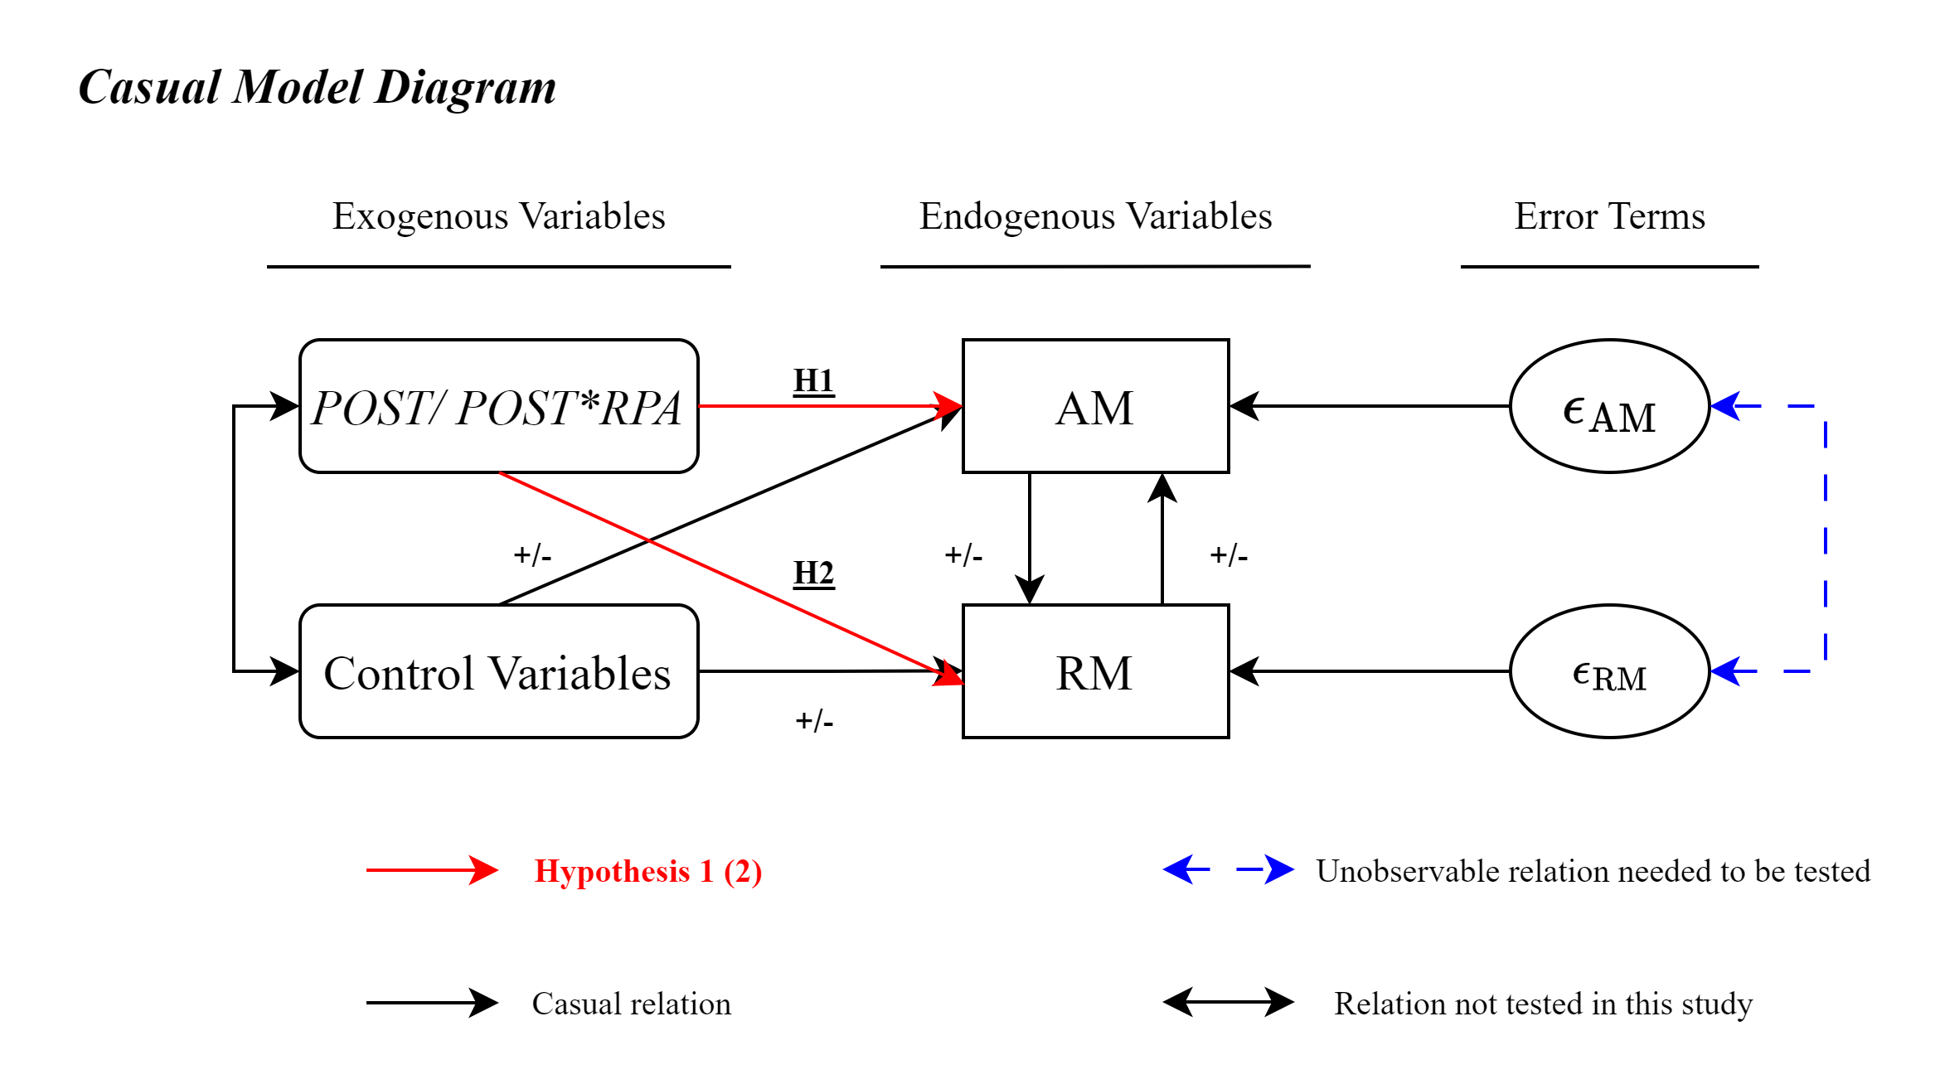
Notes:
This causal model diagram visualize our model's mechanism. The red lines indicate the relationships we aim to explore for hypothesis 1 and hypothesis 2.
However, we first need to examine whether AM and RM in our sample are endogenous. The blue lines show an unobservable relationship that needs to be tested first.

Slide 27
Hausman Auxiliary Regressions Test (Hill et al. 2018)
$$AM=c\left(Exogenous Variables\right)+ε_{AM}$$
$RM=AM+c\left(Exogenous Variables\right)$ $+δε_{AM}+ε$
$RM=predictAM+c\left(Exogenous Variables\right)$ $+ε$
2SLS comes to an approach to mitigate the endogeneity bias inherent from OLS.
Actual AM (RM) are replaced with predicted value from the first-stage equations
Notes:
We adopt the Hausman Auxiliary regressions method from Hill et al.
Taking AM as an example, we first regress AM on exogenous variables to obtain the residuals of AM. Then, we regress RM on AM, exogenous variables, and the residuals of AM.
If the coefficient of the AM residuals is significantly different from zero, it suggests that AM is endogenously related to RM.
Finally, the predicted value of AM from the first-stage equations will substitute the actual AM in the regression of the empirical models. Using 2SLS will be a better approach than OLS to address endogeneity

Slide 28
04 Results
Within Treatment Group Analysis
Matched Result Analysis with RPA Adopted and RPA Non-Adopted Sample
Additional Analysis: Alternative Measure for AM proxy
Notes:
The fourth part will illustrate the results of the model.

Slide 29
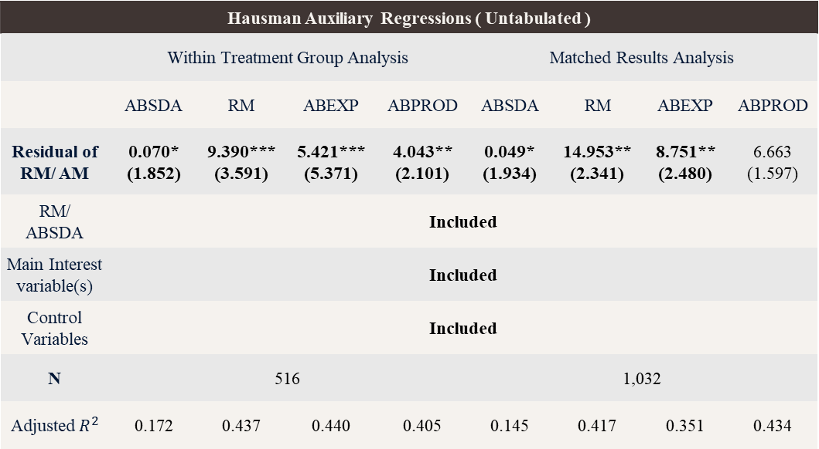
Testing for Endogeneity
Hausman Auxiliary Regressions ( Untabulated )
 | Within Treatment Group Analysis |  |  |  | Matched Results Analysis
 | ABSDA | RM | ABEXP | ABPROD | ABSDA | RM | ABEXP | ABPROD
Residual of RM/ AM | 0.070* (1.852) | 9.390*** (3.591) | 5.421*** (5.371) | 4.043** (2.101) | 0.049* (1.934) | 14.953** (2.341) | 8.751** (2.480) | 6.663 (1.597)
RM/ ABSDA | Included
Main Interest variable(s) | Included
Control Variables | Included
N | 516 |  |  |  | 1,032
Adjusted $R^{2}$ | 0.172 | 0.437 | 0.440 | 0.405 | 0.145 | 0.417 | 0.351 | 0.434
Notes:
In our previous test for endogeneity, we ran the Hausman auxiliary regressions and found that endogeneity is indeed present in our sample.

Slide 30
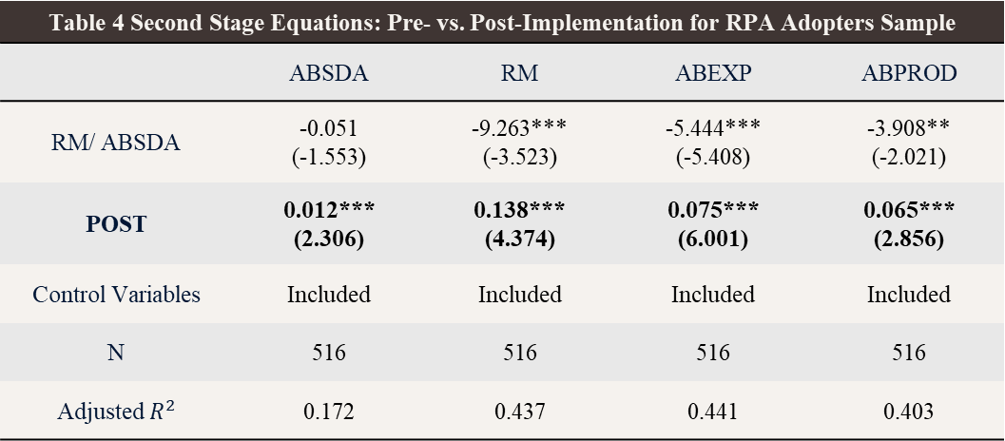
Within Treatment Group Analysis
Table 4 Second Stage Equations: Pre- vs. Post-Implementation for RPA Adopters Sample
 | ABSDA | RM | ABEXP | ABPROD
RM/ ABSDA | -0.051 (-1.553) | -9.263*** (-3.523) | -5.444*** (-5.408) | -3.908** (-2.021)
POST | 0.012*** (2.306) | 0.138*** (4.374) | 0.075*** (6.001) | 0.065*** (2.856)
Control Variables | Included | Included | Included | Included
N | 516 | 516 | 516 | 516
Adjusted $R^{2}$ | 0.172 | 0.437 | 0.441 | 0.403
Notes:
Our first regressions test whether earnings management increases after RPA adoption within the treatment group.
We find that the coefficients for both AM and RM are significantly greater than zero, supporting our hypotheses 1 and 2 that RPA implementation is positively related to earnings management.

Slide 31
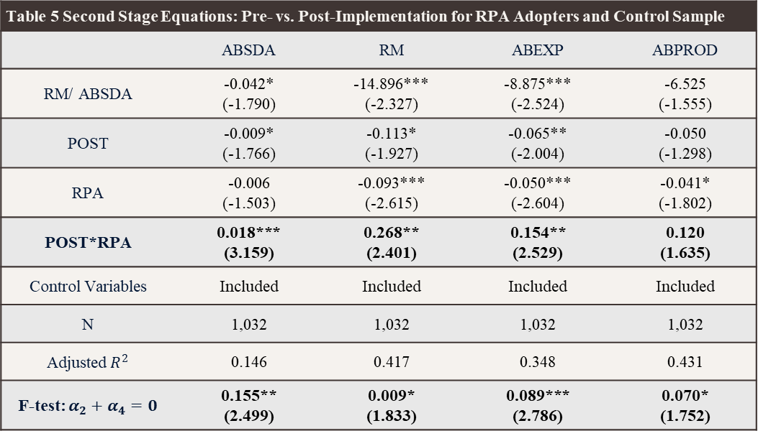
Matched Results Analysis
Table 5 Second Stage Equations: Pre- vs. Post-Implementation for RPA Adopters and Control Sample
 | ABSDA | RM | ABEXP | ABPROD
RM/ ABSDA | -0.042* (-1.790) | -14.896*** (-2.327) | -8.875*** (-2.524) | -6.525 (-1.555)
POST | -0.009* (-1.766) | -0.113* (-1.927) | -0.065** (-2.004) | -0.050 (-1.298)
RPA | -0.006 (-1.503) | -0.093*** (-2.615) | -0.050*** (-2.604) | -0.041* (-1.802)
POST*RPA | 0.018*** (3.159) | 0.268** (2.401) | 0.154** (2.529) | 0.120 (1.635)
Control Variables | Included | Included | Included | Included
N | 1,032 | 1,032 | 1,032 | 1,032
Adjusted $R^{2}$ | 0.146 | 0.417 | 0.348 | 0.431
F-test: $α_{2}+α_{4}=0$ | 0.155** (2.499) | 0.009* (1.833) | 0.089*** (2.786) | 0.070* (1.752)
Notes:
When we include control firms in the regression analysis, we conduct a linear hypothesis test to determine if the sum of the coefficients for POST and the interaction term of POST and RPA is greater than zero.
The F-test shows that all coefficients are greater than zero, indicating that RPA-adopting firms are more likely to engage in earnings management compared to control firms after the implementation period. This result supports both our hypotheses 1 and 2.

Slide 32
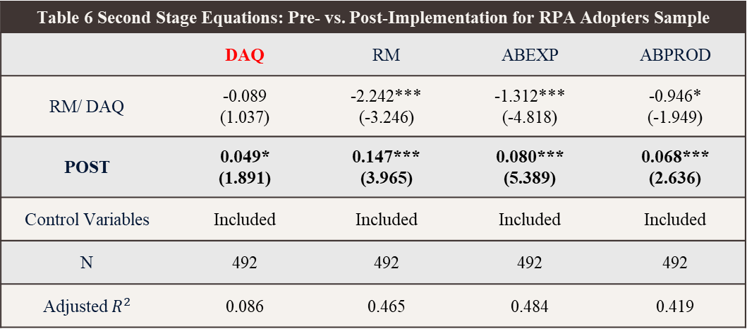
Within Treatment Group Additional Analysis
Table 6 Second Stage Equations: Pre- vs. Post-Implementation for RPA Adopters Sample
 | DAQ | RM | ABEXP | ABPROD
RM/ DAQ | -0.089 (1.037) | -2.242*** (-3.246) | -1.312*** (-4.818) | -0.946* (-1.949)
POST | 0.049* (1.891) | 0.147*** (3.965) | 0.080*** (5.389) | 0.068*** (2.636)
Control Variables | Included | Included | Included | Included
N | 492 | 492 | 492 | 492
Adjusted $R^{2}$ | 0.086 | 0.465 | 0.484 | 0.419
Notes:
For the additional analysis, we choose the alternative AM proxy following Francis et al. to check whether our regression results are robust.
In terms of within group analysis, the results keep the same.

Slide 33
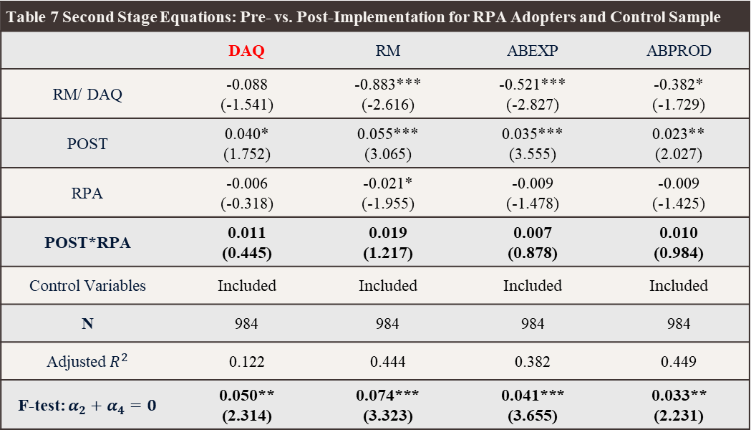
Matched Results Additional Analysis
Table 7 Second Stage Equations: Pre- vs. Post-Implementation for RPA Adopters and Control Sample
 | DAQ | RM | ABEXP | ABPROD
RM/ DAQ | -0.088 (-1.541) | -0.883*** (-2.616) | -0.521*** (-2.827) | -0.382* (-1.729)
POST | 0.040* (1.752) | 0.055*** (3.065) | 0.035*** (3.555) | 0.023** (2.027)
RPA | -0.006 (-0.318) | -0.021* (-1.955) | -0.009 (-1.478) | -0.009 (-1.425)
POST*RPA | 0.011 (0.445) | 0.019 (1.217) | 0.007 (0.878) | 0.010 (0.984)
Control Variables | Included | Included | Included | Included
N | 984 | 984 | 984 | 984
Adjusted $R^{2}$ | 0.122 | 0.444 | 0.382 | 0.449
F-test: $α_{2}+α_{4}=0$ | 0.050** (2.314) | 0.074*** (3.323) | 0.041*** (3.655) | 0.033** (2.231)
Notes:
Likewise, we use the alternative proxy in the matched regressions and the F-test statistics are all larger than zero.

Slide 34
05 Conclusion
Key findings
Contributions
Limitations
Future research
Notes:
The last part is conclusion.

Slide 35
Key Findings
Firms with RPA are more inclined towards earnings management (EM) in the post-implementation period.
Multivariate analysis with control groups supports the broader applicability and robustness of the findings.
Regression models using additional AM proxy are robust and consistent with the hypothesis.
Notes:
The main findings of this study focus on whether earnings management increases after RPA implementation.
We find that all types of earnings management increase following RPA adoption, as shown through both within-treatment group analysis and matched results analysis. Additionally, this conclusion is supported by our additional analysis

Slide 36
Contribution
Emphasizes leveraging the benefits of automation while mitigating risks associated with earnings management.
Firms
Highlights the need for regulatory frameworks in the context of rapidly evolving digital transformation.
Regulators
Improves audit quality and effectiveness by enabling auditors to tailor their approaches to better detect and address potential earnings management in the era of automation.
Audit Firms
Notes:
This study highlights RPA's impact on earnings management for firms, regulators, and auditors.
For firms, it emphasizes the need for robust control standards and risk management practices when implementing RPA.
Regulators can use these insights to shape policies ensuring corporate transparency and accountability amid digital transformation.
For audit firms, understanding RPA's effects can enhance audit quality and effectiveness, allowing auditors to better detect and address potential earnings management.

Slide 37
Limitations and Future Research
Reliance on annual reports instead of contract details.
Use Taiwanese data rather than USA’s data.
Limitation
Investigate relation between internal control weaknesses and RPA.
Evaluate the degree of RPA utilization based on the quantity of attended and unattended licenses for a direct measure of operational engagement.
Future Research
Notes:
For the limitations of this research, we face restricted sources for checking whether a firm has adopted RPA via annual reports.
Some control firms may not consider RPA utilization material enough to disclose in their reports or on public platforms.
Additionally, our data is solely from Taiwan, which may limit the generalizability of our findings.
Despite these limitations, future research can further examine the relationship between internal control and RPA adoption. Moreover, assessing the extent of a company's RPA deployment could be improved by using measurable proxies, such as the number of licenses usage.

Slide 38
Thanks

Slide 39
Endogeneity issues

