Slide 1
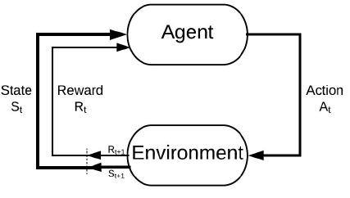
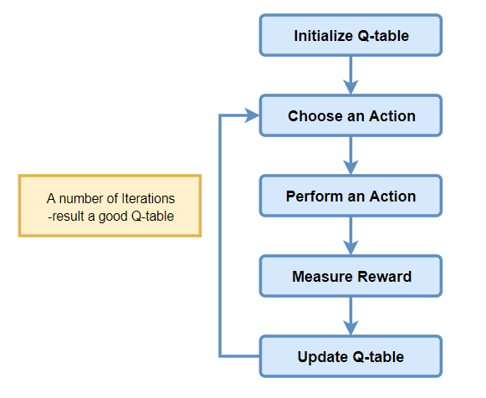

Slide 2
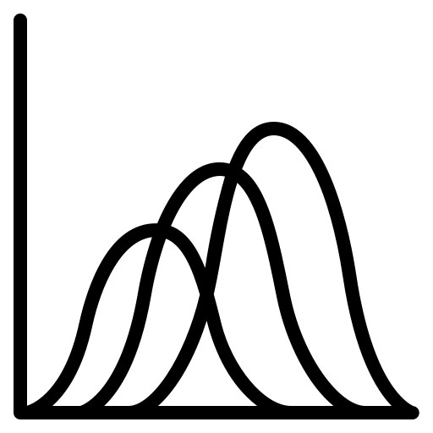


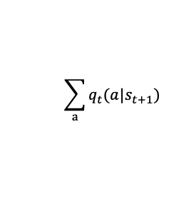




Initialize Q-Table
Agent
Choose an Action
Mental Model
Perform an Action
$$\sum_{a}{q_{t}(a|s_{t+1})}$$
Action
Measure Reward
$$A_{t}$$
Mental Model
$$R_{t+1}$$
Environment
Update Q-Table
$$Reward R_{t+1}$$
$${State S}_{t+1}$$
$$S_{t+1}$$

