Slide 1
Raspberry pi 3
Install Raspbian Build kernel Assembly
TA: Hsu-Heng Chou
Professor: Hsiao-Ping Tsai
Date: 11/25/2017

Slide 2
Outline
Readme
Install Raspbian in rpi3
Vm Install Ubuntu
Build kernel
SSH
vnc
Cross compiling Assembly
HW

Slide 3
Read me
This chapter will use git please install, install Ubuntu in teaching
We use rpi3 to represent Raspberry pi 3

Slide 4
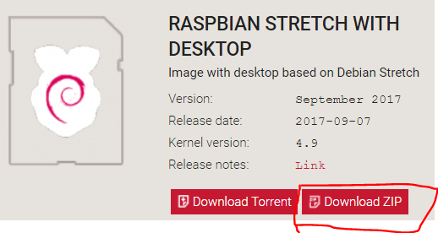
Install Raspbian
Download Raspbian
https://www.raspberrypi.org/downloads/raspbian/

Slide 5
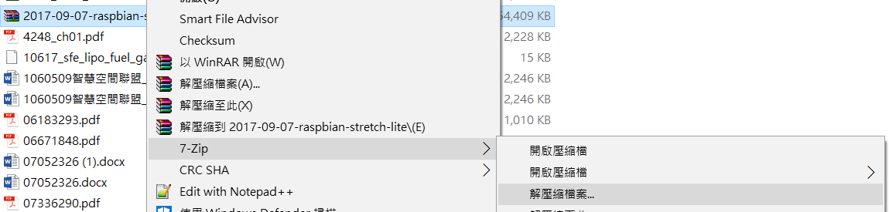
Install Raspbian
Download 7-zip
http://www.developershome.com/7-zip/
Use 7-zip to unzip the raspbian

Slide 6
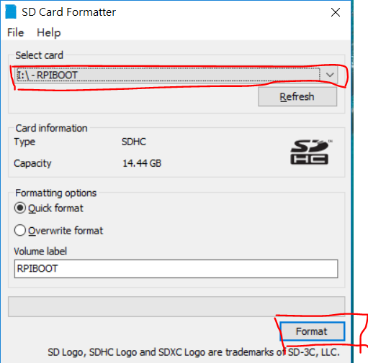
Install Raspbian
Download SD Card Formatter and install it
https://www.sdcard.org/cht/downloads/formatter_4/
Format memory card

Slide 7
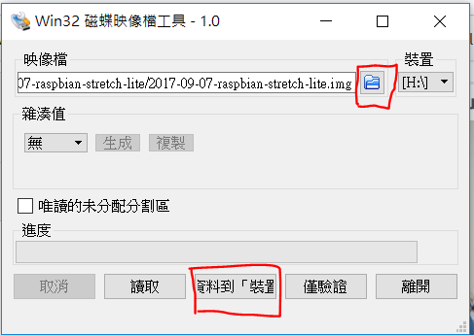
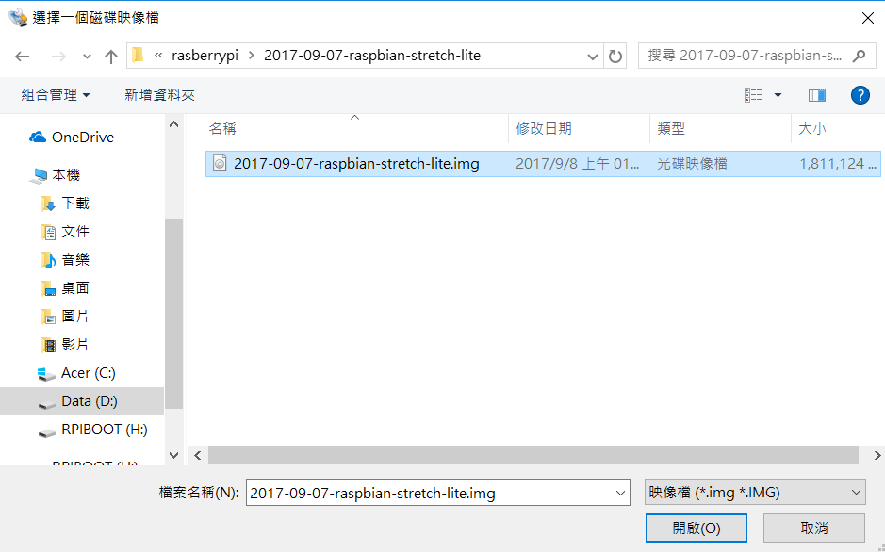
Install Raspbian
Download Win32 Disk Imager
https://sourceforge.net/projects/win32diskimager/
Choose image file and write to memory card

Slide 8
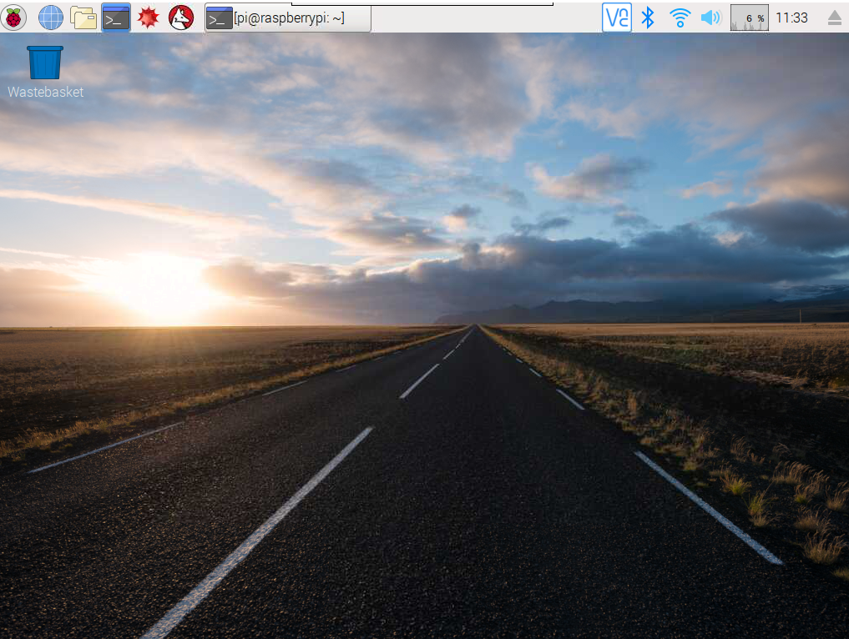
Install Raspbian
Quit memory card, put on rpi3
Connect power supply and hdmi vga converter
Boot rpi3

Slide 9
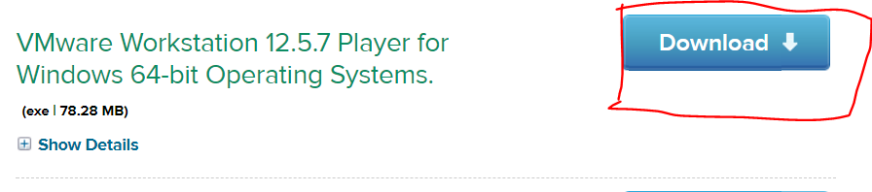
Vm Install Ubuntu
Download vmware and install
https://my.vmware.com/en/web/vmware/free#desktop_end_user_computing/vmware_workstation_player/12_0

Slide 10
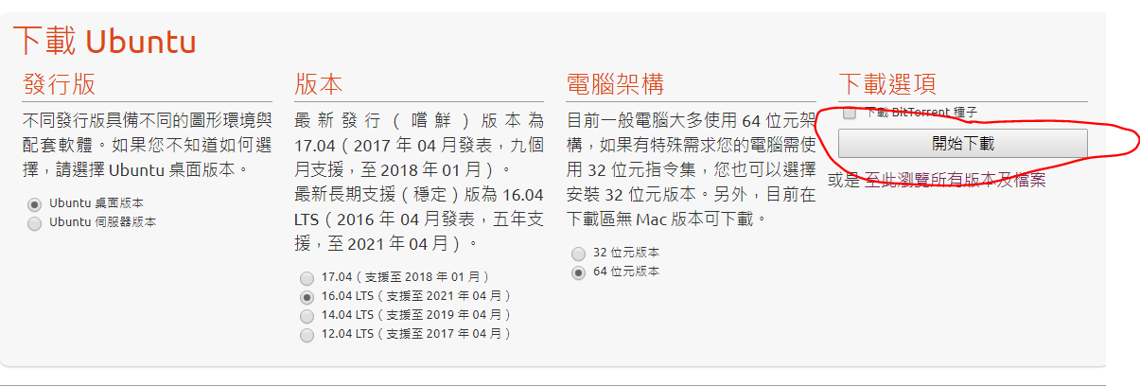
Vm Install Ubuntu
Doenload ubuntu1604
https://www.ubuntu-tw.org/modules/tinyd0/

Slide 11
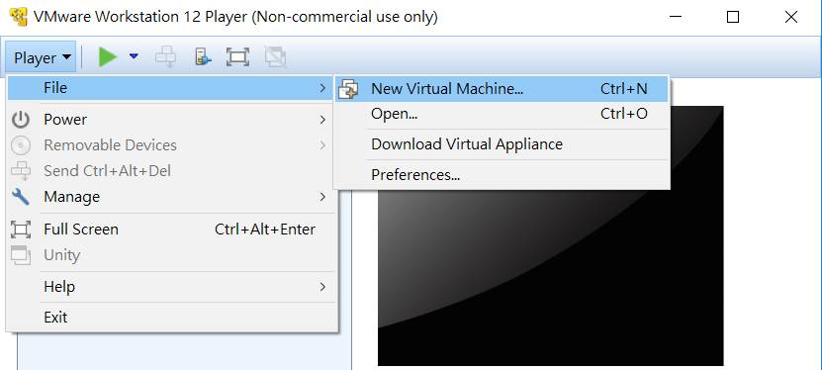
Vm Install Ubuntu
Mount Ubuntu on vmware

Slide 12
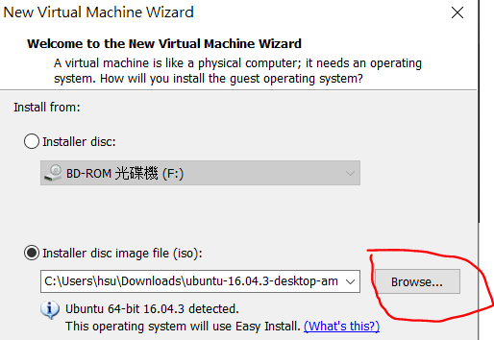
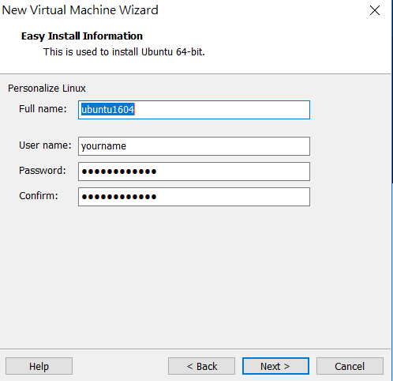
Vm Install Ubuntu

Slide 13
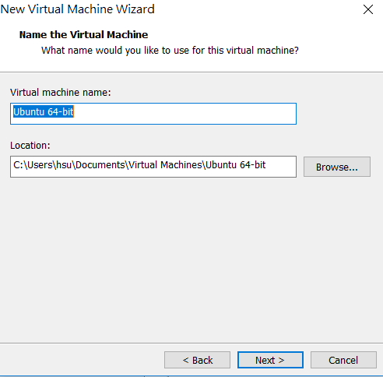
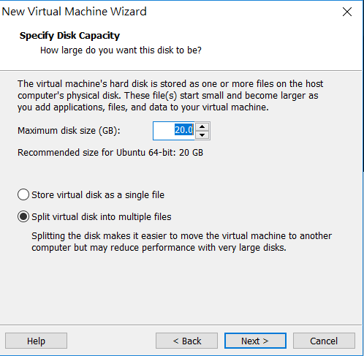
Vm Install Ubuntu
Use Default settings

Slide 14
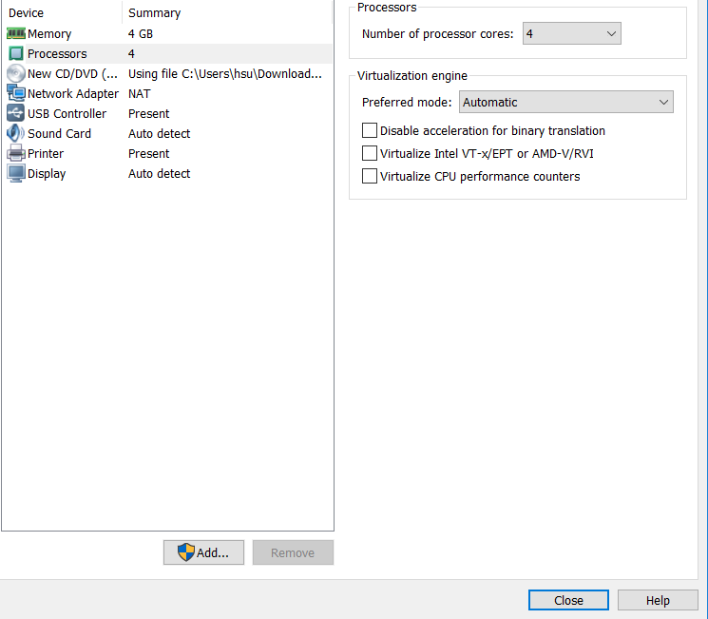
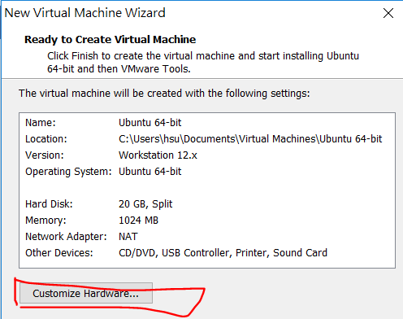
Vm Install Ubuntu
Set customize hardware
You can follow TA settings, or set by yourself
Memory: 4G
Core: 4cores

Slide 15
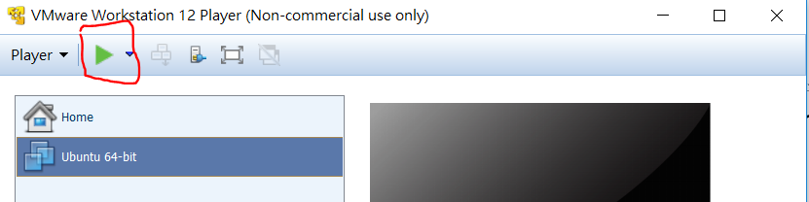
Vm Install Ubuntu
Start
Installation without setting, Vmware will help you as root installation, the general installation of linux will have many settings.

Slide 16
Build Kernel
Cross compiling tools install
Search Terminal and open it
Install toolchain
Install Linux
Install arm complier

Slide 17
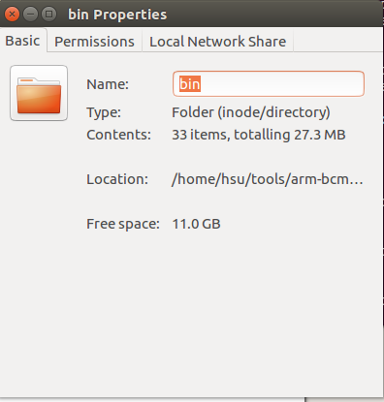
Build Kernel
Edit envirmoment variables

Slide 18
Build Kernel
Build source

Slide 19
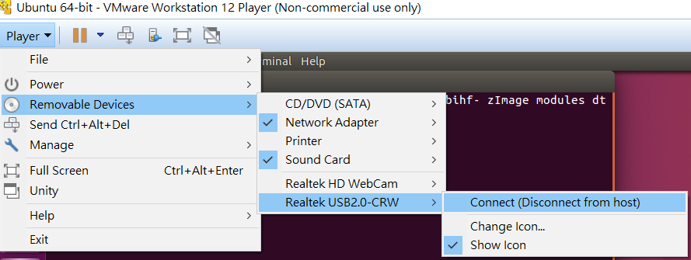
Build Kernel
Build source
Vm connect sd card，Assistant here is a laptop with built-sdcard card reader, please adjust according to personal circumstances

Slide 20
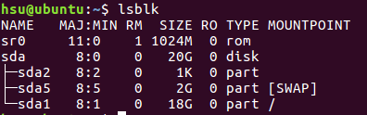
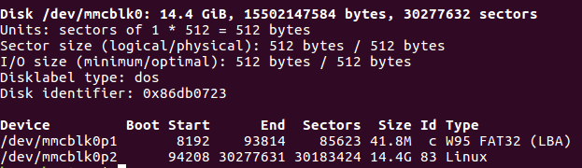
Build Kernel
Check the memory card device
Use VM
Without vm

Slide 21
Build Kernel
Set up a mount environment
Mount memory card

Slide 22
Build Kernel
Write to sdcard
Copy old kernel

Slide 23
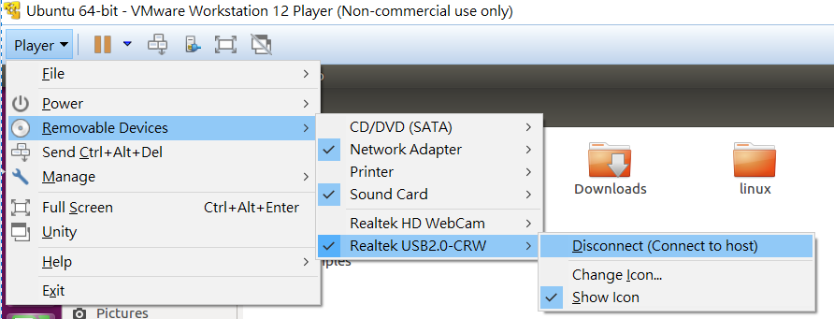
Build Kernel
Umount memory card

Slide 24
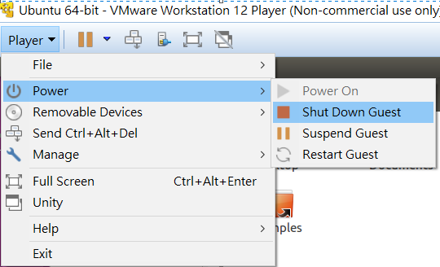
Build Kernel
Close vm

Slide 25
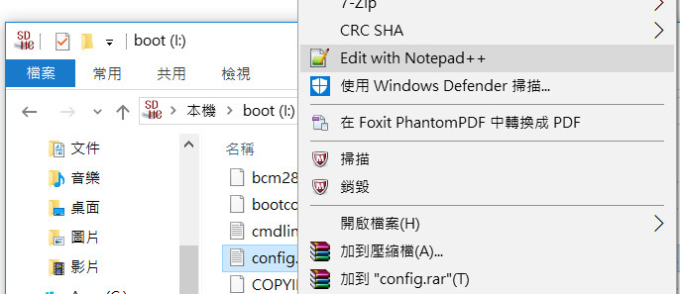

Build Kernel
Change the kernel, use notepad ++ open config.txt, add the following two lines after the save, put the memory card to rpi3

Slide 26
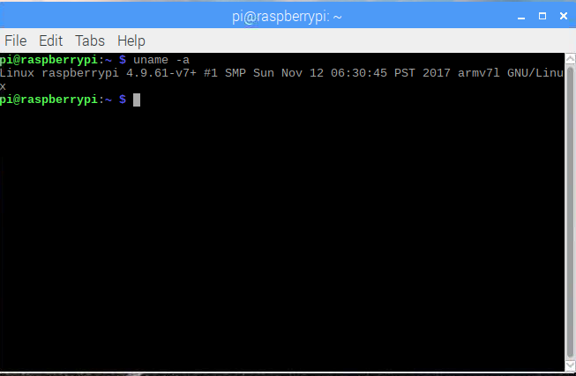
Build Kernel
Open Terminal on rpi3, enter uname -a you can see the compilation time
Original
TA build

Slide 27
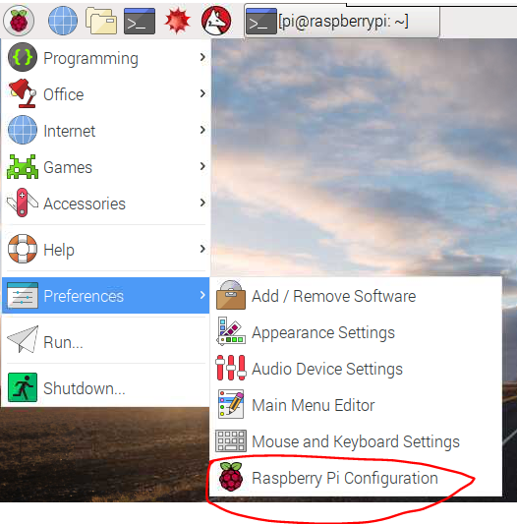
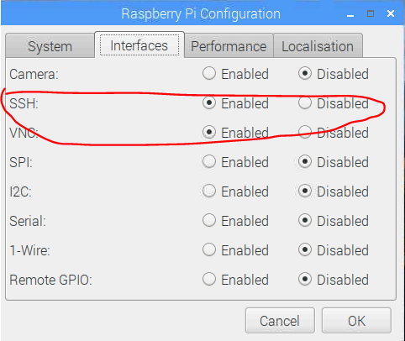
SSH
Suppose your wifi or internet connected
Setting ssh enable

Slide 28
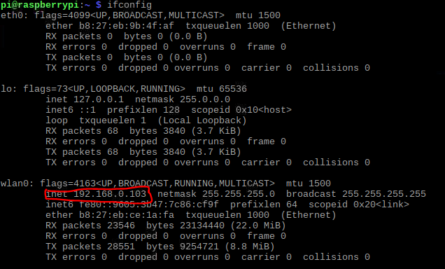
SSH
Get ip

Slide 29
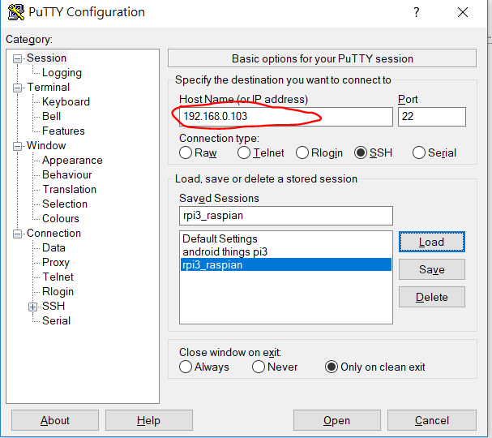
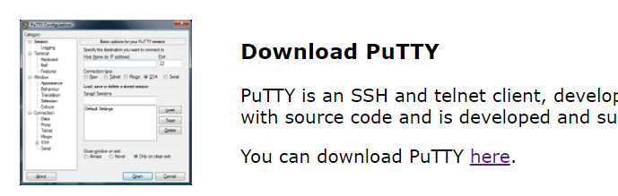
SSH
Install putty
http://www.putty.org/
Change ip setting

Slide 30
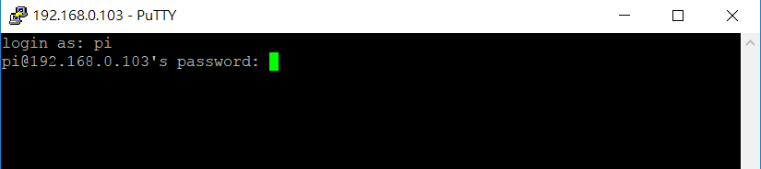
SSH
account: pi
pwd: raspberry

Slide 31
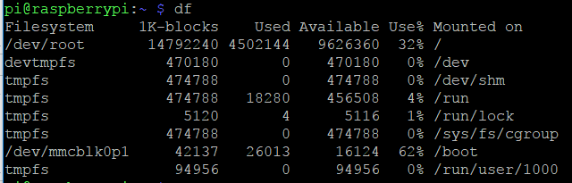
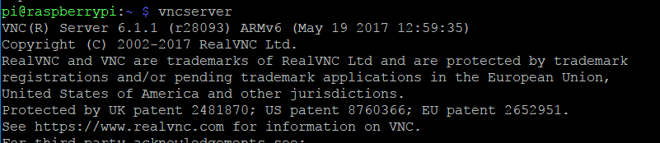
VNC
Through ssh remote to pi and set vnc enable
Quit ssh

Slide 32
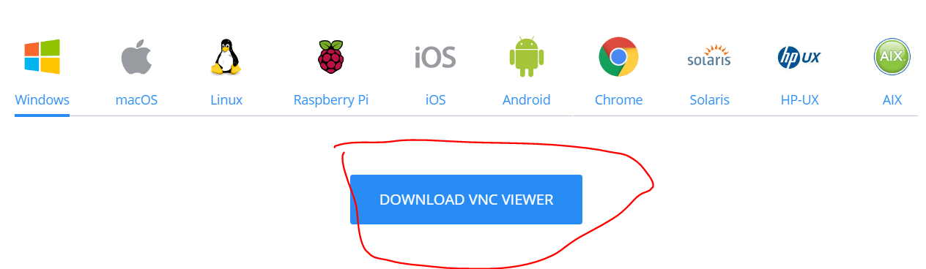
VNC
Download vnc
https://www.realvnc.com/en/connect/download/viewer/

Slide 33
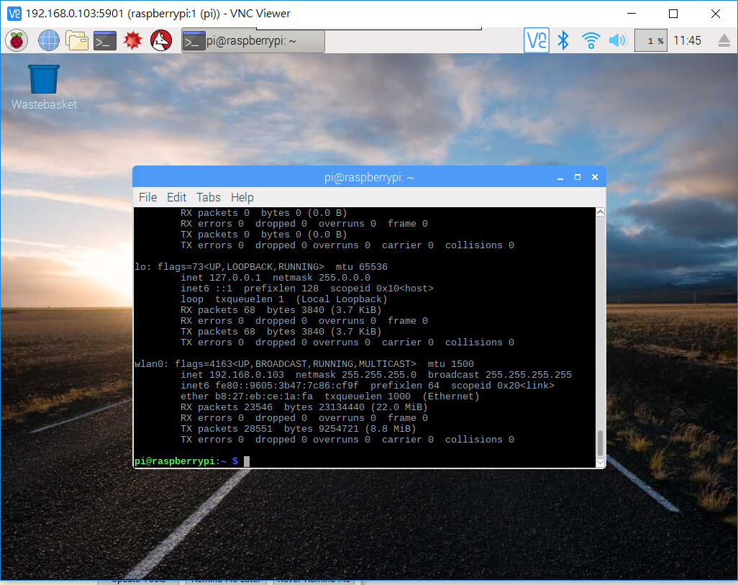
VNC
Setting ip address and port number, default port: 5901

Slide 34
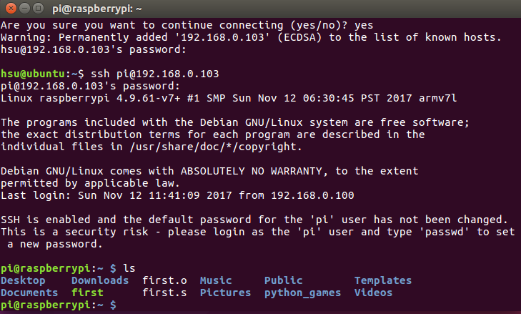
Cross compiling Assembly
Use ubuntu ssh to pi
Use vmware to cross compile

Slide 35
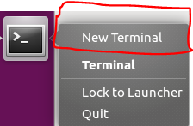
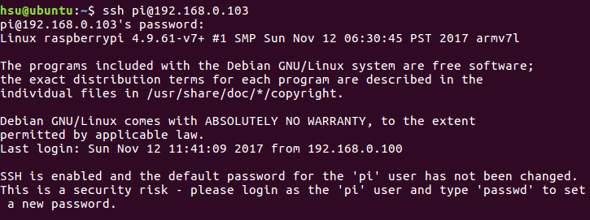
Cross compiling Assembly
Build a new Terminal
Use ssh connect pi
Password : raspberry

Slide 36
Cross compiling Assembly
Make a directory on pi
Make a directory on Ubuntu
Enter into directory

Slide 37
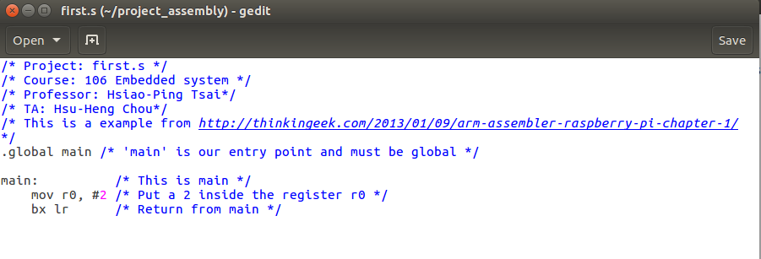
Cross compiling Assembly
Write first assembly

Slide 38
Cross compiling Assembly
Compile on Ubuntu
Run on Ubuntu, and it failed
Send to pi to run it

Slide 39


Cross compiling Assembly
Run the program on pi
Congratulation, we know how to cross compiling on pi

Slide 40
Reference
http://thinkingeek.com/2013/01/09/arm-assembler-raspberry-pi-chapter-1/
https://www.raspberrypi.org/forums/viewtopic.php?f=56&t=162408
http://hophd.com/raspberry-pi-3-model-b-installation/
https://www.raspberrypi.org/downloads/raspbian/

