Slide 1
Rasberry pi 3
Qemu Assembly
TA: Hsu-Heng chou
Professor: Hsiao-Ping Tsai
Date:2017/12/3

Slide 2
Outline
Read me
Qemu rpi
Cross compile

Slide 3
Read me
本教程將會使用win作為開發的電腦系統，助教使用的是win10
使用qemu模擬器模擬pi raspbian的系統
建立模擬器上的cross compling
請先看完106embeddedsystem_rpi3_1這份ppt

Slide 4
Qemu rpi
Download tools
Raspbian
https://sourceforge.net/projects/raspbianjessie/files/
Qemu
https://qemu.weilnetz.de/w32/2017/
Qemu kernel
https://github.com/dhruvvyas90/qemu-rpi-kernel

Slide 5
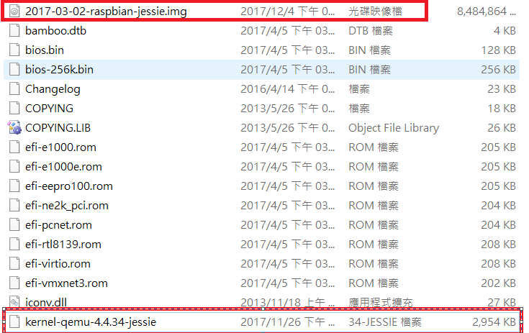
Qemu rpi
Install qemu and exact the file 2017-03-02-raspbian-jessie.img.gz
Put 2017-03-02-raspbian-jessie.img and kernel-qemu-4.4.34-Jessie on qemu directory

Slide 6
Qemu rpi
Make a file name start.bat on qemu directory
Edit it by following, or put my file start.bat on directory
qemu-system-arm -kernel kernel-qemu-4.4.34-jessie -cpu arm1176 -m 256 -M versatilepb -no-reboot -serial stdio -append "root=/dev/sda2 panic=1 rootfstype=ext4 rw init=/bin/bash" -drive "file=2017-03-02-raspbian-jessie.img,index=0,media=disk,format=raw" -redir tcp:2222::22

Slide 7
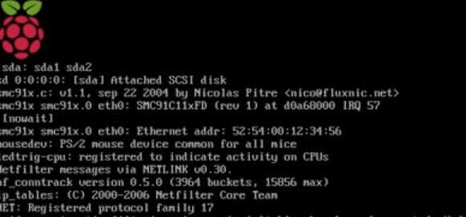
Qemu rpi
Use cmd to open it, the red frame is my root yours different should be different with me.

Slide 8

Qemu rpi
execution command
sudo nano /etc/udev/rules.d/90-qemu.rules
Edit it by following
KERNEL=="sda", SYMLINK+="mmcblk0"
KERNEL=="sda?", SYMLINK+="mmcblk0p%n"
KERNEL=="sda2", SYMLINK+="root“
After you have done, use control+x to save it

Slide 9
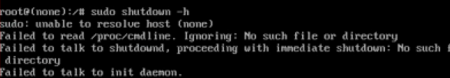

Qemu rpi
execution command
sudo shutdown –h
modified start.bat by following
Delete the context on red frame

Slide 10
Qemu rpi
execution command
qemu-img.exe resize 2017-03-02-raspbian-jessie.img +4G
You can see the 2017-03-02-raspbian-jessie.img is bigger than before

Slide 11
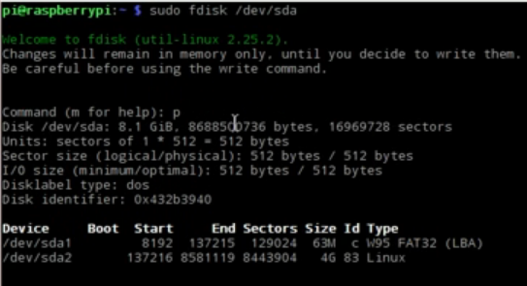
Qemu rpi
Run start.bat again
execution command on qemu pi

Slide 12
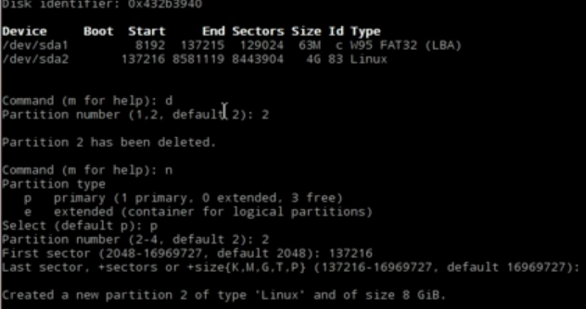
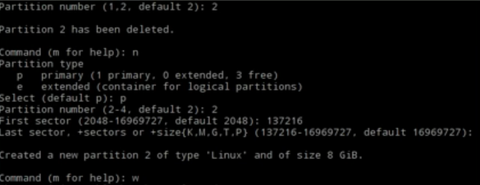
Qemu rpi

Slide 13
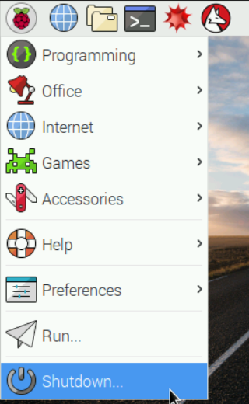
Qemu rpi
Reboot pi

Slide 14
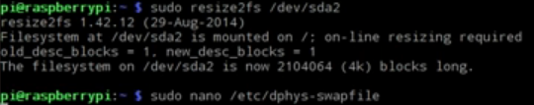
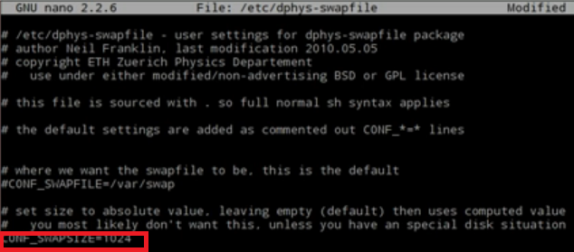
Qemu rpi
Run start.bat again
sudo resize2fs /dev/sda2
sudo nano /etc/dphys-swapfile

Slide 15

Qemu rpi
sudo /etc/init.d/dphys-swapfile stop
sudo /etc/init.d/dphys-swapfile start

Slide 16
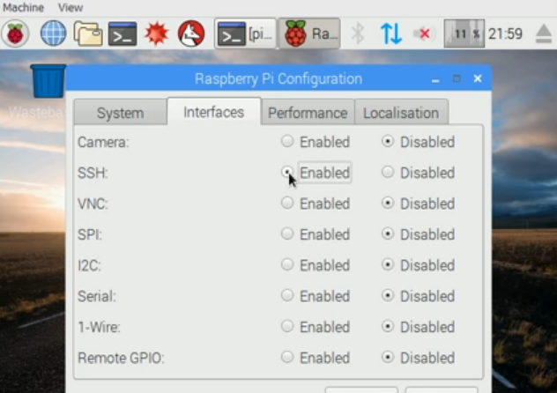
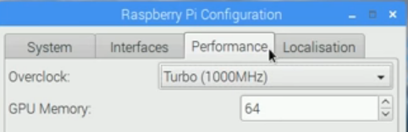
Qemu rpi
Enable ssh, modify performace
reboot

Slide 17
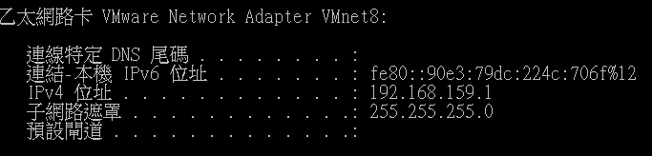
Cross compile
Open your Ubuntu vmware
Use ssh to remote control qemu pi, the ip address is your window ip address, if you don’t know your address you can use ipconfig direction.

Slide 18
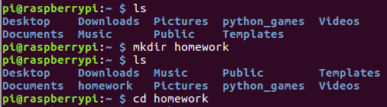

Cross compile
Make the directory on pi
Send file to pi by scp

Slide 19

Cross compile
Run it on pi

