Slide 1
Rasberry pi 3
Build kernel Assembly
GPIO
TA: Hsu-Heng chou
Professor: Hsiao-Ping Tsai
Date:2017/12/3

Slide 2
Outline
Read me
Development environment
See code work

Slide 3
Read me
這份ppt將能學到如何使用assembly控制gpio
完成自行定義的kernel
使用raspberry pi3 完成開發
本教程將會使用win作為開發的電腦系統，助教使用的是win10

Slide 4
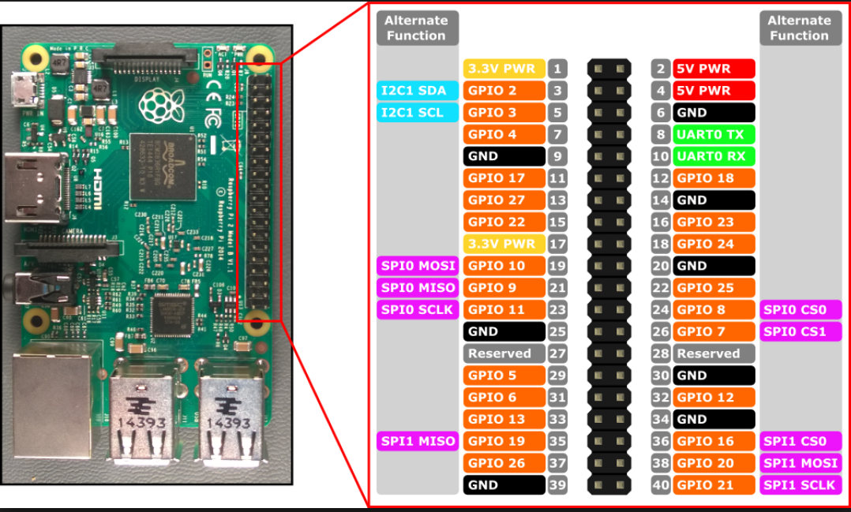
Read me
rpi3 GPIO

Slide 5
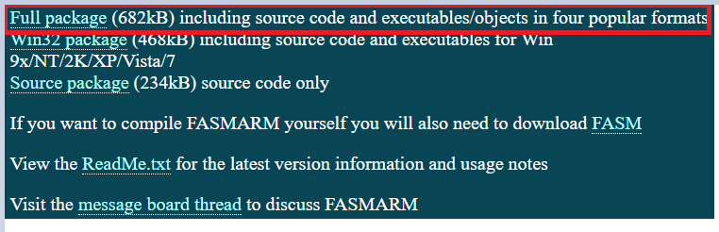
Development environment
ARM Flat Assembler Compiler
https://arm.flatassembler.net/
Use 7-zip to exact it.

Slide 6
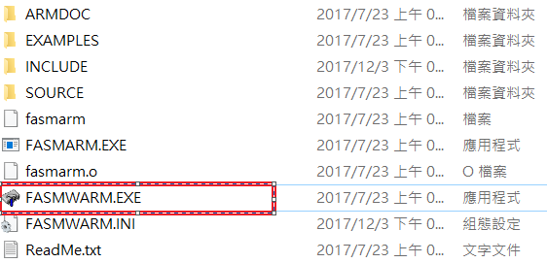
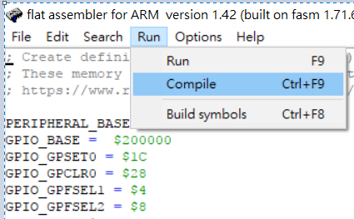
Development environment
Open the directory and open the FASMWARM.exe

Slide 7
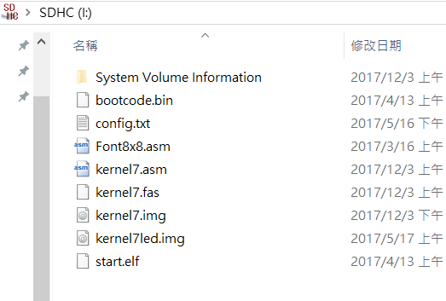
Development environment
Download example and use 7-zip to exact it
https://github.com/studica/tutorials/blob/master/Blogs/Embedded-1/EmbeddedProgrammingBlinkingLEDs.zip
Use SD card formatter format the sd card
Put all file on sdcard which you exact before

Slide 8
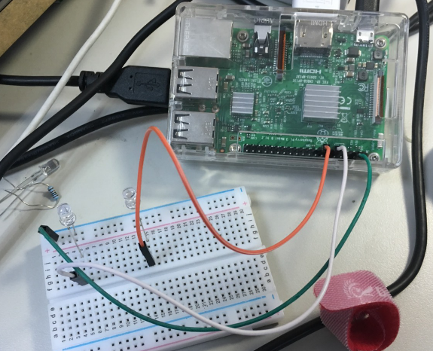
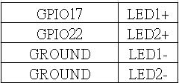
Development environment
Umount the sd card and put it in rpi
Wire your breadboard and rpi like in the below image and boot pi.
You should see your two LEDs take turns going on and off

Slide 9
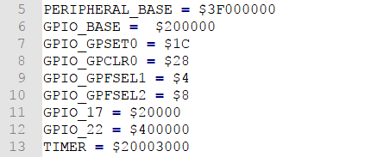

Code work
Defining Memory Addresses
Open the code name kernel7.asm, suggest use Notepad++ editor
BCM2837 the physical address is 0x3F00000
GPIO controller address is 20000
The register r0 state

Slide 10
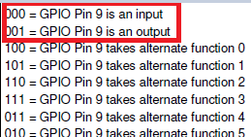
Code work
The gpio controller control 54 pin, and the manual say that there is a set of 24 bytes in the GPIO controller. So it control 10 pin by 4 byte, first and second bit don’t’t use, and use three bit to control one pin
In this example will set the gpio17 output
The mov instruction just can control 8 bit, this is why we use lsl

Slide 11
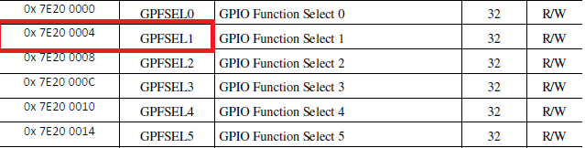
Code work
Control select
Pins 0 – 9 are part of memory address 0x0, 10 – 19 are at 0x4, 20 – 29 are at 0x8, 30- 39 are at 0xC. If we were to store our left-shifted R1 value into memory 0x0, for instance, we would instead be using GPIO pin 7, not 17.

Slide 12
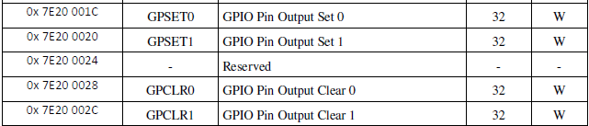
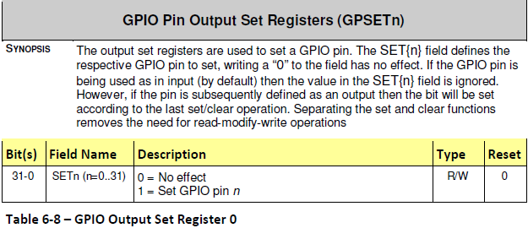
Code work
Turning LEDs On and Off

Slide 13
Code work
Turning LEDs On by follow
Move the memory address of GPIO_pin into Register 1
Store GPIO_pin memory address into R0 at the offset of GPIO_GPSET0 (0x20). This memory address tells the Pi to turn on the GPIO pin, which we set up as an output earlier.
Delay execution for 200 ms.

Slide 14
Code work
Turning LEDs off by follow
Put GPIO_pin into R1 again.
Store GPIO GPIO_pin memory address into R0 at offset GPIO_GPCLR0 (0x28). This address tells the Pi to turn off the GPIO pin.
Everything after this point is the same code except it’s using a different GPIO pin.

Slide 15
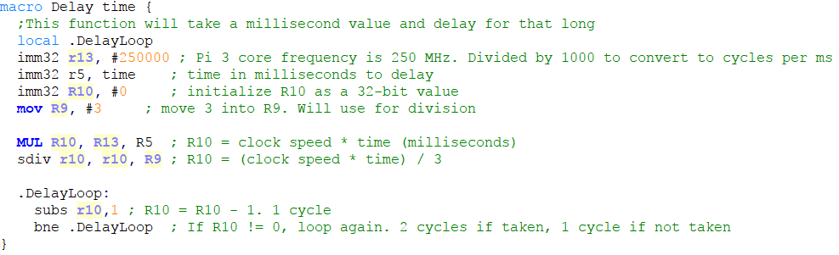
Code work
Delay Function
The details on next page

Slide 16
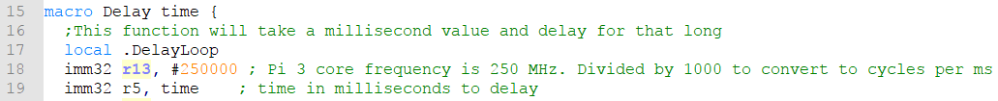
Code work
First, let’s talk about what macro means. The macro declaration is similar to creating macros in C or C++.
The macro declaration allows us to give a syntax for calling the macro, and a functionality to execute when the macro is called.
we are using 250 MHz as the clock speed because that is the default core frequency that the Pi 3 runs in an embedded systems environment. We get the number of cycles per milliseconds by dividing 250 MHz by 1000. We divide by 1000 because there are 1000 ms in 1 second.

Slide 17
Code work
Next, note that the function takes a variable named “time” as a parameter. We store this value into R5 and multiply time by the clock speed of the CPU in milliseconds to get a total number of cycles needed to compute for the time specified. Note that this code seeks to delay by milliseconds not seconds.

Slide 18
Code work
Now, we divide the total number of cycles by the number of cycles per loop iteration. We know we have 3 cycles per loop iteration because of the ARM Instruction Set Summary. Using this document as a reference, we can look at each line of code in our loop and determine that we are executing 3 cycles per loop. We divide by this value because we need an iterator to control the execution of our loop. Since our loop has 3 cycles per loop,

Slide 19
Code work
We then use the iterator value as our loop counter. We will continuously subtract 1 from the loop counter every iteration. Once the number hits 0, we leave the loop. This creates a delay that lasts for as many milliseconds as you passed into the function.

Slide 20
Referance
https://www.google.com.tw/search?q=RPI+3+GPIO&source=lnms&tbm=isch&sa=X&ved=0ahUKEwj_rcm2t-3XAhXIjLwKHa2eCaIQ_AUICigB&biw=1536&bih=759#imgrc=uzJLoQO8mMNq7M:
https://www.studica.com/blog/program-embedded-systems-raspberry-pi
http://www.cl.cam.ac.uk/projects/raspberrypi/tutorials/os/ok01.html

