Slide 1
Rasberry pi 3
GPIO, Assembly, C, Python
TA: Hsu-Heng chou
Professor: Hsiao-Ping Tsai
Date:2017/12/19

Slide 2
Outline
Readme
WiringPi
Assembly
C
Python
C application

Slide 3
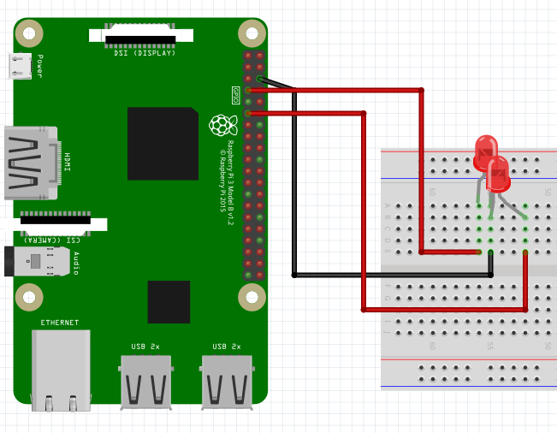
Readme
Cable Chart
Use ctrl+c to kill process

Slide 4
Readme
Pscp install reference
https://loveamberbird.wordpress.com/2013/08/21/%E3%80%90%E7%AD%86%E8%A8%98%E3%80%91%E5%9C%A8linux%E8%88%87windows%E9%96%93%E5%82%B3%E9%80%81%E6%AA%94%E6%A1%88%E6%AD%A5%E9%A9%9F%E6%95%99%E5%AD%B8/

Slide 5
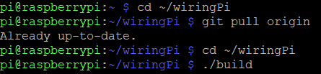
WiringPi
Install Raspbian Gpio driver
Use ssh remote control pi
Install git on pi

Slide 6
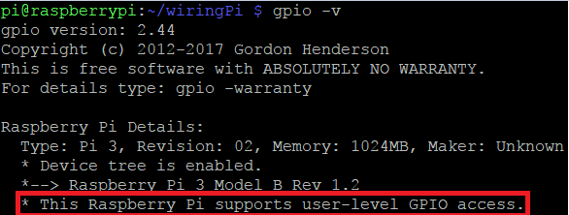
WiringPi
Test it

Slide 7
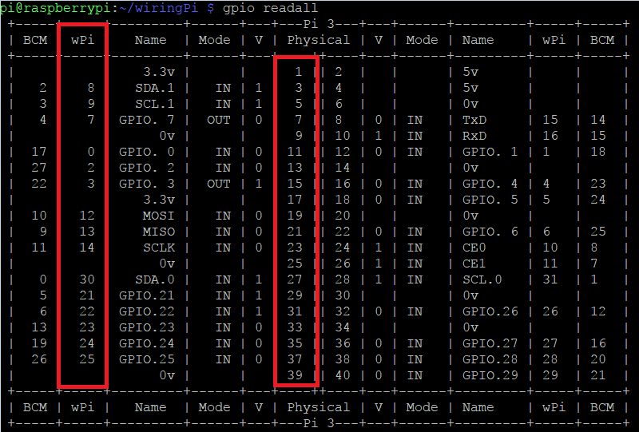

WiringPi
Get gpio table

Slide 8
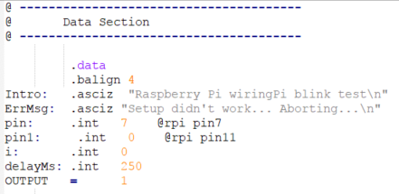
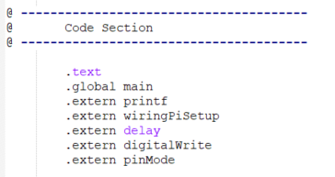
Assembly-Blink
Data
Include library

Slide 9
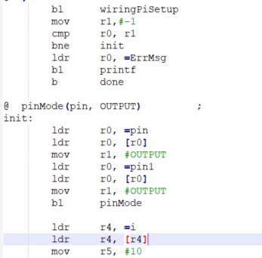
Assembly-Blink
WiringSetup

Slide 10
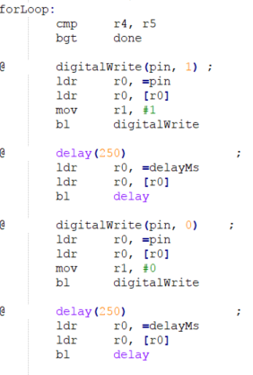
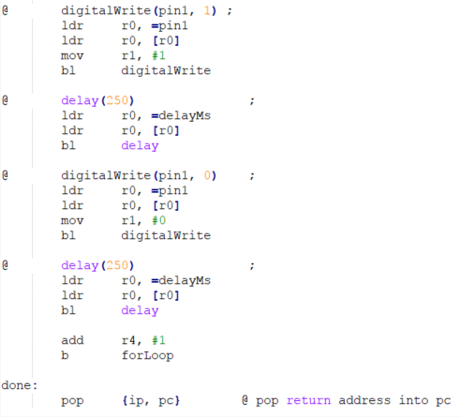
Assembly-Blink
Blink

Slide 11
Assembly-Blink
Complier at pi
as -o blink.o blink.s
gcc -o blink2 blink.o -lwiringPi
sudo ./blink2

Slide 12
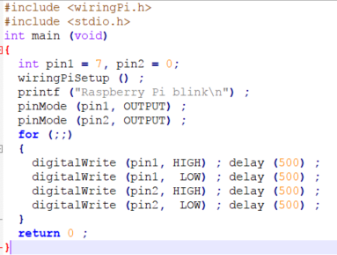
C-blink
Code
Complier at pi

Slide 13
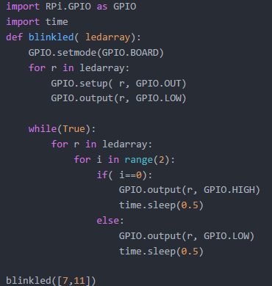
Python Blink
Code

Slide 14
C Application
In this example ta use gpio19 and gpio26 to control led, please change it.
Install package in raspberry
sudo apt-get install libgtk-3-dev
sudo apt-get install libsdl1.2-dev

Slide 15
C Application
Pscp firstapp directory to raspberry
mkdir hw5 in rpi
Send directory to pi
compile

Slide 16
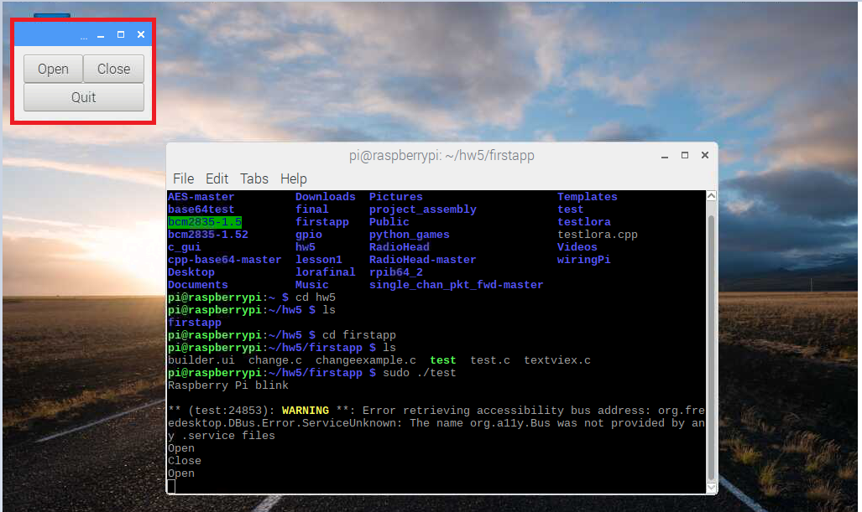
C Application
Use vnc remote control pi
Run the program

Slide 17
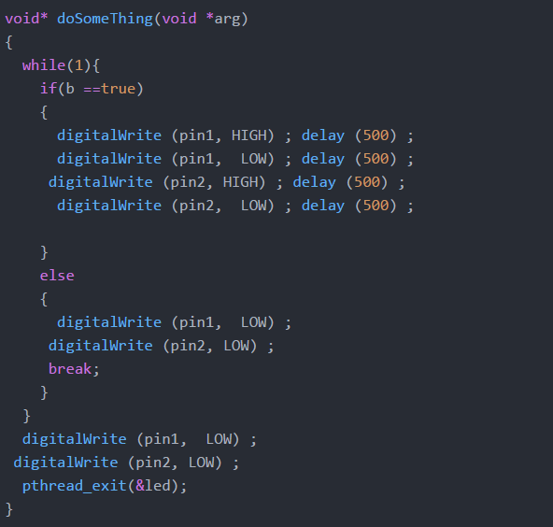
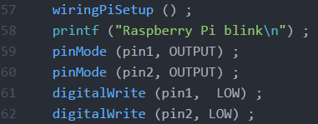
C Application
Code
如何修改
57-62宣告這要改
Function dosomething
在裡面加功能

Slide 18
Reference
http://wiringpi.com/reference/core-functions/
http://www.science.smith.edu/dftwiki/index.php/Tutorial:_Assembly_Language_with_the_Raspberry_Pi

