Slide 1
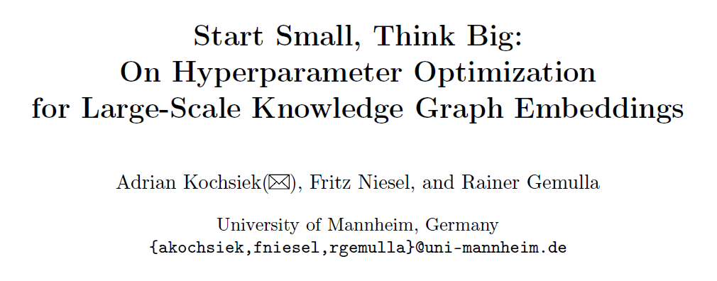
Haobo Xu
2022/7/27

Slide 2
Outlines
Multi-arm Bandit Problem
Framework
Background
Motivation
Method
KGTuner
Experiments
Kochsiek A. et al."Start Small, Think Big: On HPO for Large-Scale KGEs" arxiv. 2022

Slide 3
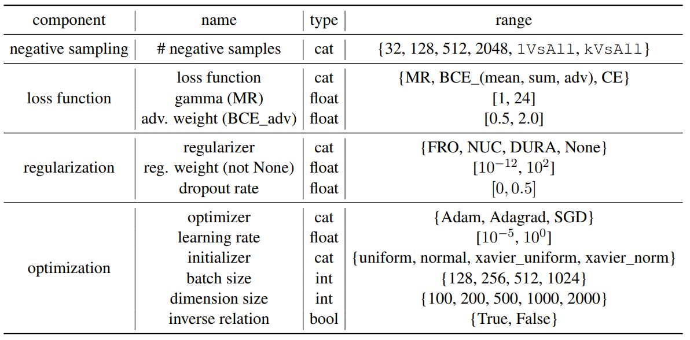

Background
Hyperparameter (HP)
Hyperparameter Optimization (HPO)
Criteria of HPO
Better performance
Lower computational cost
Full-fidelity HPO
Conduct full training runs per model and dataset
Computationally expensive, not suitable for large-scale KG
Low-fidelity HPO
Epoch reduction / graph reduction
Could not produce high-quality results

Slide 4
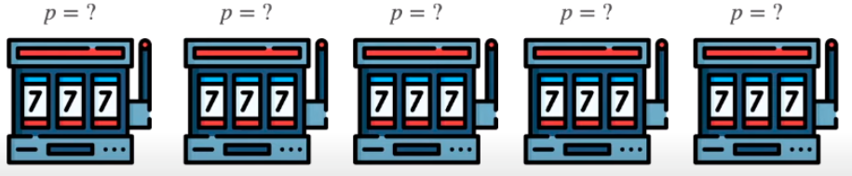
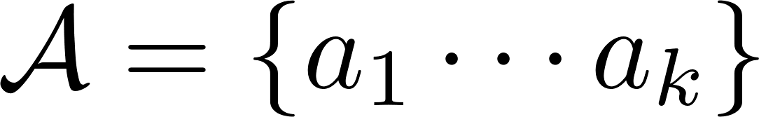

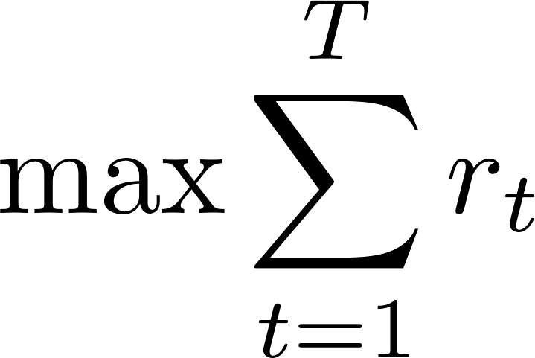
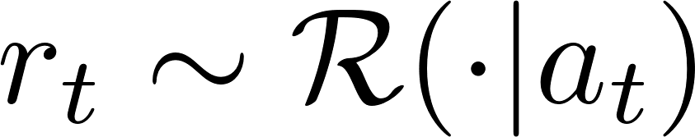

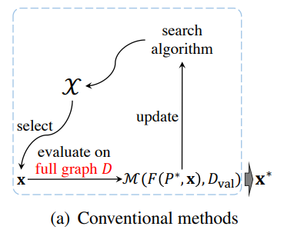
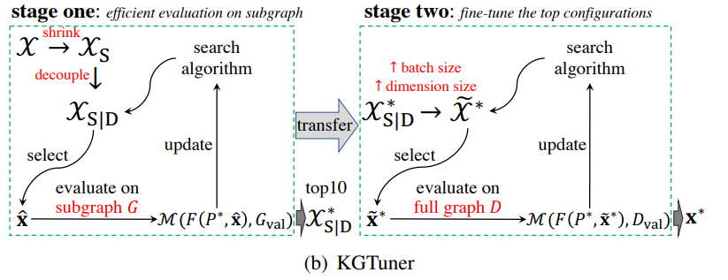
Background
Multi-arm Bandit Problem
, where denotes playing
the i-th bandit machine.
Maximum , where denotes reward of at time of t
Thompson sampling
Two-stage Method: KGTuner
Decouple: Dimensions and batch-size have
larger consistency than other factors;
Stage-one: Select top 10 configuration
candidates on subgraph of 20%
entities from the full graph, based on RF and multi-start random walk; (lower-fidelity)
Stage-two: increase dimensions and batch-size and search on the full graph. (higher-fidelity)

Slide 5
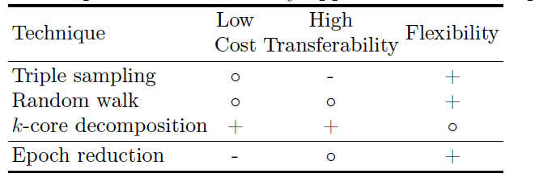
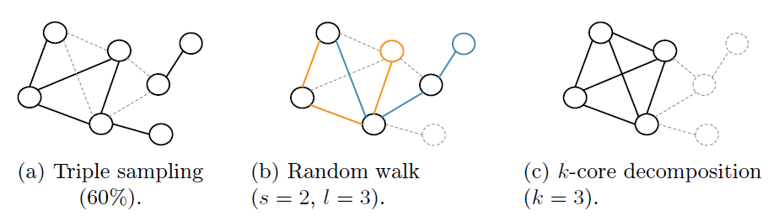
Motivation
Shortage of KGTuner
Fixed heuristics (e.g. 20%/top-10) limits flexibility of
budget allocation on each configuration candidates.
Reduce graph by random walk may lead to underperforming.
Multi-stage fidelity
Select configuration candidates by several rounds (successive halving)
Each round allocate different budget on each candidate (gradually lower-fidelity → higher-fidelity)
Graph reduction: k-core decomposition
Triple sampling
High cost and low transferability due to sparsity of graphs
Random walk
Entities better connected but high cost. KGTuner improved this.
k-core decomposition
More direct way to gain a well-connected subgraph

Slide 6
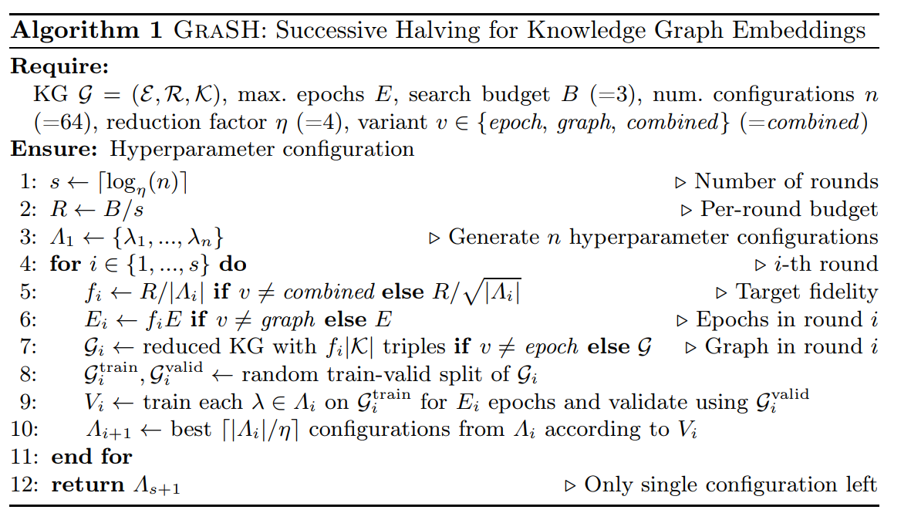
Method
Successive Halving for Knowledge Graphs
Each round has approximately the same overall budget, but differs in the number of configurations and fidelity.
Total budget is approximate to B×E epochs on the full graph, which can be change flexibly.

Slide 7
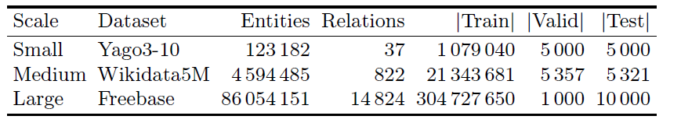
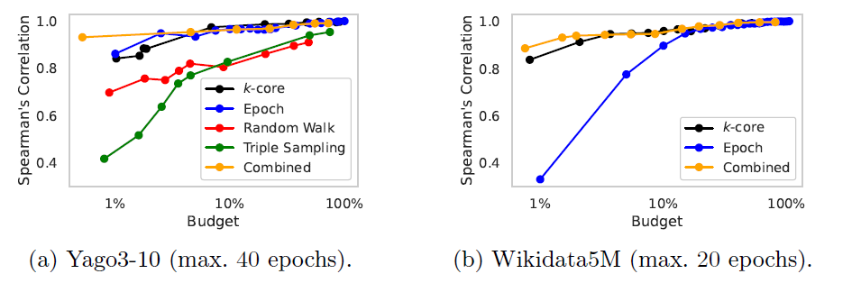
Experiments
Datasets
Models: ComplEX、TransE、RotatE
Experiment I: Different reduction methods
Use Spearman’s rank correlation
coefficient between the
low-fidelity and the high-fidelity
results (MRR).
k-core is the most efficient among
graph reduction methods.
Combination of both epoch and
graph reduction perform best.

Slide 8
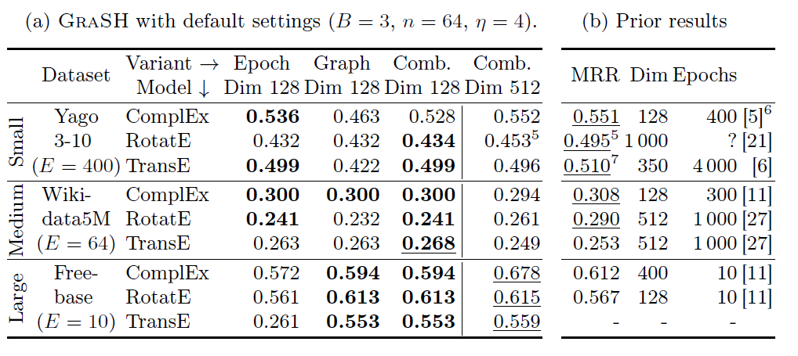
Experiments
Experiment II: compare to former SOTA results
Best prior results often use a considerably larger budget and/or model dimensionality.
Even with low budget, GraSH performed either similarly and sometimes slightly worse than the best prior results (Column: Comb. Dim 512)
On the large-scale Freebase KG, where low-fidelity hyperparameter search is a necessity, GraSH outperformed state-of-the-art results by a large margin.

Slide 9
Experiments
Experiment III: compare to KGTuner
On Yago3-10 with ComplEX
KGTuner is not suitable for larger graph due to its high computational cost.
The high computational cost of KGTuner mainly stems from its inflexible and inefficient budget allocation.
The higher quality of GraSH stems from its use of multiple fidelities (vs. two in KGTuner) and by using a combination of k-cores and epoch reduction (vs. random walks in KGTuner).
Methods | Time cost | MRR
KGTuner | 5 days | 0.505
GraSH | 1.5 hours | 0.530

Slide 10
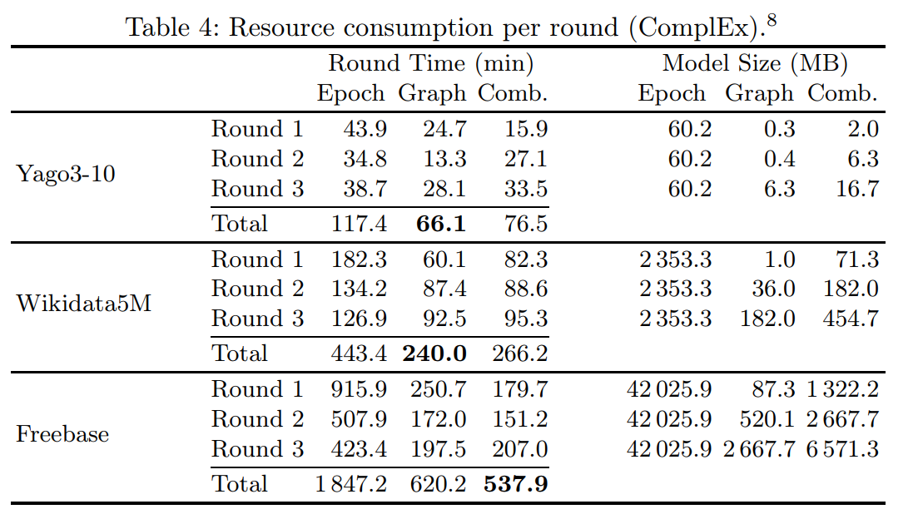
Experiments
Experiment IV: Resource Consumption between reduction methods
Memory consumption:
Epoch. is worse than Graph. and Comb. due to large model size on the full graph which exceeds GPU memory.
Runtime:
Runtime was mainly driven by
the cost of model evaluation and model initialization (see Round 1). Epoch. means the number of trials and therefore the number of model initializations and evaluations is high.
Conclusion: Epoch. is worse than Graph. and Comb.

Slide 11
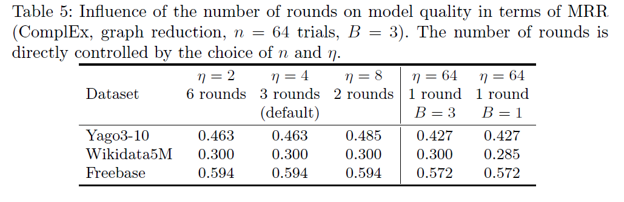
Experiments
Experiment V: Sensitivity with respect to the number of rounds
Cases of multiple rounds(#≥2) show little difference. The search was robust to changes the number of rounds
Cases between multiple rounds(#≥2) and 1 round show significant difference, which means multiple fidelity levels is essential.

Slide 12
Discussions
Differences between KGTuner and GraSH?
How can GraSH be efficient on large-scale KG?

Slide 13
Thanks！

