Slide 1
Query2Box
2022/8/7

Slide 2
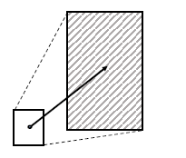
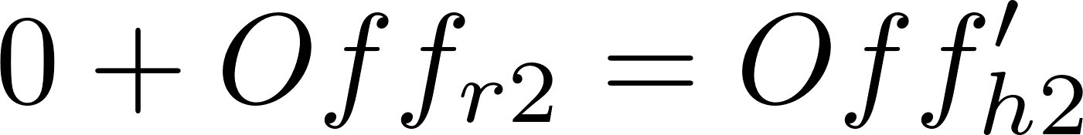
Projection (model.py:723-750)
Preprocess(model.py:477-688)
挑出X个head
正采样：挑出1个tail(single)
负采样：挑出k个tail(tail-batch)
test: 所有entity均作为tail(tail-batch)
h1
r11
r12
h1’
以chain-inter为例
((10130, (262, 97)), (1633, (49,)), 0)
tail
query_max
h2
r2
h2’
query_min

Slide 3
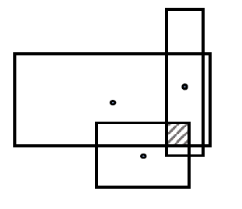

Intersection-Cen(model.py:236-341)
h1
r11
r12
h1’
tail
h2
r2
h2’
Hidden
Hidden
Output
a^{[1]}₁
*
q1
cen1’
cen1
Input
*
a^{[1]}₂
a^{[1]}₁
Inter-
center
cen1
Attention
Softmax
+
q1
off1
a^{[1]}₃
a^{[1]}₂
*
q2
(same to q1)
cen2’
cen1
*
a^{[1]}₄
注：激活函数ReLu；cen计算时是否需要考虑off是作者讨论的一个问题

Slide 4
讨论：Insection的cen进行attention时是否需要考虑off的实验结果
HITS@3m - FBK-237
w/w.o. | Avg | 1p | 2p | 3p | 2i | 3i | ip | pi | 2u | up
w.o. | 0.2706 | 0.4681 | 0.2507 | 0.1913 | 0.3239 | 0.4488 | 0.1103 | 0.2065 | 0.2453 | 0.1908
W | 0.2726 | 0.4670 | 0.2493 | 0.1880 | 0.3278 | 0.4564 | 0.1100 | 0.2143 | 0.2472 | 0.1931
注：默认为w.o.
结论：cen时考虑off效果似乎更好，这也可以通过直观感觉出——框的大小会影响该box计算cen的权重

Slide 5


Intersection-Off(model.py:211-275)
注：off计算时是否需要考虑cen，作者也写了相关代码
Inter-
offset
Input
Hidden
Output
Output
Output
a^{[1]}₁
off1
Input
off1
a^{[1]}₂
Sigmoid
*
Mean
Min
off1
a^{[1]}₃
Sigmoid
*
off2
(same to q1)
off2
a^{[1]}₄

Slide 6
Union

Slide 7
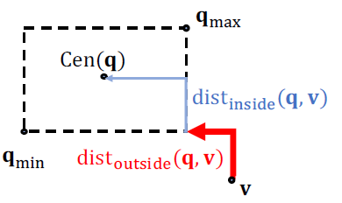

Score(model.py:211-275)
讨论：dist_inside有啥用
HITS@3m - FBK-237
α | Avg | 1p | 2p | 3p | 2i | 3i | ip | pi | 2u | up
0 | 0.2713 | 0.4678 | 0.2513 | 0.1926 | 0.3214 | 0.4506 | 0.1092 | 0.2089 | 0.2472 | 0.1927
0.02 | 0.2706 | 0.4681 | 0.2507 | 0.1913 | 0.3239 | 0.4488 | 0.1103 | 0.2065 | 0.2453 | 0.1908
0.1 | 0.2702 | 0.4677 | 0.2477 | 0.1890 | 0.3201 | 0.4539 | 0.1085 | 0.2073 | 0.2455 | 0.1924
1 | 0.2191 | 0.4041 | 0.2093 | 0.1497 | 0.2643 | 0.3760 | 0.0843 | 0.1688 | 0.1603 | 0.1558
结论：dist_inside确实没啥用

Slide 8
问题
Transductive or Inductive?
Our goal in the experiment section is to evaluate the performance of QUERY2BOX on discovering answers to complex logical queries that cannot be obtained by traversing the incomplete KG. This means, we will focus on answering queries where one or more missing edges in the KG have to be successfully predicted in order to obtain the additional answers.

Slide 9
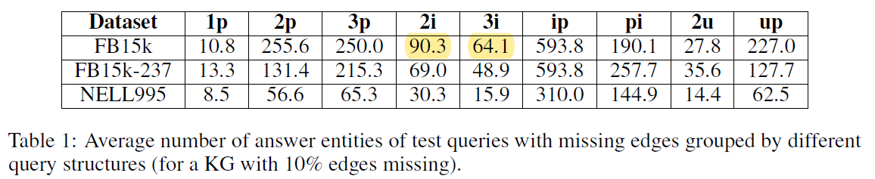
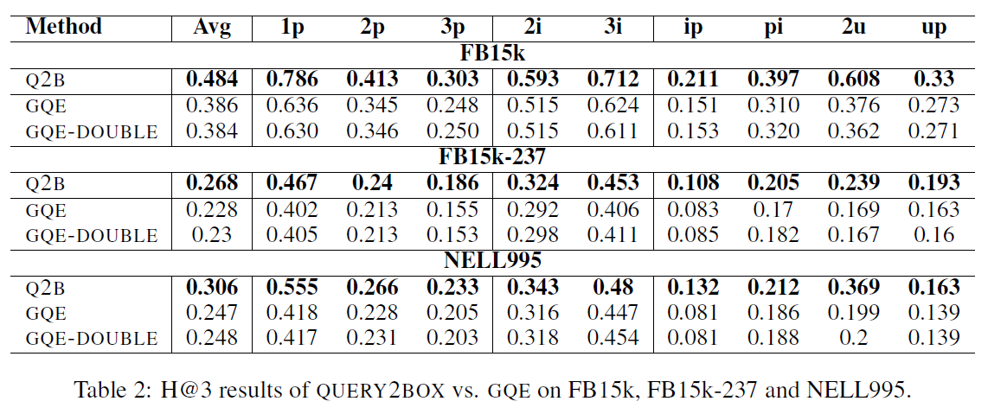
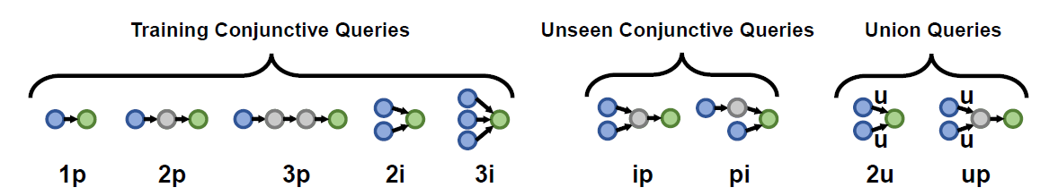
答案数与表现：负相关
解释：number更多框显然应更大，但可能跟HITS性质也有关
对数拟合(FB15k-237)

