Slide 1
Explainability in KG
23/02/10

Slide 2
Outline
  Rule-based methods

Slide 3
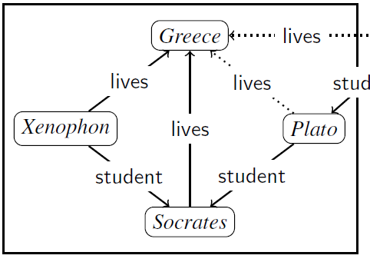
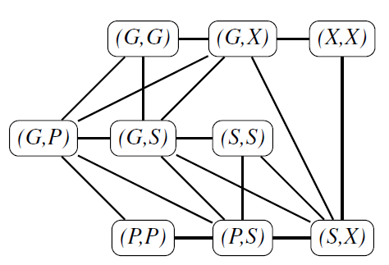
Rule-based
Encode
  节点：entity + entity之间的relation
    E.g. (h, r, t) → (H, H), (H,T), (T, T)
    节点feature dim为relation type * 2 + entity type，采用one-hot编码并区分方向
  边：只要两节点的name有交集，就连边
    E.g. (G, X) 与 (G, S)有交集则连边
  理论上边的数量随节点幂次增长，但考虑KG稀疏，故一般为线性增长
  更好地聚合了一个知识图谱中实体的多条邻居信息
INDIGO: GNN-Based Inductive Knowledge Graph Completion Using Pair-Wise Encoding. NeurIPS 2021.

Slide 4
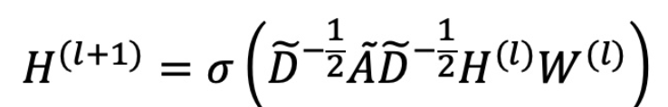
Rule-based
GCN
  采用GCN聚合邻居信息
Decode
  Encode的逆过程：当某一特征维度数值大于某阈值（如0.5）则认为存在对应三元组
  Decode还原出来的图即为补全后的KG
INDIGO: GNN-Based Inductive Knowledge Graph Completion Using Pair-Wise Encoding. NeurIPS 2021.

Slide 5

Rule-based
Capturing Logical Rules
  对于固定形式的logical rules：
    枚举B1…Bn对应的relation
    将B1…Bn代入随机选取的节点并对应到一个KG上，进行补全；反复多次；如果每次都能补全出H则说明该logical rules成立
INDIGO: GNN-Based Inductive Knowledge Graph Completion Using Pair-Wise Encoding. NeurIPS 2021.

Slide 6
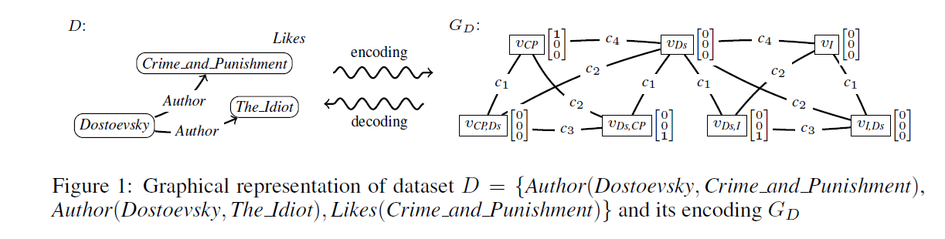
Rule-based
Decode
  与上个方法类似，但encode为染色图，节点特征dim为|relation|，边的颜色分别为：
    C1：连接Va,b和Va
    C2：连接Va,b和Vb
    C3：Va,b和Vb,a
    C4：连接Va和Vb
EXPLAINABLE GNN-BASED MODELS OVER KNOWLEDGE GRAPHS. ICLR 2022.

Slide 7

Rule-based
GNN
    其中B与c的种类有关，Nc为邻居集合，A、B元素非负
EXPLAINABLE GNN-BASED MODELS OVER KNOWLEDGE GRAPHS. ICLR 2022.

Slide 8
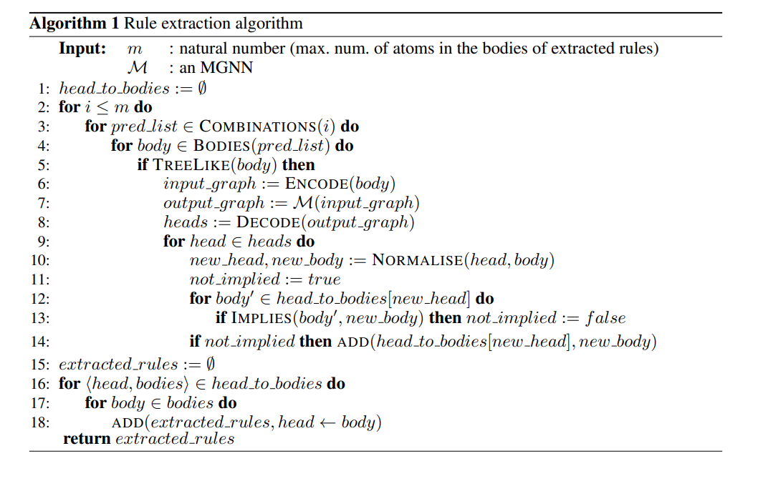
Rule-based
Rule extraction
枚举i个谓词（可重复）
如[A,R]
枚举谓词的变量
如
检查枚举出的逻辑树是否需要被剪枝
Encode → GNN → Decode
确认变量(如x,y)顺序
加入搜索到的rule列表中
EXPLAINABLE GNN-BASED MODELS OVER KNOWLEDGE GRAPHS. ICLR 2022.

Slide 9
Rule-based: possibility methods
DRUM
DRUM: End-To-End Differentiable Rule Mining On Knowledge Graphs. (NeurIPS 2019)
AnyBURL
Anytime Bottom-Up Rule Learning for Knowledge Graph Completion. (IJCAI 2018)
RNNLogic
RNNLOGIC: LEARNING LOGIC RULES FOR REASONING ON KNOWLEDGE GRAPHS.

