Slide 1
tKG 调研

Slide 2
Dataset
Integrated Crisis Early Warning System (ICEWS)
Contains: political events with a specific timestamp
Additional information: http://www.icews.com/

Slide 3
tKG
Only for interpolation
Quadruple-based
Subgraph-based
For both interpolation & extrapolation
Time embedding
Encoding into entity embedding
With RNN
Encoding into entity
Encoding into relation
With RNN
Know-Evolve
T-RED-GNN

Slide 4
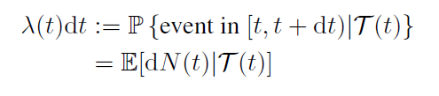


Know-Evolve
Conditional intensity function
Heterogeneous temporal patterns of events between entities
where ，t^{e}- means the latest time event happened related to entity e，f(·)=exp(·), g is a bilinear scoring function
Discuss:
Discrete epoch based methods to model such temporal behavior fail to capture the underlying intricate temporal dependencies.
Trivedi, R., Dai, H., Wang, Y., & Song, L. Know-evolve: Deep temporal reasoning for dynamic knowledge graphs. ICML 2017.

Slide 5

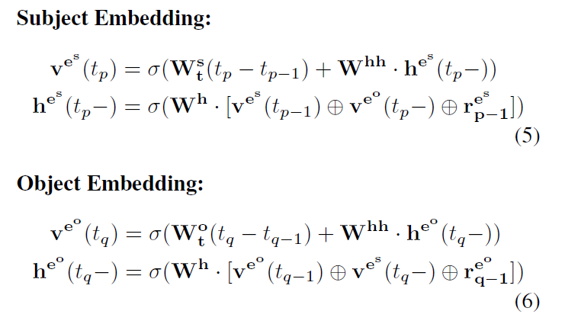
Know-Evolve
Bilinear scoring function
where R_{r} is relation representation, v is entity representation (at time t-)
Entity Representation evolve (just like RNN)
t_{p} means the time of p-th event related to es
t_{q} means the time of q-th event related to eo
Discuss:
When t_{p} = t_{p-1} , which means >=2 events happened at t_{p} , the first term of eq.(5) = 0.
An entity’s features may update only when it forges a relationship with other entity within the graph. Otherwise, remains unchanged.
Relation representations donnot evolve.

Slide 6
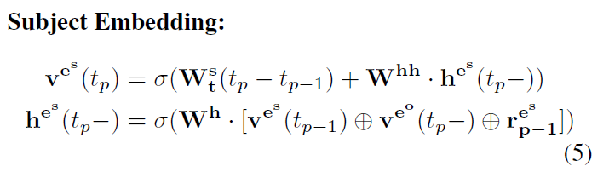
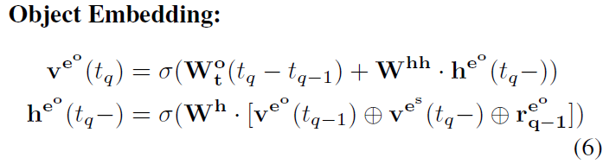
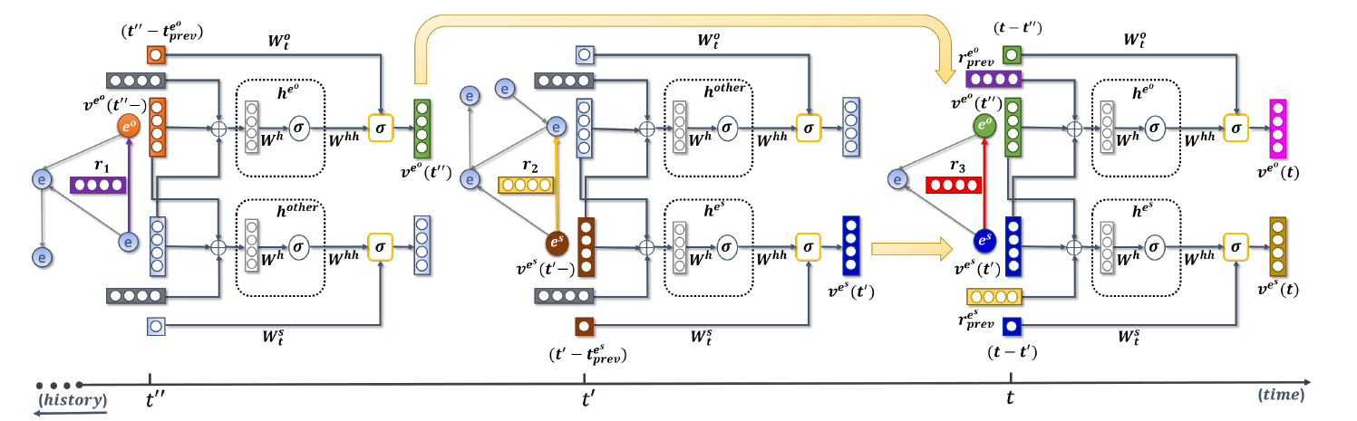
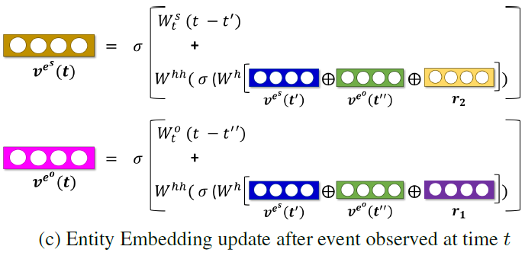
Know-Evolve
For quadruple (es, r3, eo, t), latest event related to eo is (other, r1, eo, t’’), and es is (es, r2, other, t’),
v^{eo}(t’’) updated by r1 & es at t’’, while v^{es}(t’) updated by r2 & eo at t’.

Slide 7
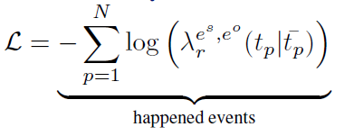
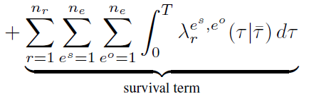
Know-Evolve
Training
Loss: negative log likelihood of intensity function
λ is the derivative of probability, and through maximum negative log likelihood of intensity function, we can get the Maximum Likelihood Estimation of distribution.
First term: maximizes the probability of specific type of event between two entities
Second term: penalizes non-presence of all possible types of events between all possible entity pairs in a given observation window
Training methods: Back Propagation Through Time (BPTT)
Computational complexity: O(2nrm), where m is size of mini-batch and n and r represent number of entities and relations in the mini-batch.

Slide 8



Know-Evolve
Evaluation
Link prediction: (es, r, ?, t)
Sort all the quadruplets in the descending order of this density to rank
Time prediction: (es, r, eo, ?)
MAE

Slide 9
Know-Evolve
Discussion
Computational complexity
Memory complexity
Continuous time based method
(rather than entity/relation linkage based)
Time Prediction

Slide 10
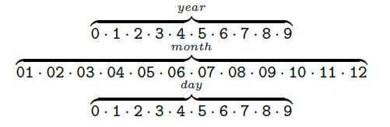
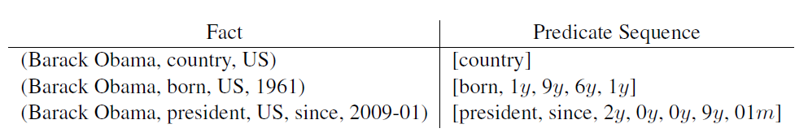
TA-DistMult/TA-TransE
Motivation
Time expressions are sparse and irregular, so learning expressions that carry temporal information is challenging
Methods
Temporal tokens
Turn time expressions into sequences of tokens (NLP based)
Predicate Sequence
Encode temporal tokens to relation representations
Garcia-Duran, A., Dumančić, S., & Niepert, M. (2018). Learning Sequence Encoders for Temporal Knowledge Graph Completion. EMNLP 2018.

Slide 11
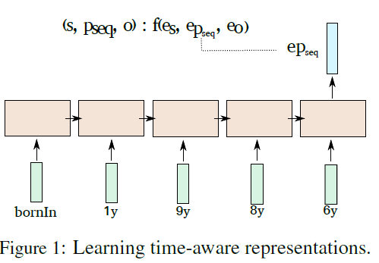
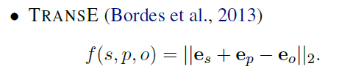
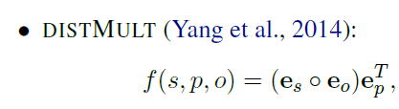

TA-DistMult/TA-TransE
Methods
Learning time-aware representations
Neural network arch: LSTM
Scoring functions

Slide 12
TA-DistMult/TA-TransE
Self-created dataset
Yago-15k: containing modifiers, namely, ‘since’, ‘until’… (not followed by other papers)
Discussions:
Special modifiers: since, until…
Can obtain a representation for a timestamps even though it never appeared in training set
Can use triples with/w.o. temporal information for training

Slide 13


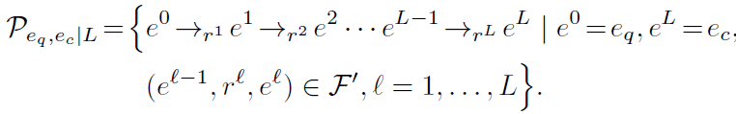
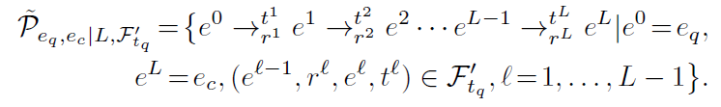
T-RED-GNN
Dynamic
Reverse relation
Relation path
Bind time stamp with relation type
Time stamps are not considered when creating path
Temporal process
Static
Reverse relation
Relation path

Slide 14
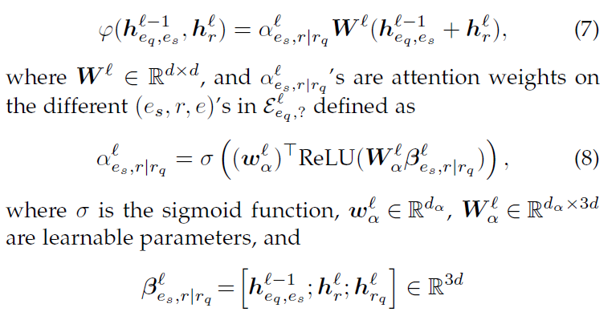
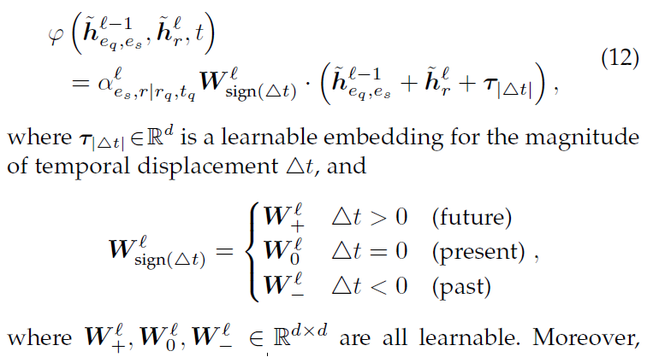


T-RED-GNN
Static
Message Passing
Dynamic
Message Passing: query (eq, r, ?, tq)
Δt = t – tq

Slide 15
T-RED-GNN
Discussion
Hard for time prediction task: message passing with known tq
|delta t|没见过
重点在于建模时间

