Slide 1
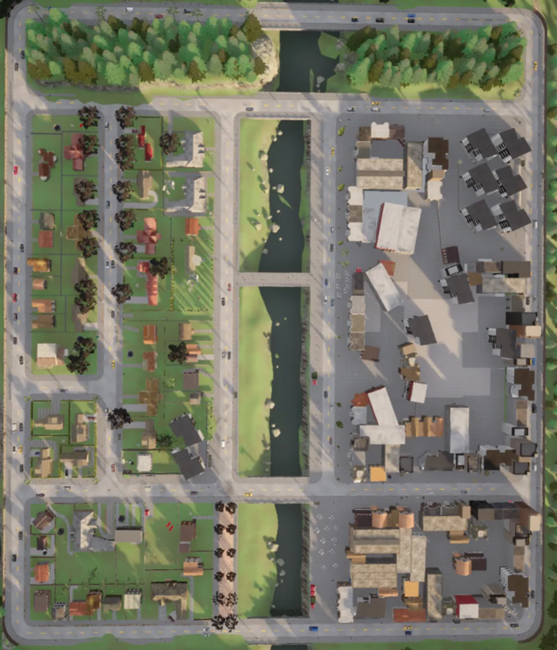
Town 1
,
92.25, 147.5
,
88.25, 116.5
173, 55.5
154, 40.5
105, 195
92.25, 213
334.75, 182
338, 212
353, -2
322, 2

Slide 2
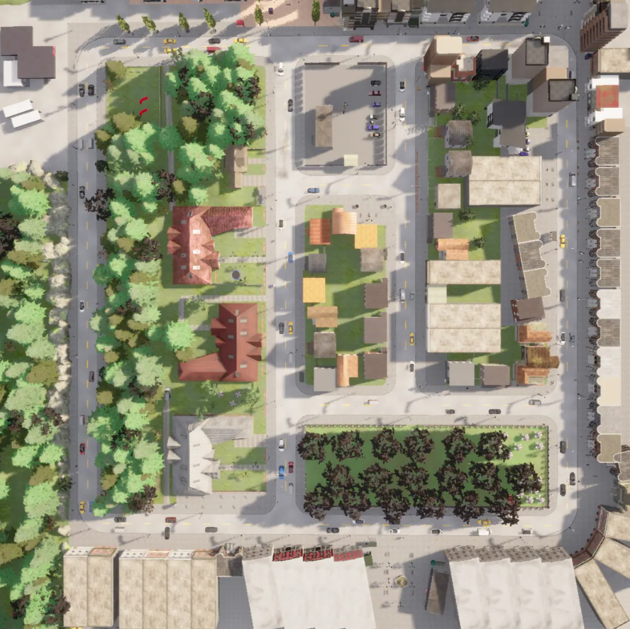

Town 2
59,187.5
X:55,54,53
Y:183.5~195.5,197
,191.5
59, 237
X:53,50,38
Y:233~245,230,231
46, 225
132, 224
X:128~140
Y:229,230,231
129, 238.5(-45)
190, 175
X:186.5~197
Y:180,199,200
194, 205
人行道邊緣有欄杆
測試過，行人會亂走

Slide 3
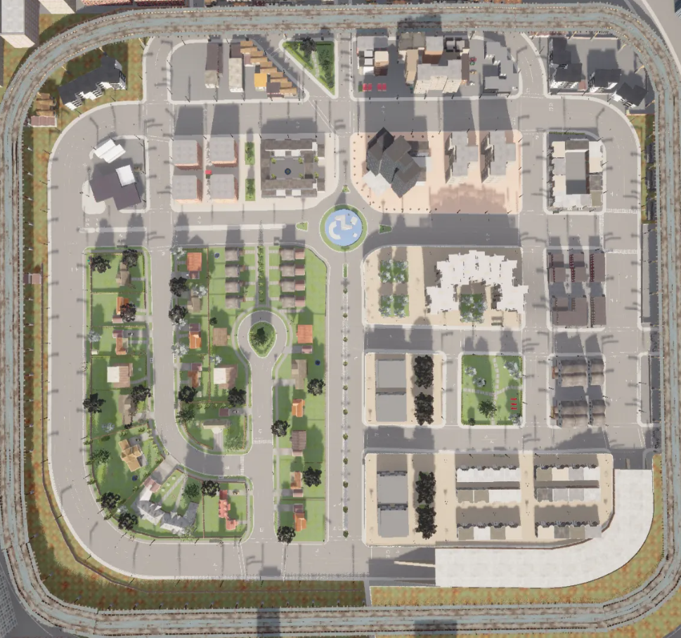
Town 3
9.5,-121.25(-85)
X:55,54,53
Y:183.5~195.5,197
6,-121.25(-85)

Slide 4
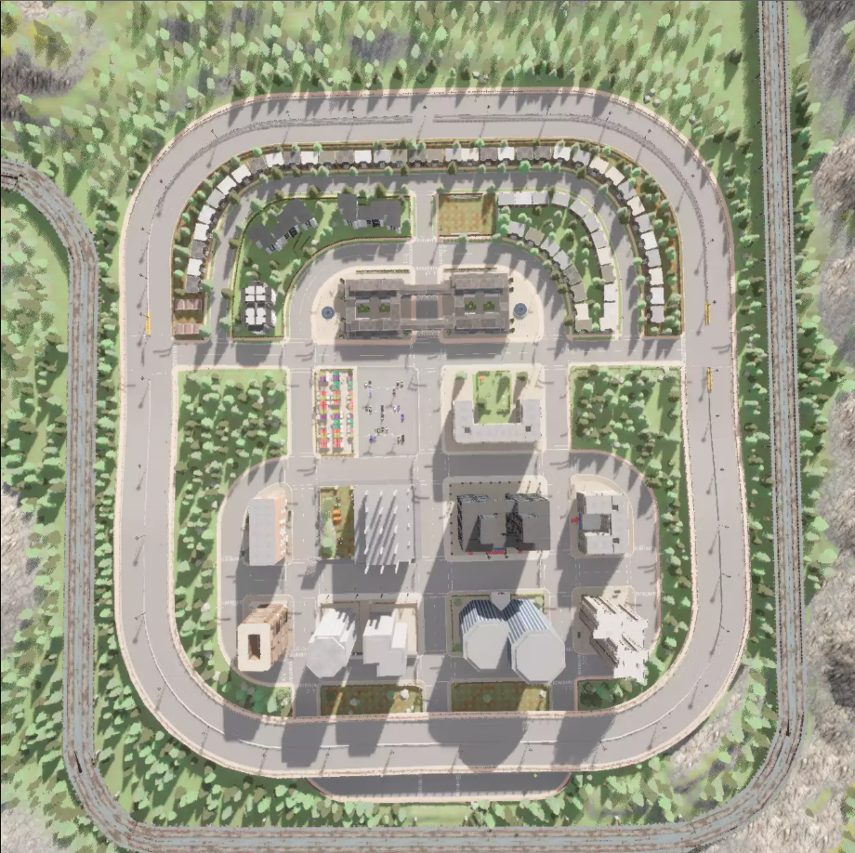
Town 5
-67.5, 2.75
-47, 19.1
-33.25, -1
-51, 14.8

