Slide 1
Intro to Vue.jS
主講人：W00-許瀚升 W00-彭震宗

Slide 2
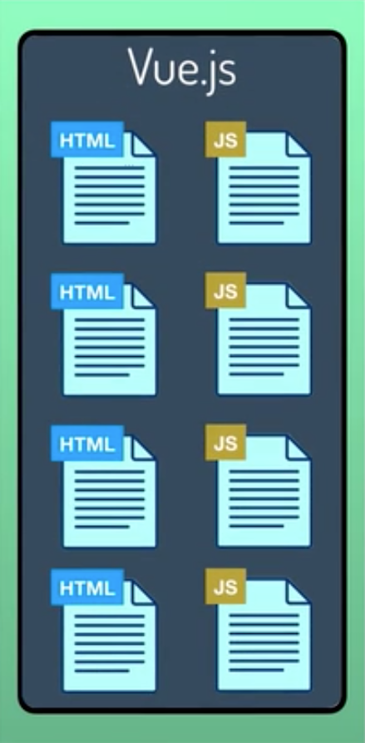
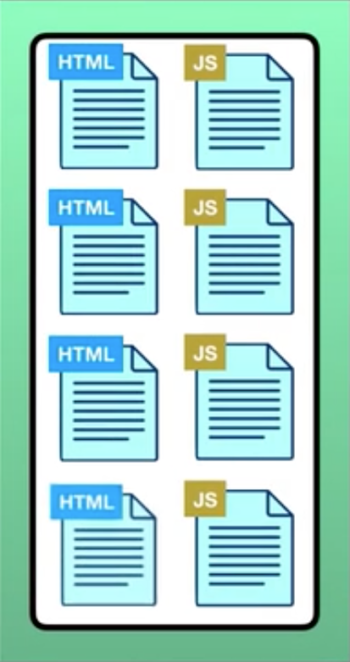
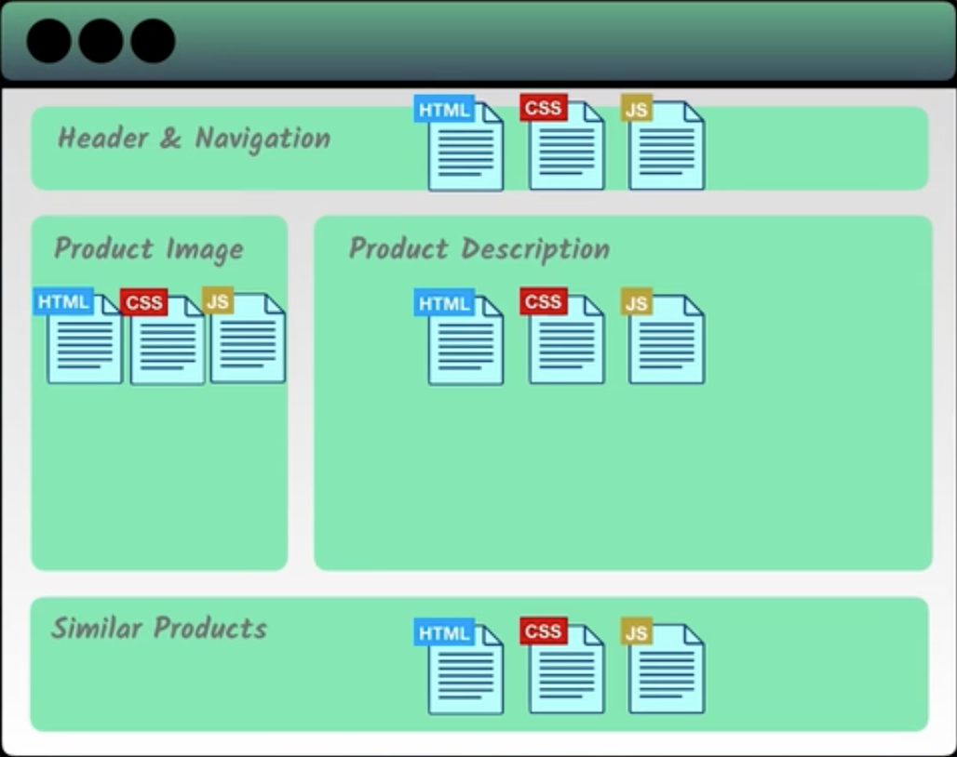
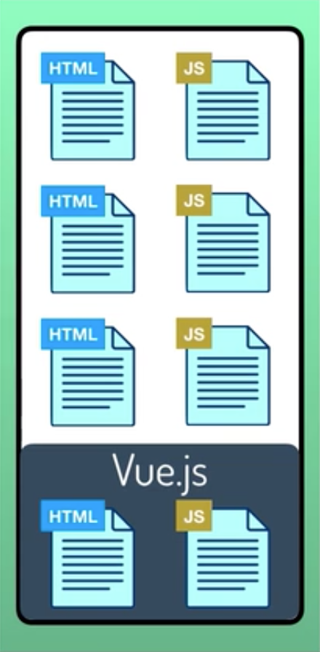

What is Vue.js
The core library is focused on the view layer only, and is easy to pick up and integrate with other libraries or existing projects.

Slide 3
Widely Used Attribute
{{ message }}
v-bind:attribute and :attribute
v-model
v-text
v-html
v-on and @
v-if and v-show
v-for
Go to Example

Slide 4
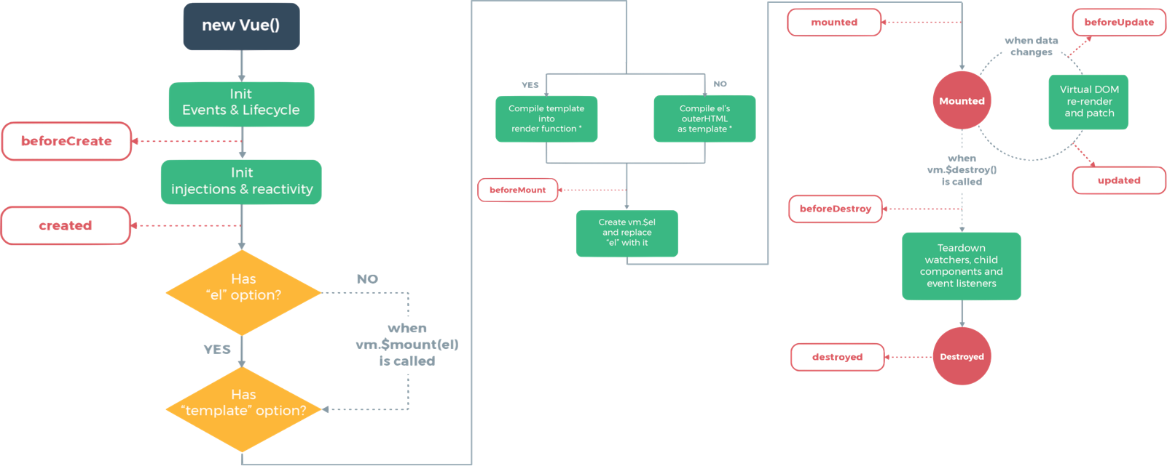
Lifecycle of Vue.js

Slide 5
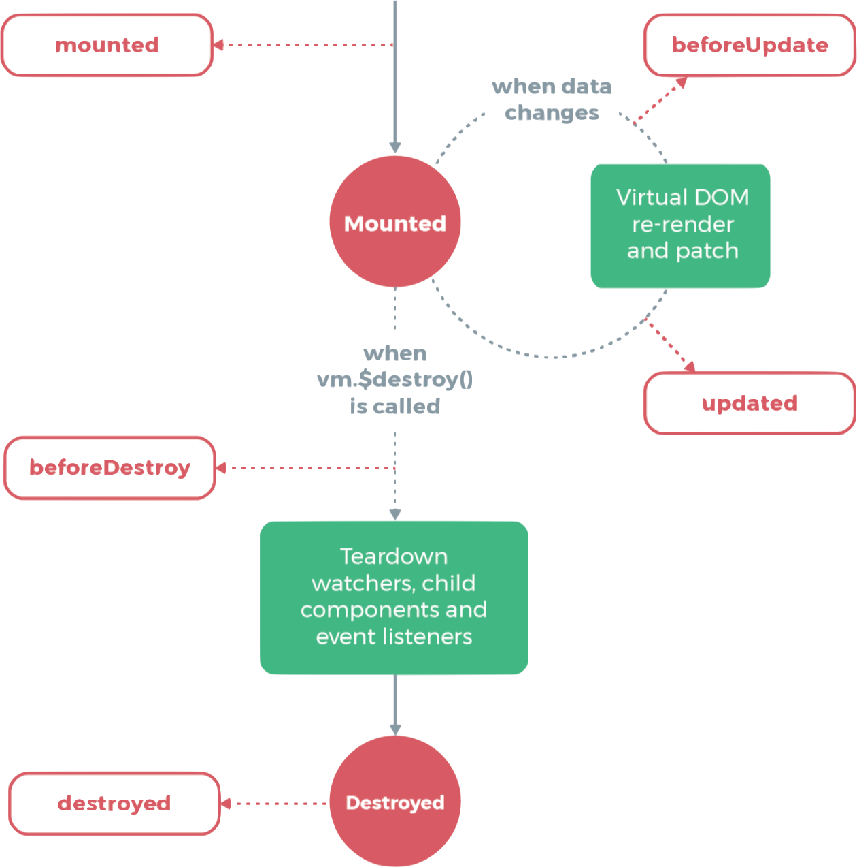

Lifecycle of Vue.js

Slide 6
FAQ. Listener registered when re-render

Slide 7
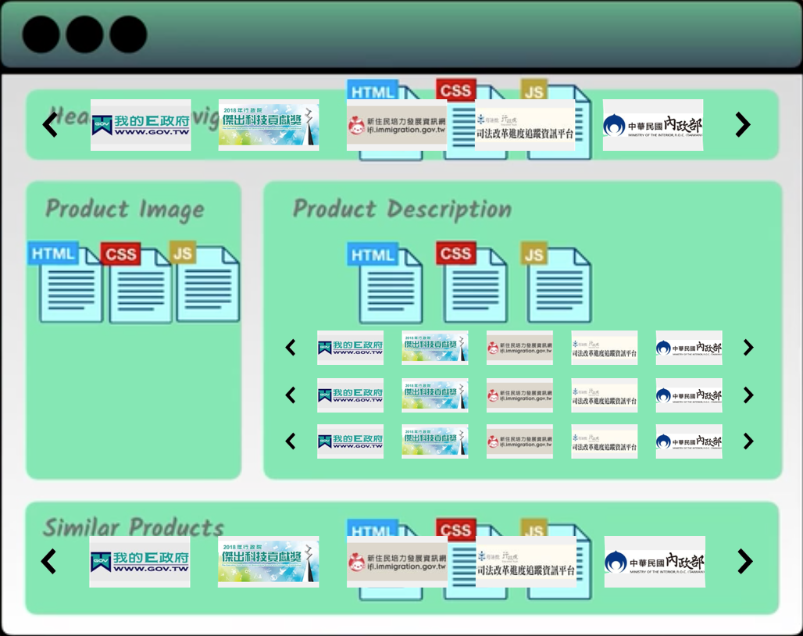
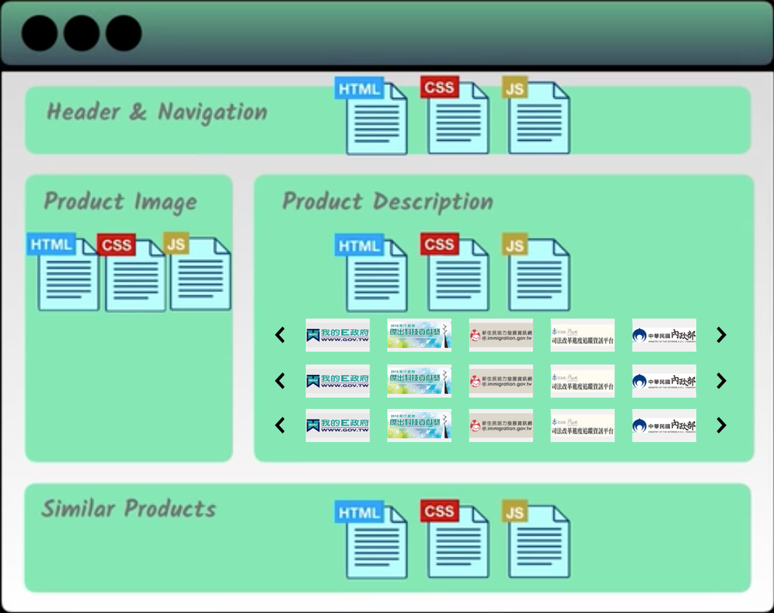
Components Basics

Slide 8
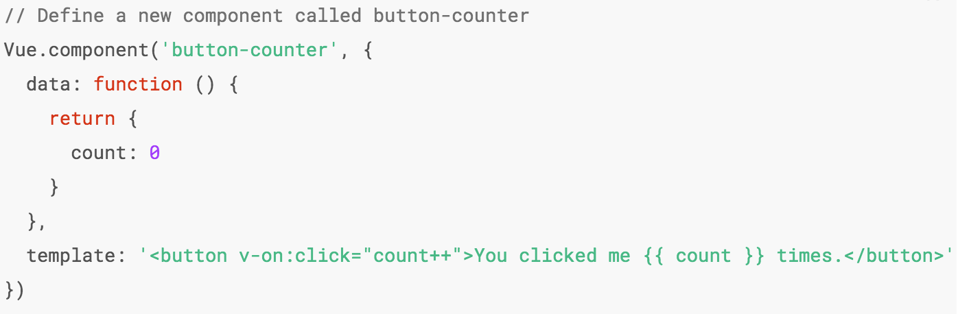
Global Registration V.S Single File Components
Global definitions force unique names for every component
String templates lack syntax highlighting and require ugly slashes for multiline HTML
No CSS support means that while HTML and JavaScript are modularized into components, CSS is conspicuously left out
No build step restricts us to HTML and ES5 JavaScript, rather than preprocessors like Pug (formerly Jade) and Babel

Slide 9
Example. Single File Components

Slide 10
Example. Combine Components

Slide 11
Change Summer Intro

