Slide 1
HW9_LSD

Slide 2


LSD stands for Longest Shortest Distance …

Slide 3
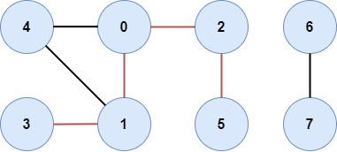
Assignment Requirement:
Your program will take a two-dimensional integer array as input.
Each element in the array represents nodes lined together
Please return the longest shortest-path in the given graph.
Given a graph G = (V, E), find max_{u,v} d(u, v), where d(u,v) denotes the shortest path length between node u and node v, for all possible u, v
(In this home work, You may use java.util.collections、 java.util.ArrayList 、 java.util.Stack,
but java.util.* is not allowed.)
Input:
[[0,1][0,2][0,4][1,3][1,4][2,5][6,7]]
Output: 4

