Slide 1

Resort Management System
Developed By
Yohannes Seyoum Gebreslasie
Hsu Min Htet
James Balimunsi
Hasan Mahmoud Alyousef

Slide 2
SDLC
Read the requirements
1
Designed the Class Diagram
2
Designed the Use cases.
3
Distributed the use cases.
4
Combined the code.
5
Tested the code.
6
Deployed.
7

Slide 3
System overview
We developed a RESTFUL application (The backend part) for a resort and we have two type of users:
Customer
Admin

Slide 4

The customer operations
Create an account.
Login into his account.
Update his account information.
Get a list of the products.
Make/delete/update/return a reservation.

Slide 5

The admin operations
Create an account.
Login into his account.
Update his account information.
Make/delete/update/return a product.
Get a list of the customers.
Get a list of the reservations.
Get a list of the products.

Slide 6
Enterprise application
Security
Controller
Service
DTO
Domain
Repository

Slide 7
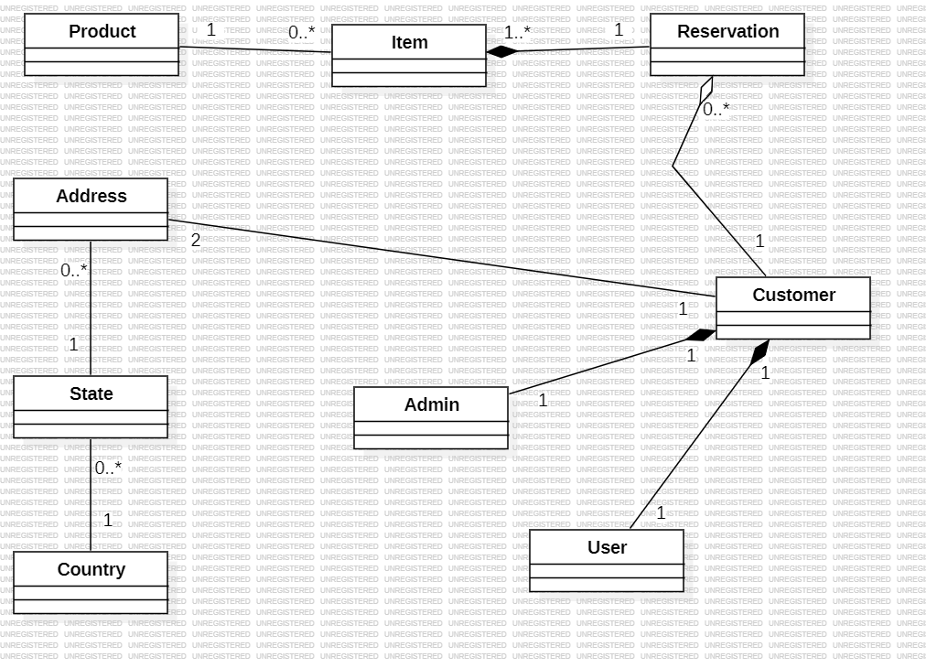
Class diagram

Slide 8
Use Case Diagram
Product Registration
(Update, Delete and Search)
Active/De-active to Customer
Admin
Login/Logout
Resort Reservation System
Sign Up By Visitor
Customer
Register for Resort Reservation
Check In/Out
Customer Registration
(Update, Delete and Search)

Slide 9


Slide 10


