Slide 1
CA Final Presentation
齊煒禎
彭俊又
徐彥旻
Group 10

Slide 2
Baseline Design (Pre Process)
Instruction Set of our Pipeline MIPS

Slide 3
Baseline Design (Pre Process)
Control Unit (Decoder)
Notes:
Control , ALU Control are both decoder
Use a table to Help our design

Slide 4
Baseline Design (Pre Process)
ALU Control (Decoder)

Slide 5
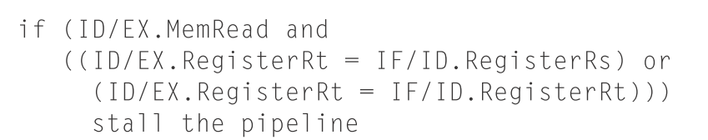
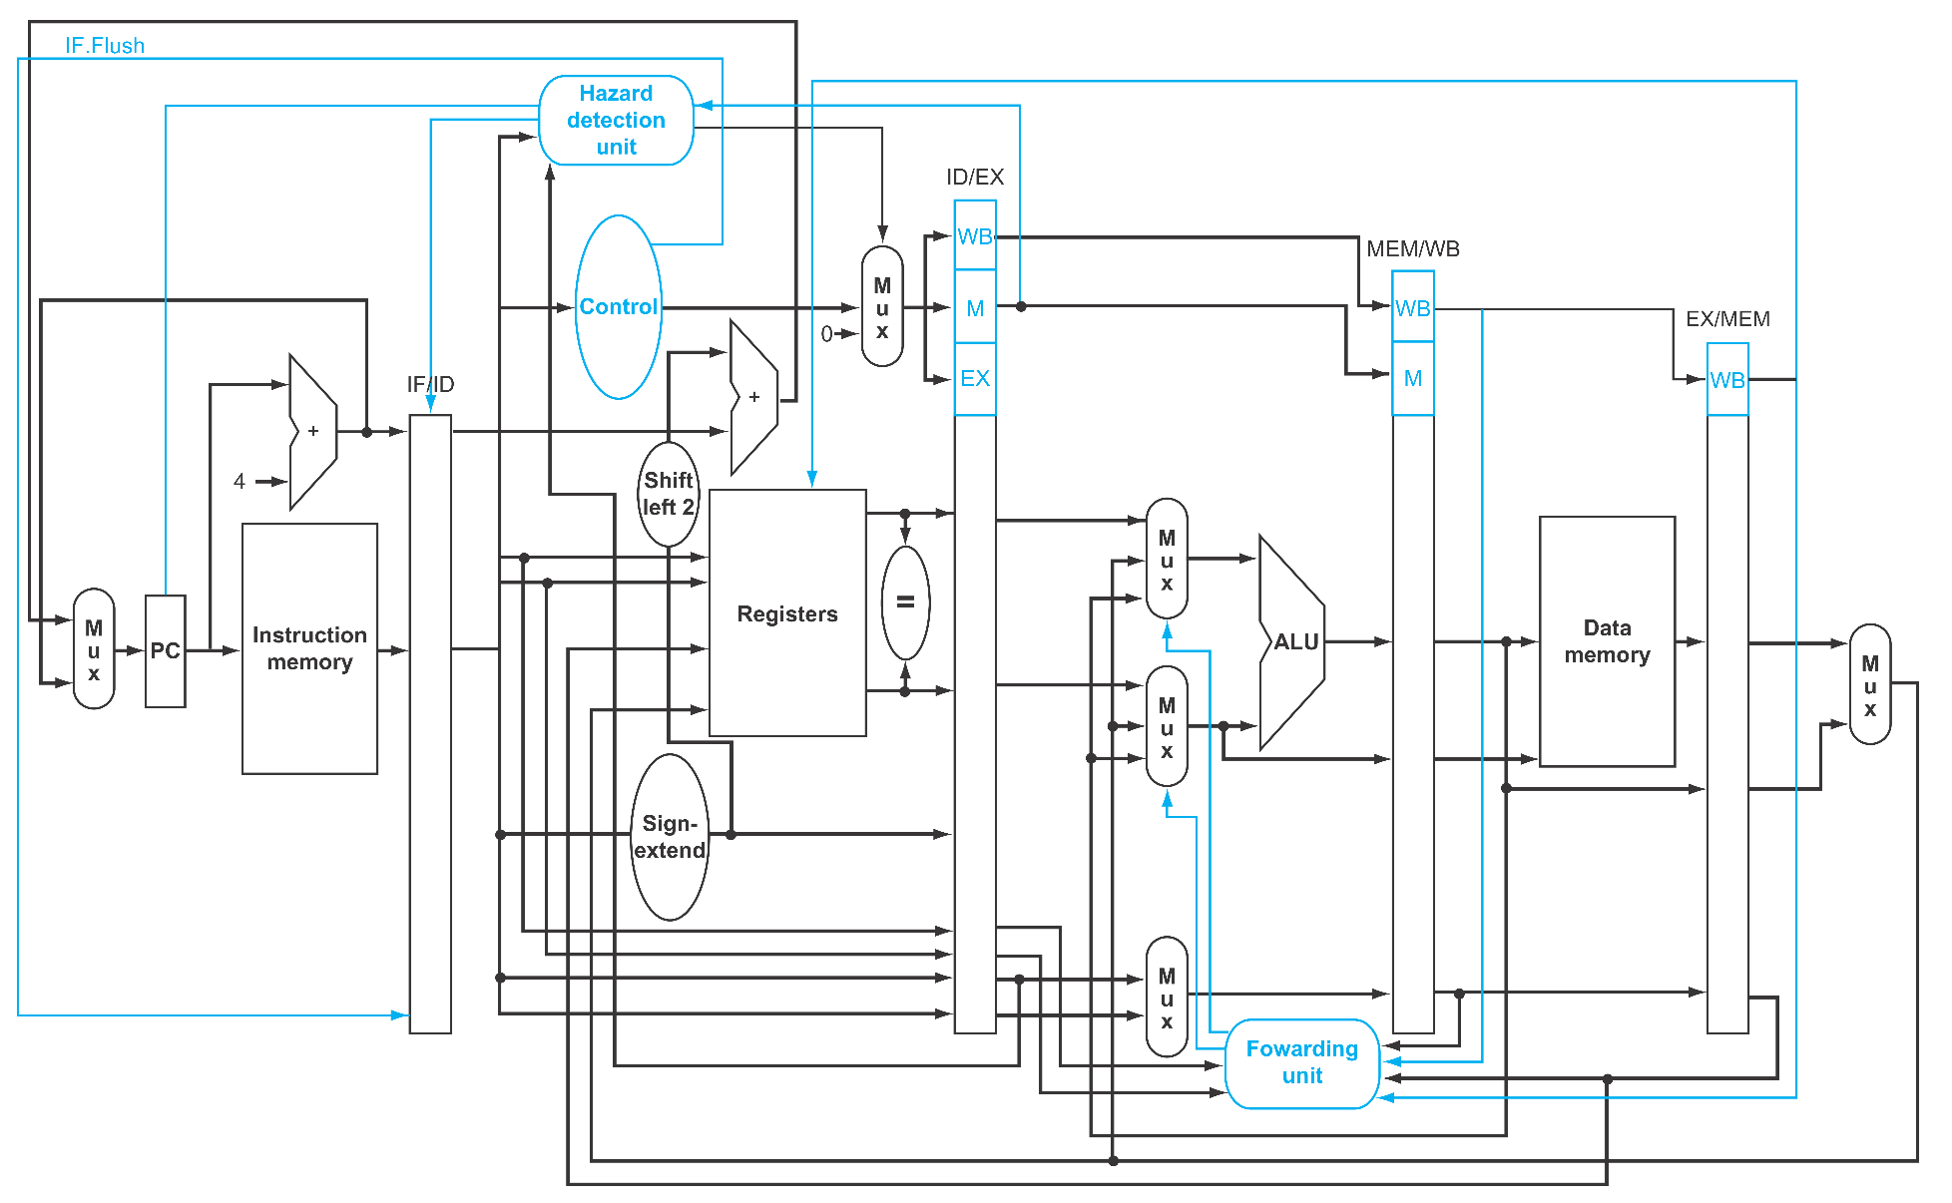
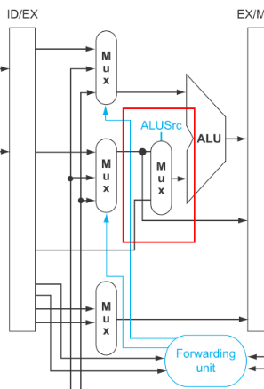
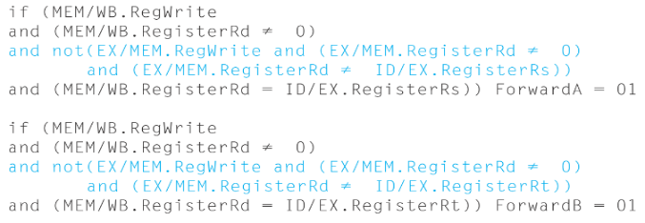
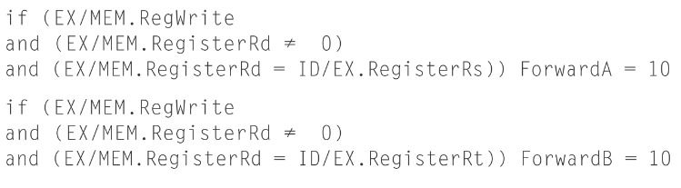
Baseline design (textbook)
Notes:
依照課本的架構實作
BEQ compare at Instruction Decode Stage …. Only a comparer, can be done with several XOR
Forwarding Unit is Enough
No J, Jal, Jr
Hazard Detection Unit is Flawed.

Slide 6
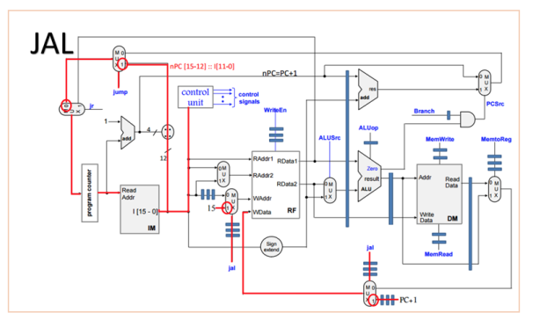
Baseline design (J,Jal,Jr)
Jr
JAL
Jump
Notes:
Implementation from the Internet

Slide 7
Baseline design (Hazard)
Memory Read … stall when Read from Memory (textbook)
Register Write … stall when Read & Write has same addr
Branch … stall when Register is not yet being Write
Jr after Jal … stall till Jal is done
3
4
1
2
Notes:
Hazard detection is the most Problematic part of the design
Memory Read … stall when Read from Memory (textbook)
Register Write … stall when Read & Write has same addr
Branch … stall when Register is not yet being Write (up to 3 cycle)
Jr after Jal … stall till Jal is done (up to 3 cycle)

Slide 8
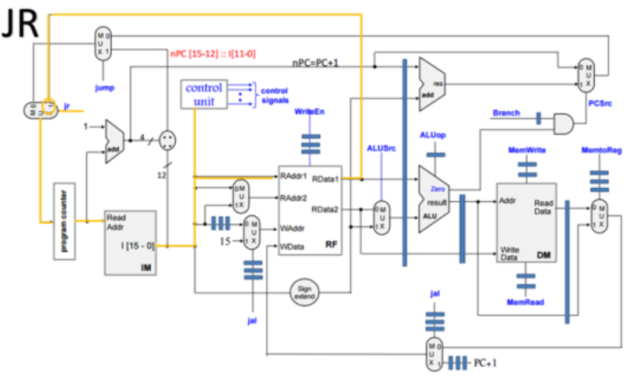
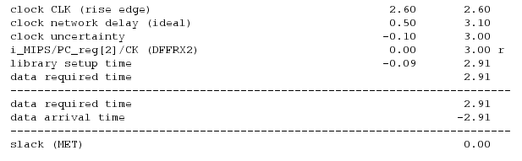
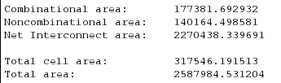
Baseline design (Result)
Critical Path

Slide 9
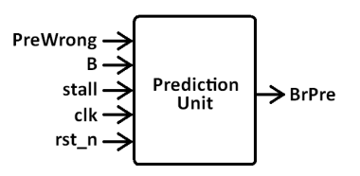
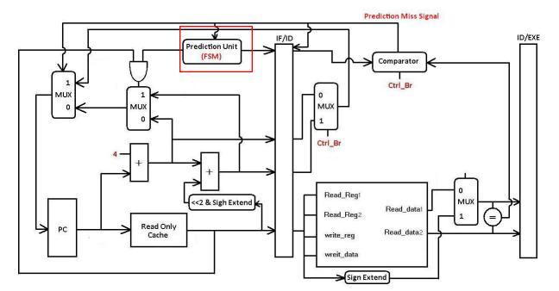
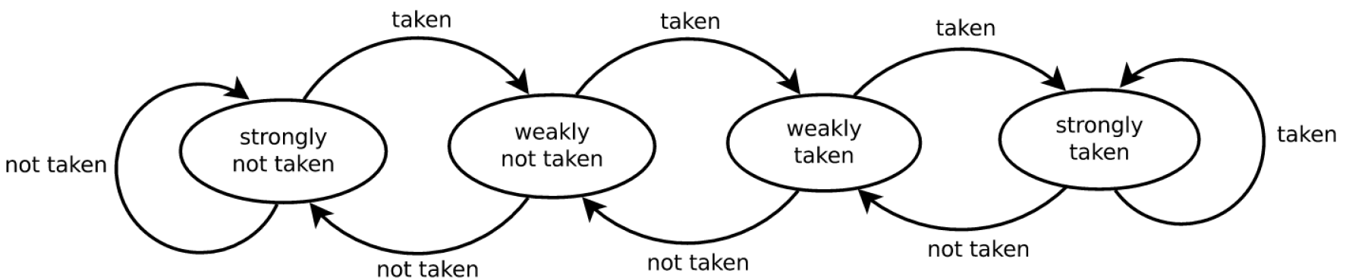
Branch Prediction (Design)
PreRight

Slide 10
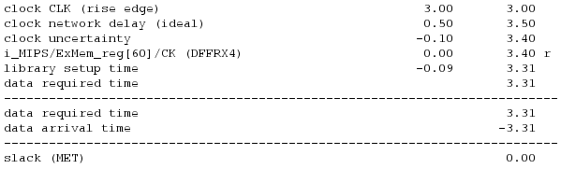
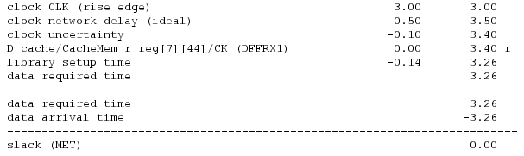

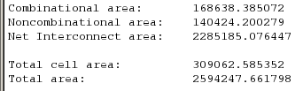
Branch Prediction (Result)
BPU Total Cell Area: 11458

Slide 11
Assembly
Convert Assemble code to machine code
Execute the machine code on designed processor
Modify the assembly code to get better performance

Slide 12
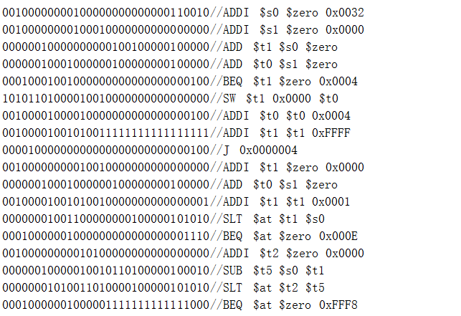
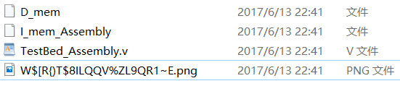
Assembly
Convert Assemble code to machine code

Slide 13
Assembly
2. Execute the machine code on designed processor
`define TestPort 30'h40
`define BeginSymbol 32'h00000932
`define EndSymbol 32'h00000D5D
`define CheckNum 6'd50
check&debug
Count for clk

Slide 14
Assembly
3.Modify the assembly code to get better performance
a. Hazard
IdExMemRead && ((IdExRegRt == IfIdRegRs)
WbRegWrite && ((IfIdRegRd == IfIdRegRs)
Branch
ExRegWrite && ((ExRegWriteAddr == IfIdRegRs)
MemRegWrite && ((MemRegWriteAddr == IfIdRegRs)
WbRegWrite && ((WbRegWriteAddr == IfIdRegRs)
b. Branch
c. detail

Slide 15
500 | Best case | Average case | Worst case
Bubble sort | 2721316 | 3141275 | 3314274
Modified | 2347046 | 2839610 | 3064771
Approved(％) | 13.8 | 9.6 | 7.5
50 | Best case | Average case | Worst case
Bubble sort | 26058 | 28834 | 30433
Bubble modified | 22381 | 25862 | 27980
Quick sort | 33353 | 9123 | 29652
Quicksort modified | 32654 | 8630 | 29027

Slide 16
Assembly
Summarize
Hazard in critical region is very important
An advanced algorithm doesn’t promise better performance

Slide 17
L2 Cache
Two-way L1 cache
512 words L2 cache

Slide 18
L2 Cache (RTL simulation)
 | Two-Way L1 cache | Direct map L1 cache
256 words L2 Cache | 267182500 ps | 264787500 ps
512 words L2 Cache | 267182500 ps | 264787500 ps

Slide 19
L2 Cache
Future(= next week’s) work
Avg. memory access time
Total execution time

Slide 20
謝謝 大家

