Slide 2

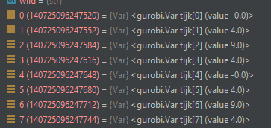
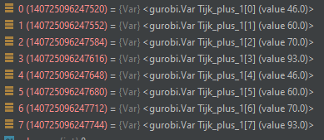

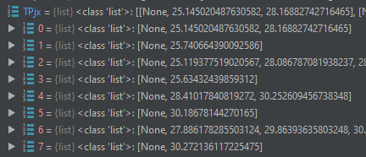
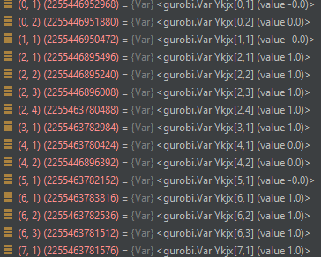


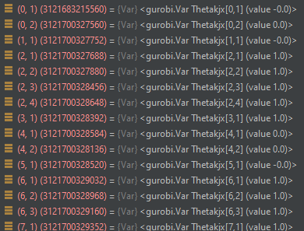
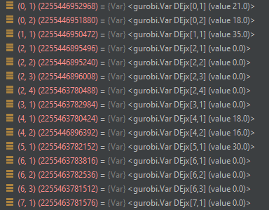
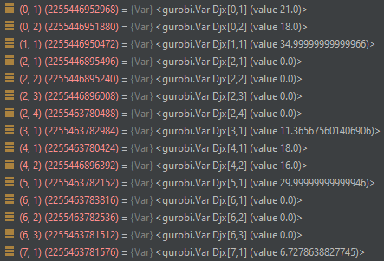
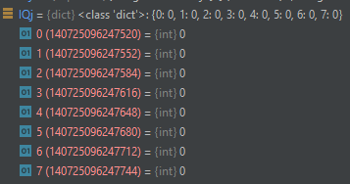

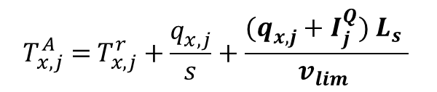

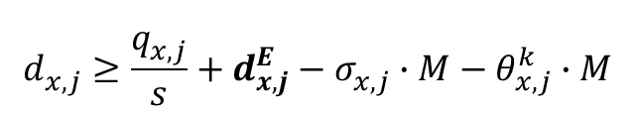
Step = 8
修正v1
Qjx
tijk
Tijk+1
Tijk
TPjx
sigma
TAjx
theta
DEjx
Djx
Trjx
$$d_{x,j}^{}≥\frac{q_{x,j}^{}}{s}+d_{x,j}^{E}−σ_{x,j}^{}∙M−θ_{x,j}^{k}∙M$$
$$T_{x,j}^{A}\text{ =} T_{x,j}^{r}+\frac{q_{x,j}^{}}{s}+\frac{(q_{x,j}^{}+I_{j}^{Q}) L_{s} }{v_{lim} }$$
$$d_{x,j}^{E}=T_{j,k+1}^{i}\text{ − (}T_{x,j}^{A}\text{)}$$

Slide 3

Step = 8
原始
TAjx
sigma
theta

Slide 4

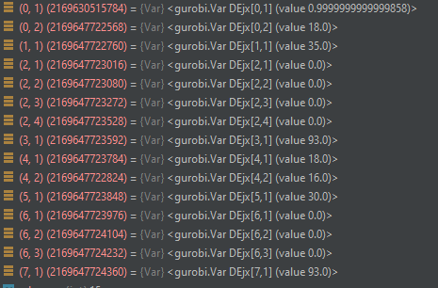

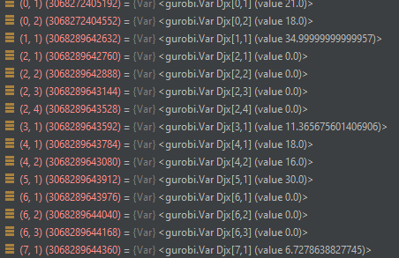
Step = 8
修正V2
sigma
theta

Slide 5








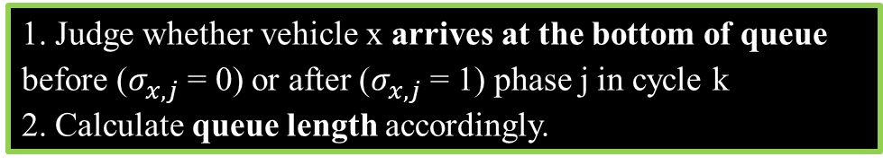






1. Judge whether vehicle x arrives at the bottom of queue
before ($σ_{x,j}^{}$ = 0) or after ($σ_{x,j}^{}$ = 1) phase j in cycle k
2. Calculate queue length accordingly.
Delay of Approaching vehicle
Judge whether vehicle x can arrive at stop bar ($y_{x,j}^{k}$ = 1) or not ($y_{x,j}^{k}$ = 0) of phase j in cycle k
$$T_{x,j}^{r}≤T_{j,k}^{i}+(1−σ_{x,j}^{})∙M$$
$T_{x,j}^{P}>T_{j,k}^{i}+τ_{j,k}^{i}∙(1−P_{j,k}^{i})+ t_{j,k}^{i} −y_{x,j}^{k}$ $∙M$
$$T_{x,j}^{r}>T_{j,k}^{i}−σ_{x,j}^{}∙M$$
$$T_{x,j}^{P}≤T_{j,k}^{i}+τ_{j,k}^{i}∙(1−P_{j,k}^{i})+ t_{j,k}^{i}+\left(1−y_{x,j}^{k}\right)∙M$$
$$q_{x,j}^{}≥\left\lfloor \frac{x−1}{N_{j}}\right\rfloor −(1−σ_{x,j}^{})∙M$$
$$q_{x,j}^{}≥0$$
$$θ_{x,j}^{k}≤y_{x,j}^{k}$$
$$q_{x,j}^{}≥\left\lfloor \frac{x−1}{N_{j}}\right\rfloor −s\left(T_{x,j}^{r}−T_{j,k}^{i}\right)−σ_{x,j}^{}∙M$$
Calculate delay accordingly.
$$d_{x,j}^{}≥\frac{q_{x,j}^{}}{s} + T_{j,k} −T_{x,j}^{r}− (1−σ_{x,j}^{})M− (1−θ_{x,j}^{k})M$$
$$T_{x,j}^{r}=T_{x,j}^{P} − \frac{q_{x,j}^{}∙ L_{s}}{v_{x}}$$
Calculate the time for vehicle x arrives at the bottom of queue .
$$d_{x,j}^{}≥\frac{q_{x,j}^{}}{s} + T_{j,k} −T_{x,j}^{r}+d_{x,j}^{E}− (1−σ_{x,j}^{})M− θ_{x,j}^{k}M$$
$$d_{x,j}^{E}=T_{j,k+1}^{i}\text{ −}\text{ (}T_{j,k}^{i}\text{ +}t_{j,k}^{i}\text{) }$$
Calculate extra delay for vehicle x
(i.e. total waiting time for phase j)
$$d_{x,j}^{}≥\frac{q_{x,j}^{}}{s}−σ_{x,j}^{}∙M− (1−θ_{x,j}^{k})∙M$$
$$d_{x,j}^{}≥\frac{q_{x,j}^{}}{s}+d_{x,j}^{E}−σ_{x,j}^{}∙M−θ_{x,j}^{k}∙M$$

Slide 6
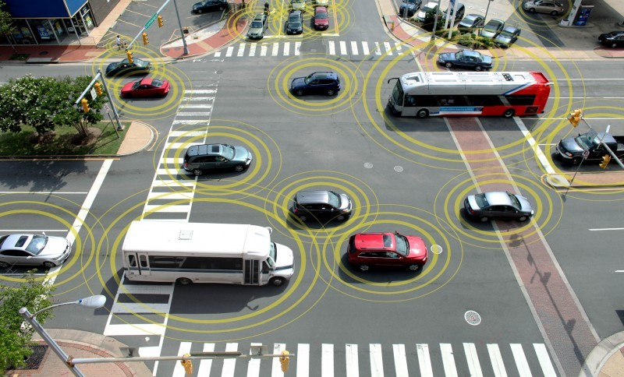
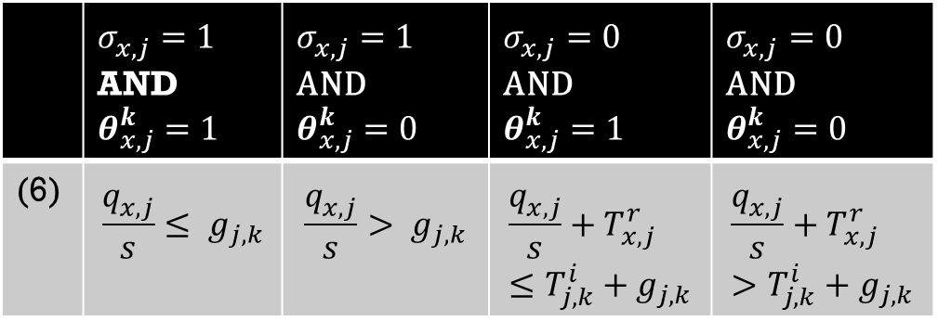

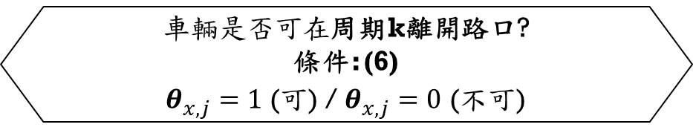

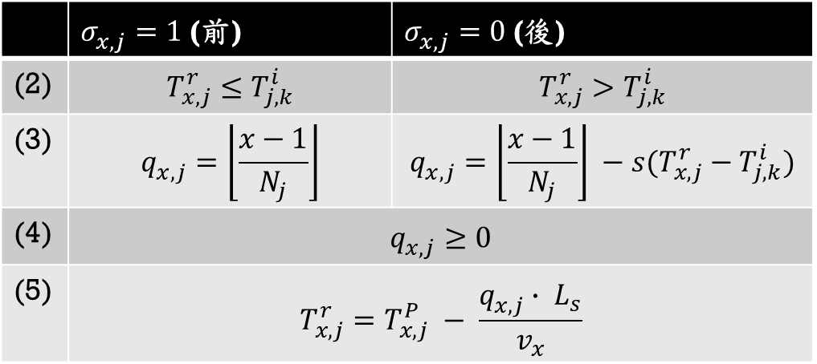

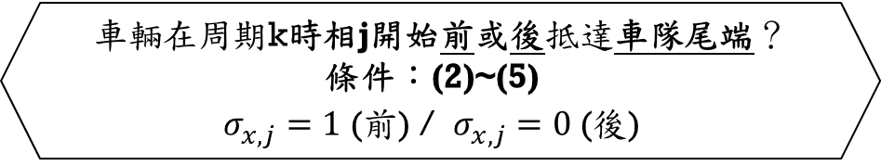


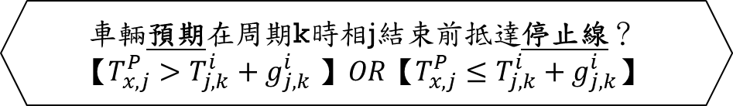


Idea And Methodology
2.正要抵達路口之車輛
決策變數: $T_{j,k}^{i} , g_{j,k}^{i}$
 | $σ_{x,j}^{}=1$ (前) | $σ_{x,j}^{}=0$ (後)
(2) | $$T_{x,j}^{r}≤T_{j,k}^{i}$$ | $$T_{x,j}^{r}>T_{j,k}^{i}$$
(3) | $$q_{x,j}^{}=\left\lfloor \frac{x−1}{N_{j}}\right\rfloor$$ | $$q_{x,j}^{}=\left\lfloor \frac{x−1}{N_{j}}\right\rfloor −s(T_{x,j}^{r}−T_{j,k}^{i})$$
(4) | $$q_{x,j}^{}≥0$$
(5) | $$T_{x,j}^{r}=T_{x,j}^{P} − \frac{q_{x,j}^{}∙ L_{s}}{v_{x}}$$
車輛預期在周期k時相j結束前抵達停止線？
$$【T_{x,j}^{P}>T_{j,k}^{i}+g_{j,k}^{i} 】OR【T_{x,j}^{P}≤T_{j,k}^{i}+g_{j,k}^{i}】$$
否(y=0)
是(y=1)
車輛在周期k時相j開始前或後抵達車隊尾端？
條件：(2)~(5)
$σ_{x,j}^{}=1$ (前) / $σ_{x,j}^{}=0$ (後)
前
後
前
後
 | $σ_{x,j}^{}=1$ AND $θ_{x,j}^{k}=1$ | $σ_{x,j}^{}=1$ AND $$θ_{x,j}^{k}=0$$ | $σ_{x,j}^{}=0$ AND $θ_{x,j}^{k}=1$ | $σ_{x,j}^{}=0$ AND $θ_{x,j}^{k}=0$
(6) | $$\frac{q_{x,j}^{}}{s}≤ g_{j,k}$$ | $$\frac{q_{x,j}^{}}{s}> g_{j,k}$$ | $$\frac{q_{x,j}^{}}{s}+T_{x,j}^{r}≤T_{j,k}^{i}+g_{j,k}$$ | $$\frac{q_{x,j}^{}}{s}+T_{x,j}^{r}>T_{j,k}^{i}+g_{j,k}$$
$車輛是否可在$周期k離開路口?
條件: (6)
$θ_{x,j}^{}=1$ (可) / $θ_{x,j}^{}=0$ (不可)
不可
可
不可
可
不可
$$D_{2}$$
$$D_{4}$$
$$D_{1}$$
$$D_{2}$$
$$D_{3}$$
$$D_{4}$$
2-1
2-2
2-3
2-4
2-5
2-6

Slide 7














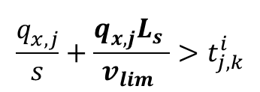




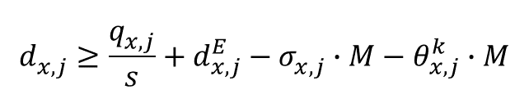




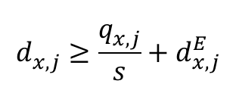






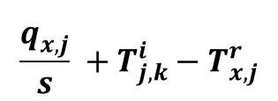
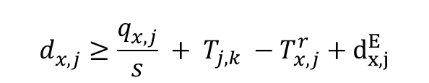
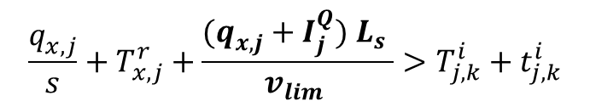

Idea And Methodology
$$d_{x,j}^{}≥\frac{q_{x,j}^{}}{s}+d_{x,j}^{E}−σ_{x,j}^{}∙M−θ_{x,j}^{k}∙M$$
$$d_{x,j}^{E}=T_{j,k+1}^{i}\text{ −}\text{ (}T_{x,j}^{A}\text{)}$$
2-2
2-1
$$σ_{x,j}^{}=1$$
$$θ_{x,j}^{k}=0$$
$$σ_{x,j}^{}=0$$
$$θ_{x,j}^{k}=0$$
$$y_{x,j}^{k}=0$$
$$y_{x,j}^{k}=0$$
Distance
Distance
Approaching vehicle
Queued vehicle
vehicle x
$$v_{x}$$
$$\frac{q_{x,j}^{}}{s}$$
$$\frac{q_{x,j}^{}}{s} +T_{j,k}^{i}−T_{x,j}^{r}$$
vehicle x
$$T_{x,j}^{r}$$
$$T_{x,j}^{r}$$
s
$$v_{lim}$$
$$v_{lim}$$
$$T_{x,j}^{A}$$
$$q_{x,j}^{}$$
s
$$T_{x,j}^{A}$$
$$q_{x,j}^{}$$
$$d_{x,j}^{E}$$
$$I_{j}^{Q}$$
$$d_{x,j}^{E}$$
Intersection i
路口i
Time
$$0$$
Time
$$T_{j,k}^{i}$$
$$t_{j,k}^{i}$$
$$T_{x,j}^{P}$$
$$t_{j,k}^{i}$$
$$T_{x,j}^{P}$$
$$T_{j,k}^{i}$$
$$d_{x,j}^{}≥\frac{q_{x,j}^{}}{s} + T_{j,k} −T_{x,j}^{r}+d_{x,j}^{E}$$
$$\frac{q_{x,j}^{}}{s}+\frac{q_{x,j}^{}L_{s} }{v_{lim} }>t_{j,k}^{i}$$
$$σ_{x,j}^{}=1 θ_{x,j}^{k}=0$$
$$d_{x,j}^{}≥\frac{q_{x,j}^{}}{s}+d_{x,j}^{E}$$
$$\frac{q_{x,j}^{}}{s}+T_{x,j}^{r}+\frac{(q_{x,j}^{}+I_{j}^{Q}) L_{s} }{v_{lim} }>T_{j,k}^{i}+t_{j,k}^{i}$$
$$σ_{x,j}^{}=0 θ_{x,j}^{k}=0$$

Slide 8
















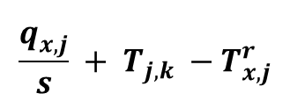










Idea And Methodology
2-4
2-6
$$σ_{x,j}^{}=1$$
$$θ_{x,j}^{k}=0$$
$$σ_{x,j}^{}=0$$
$$θ_{x,j}^{k}=0$$
Distance
Distance
vehicle x
$$v_{x}$$
$$v_{x}$$
$$\frac{q_{x,j}^{}}{s} + T_{j,k} −T_{x,j}^{r}$$
$$\frac{q_{x,j}^{}}{s}$$
vehicle x-1
$$T_{x,j}^{r}$$
$$T_{x,j}^{r}$$
s
$$v_{lim}$$
vehicle x-2
$$q_{x,j}^{}$$
s
$$T_{x,j}^{A}$$
$$v_{lim}$$
$$T_{x,j}^{A}$$
$$T_{j,k+1}^{i}$$
$$T_{j,k+1}^{i}$$
$$q_{x,j}^{}$$
$$d_{x,j}^{E}$$
$$I_{j}^{Q}$$
$$d_{x,j}^{E}$$
路口i
$$0$$
Time
Time
$$T_{x,j}^{P}$$
$$t_{j,k}^{i}$$
$$T_{j,k}^{i}$$
$$t_{j,k}^{i}$$
$$T_{j,k}^{i}$$

