Slide 1
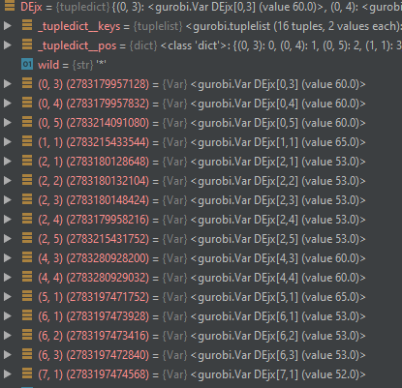
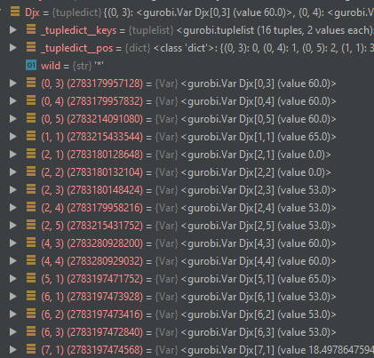
Step = 1217
<gurobi.LinExpr: 1.5 Djx[0,3] + 1.5 Djx[0,4] + 1.5 Djx[0,5] + 1.5 Djx[1,1] + 1.5 Djx[2,1] + 30.0 Djx[2,2] + 1.5 Djx[2,3] + 1.5 Djx[2,4] + 1.5 Djx[2,5] + 1.5 Djx[4,3] + 1.5 Djx[4,4] + 1.5 Djx[5,1] + 1.5 Djx[6,1] + 1.5 Djx[6,2] + 1.5 Djx[6,3] + 1.5 Djx[7,1] + 1.5 DQjx[0,1] + 1.5 DQjx[0,2] + 1.5 DQjx[3,1] + 1.5 DQjx[4,1] + 1.5 DQjx[4,2]>

Slide 2
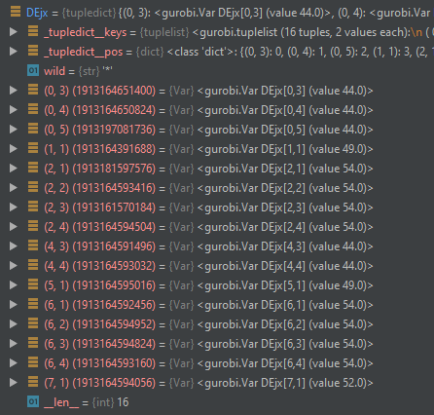
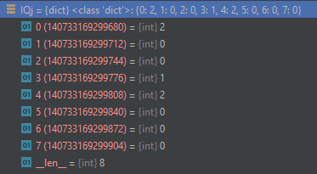
Step = 1218
<gurobi.LinExpr: 1.5 Djx[0,3] + 1.5 Djx[0,4] + 1.5 Djx[0,5] + 1.5 Djx[1,1] + 30.0 Djx[2,1] + 1.5 Djx[2,2] + 1.5 Djx[2,3] + 1.5 Djx[2,4] + 1.5 Djx[4,3] + 1.5 Djx[4,4] + 1.5 Djx[5,1] + 1.5 Djx[6,1] + 1.5 Djx[6,2] + 1.5 Djx[6,3] + 1.5 Djx[6,4] + 1.5 Djx[7,1] + 1.5 DQjx[0,1] + 1.5 DQjx[0,2] + 1.5 DQjx[3,1] + 1.5 DQjx[4,1] + 1.5 DQjx[4,2]>
Obj: 2667.24

Slide 3
----optSignalPlanForCycleK----
[0]: 8 [1]: 4 [2]: 21 [3]: 4
[4]: 8 [5]: 4 [6]: 21 [7]: 4
arrival time = 40.0
currentPhaseGreen = False
phaseSplitTime = [0, 22, 43, 81, 99, 138, 156, 195, 213, 252]
路口[ I1 ]通過機率 = 0.934543 > 目標機率 0.500000，不用計算建議速度
----optSignalPlanForCycleK----
[0]: 8 [1]: 4 [2]: 19 [3]: 4
[4]: 8 [5]: 4 [6]: 19 [7]: 4
arrival time = 41.0
currentPhaseGreen = False
phaseSplitTime = [0, 22, 41, 79, 97, 136, 154, 193, 211, 250]
路口[ I1 ]通過機率 = 0.501350 > 目標機率 0.500000，不用計算建議速度
----optSignalPlanForCycleK----
[0]: 8 [1]: 4 [2]: 19 [3]: 4
[4]: 8 [5]: 4 [6]: 19 [7]: 4
arrival time = 40.0
currentPhaseGreen = False
phaseSplitTime = [0, 22, 41, 79, 97, 136, 154, 193, 211, 250]
路口[ I1 ]通過機率 = 0.692812 > 目標機率 0.500000，不用計算建議速度
----optSignalPlanForCycleK----
[0]: 8 [1]: 4 [2]: 19 [3]: 4
[4]: 8 [5]: 4 [6]: 19 [7]: 4
arrival time = 41.0
currentPhaseGreen = False
phaseSplitTime = [0, 22, 41, 79, 97, 136, 154, 193, 211, 250]
路口[ I1 ]通過機率 = 0.501350 > 目標機率 0.500000，不用計算建議速度
----optSignalPlanForCycleK----
[0]: 8 [1]: 4 [2]: 20 [3]: 4
[4]: 8 [5]: 4 [6]: 20 [7]: 4
arrival time = 40.0
currentPhaseGreen = False
phaseSplitTime = [0, 22, 42, 80, 98, 137, 155, 194, 212, 251]
路口[ I1 ]通過機率 = 0.842695 > 目標機率 0.500000，不用計算建議速度
----optSignalPlanForCycleK----
[0]: 8 [1]: 4 [2]: 22 [3]: 4
[4]: 8 [5]: 4 [6]: 22 [7]: 4
arrival time = 41.0
currentPhaseGreen = False
phaseSplitTime = [0, 22, 44, 82, 100, 139, 157, 196, 214, 253]
路口[ I1 ]通過機率 = 0.934543 > 目標機率 0.500000，不用計算建議速度
----optSignalPlanForCycleK----
[0]: 8 [1]: 4 [2]: 22 [3]: 4
[4]: 8 [5]: 4 [6]: 22 [7]: 4
arrival time = 40.0
currentPhaseGreen = False
phaseSplitTime = [0, 22, 44, 82, 100, 139, 157, 196, 214, 253]
路口[ I1 ]通過機率 = 0.978600 > 目標機率 0.500000，不用計算建議速度

