Slide 1
The SLC25A47 locus controls gluconeogenesis and energy expenditure

Slide 2
Background

Slide 3
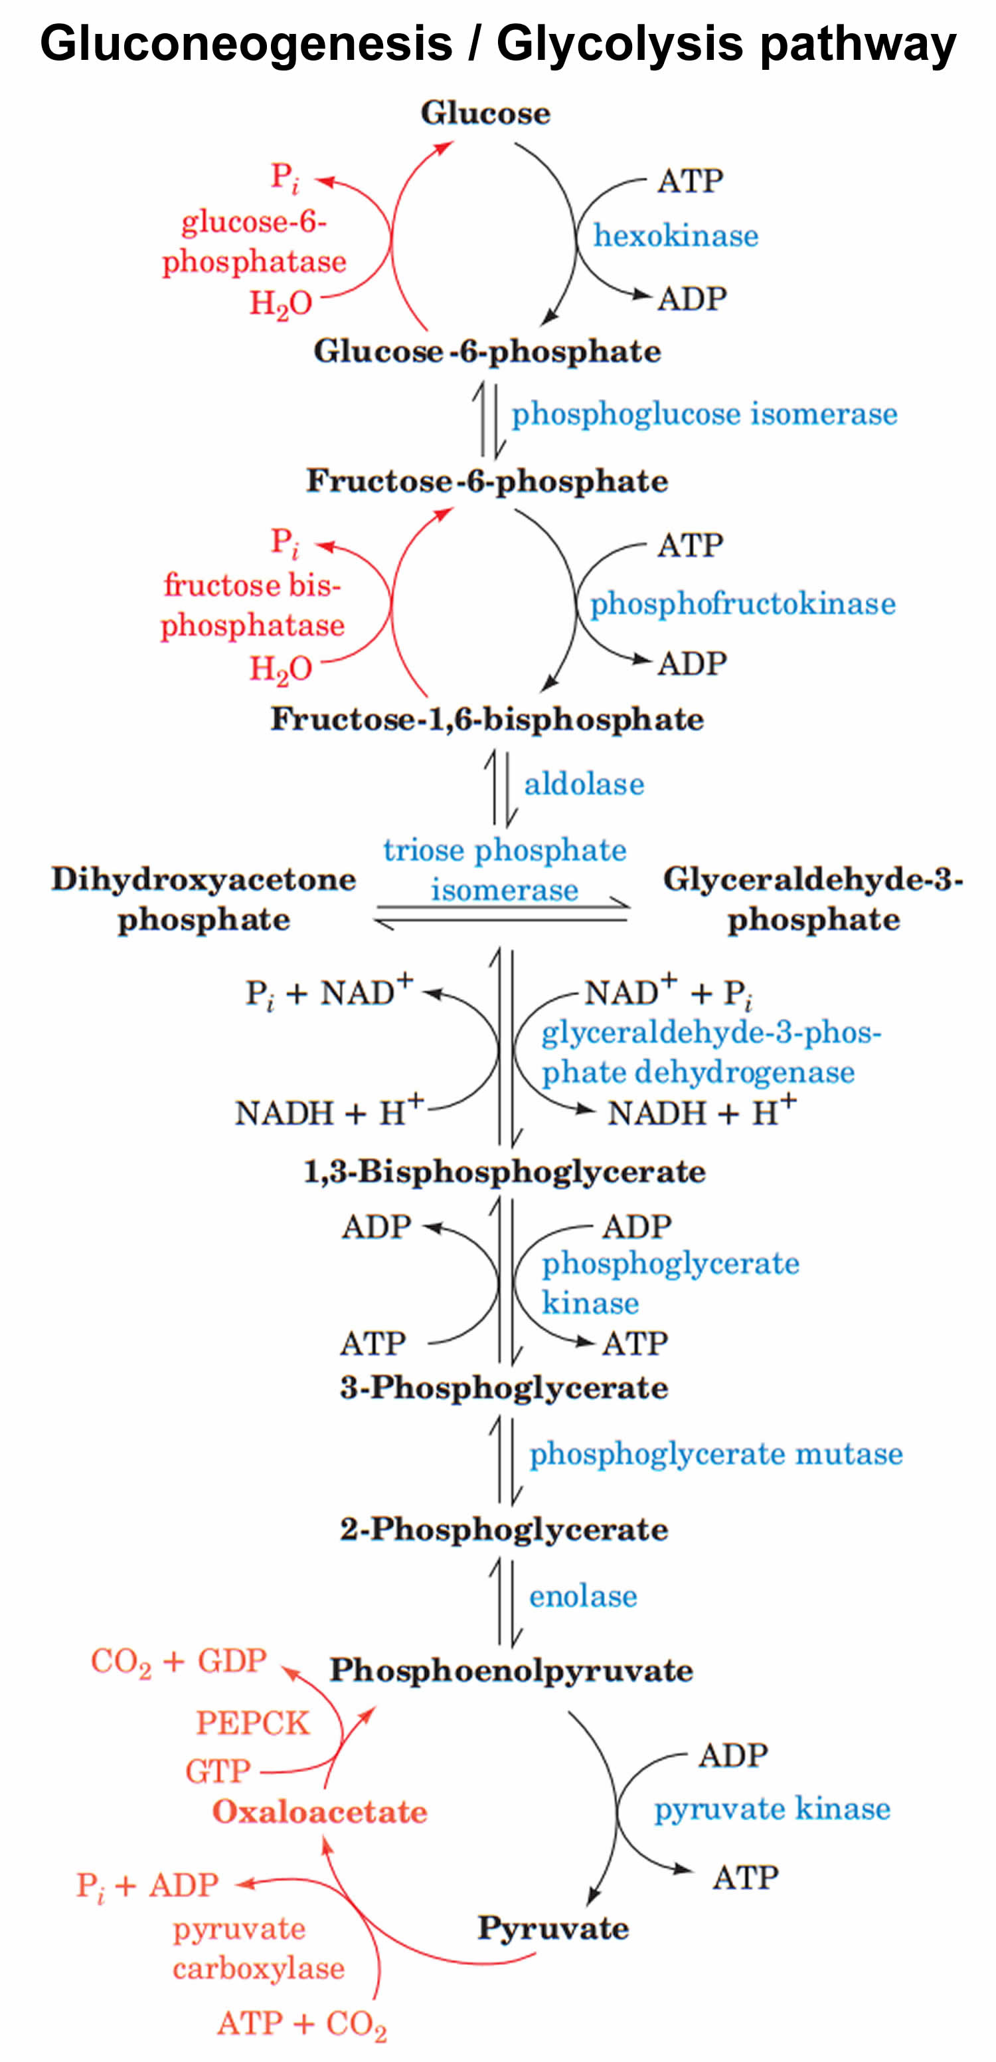
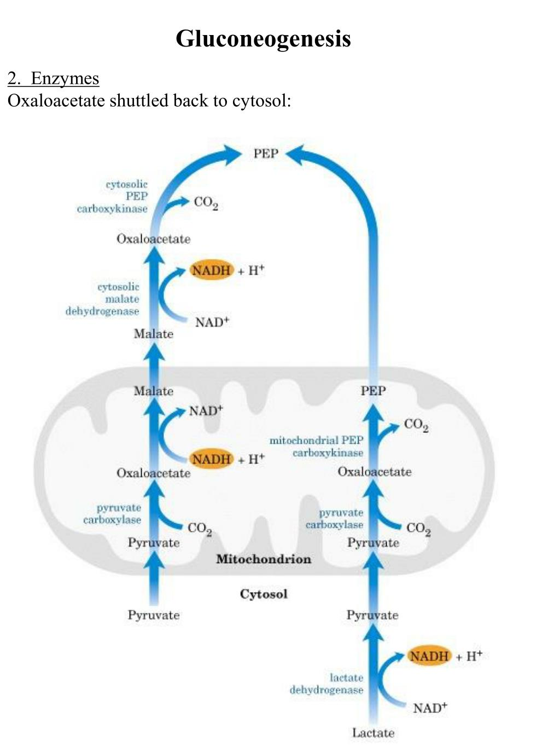
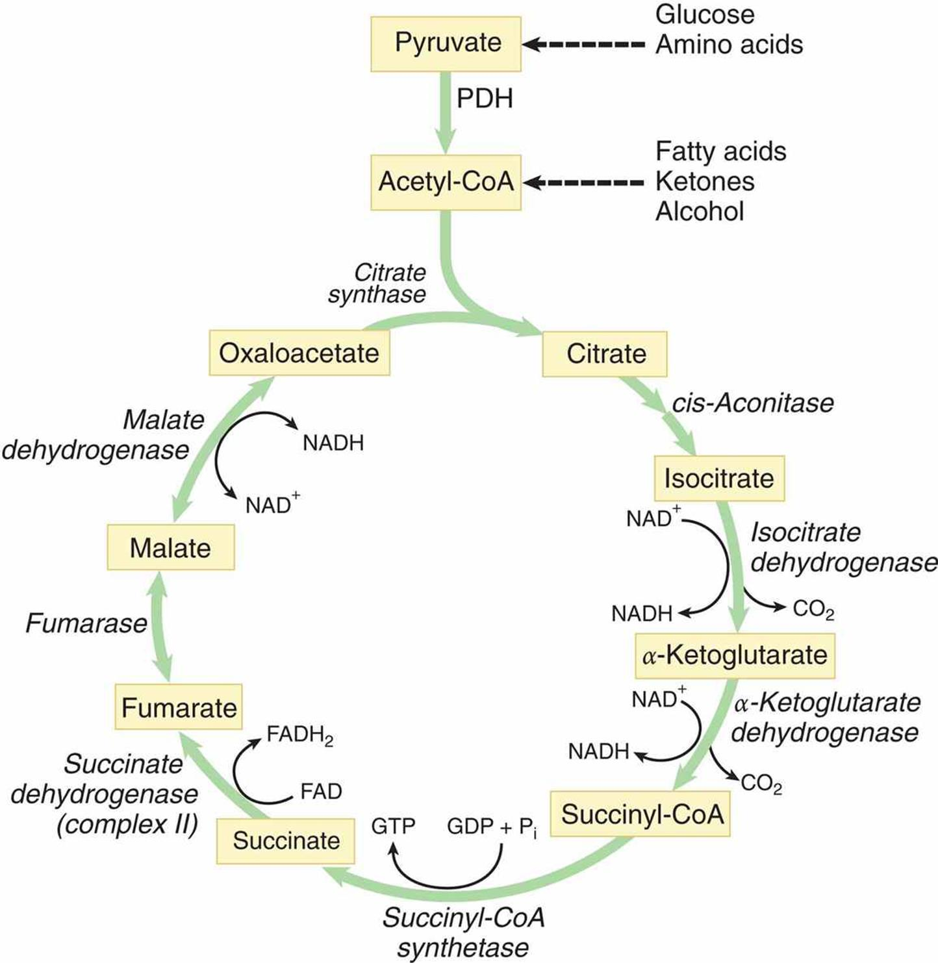
TCA cycle

Slide 4
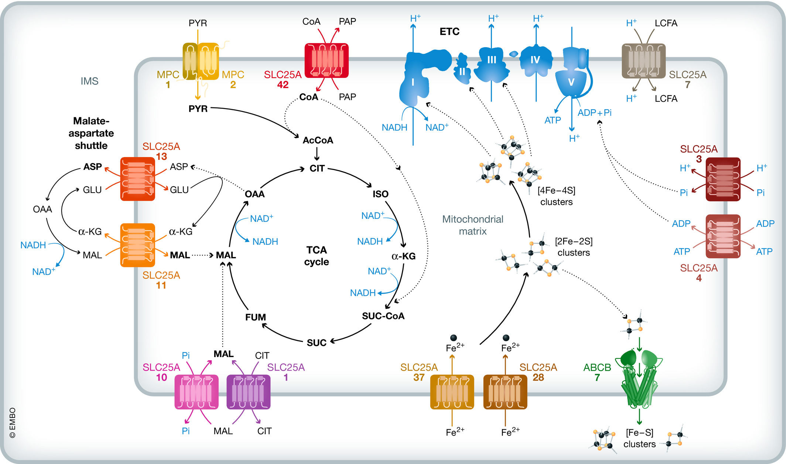
SLC25A family members: mammals mitochondrial inter-membrane metabolite carriers

Slide 5
Examples
SLC25A39, which is responsible for glutathione import
SLC25A44 for branched-chain amino acids import
SLC25A51 for nicotinamide adenine dinucleotide (NAD+ ) import
Because of their essential roles, nearly all mitochondrial metabolite carriers (e.g., SLC25A family members) are ubiquitously expressed in mammalian tissues.
SLC25A7(also known as uncoupling protein 1, UCP1) that is selectively expressed in brown/beige fat
SLC25A47(an orphan carrier), which is expressed selectively in the liver

Slide 6
SLC25A47 descriptions from papers
mitochondrial protein of which expression was down-regulated in hepatocellular carcinoma and that could reduce mitochondrial membrane potential in cultured Hep3B cells, a liver-derived epithelial cell line
In yeast, SLC25A47 overexpression elevated mitochondrial electron transport chain uncoupling, implicating its protective role
genetic loss of Slc25a47 led to mitochondrial dysfunction, mitochondrial stress, and liver fibrosis in mice
Inconsistent reports → what is actual function of SLC25A47?

Slide 7
Result

Slide 8
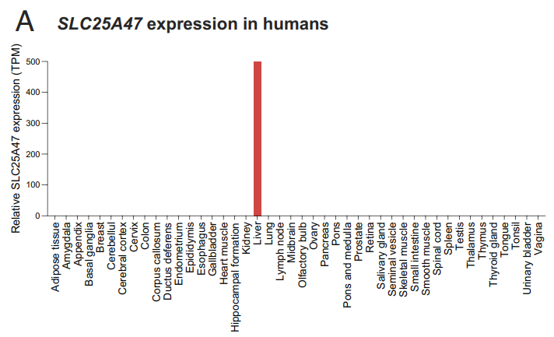
Known: 1.SLC25A47 is unique, it expressed selectively in the liver of mice. 2. hepatocytes are the primary cell type that expresses SLC25A47 (while Kupffer cells also express 10% in-liver SLC25A47) →Experiment for human(relative mRNA levels)

Slide 9
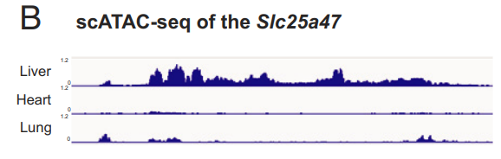
examined the genetic mechanism through which Slc25a47 is selectively expressed in the liver.
The analysis of ATAC-seq found an open chromatin architecture in the Slc25a47 gene locus specific to the liver, whereas the same region appeared to form a heterochromatin structure in the heart and lung(chromosome 12: 108,815,740 to 108,822,741)
ATAC-seq:assay of transposase accessible chromatin sequencing
[Data from gene expression omnibus (GEO) (GSE111586)]

Slide 10
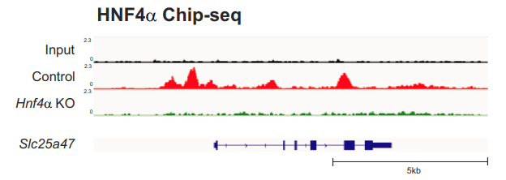
Notably, the euchromatin region of the Slc25a47 gene contained binding sites of HNF4α, to which HNF4α is recruited in the liver
HNF4α:hepatocyte nuclear factor 4 alpha
[ChIP-seq data from GEO (GSE90533)]

Slide 11
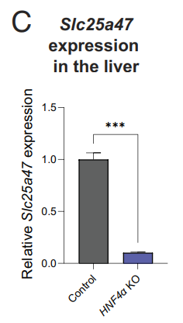
HNF4α
Known:
1.mutations of HNF4α → cause MODY 1
2.central role in the regulation of hepatic and pancreatic transcriptional networks
*3.genetic loss of HNF4α significantly attenuated the expression of Slc25a47 in the mouse liver
HNF4α is required for the hepatic expression of Slc25a47
MODY 1:maturity onset diabetes of the young

Slide 12
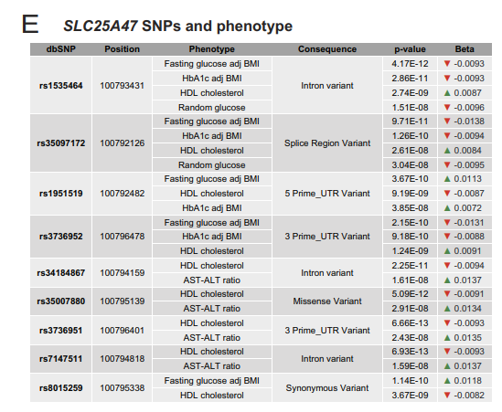
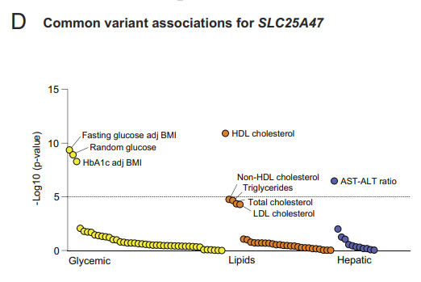
SLC25A47 is involved in the regulation of glucose and lipid homeostasis, although how these SNPs affect SLC25A47 expression remains unknown.
SNP:single nucleotide polymorphisms

Slide 13
Fig 1A-C:
SLC25A47 Is a Liver-Specific Mitochondrial Carrier
Fig 1D-E:
SLC25A47 links to Human Metabolic Disease.

Slide 14
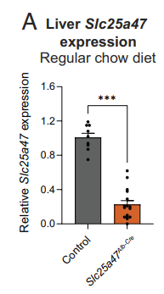
Slc25a47^{Alb-Cre} mice expressed < Slc25a47^{flox/flox}
To determine the physiological role of SLC25A47 in energy homeostasis: cross Slc25a47flox/flox mice with Albumin-Cre
→Slc25a47^{Alb-Cre} mice (lacked SLC25A47 in a liver).
(-80%)
The remaining mRNA in Slc25a47^{Alb-Cre}mice could be attributed to inefficient Cre expression or the transcripts in nonhepatocytes (Kupffer cells)

Slide 15
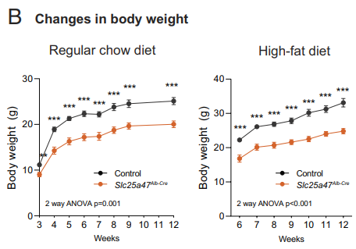
1. Slc25a47^{Alb-Cre} mice gained significantly less weight than controls at 3 wk of age and thereafter on a regular-chow diet 2. This phenotype was more profound when mice at 6 wk of age were fed on a high-fat diet (HFD, 60% fat)

Slide 16
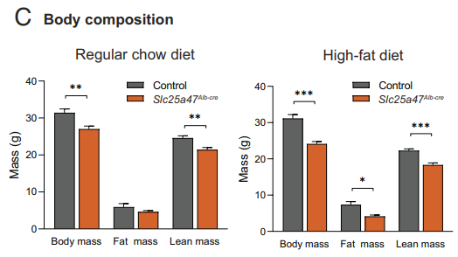
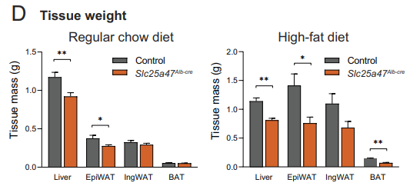
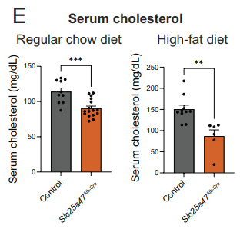
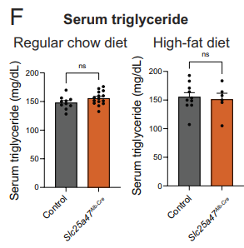
Lean mass, fat mass both reduce
→ Body mass : SLC25A37 < control
Liver, Adipose tissue(BAT, WAT) reduced
→ Tissue weight : SLC25A37 < control
Serum cholesterol level : SLC25A37 < control
Serum triglyceride(TG) level : SLC25A37 = control

Slide 17
Fig 2B-D:
Liver-Specific Depletion of SLC25A47 Protects against Body-Weight Gain(lower body weight)
Fig 2E:
Liver-Specific Depletion of SLC25A47 Lowers Plasma Cholesterol Levels.

Slide 18
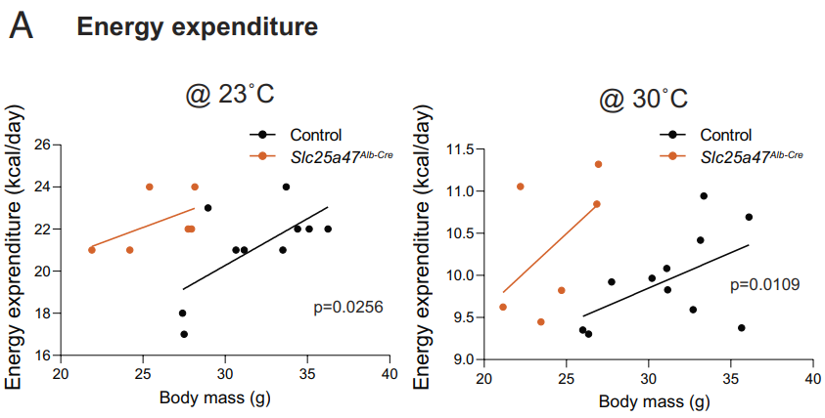
Body mass different between Alb-Cre & control? whole-body energy expenditure (kcal/day) independent of body mass: Slc25a47^{Alb-Cre} mice exhibited > control
CaIR-analysis of covariance (ANCOVA) analysis

Slide 19
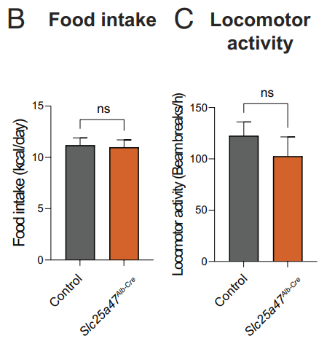
There was no difference in their food intake and locomotor activity between the genotypes
ns : not significant

Slide 20
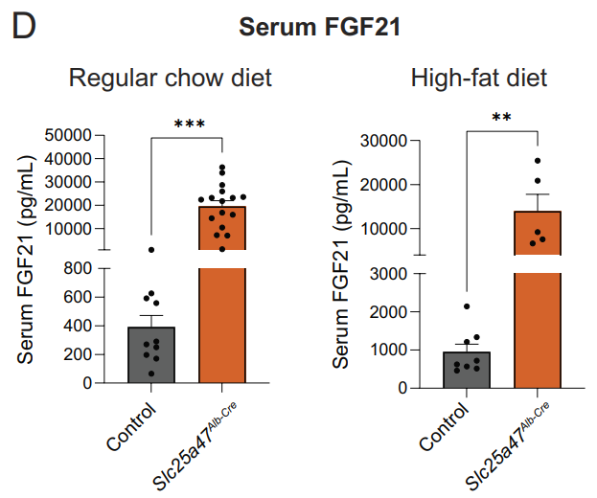
Any change in circulating hormonal factors that influenced whole-body energy expenditure of Slc25a47^{Alb-Cre} mice?
Known: FGF21 is a well-established endocrine hormone that increases energy expenditure by activating the sympathetic nervous system → FGF21 is a probable candidate Exp
→serum levels of FGF21 : Slc25a47^{Alb-Cre} mice > control
FGF21: Fibroblast growth factor 21

Slide 21
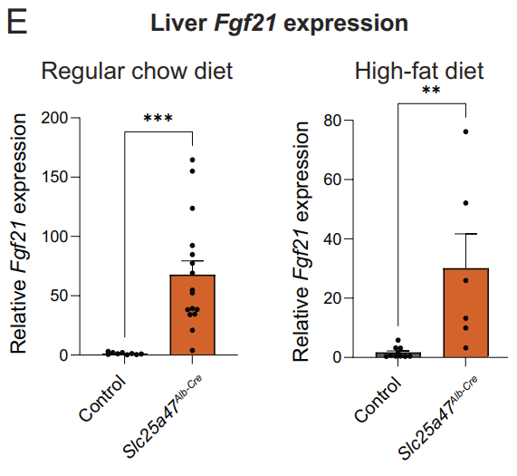
The increase in circulating FGF21 levels was due to elevated Fgf21 transcription in the liver

Slide 22
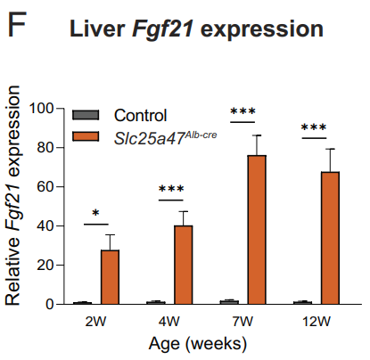
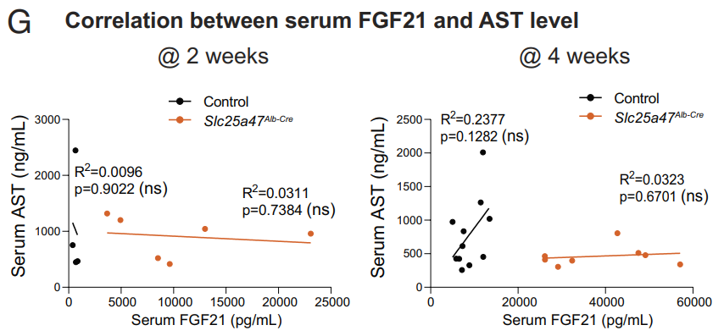
1.At 2 wk: elevated Fgf21 gene expression in Slc25a47^{Alb-Cre} 2. FGF21 & AST level : no correlation
AST : aspartate aminotransferase ALT : alanine aminotransferase
AST/ALT : The ratio between the concentrations of the enzymes AST and ALT in the blood of a human or animal.

Slide 23
Fig 3:
Depletion of SLC25A47 Led to Elevated Whole-Body Energy Expenditure.

Slide 24
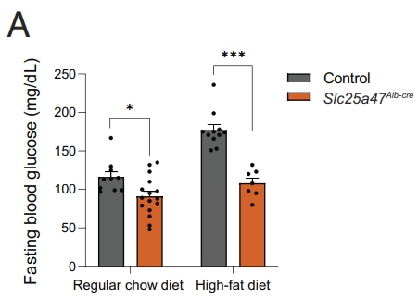
glucose levels: Slc25a47^{Alb-Cre}mice were < controls → to which SLC25A47 regulates systemic glucose homeostasis?

Slide 25
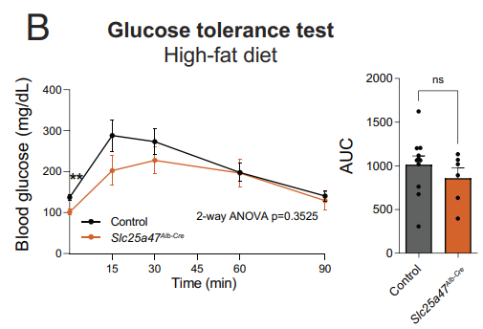
At 4 wk of high-fat diet, glucose tolerance : no major difference . (although fasting glucose levels : Slc25a47^{Alb-Cre} mice < control)
Glucose tolerant test : glucose is given and blood samples taken afterward to determine how quickly it is cleared from the blood.
AUC:Area under the curve

Slide 26
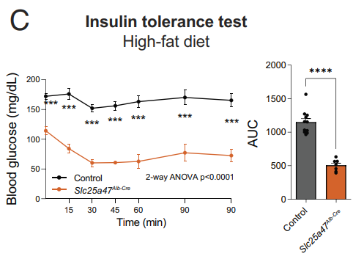
At 4 wk of high-fat diet, insulin tolerance : Slc25a47^{Alb-Cre} mice > control (low dose insulin) →Slc25a47^{Alb-Cre} mice remained hypoglycemic (<70mg/dL)
Insulin tolerant test : insulin is given and blood samples taken afterward to determine how quickly it is cleared from the blood.

Slide 27
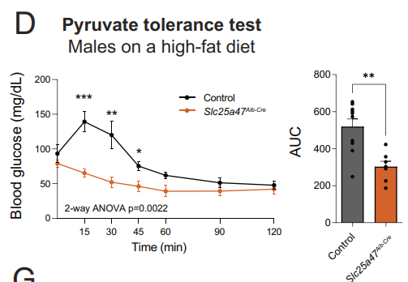
At 3 wk of high-fat diet, Pyruvate tolerance tests : Slc25a47 ^{Alb-Cre} mice < control mice →hepatic gluconeogenesis : Slc25a47 ^{Alb-Cre} mice < control mice
Pyruvate tolerant test:pyruvate is given and blood samples taken afterward to determine how quickly it is cleared from the blood.

Slide 28
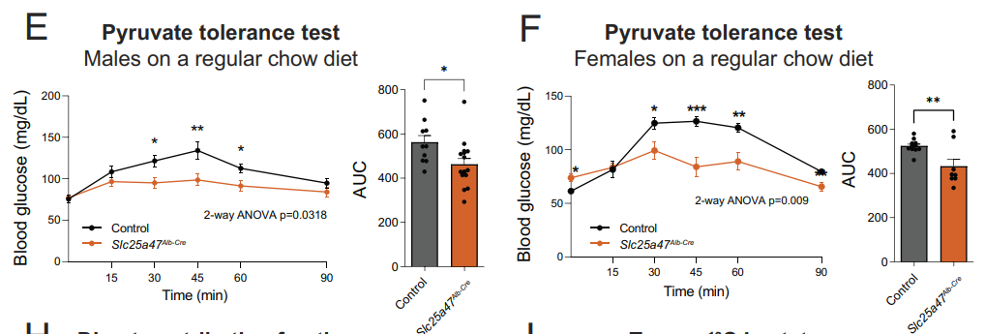
The difference in pyruvate tolerance was independent of diet and sex

Slide 29
Hypothesis:
lower fasting glucose levels seen in Slc25a47^{Alb-Cre} mice are attributed to reduced hepatic gluconeogenesis
(rather than impaired glycogenolysis or elevated insulin sensitivity in the skeletal muscle.)
To test the hypothesis:
examined the contribution of hepatic gluconeogenesis to circulating glucose by infusing fasted mice with U-13C-labeled lactate or 13C-labeled glucose

Slide 30
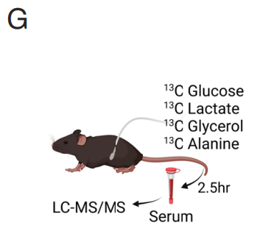
To examine the contribution of hepatic gluconeogenesis and its precursor, infused fasted mice with U-¹³C-labeled lactate/glucose/glycerol/alanine
1.Known:
circulating lactate is the primary contributor to gluconeogenesis and in rapid exchange with pyruvate
→ use ¹³C-lactate as a gluconeogenic precursor instead of pyruvate
2. During the infusion, we collected and analyzed serum from fasted mice using liquid-chromatography–mass spectrometry (LC–MS), as described in recent studies
LC-MS:
liquid-chromatography–mass spectrometry

Slide 31
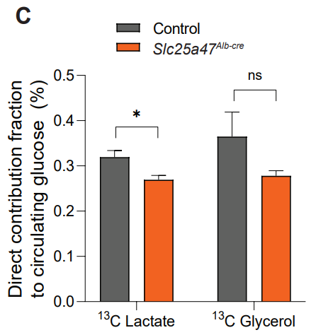
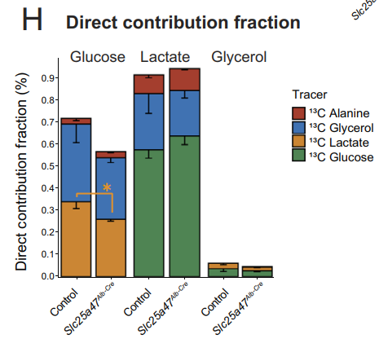
¹³C-lactate(orange)→glucose production : Slc25a47^{Alb-Cre} mice < control mice ¹³C-glycerol(blue)→glucose production: no significant difference ¹³C-alanine(red)→serum glucose: alanine << lactate
C-glucose → pyruvate : ns
C-glucose → lactate : ns

Slide 32
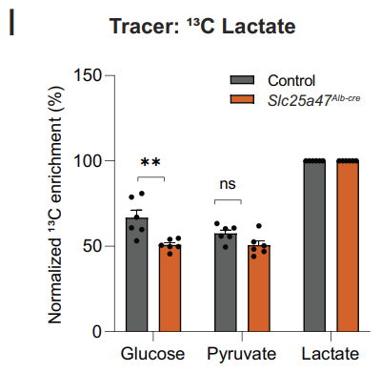
The lactate-to-pyruvate conversion was unaffected in Slc25a47^{Alb-Cre} mice →impaired gluconeogenesis from lactate is attributed to reduced pyruvate utilization in the liver

Slide 33
These results indicate that SLC25A47 is required selectively for gluconeogenesis from lactate under a fasted condition
Fig 4:
SLC25A47 Is Required for Pyruvate-Derived Hepatic Gluconeogenesis In Vivo.

Slide 34
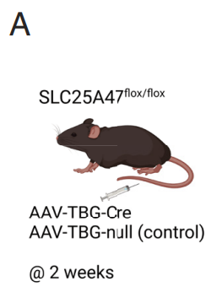
To exclude metabolic complications caused by chronic deletion of SLC25A47 →acutely depleted SLC25A47 in adult mice by delivering AAV-TBG-Cre or AAV-TBG-null (control) into the liver of Slc25a47flox/flox mice via tail-vein
AAV:adeno-associated virus
TBG: thyroxine binding globulin

Slide 35
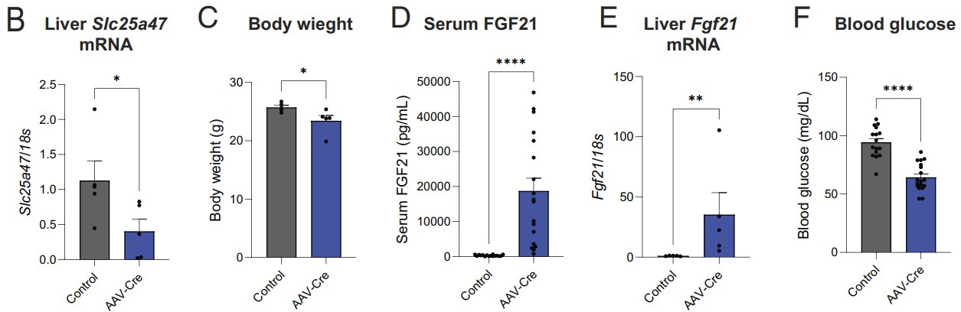
Glucose Homeostasis aspect:
2 wk after AAV injection
(50%)
Although 50% < 80%
Observe hepatic glucose production and energy expenditure avoiding metabolic complications associated with chronic SLC25A47 deletion
acute SLC25A47 depletion resulted in reduced fasting serum glucose levels (= energy expenditure)

Slide 36
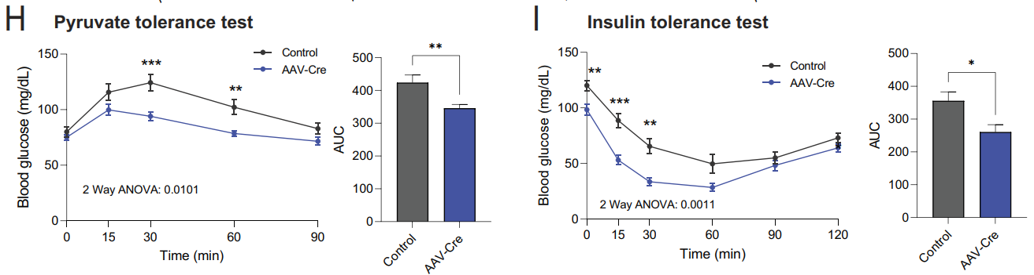
acute SLC25A47 depletion : pyruvate tolerance and insulin tolerance

Slide 37
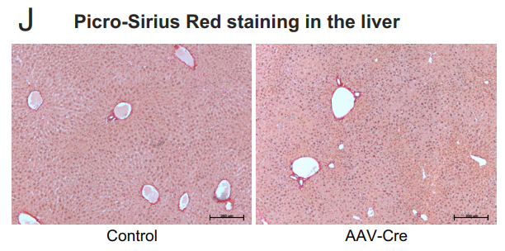
Tissue aspect: whether such metabolic changes were associated with liver injury in vivo? Histological analyses by Picro-Sirius Red staining did not find any noticeable sign of liver fibrosis

Slide 38
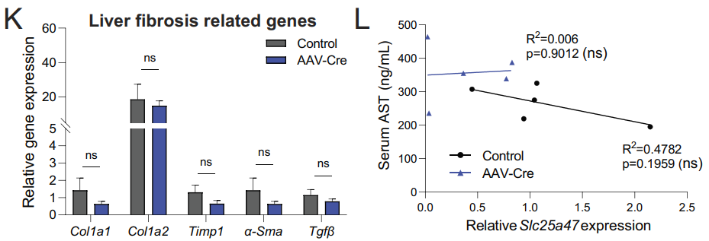
1.acute SLC25A47 depletion did not alter the expression of liver fibrosis marker genes 2.serum AST levels & hepatic SLC25A47 expression no significant correlation

Slide 39
These data suggest that acute SLC25A47 depletion sufficiently enhanced hepatic FGF21 expression, pyruvate tolerance, and insulin tolerance(independent of liver damage and hepatic mitochondrial dysfunction)
Fig 5B-I:
Acute Depletion of SLC25A47 Improved Glucose Homeostasis
Fig 5J-L:
Without Causing Liver Damage

Slide 40
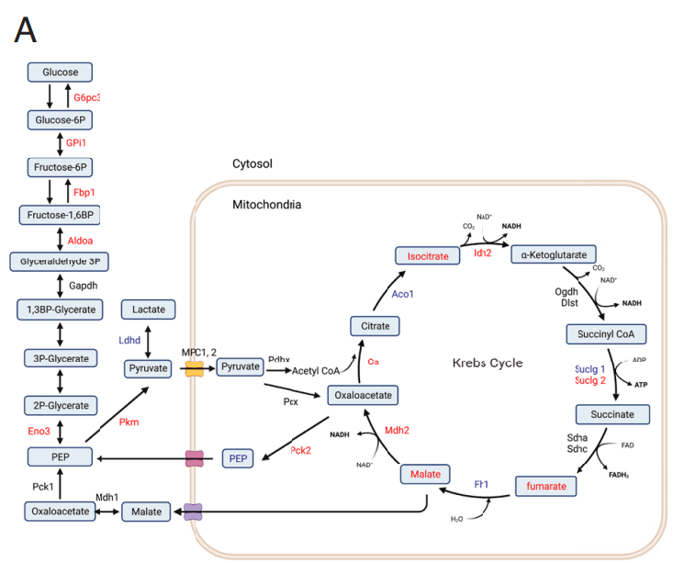
mitochondrial metabolomics analyses in the liver of Slc25a47^{Alb-Cre} mice and littermate controls under a fasted condition
which steps of the lactate-derived hepatic gluconeogenesis were altered in Slc25a47^{Alb-Cre} mice?
Red letters: up-regulated in Slc25a47Alb-Cre relative to controls Blue letters: down-regulated in Slc25a47Alb-Cre
Black letters: no statistical changes

Slide 41
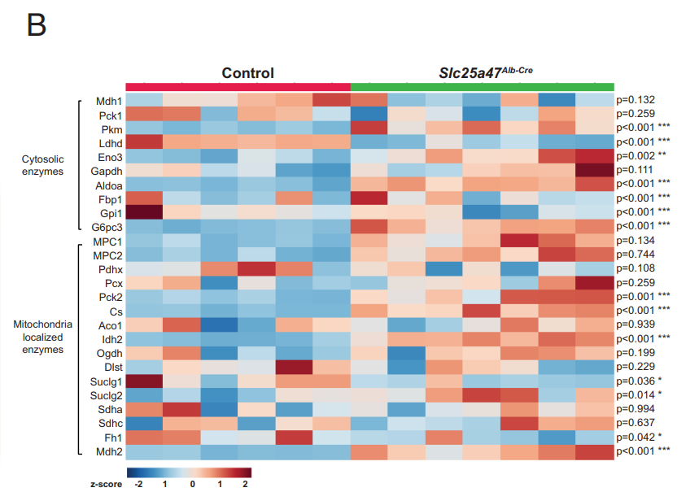
The RNA-seq data analysis : the liver of Slc25a47^{Alb-Cre} mice expressed significantly higher levels of Pkm, Eno3, Aldoa, Fbp1, Gpi1, and G6pc3
1. SLC25A47 loss leads to a distinct gene expression pattern of mitochondrial vs. cytosolic enzymes that control hepatic gluconeogenesis. mice.
2. MPC1 and MPC2 was not different between the genotypes
→pyruvate import?

Slide 42
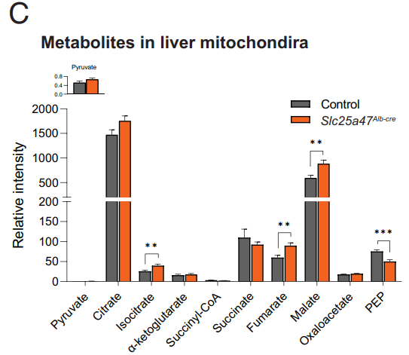
The mitochondrial metabolomics analysis accumulation of isocitrate, fumarate, and malate: mitochondria of Slc25a47^{Alb-Cre} > control →pyruvate flux?

Slide 43
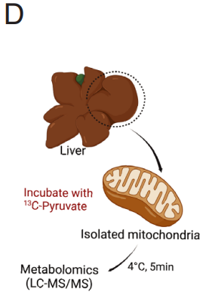
Hypothesis: SLC25A47 controls either pyruvate import to the mitochondrial matrix or pyruvate flux within the mitochondria. →isolated mitochondria from the liver of Slc25a47^{Alb-Cre} mice & littermate controls under a fasted condition, incubated with [U-¹³C] labeled pyruvate and subsequently analyzed by LC–MS/ MS

Slide 44
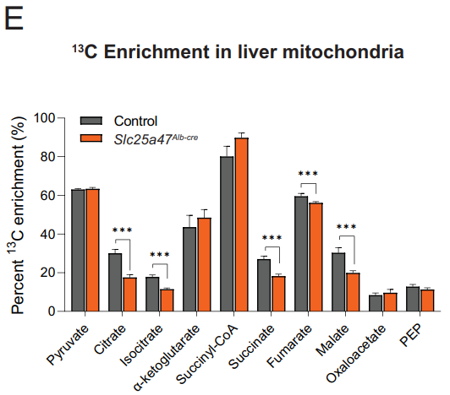
1. ¹³C-labeled pyruvate uptake per se was not altered in the liver of Slc25a47^{Alb-Cre} mice, it is in agreement with MPC1 and MPC2 was not different between the genotypes 3. ¹³C-labeled citrate, isocitrate, succinate, fumarate, and malate : Slc25a47^{Alb-Cre} mice < controls
per se : by or of itself
MPC : Mitochondrial pyruvate carrier

Slide 45

genetic loss of SLC25A47
→impaired mitochondrial pyruvate flux
→leading to an accumulation of fumarate, malate, and isocitrate in the liver mitochondria.
→Impaired export of malate from the mitochondria into the cytosolic compartment
→leads to reduced lactate-derived hepatic gluconeogenesis under a fasted condition
Fig 6:
SLC25A47 Is Required for Mitochondrial Pyruvate Flux and Malate Export.

Slide 46
Discuccion

Slide 47
However, the present study could not exclude the possibility that SLC25A47 mediates the transport of cofactors needed for mitochondrial pyruvate flux
Our future study aims to determine the specific substrate of SLC25A47 by biochemically reconstituting this protein in a cell-free system, such as liposomes
Our future study will explore the mechanisms through which SLC25A47-mediated mitochondrial signals control the nuclear-coded transcriptional program in a nutrition-dependent manner
With these results in mind, we consider that SLC25A47 is a plausible target for hyperglycemia and type 2 diabetes for the following reasons

Slide 48
END

Slide 49
Hypothesis : high energy expenditure might be the enhance of
1. thermogenic capacity of BAT
2.BAT sensitivity to β3-AR signaling
→examining BAT thermogenesis in response to a β3-AR agonist (CL316,243) at 30 °C.
→a single administration of β3-AR agonist (CL316,243) at 0.5 mg/kg (high dose) potently increased whole-body energy expenditure both in Slc25a47^{Alb-Cre} and littermate controls to a similar degree
This result suggests that the cell-intrinsic thermogenic capacity of BAT appears comparable between the two groups.(if maximumly activated by a β3-AR stimulus)
β3-AR : β3-adrenergic receptor

Slide 50
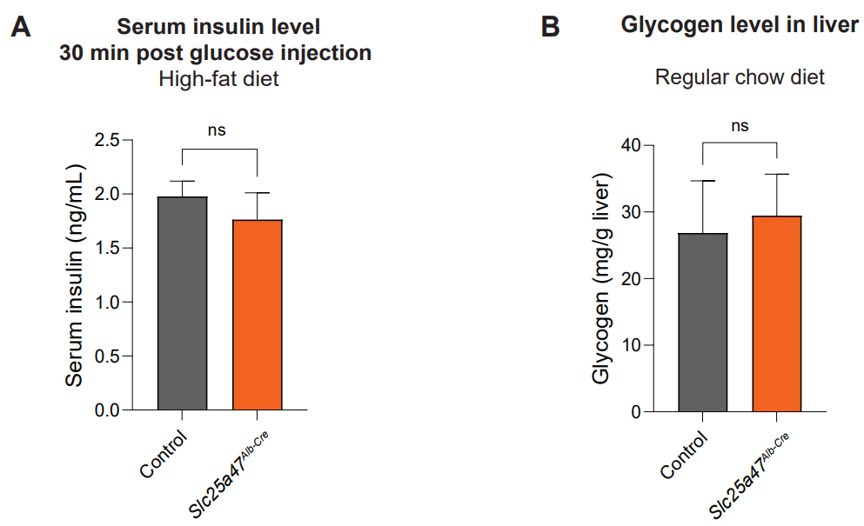
//On the other hand, there was no difference in glucose-stimulated serum insulin levels and hepatic glycogen contents between the two groups

