Slide 1
NBA player data comparison (終於找到五個人)

Slide 2
Work distribution
Member | Student ID
許家和 | 407210046
王宇軒 | 408420001
陳韋丞 | 408420069
周韋良 | 408420082
黃國琨 | 409220042

Slide 3
Database System Introduction
This database system is based on the purpose to compare each player’s performance in NBA.
What we have done is to make a program that can deal with all the data we are interested in by controlling functions we made.

Slide 4
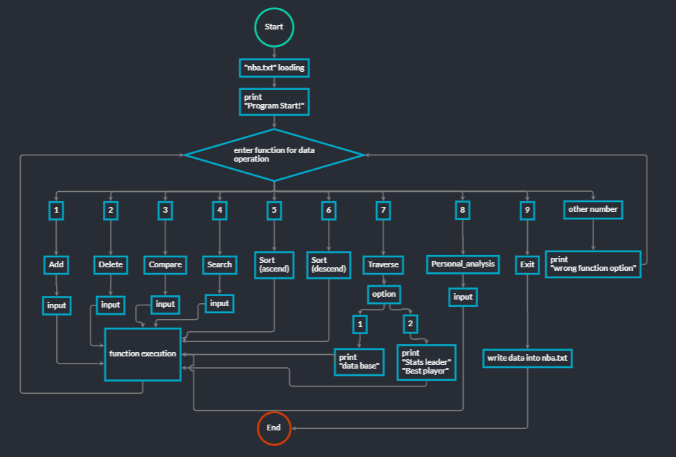
Program Design

Slide 5
Function Introduction
0.Background
1.Add
2.Delete
3.Compare
4.Search
5.Sort (ascend)
6.Sort (descend)
7.Traverse
8.Personal_analysis
9.Exit

Slide 6
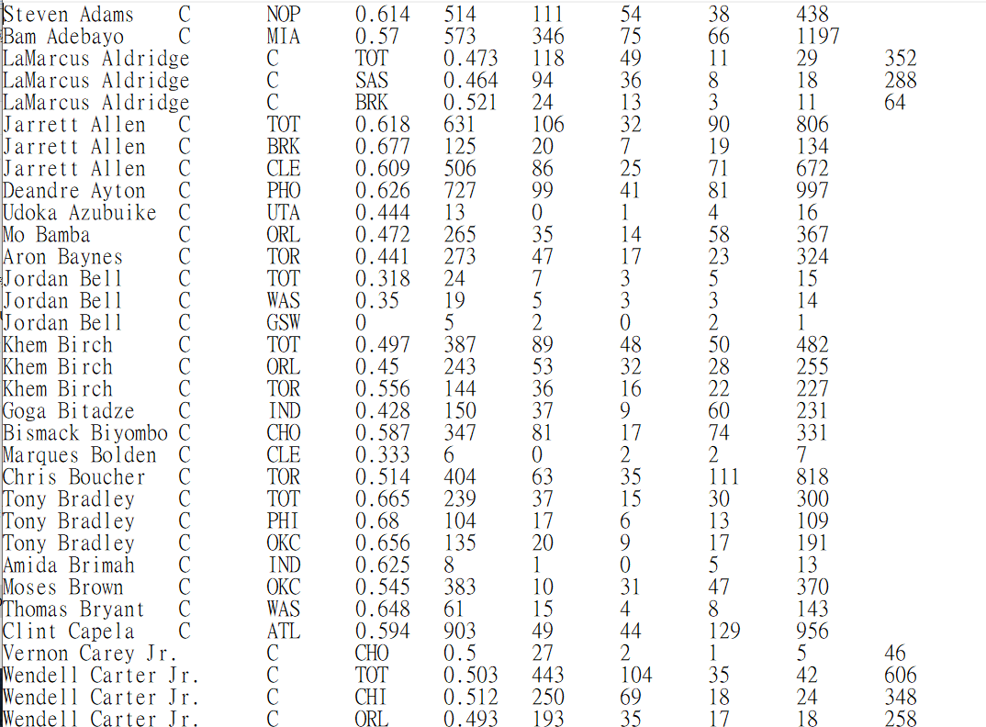
0.nba.txt (~700 data) as database

Slide 7
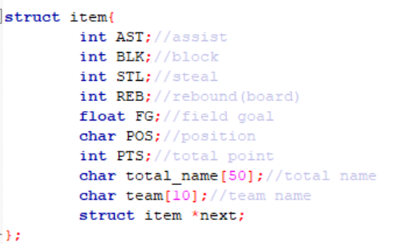
0.Structure Item (Record Item Type)

Slide 8
1.Add (database , new_member);
Function:
Add a new item to the database system.
How to use:
input 1, then input each item type for a player

Slide 9
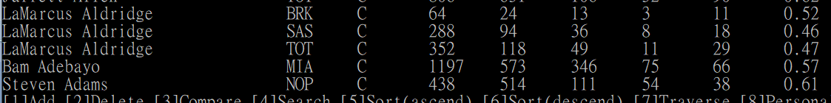
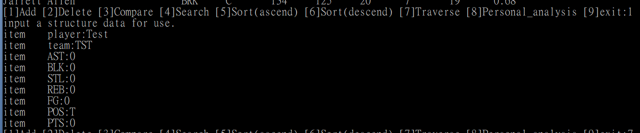
Example

Slide 10
2.Delete(database,target_name);
Function:
Delete a given item from the database.
How to use:
input 2, then input a player's name, and then choose the team for the player

Slide 11
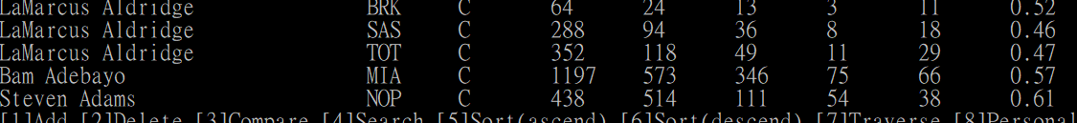
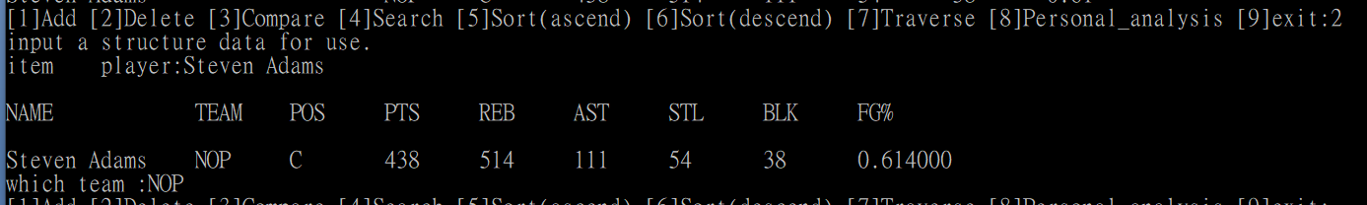
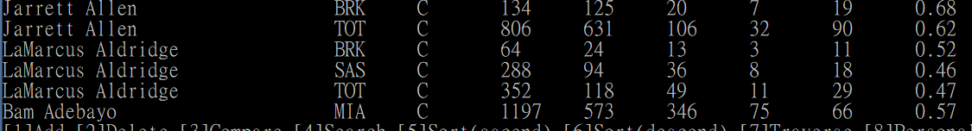
Example

Slide 12
3.Compare(database,player1,player2);
Function:
Compare two data between 2 players
How to use:
input 3, then input first player's name, then input second player's name then input the correct team for player1,player2 respectively

Slide 13
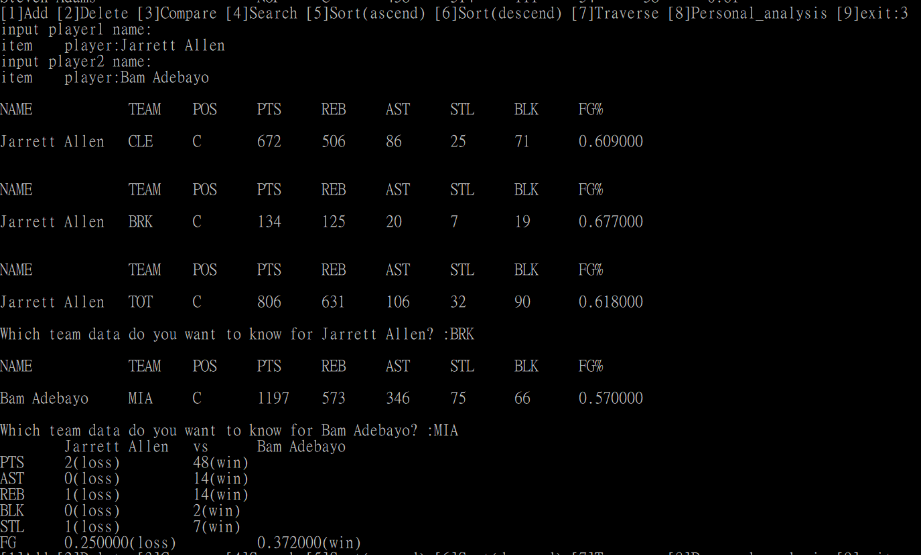
Example

Slide 14
4.Search(item_type,datum);
Function:
Given certain information about the item, the program needs to find and print the specific item.
How to use
input 4, then input item type(NAME,TEAM,POS), then input datum for the item type

Slide 15
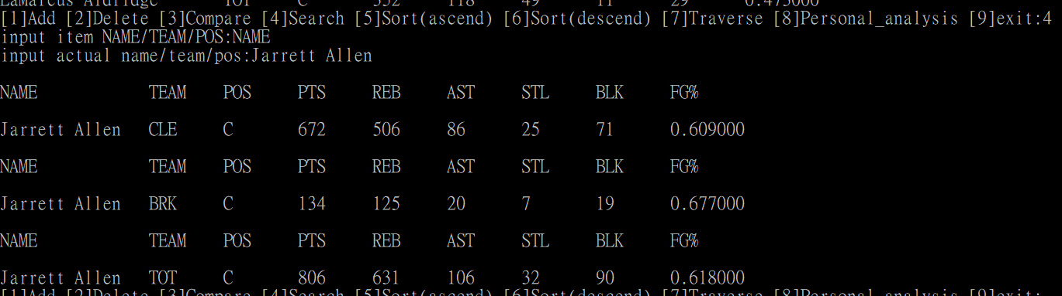
Example

Slide 16
5.6.Sort(database,item_type);
Function*2:
sort data in ascend or descend form
How to use
input 5/6, then input a item type

Slide 17
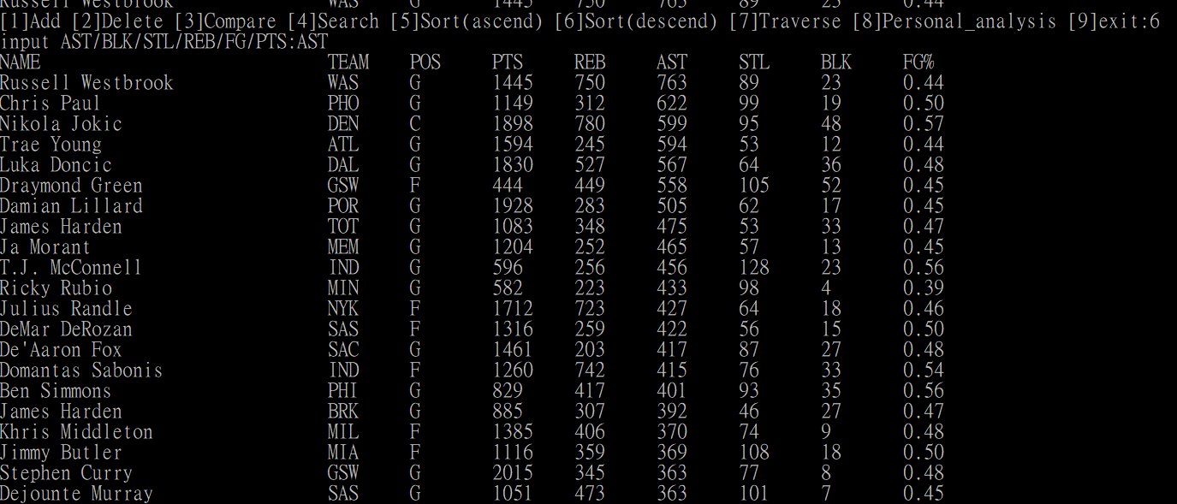
Example

Slide 18
7.Traverse(database);
Function:
Print all items in the database in a specific format.
How to use
input 7,then input 1 for all database;2 for bestplayer and five highest for each item type

Slide 19
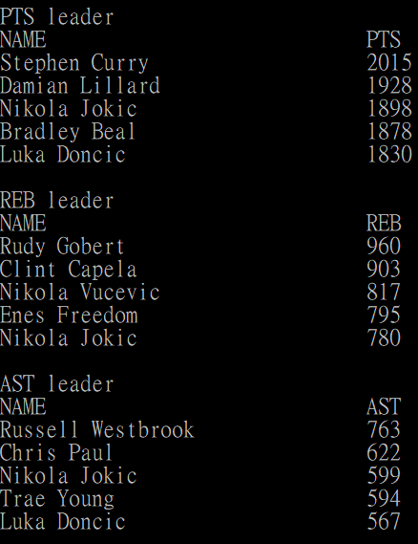
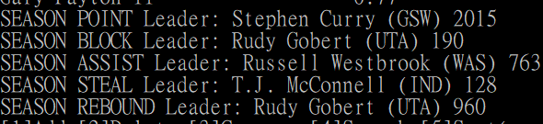
Example

Slide 20
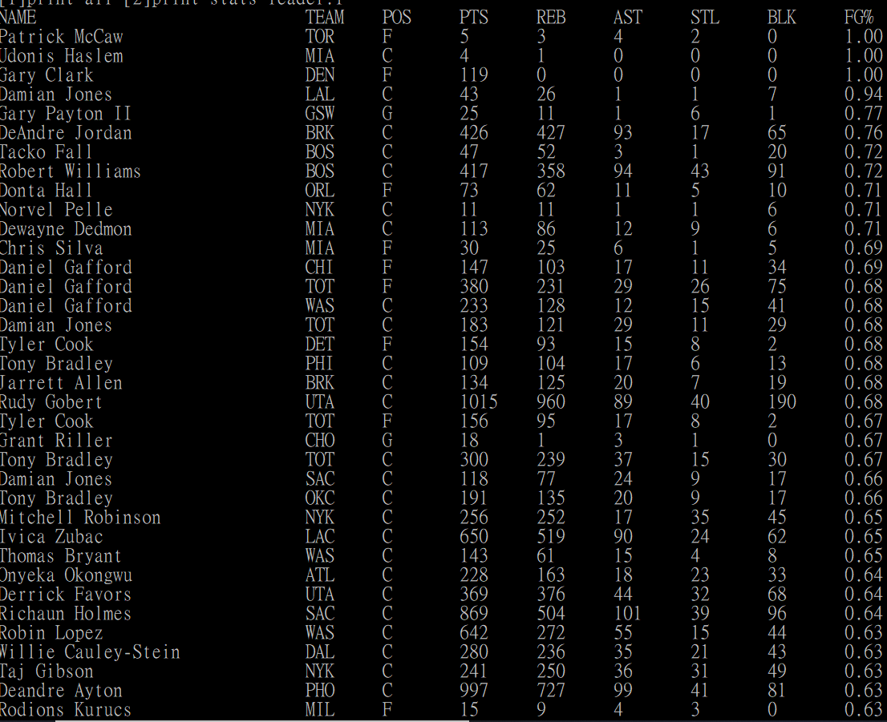
Example

Slide 21
8.Personal_analysis(database);
Function:
Analyze the player’s data in each team he stayed .
How to use
input 8,then input player's name, then input item_type, and then choose ascend or descend form for data

Slide 22
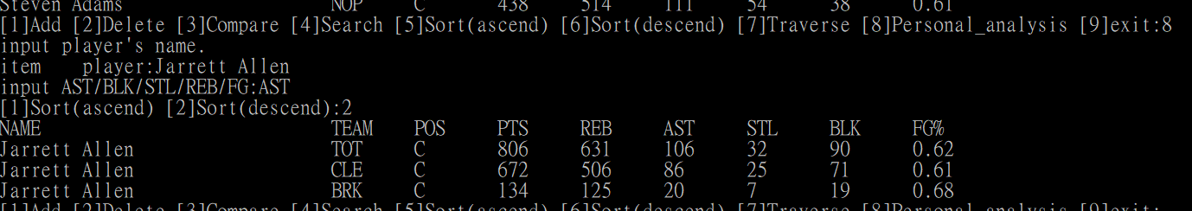
Example

Slide 23
9.Exit(database);
Function:
Terminates the program
How to use
input 9

Slide 24
Example

Slide 25
END

