Slide 1
Plot Distribution
HY

Slide 2
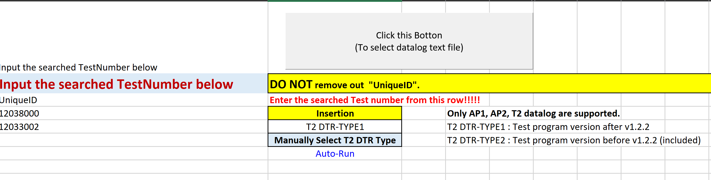
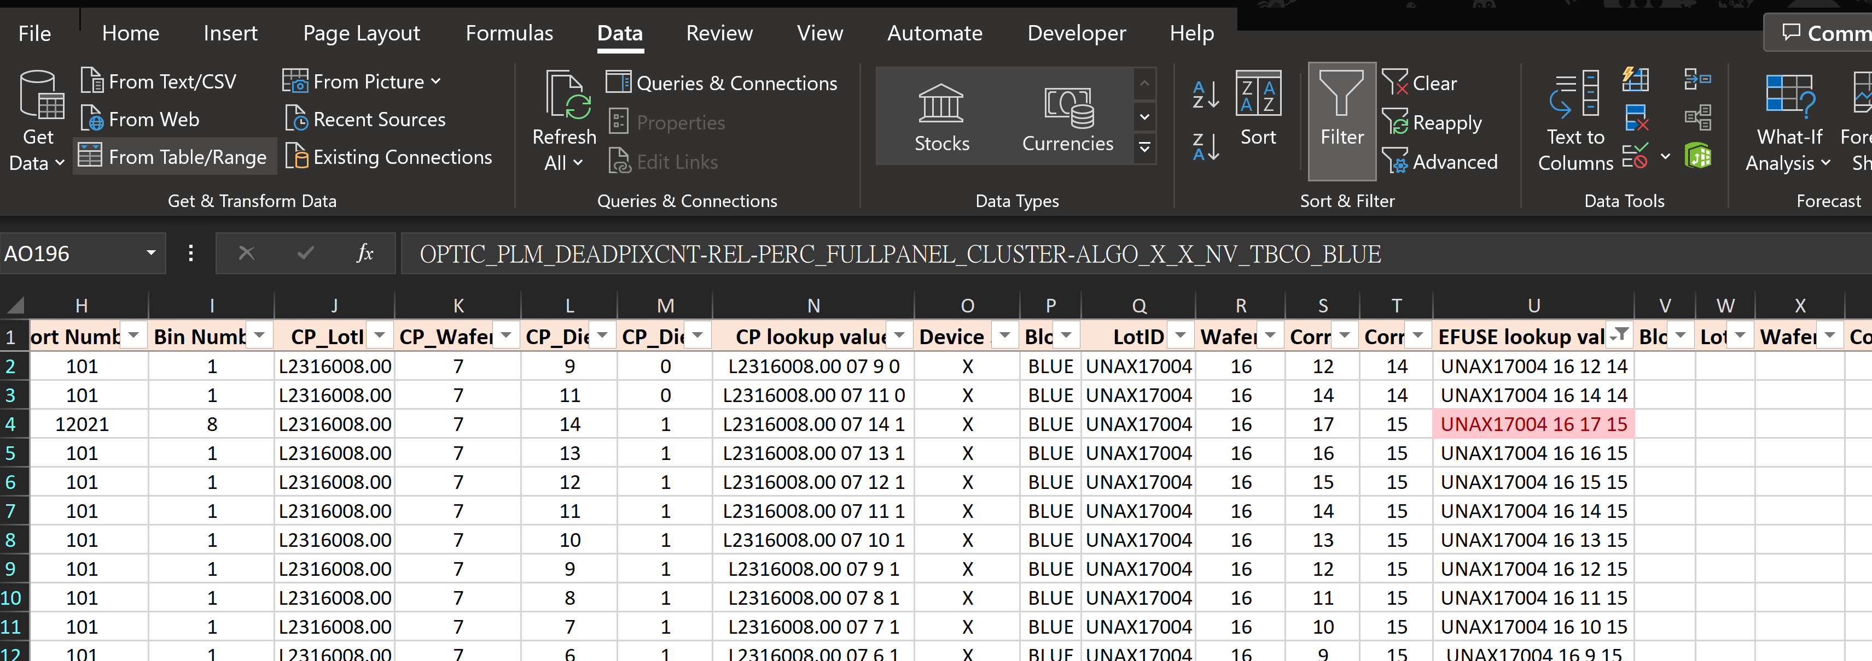

Data preparing
Need to use the EfuseID_Sorting_Tool to get data.
Summary report need to remove duplicates row.(Need to reserve retest data, not first data.)

Slide 3
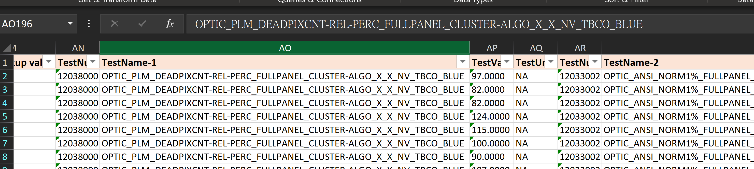
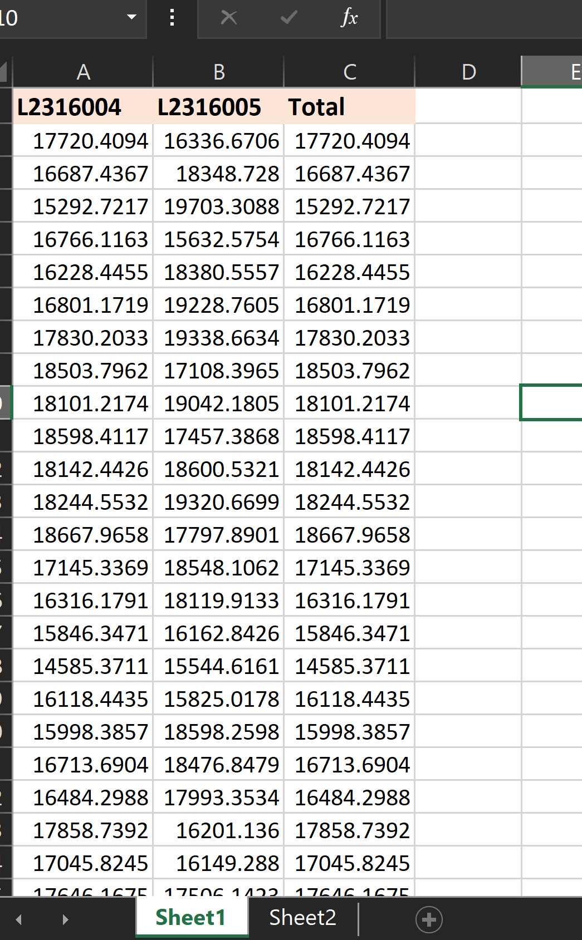
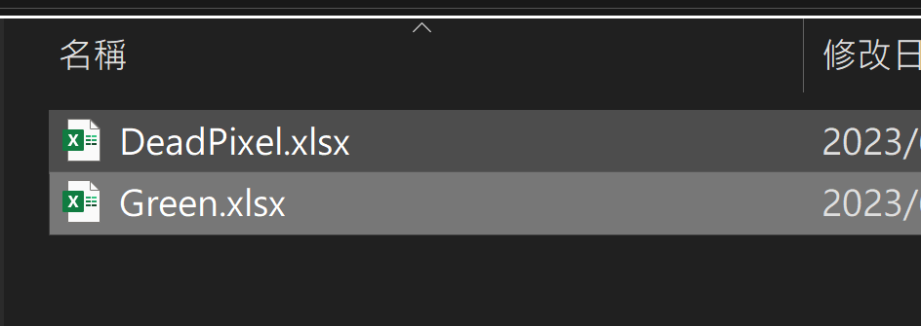
Data preparing
Past the Value into new excel sheet. (ps. Need to use “Sheet1”)
New Excel File

Slide 4
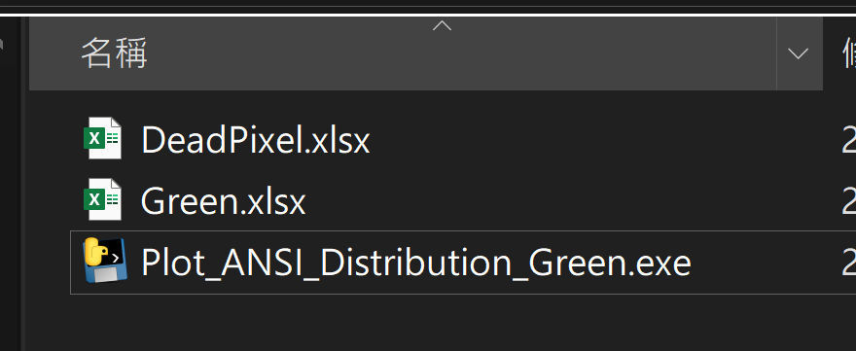
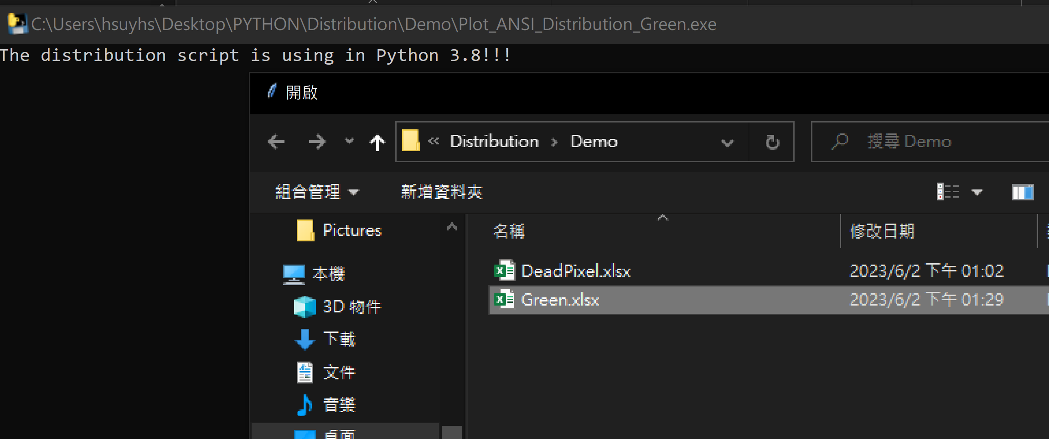
Data preparing
By different data, you can use the .exe to plot the distribution and get summary log.
Open your select file

Slide 5
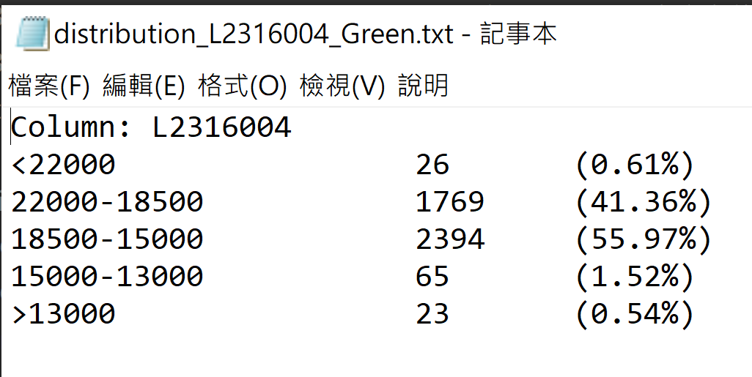
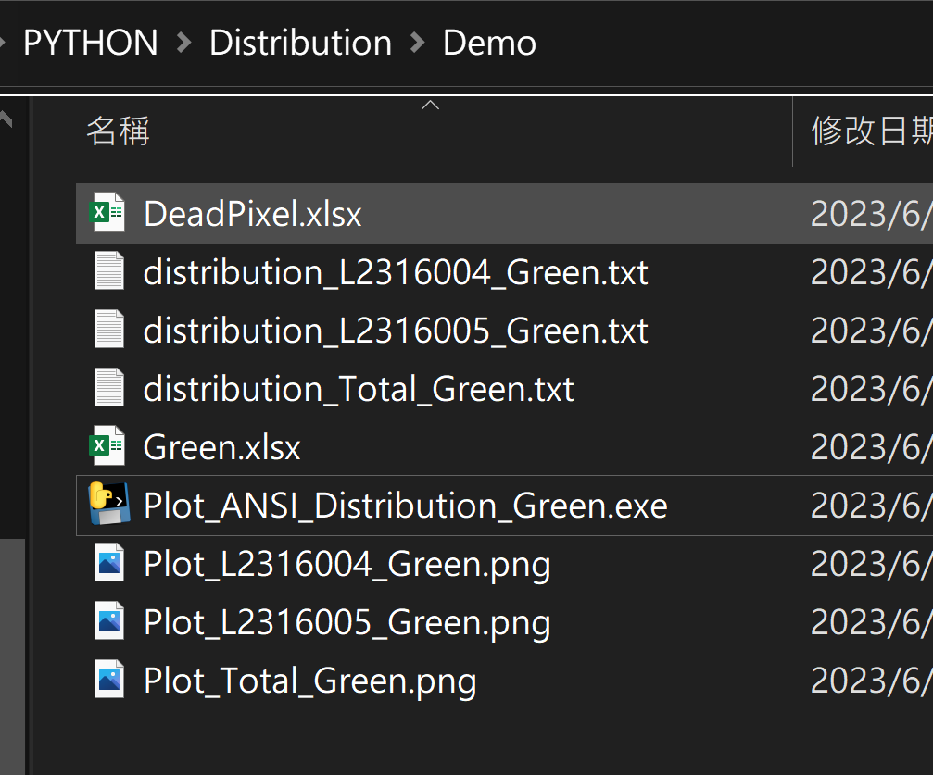
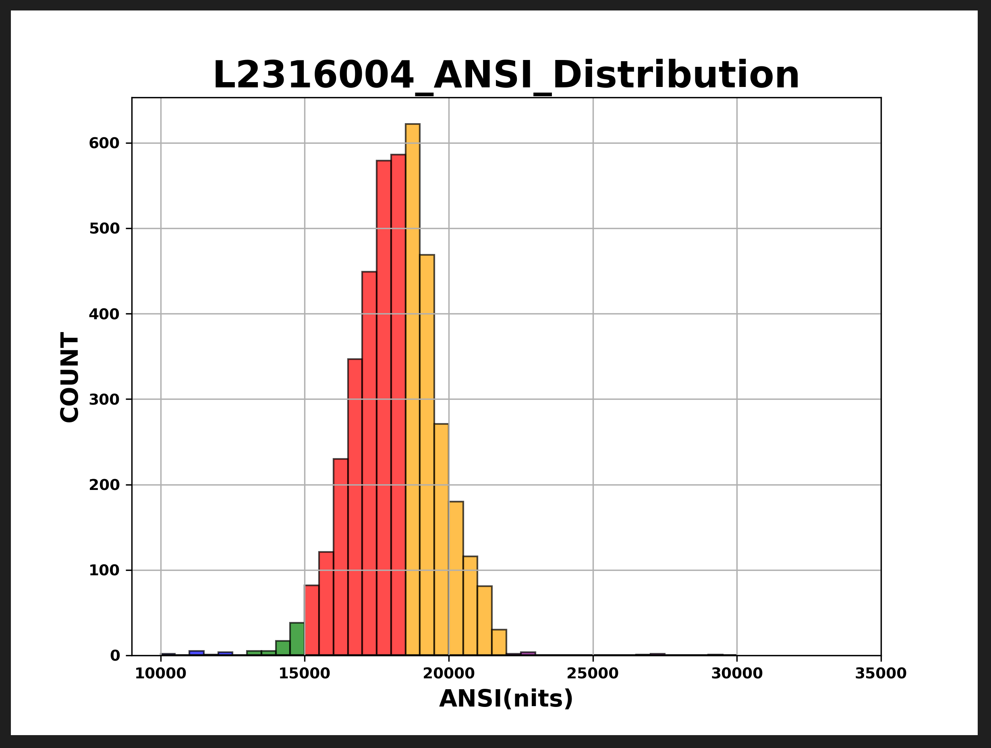
Data preparing
By different data, you can use the .exe to plot the distribution and get summary log.

Slide 6
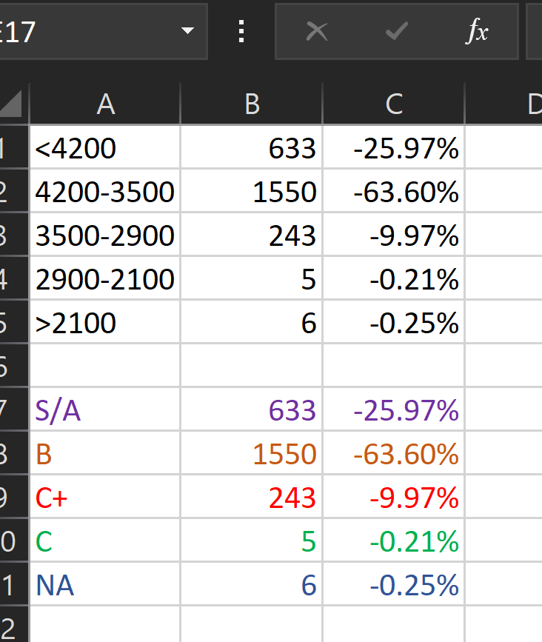
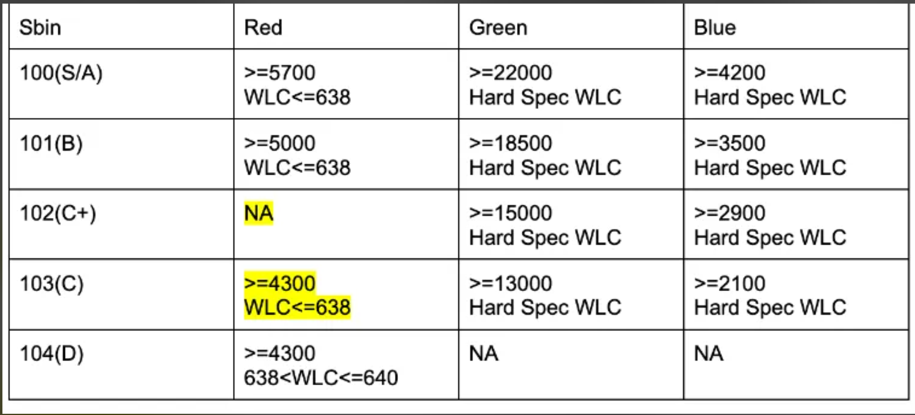
Data preparing
Post the chart and summary data into ppt
First : copy summary data into excel and modify color and title as below:
(Purple , Orange , Red , Green , Blue)
Example color blue
Meta criteria for different color

Slide 7
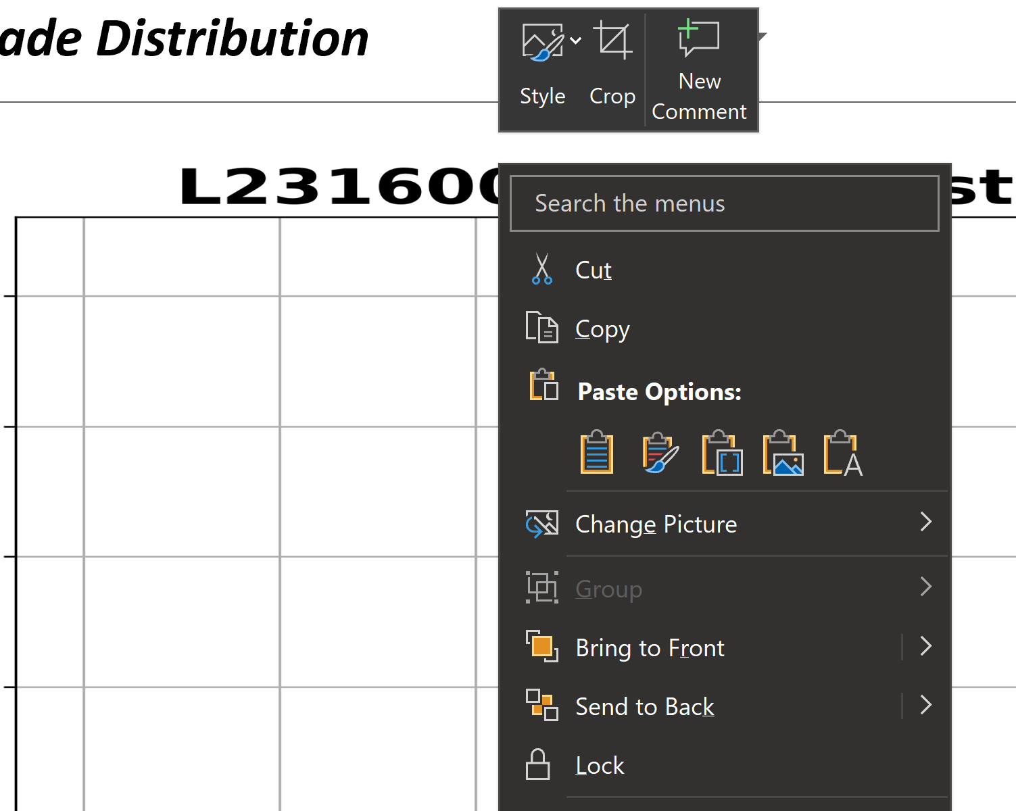
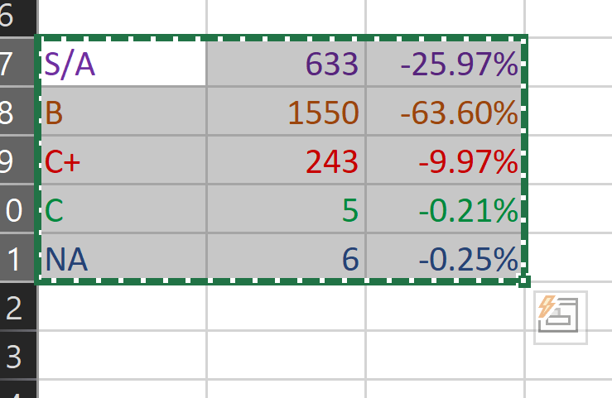
Data preparing
Post the chart and summary data into ppt
Second: Copy into PPT( Use “Keep source formatting”)
Excel copy

Slide 8
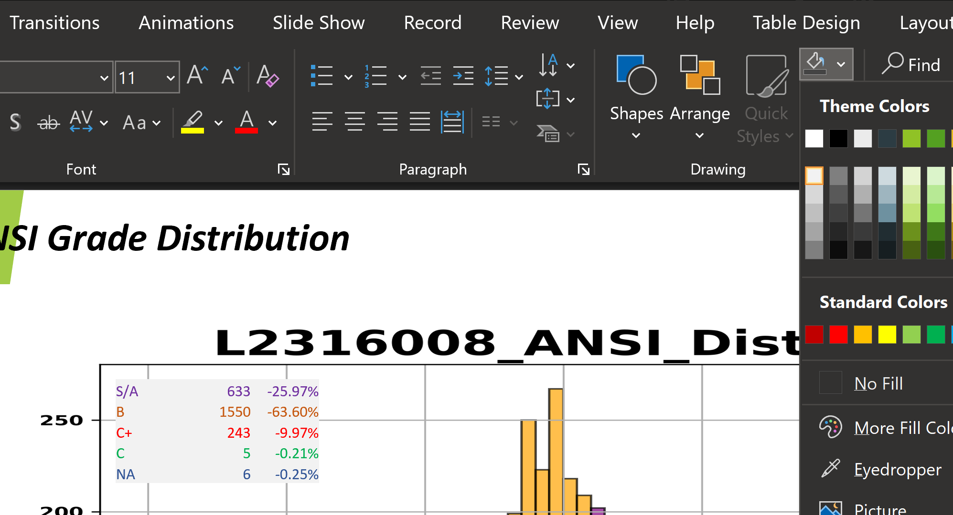
Data preparing
Post the chart and summary data into ppt
Third: Change the background color and move to your like location.

