Slide 1
RGPT2:
Rap Generator Based on GPT-2
Kurtis Shen
&
Hsueh-Yi Lu
Dec. 12, 2022

Slide 2
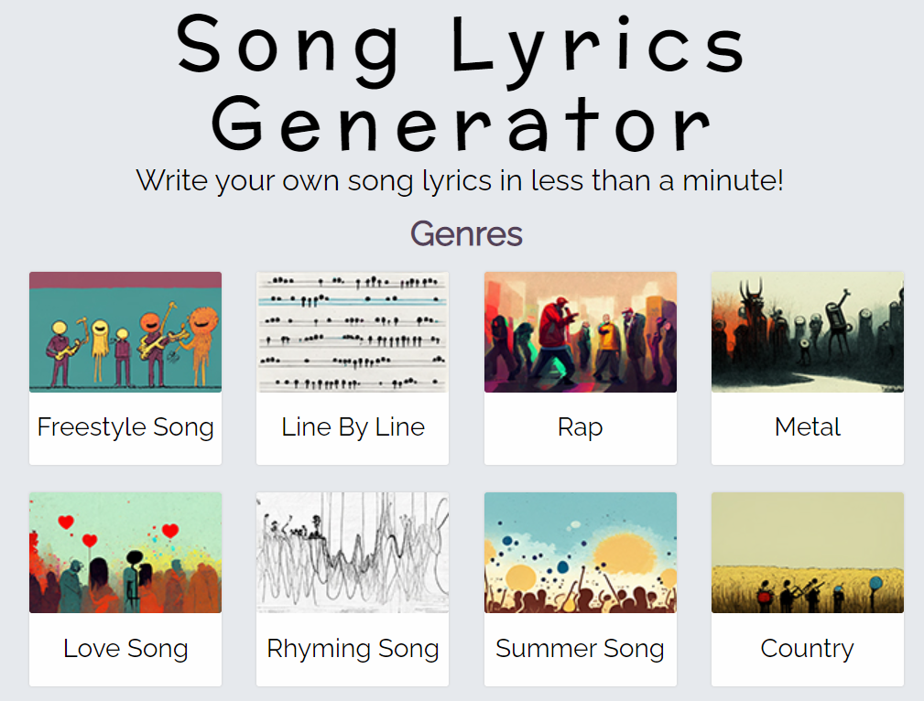
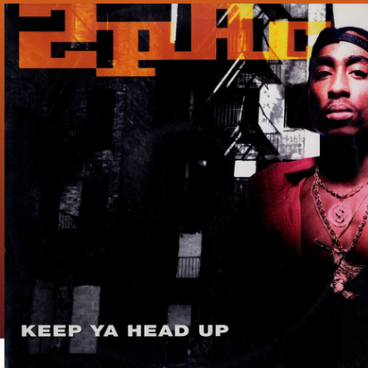
Project Introduction

Slide 3
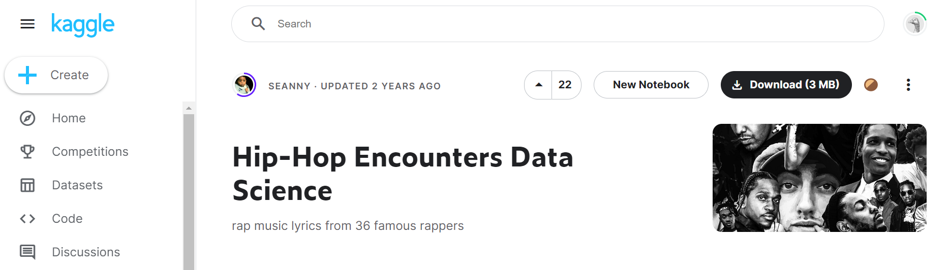
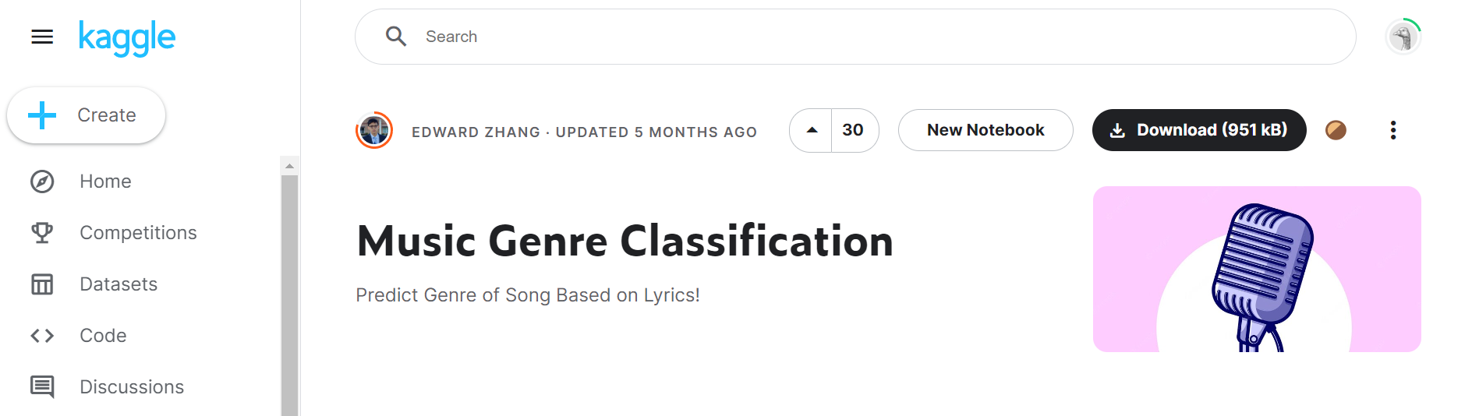
Datasets

Slide 4
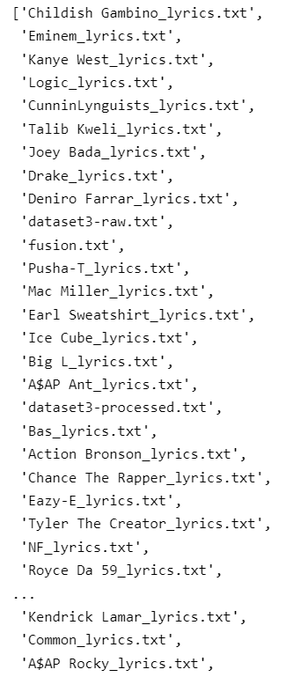
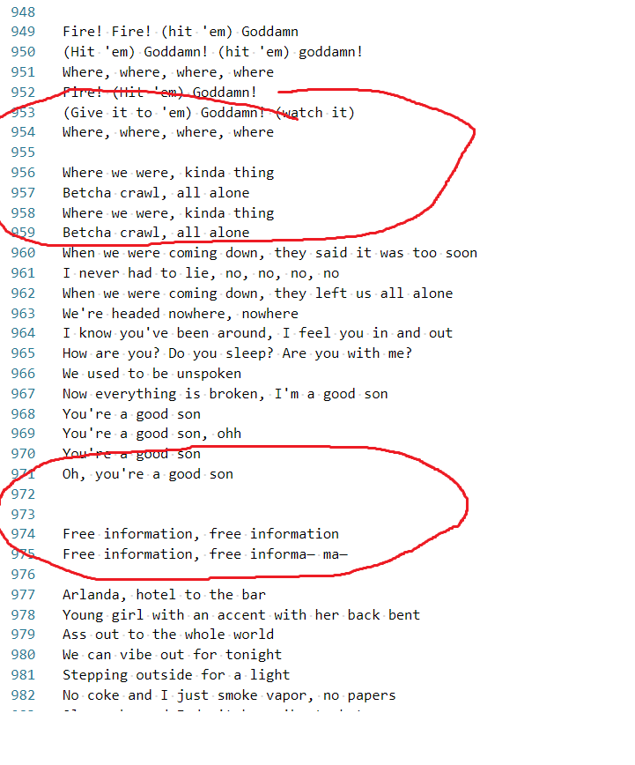
Dataset
Rap Lyrics
39 Artists in total
Training sample: 30493
Validation sample: 7624

Slide 5
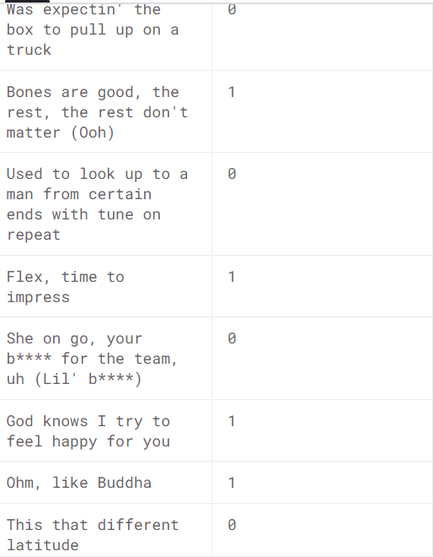
Dataset
Lyrics of pop & rap
51054 samples
pop music (1) : 22169
rap music (0) : 28885

Slide 6
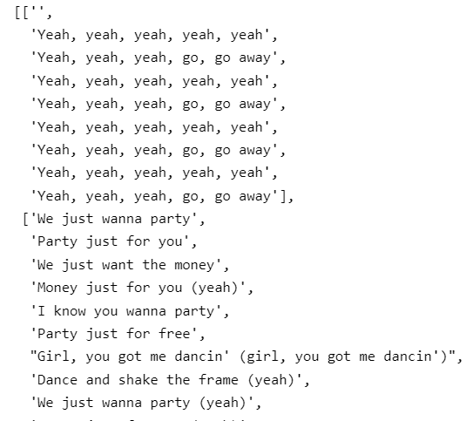
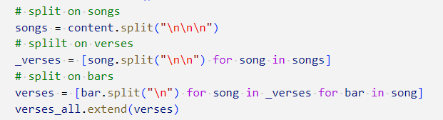
Post-Processed Data

Slide 7

GPT2
Generative Pre-trained Transformer 2 (GPT-2) is an open-source artificial intelligence created by OpenAI in February 2019.
GPT-2 translates text, answers questions, summarizes passages, and generates text output
The GPT architecture implements a deep neural network, specifically a transformer model,which uses attention in place of previous recurrence- and convolution-based architectures..
Notes:
GPT-2 (a successor to GPT), was trained simply to predict the next word in 40GB of Internet text. Due to our concerns about malicious applications of the technology, we are not releasing the trained model. As an experiment in responsible disclosure, we are instead releasing a much smaller model for researchers to experiment with, as well as a technical paper.
GPT-2 展示了一系列廣泛的功能，包括生成質量前所未有的條件合成文本樣本的能力，我們在其中為模型提供輸入，並讓它生成一個冗長的延續。此外，GPT-2 優於其他在特定領域（如維基百科、新聞或書籍）上訓練的語言模型，而無需使用這些特定領域的訓練數據集。在諸如問答、閱讀理解、總結和翻譯等語言任務上，GPT-2 開始從原始文本中學習這些任務，不使用特定於任務的訓練數據。雖然這些下游任務的分數遠非最先進，但它們表明，如果有足夠的（未標記的）數據和計算，這些任務可以受益於無監督技術。

Slide 8
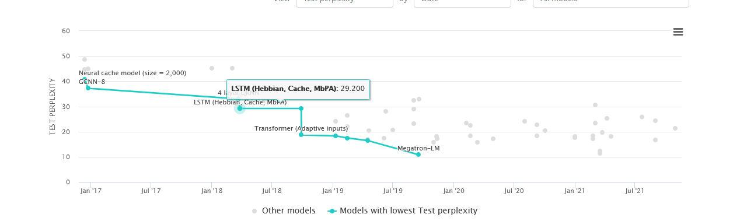
State-Of-Art Language Model
(Language Modelling on WikiText-103, n.d.)

Slide 9
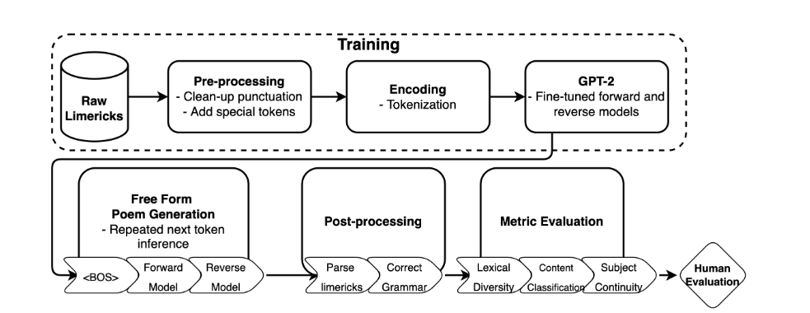
Task FLow
(Lo, Ariss, & Kurz, 2022)

Slide 10
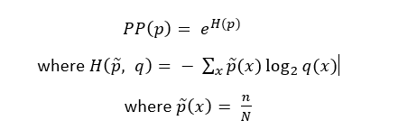
Perplexity

Slide 11
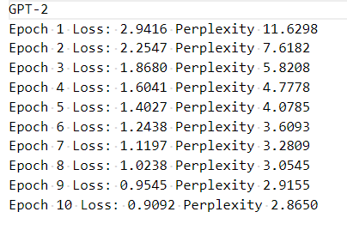
Metrics

Slide 12
Generating
Standard Model Generating The First Verse
Who would have dreamed this You couldn’t mean this
Using only the first bar
Who would have dreamed this You couldn’t mean this <LINE> It would be some type of meanness to where you are <LINE> ‘Cause I don’t know where to go <LINE> And no one else seems to Know <LINE> And no one else seems to know <LINE> Yeah, and … <LINE> We last : below down <LINE> We got louder, louder, louder <LINE> Louder, derlou
Generated Verse
Who would have dreamed this You couldn’t mean this <LINE> It would be some type of meanness to where you are <LINE> ‘Cause I don’t know where to go <LINE> And no one else seems to know <LINE> ‘Cause I don’t know where to go <LINE> And no one else seems to know <LINE> Yeah, and …
Processed Generated Verse

Slide 13
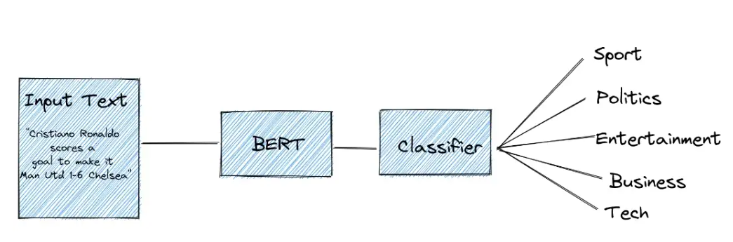
Text Classifier
SUBTITLE

Slide 14
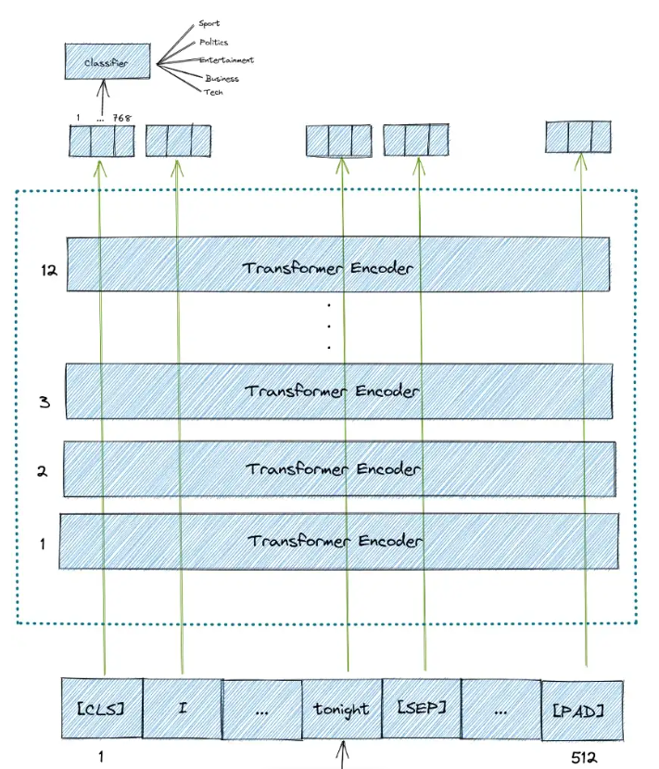
BERT
Bidirectional Encoder Representations from Transformers (BERT)
a transformer-based machine learning technique for natural language processing (NLP) pre-training developed by Google
It is pre-trained on unlabeled data extracted from BooksCorpus, which has 800M words, and from Wikipedia, which has 2,500M words.
As the name suggests, it is pre-trained by utilizing the bidirectional nature of the encoder stacks. This means that BERT learns information from a sequence of words not only from left to right, but also from right to left.

Slide 15
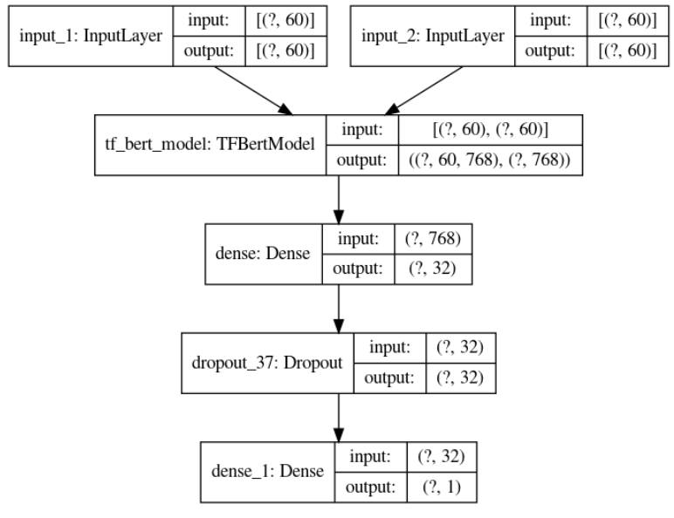
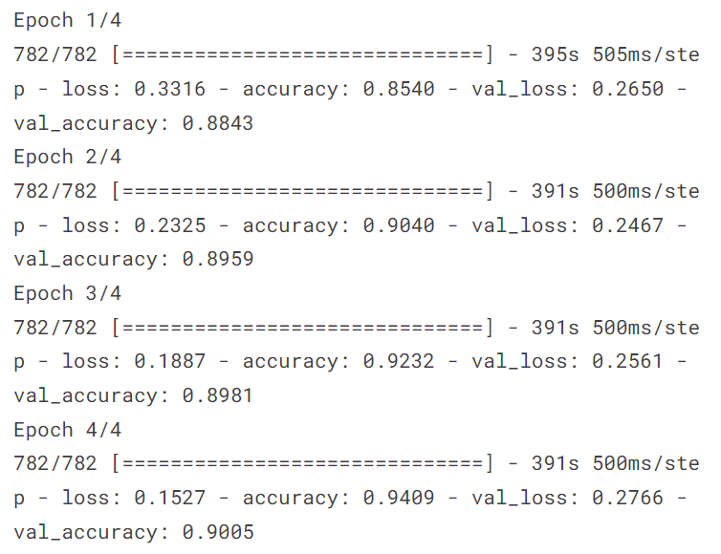
Training

Slide 16
Results
(Let them know!) Do you (Let them know!) Do you (Let them know!) Know who you fucking with? Know who you fucking with? Do you (Let them know!) Do you (Let them know!) Know who you fucking with? Know who you fucking with? Always (Always!) Always (Always!)
We gon' roll up, we gon' roll up We gon' roll up, we gon' roll up We gon' roll up, we gon' roll up Do you like feel me? We gon' roll up, roll up Back up, rolled up, rolled up
Now back to the story about the bitches And tell how this kid went from right to riches Now he's drivin' fancy cars gettin' bitches galore He was a dirty little boy that I knew next door He was a dirty little boy that I even knock on the next door
This shit is a gift I never felt so alive I never felt so alive I never felt so alive (I never felt so alive) I never felt so alive (I never felt so alive)
Come on, yeah (repeat 10X) Standing, hold me down for my Jesus Come on, yeah (repeat 10X) Standing, hold me down for my Jesus Standing, hold me down for my Jesus (repeat 10X)
pop : 7
(13%)
rap : 45 (86%)

Slide 17
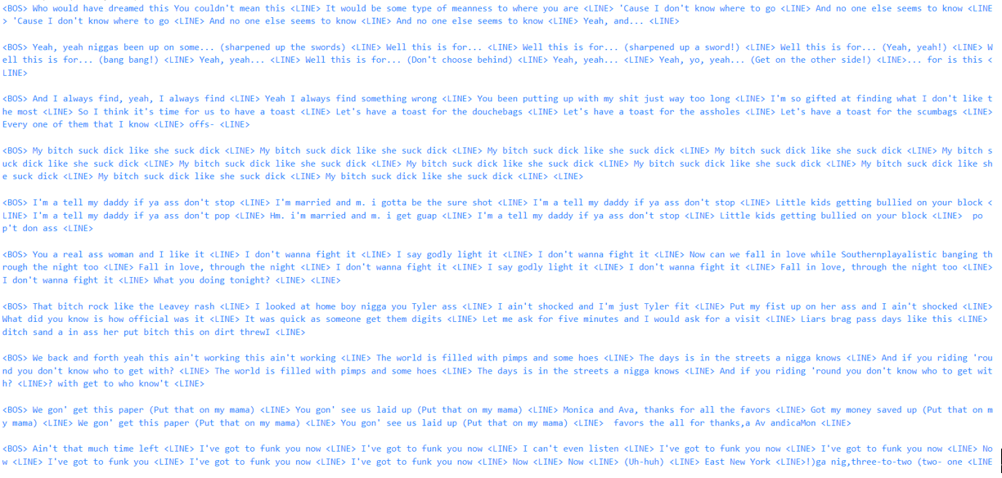
Conclusion
SUBTITLE

Slide 18



Future Works
More Qualitative Results
—Limerick Rhyming Structure Performance
Dataset samples
Notes:
syntactically correct (i.e. correct grammar, valid words, valid punctuation and capitalization)
lexically diverse (i.e. not be overly repetitious and have a high ratio of unique poems to overall tokens in a poem

Slide 19
References
References
Language Modelling on WikiText-103. (n.d.). Retrieved from PaperWithCode: https://paperswithcode.com/sota/language-modelling-on-wikitext-103
Lo, K.-L., Ariss, R., & Kurz, P. (2022, 5 18). GPoeT-2: A GPT-2 Based Poem Generator. Retrieved from arxiv: https://arxiv.org/abs/2205.08847

Slide 20
Q & A

Slide 21
THE END
ENJOY WINTER BREAK !!!!!!!
ε≡ﾍ( ´∀`)ﾉ
♡(*´∀｀*)人(*´∀｀*)♡ ─=≡Σ((( つ•̀ω•́)=c＜一ω<))
ヽ(∀ﾟ )人(ﾟ∀ﾟ)人( ﾟ∀)人(∀ﾟ )人(ﾟ∀ﾟ)人( ﾟ∀)ﾉ
⎝(◕u◕)⎠
｡:.ﾟヽ(*´∀`)ﾉﾟ.:｡ (“￣▽￣)-o█ █o-(￣▽￣”)/ ﾚ(ﾟ∀ﾟ;)ﾍ ﾍ( ﾟ∀ﾟ;)ﾉ (ΦωΦ)
( ﾟ∀ﾟ)つ≡≡≡♡♡♡)`ν゜)ｸﾞｼｬ ༼ つ/̵͇̿̿/’̿’̿ ̿ ̿̿ ̿̿◕ _◕ ༽つ/̵͇̿̿/’̿’̿ ̿ ̿̿ ̿̿ ̿̿ (́순◞౪◟순‵)

