Slide 1
SimpleDB Overview & Lab 0 Introduction
Zihao Xu

Slide 2
What is SimpleDB?
A basic database system developed by Sam Madden and others from MIT，written in Java
Main components
Heap files (Lab 1)
Buffer Pool (Labs 1-5)
Basic Operators (Labs 1 & 3)
Scan, Filter, Join, Aggregate
B-Tree Indexes (Labs 2)
Query optimizer (Lab 4)
Transaction (Lab 5)
Javadoc is your friend!
Grade Test will be provided
Notes:
Heap file: 普通的数据库存储文件形式
Buffer pool: 存储层次结构带来的产物，数据块的放置，识别，替换，写入（写回）
BO：一些基本算子，关系算子的具象化
B-Tree: 新的索引，加速增、删、改、查
Transaction: 多线程相关问题，死锁等，高并发，一组数据库动作被称为一个transaction，要么全做，要么一个都不做
Query optimizer: 优化查询

Slide 3
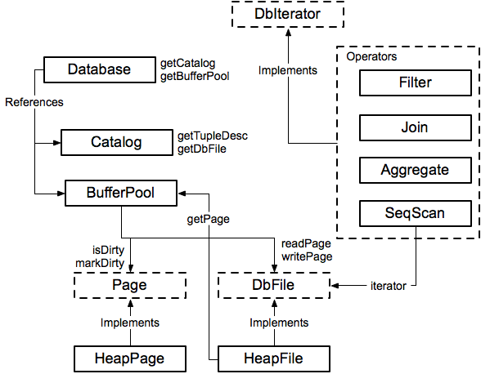
Module Diagram
Notes:
Entity relation model? 笑。。

Slide 4
SimpleDB
Score (100%):
Lab 0: 0%
Lab 1-4: 17.5% each
Lab 5: 30%

Slide 5
SimpleDB
Use:
Jave for code
Github for submission
Azure Pipeline for self check
Working pipeline:
Write code -> Test locally -> Upload code to github -> Use azure pipeline to get estimated results on grading system
Notes:
解释一下为什么要用Azure pipeline：充当虚拟机的角色，可以持续地获取你的代码并且部署在任意平台上

Slide 6
SimpleDB
Our evaluation platform:
Ubuntu 16.04
JDK 1.8 (openjdk-8)
Notes:
解释一下为什么要用Azure pipeline：充当虚拟机的角色

Slide 7
SimpleDB
If really want to use JDK other than 1.8......
While hand in the code on github, also hand in a docker image of your code environment on dockerhub and inform the TA.

Slide 8
Lab 0: Environment Preparation
Due: Fri, Mar 27th 12:55 PM
Main tasks:
Software Preparation
Local test tool practice (use Ant)
Grading system environment test (use Azure pipelines)
Github page will tell you details:
https://github.com/shsjxzh/ACM-DB
Notes:
测试工具：ant

Slide 9
Lab 0: Environment Preparation
Software preparation
JDK 1.8.* (openjdk-8)
Ant
Git
Notes:
解释一下为什么要用Azure pipeline：充当虚拟机的角色

Slide 10
Lab 0: Environment Preparation
Local test tool setup
Ant: similar to make, better suited for java
Three ways to use ant:
Command line (Demo show)
Use Eclipse
Use Intellij (Demo show)
Notes:
解释一下为什么要用Azure pipeline：充当虚拟机的角色

Slide 11
Lab 0: Environment Preparation
Grading system environment test
Azure pipelines: “an online virtual machine”
Fetch code from github and run tests
Grading machine configuration will be provided
Demo on using it to verify your code
Notes:
具体跑一下自己的Azure pipeline程序

Slide 12
Lab 0: Environment Preparation
Q & A

