Slide 1
组会报告
马旭宁
2013 12 11

Slide 2
BOSS Environment Setting
For environment setting
$ cp -rf /afs/ihep.ac.cn/bes3/offline/Boss/cmthome/cmthome-6.6.4 ./
Create a directory as workarea
$ mkdir workarea
Connect with CMT
$ cd cmthome-6.6.4
$ source setupCMT.csh
Modify the requirements file
$ vim requirements
Uncomment the sentences:
#set WorkArea “/ihepbatch/bes/maqm/workarea”
#path_remove CMTPATH “${WorkArea}”
#path_prepend CMTPATH “${WorkArea}”
And modify “/ihepbatch/bes/maqm/workarea “ into “/afs/ihep.ac.cn/users/m/maxn/workarea”

Slide 3
Run A Simple Example
Copy TestRelease to local workarea
$ cp -rf $BesArea/TestRelease ./
Config and compile
$ cd ~/workarea/Testrelease/*/cmt
$ cmt broadcast cmt config
$ cmt broadcast gmake
$ source setup.csh
$ cd ../run
Run a job
$ boss.exe jobOptions_sim.txt (for simulation )
$ boss.exe jobOptions_rec.txt (for reconstruction )
$ boss.exe jobOptions_ana_rhopi.txt (for analysis)

Slide 4

Run The Rhopi Example
Physics Processess
Copy the RhopiAlg package
$ cd ~/workarea
$ cp -rf $BesArea/Analysis/Physics/RhopiAlg/ ./
Compile
$ cd RhopiAlg/*/cmt
$ gmake
$ source setup.csh
Run(test)
$ cd ~/workarea/TestRelease/*/run
$ boss.exe jobOption_sim.txt
(simulation, rhopi.dec required, and rhopi.rtraw produced)
$ boss.exe jobOption_rec.txt
(reconstruction, rhopi.rtraw required, and rhopi.dst produced)
$ boss.exe jobOption_ana_rhopi.txt
(analysis, rhopi.dst required, and rhopi_ana.root produced)

Slide 5
Run The Rhopi Example With large Event Number
If the test run succeeds, what to do next is to modify the jobOption_sim.txt jobOption_rec.txt jobOption_ana_rhopi.txt
modify BesRndmGenSvc.RndmSeed to be 10000, and ApplicationMgr.EvtMax to be 5000;
Run the example
first, do
$ boss -q jobOption_sim.txt
after it's done, do
$ boss -q jobOption_rec.txt
after it's done, do
$ boss -q jobOption_rec.txt

Slide 6
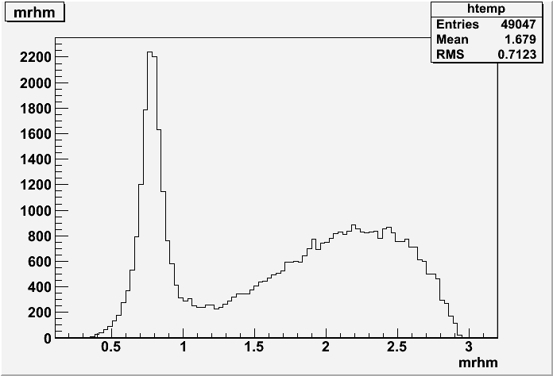
Analysis
When the analysis algorithm is done, ana_rhopi.root is produced, then do
$ root -l ana_rhopi.root
Then analysis using ROOT
root[ ] Tbrowser a
root[ ] fit5c->Draw(“mrhm”)

Slide 7
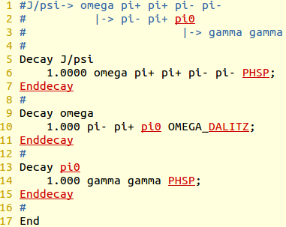
What I am doing
Modify Rhopi.cxx to analysis the process
Main parameters to be concentrated on:
nGood, nGam, Vertexfit, KinematicFit, …
Modify the decay card
Run the process and analyze it

Slide 8
Thank you

