Slide 1



Slide 2


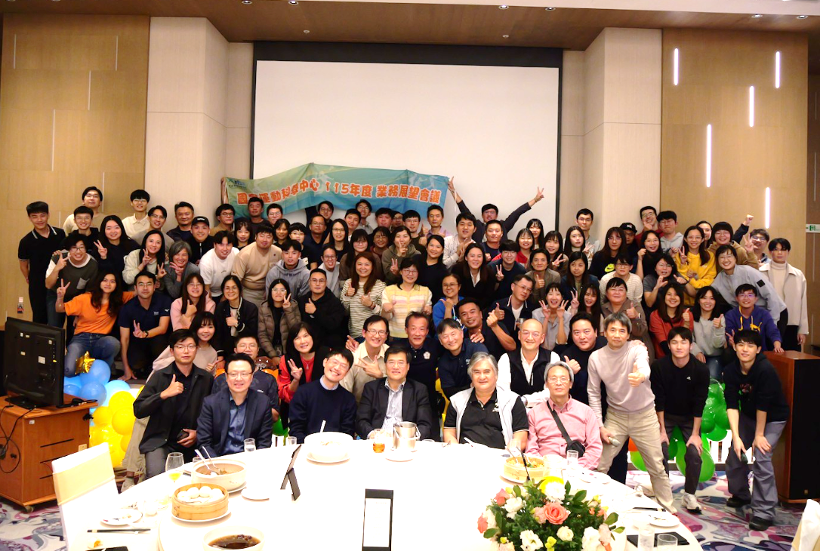
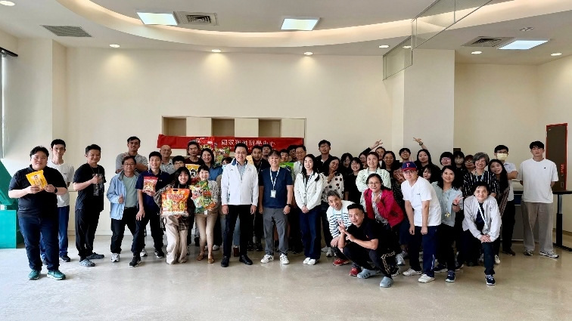
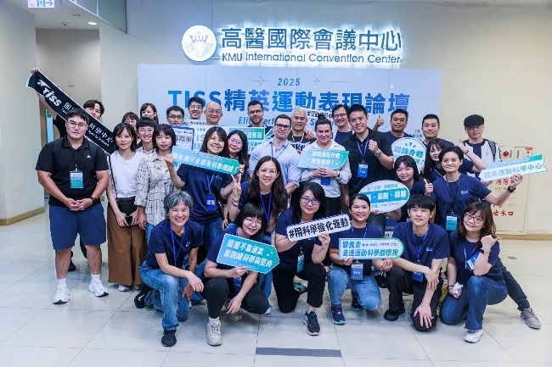
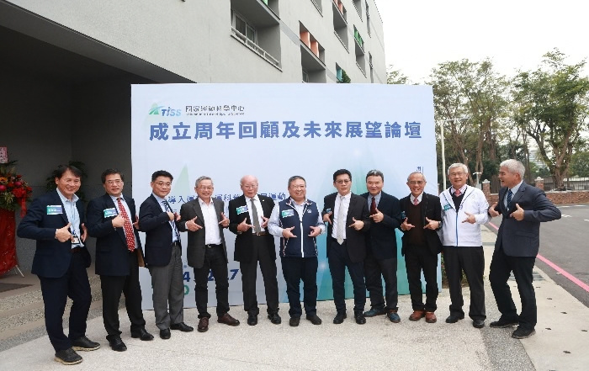
Photos of Us

Slide 3






Ministry of Sports Organization
Core Governing Body
Three administrative agencies under the Ministry of Sports
National Sports Training Center (NSTC)
Policy-making and resource allocation
  Drives elite athletic performance, facility optimization, and championship-level development programs
Sports for All Agency | Sports for All Agency
Department of Planning | Department of Competitive Sports
Department of Sports Industry and Technology | Department of Adapted Sports
Department of International Affairs | Department of Facility Planning
Taiwan Institute of Sports Science (TISS)
Advances sports science research and application to boost international competitiveness
  Sports technology R&D
  Elite athlete support
  Industry development
* The Industry & Technology Department is the lead policy unit for advancing sports technology
National Sports Industry Development Center
  Bridges the tech ecosystem to scale smart-venue pilots and launch cross-sector commercialization models
Notes:
‹#›

Slide 4
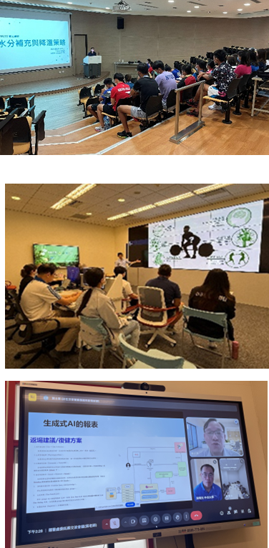
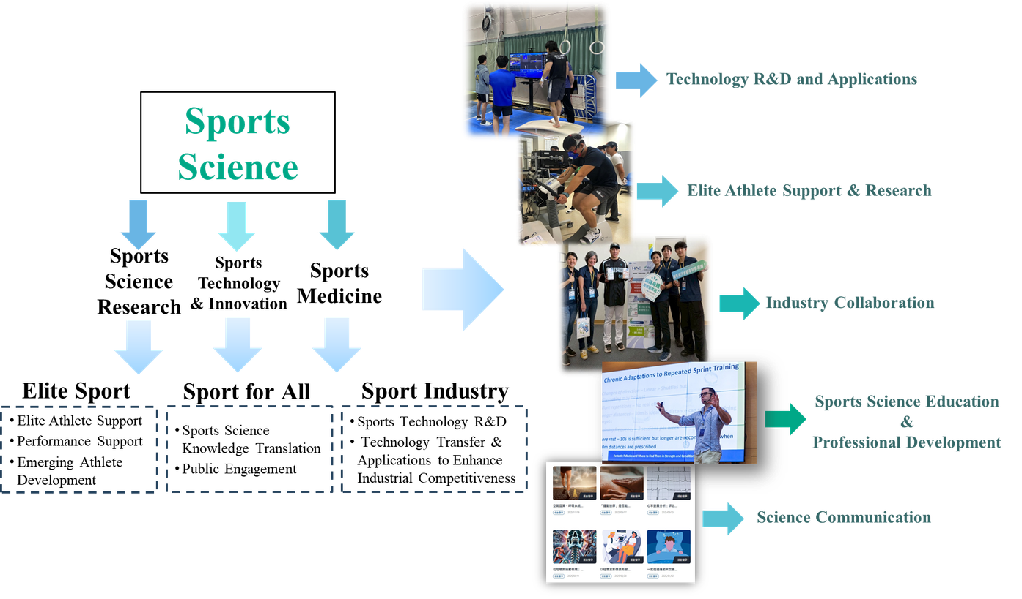
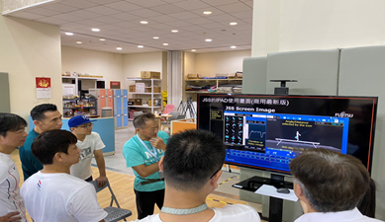
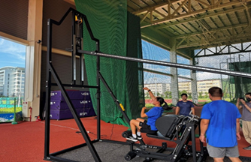
Organization of TISS
As an administrative body, TISS sits between a traditional government agency and a private enterprise — freed from rigid civil-service HR and accounting rules so it can pursue specific public functions with greater professionalism, flexibility, and operational efficiency.
Notes:
‹#›

Slide 5
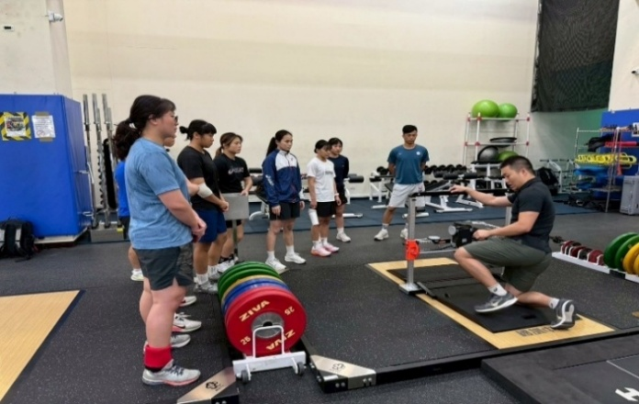
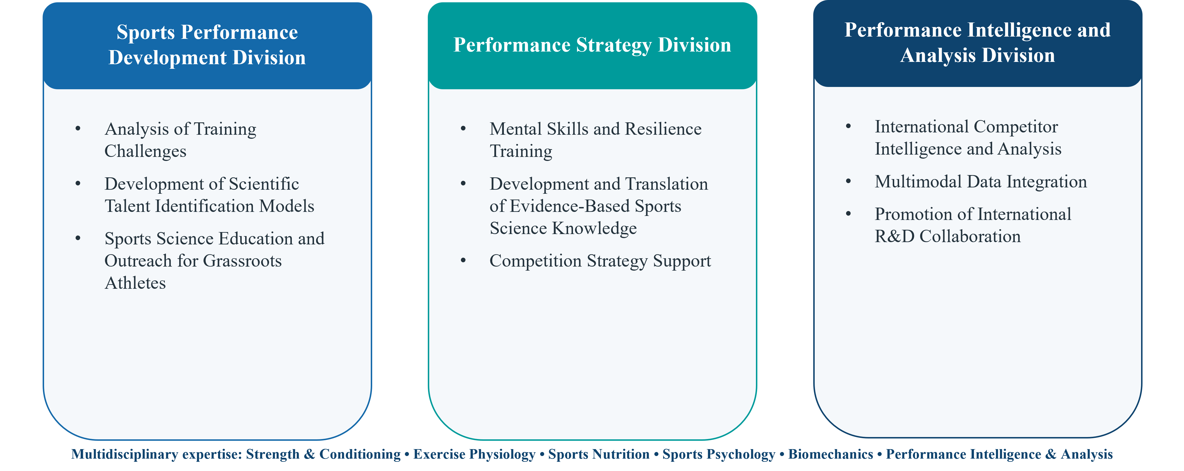
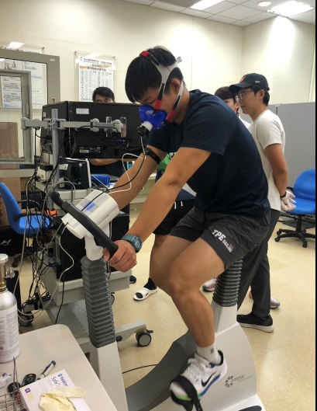
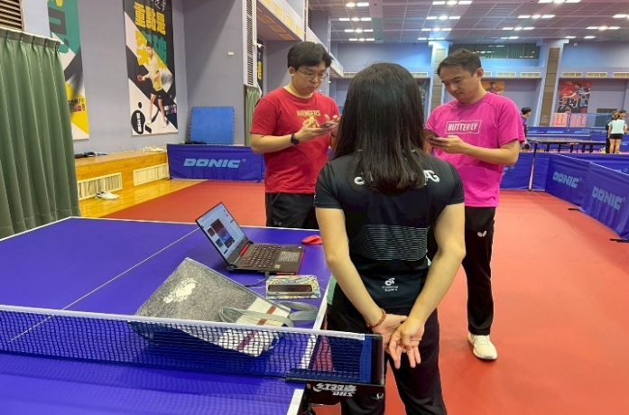
Department of Sports Science Research
Translating Sports Science Research into Athlete Support and Practices
Multidisciplinary expertise: Strength & Conditioning • Exercise Physiology • Sports Nutrition • Sports Psychology • Biomechanics • Performance Intelligence & Analysis
Notes:
‹#›

Slide 6
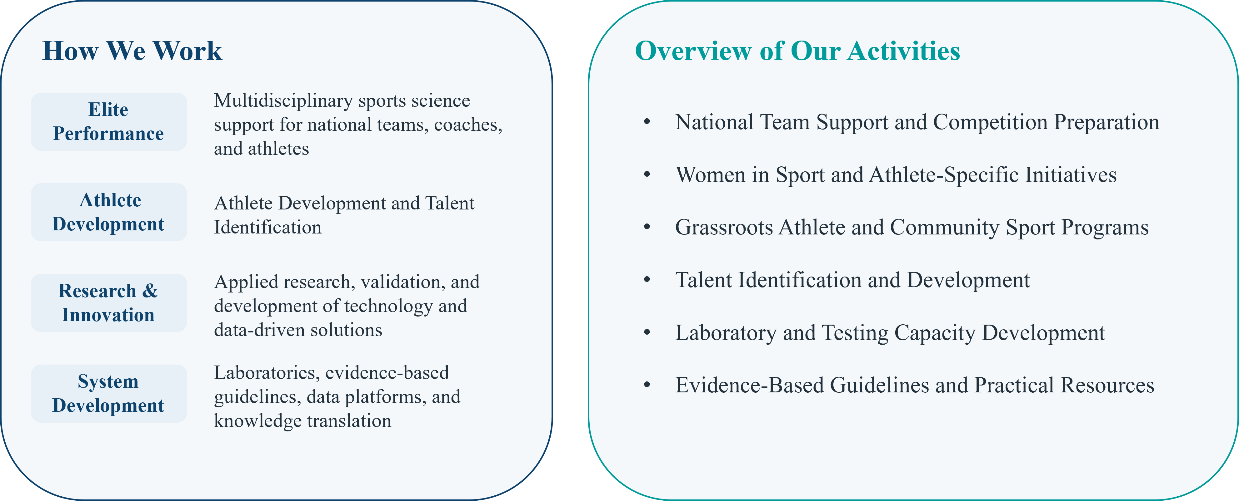
Department of Sports Science Research
Our Responsibilities
From Research to Practices
Notes:
‹#›

Slide 7
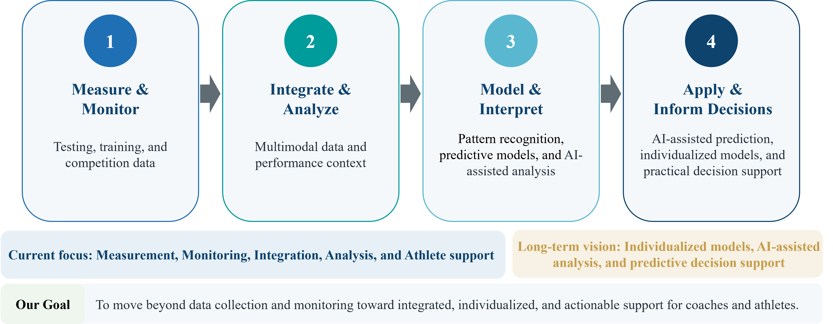
Department of Sports Science Research
Our Approach
Turning Sports Science Data into Actionable Support for Coaches and Athletes
Notes:
‹#›

Slide 8
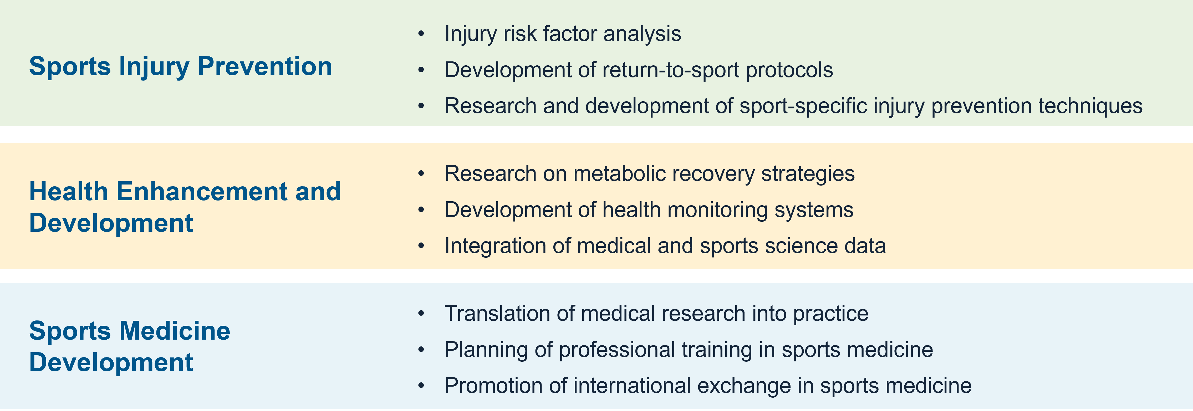
Department of Sport Medicine Research
Our objectives
Apply research and athlete health data to support safer participation, recovery and performance.
Notes:
‹#›

Slide 9
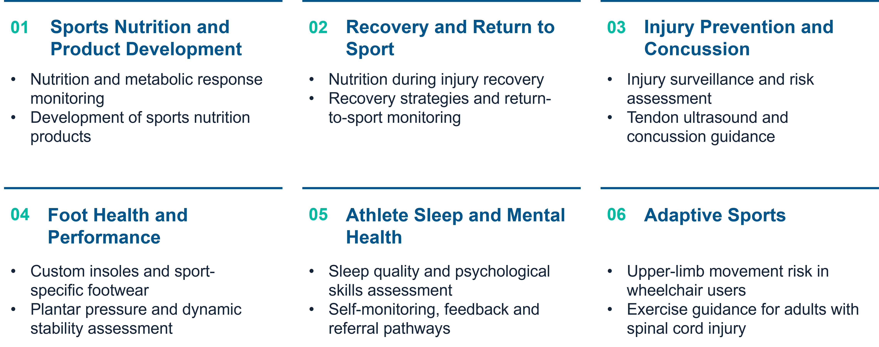
Department of Sport Medicine Research
Research Priorities
Current and developing areas of research
Notes:
‹#›

Slide 10
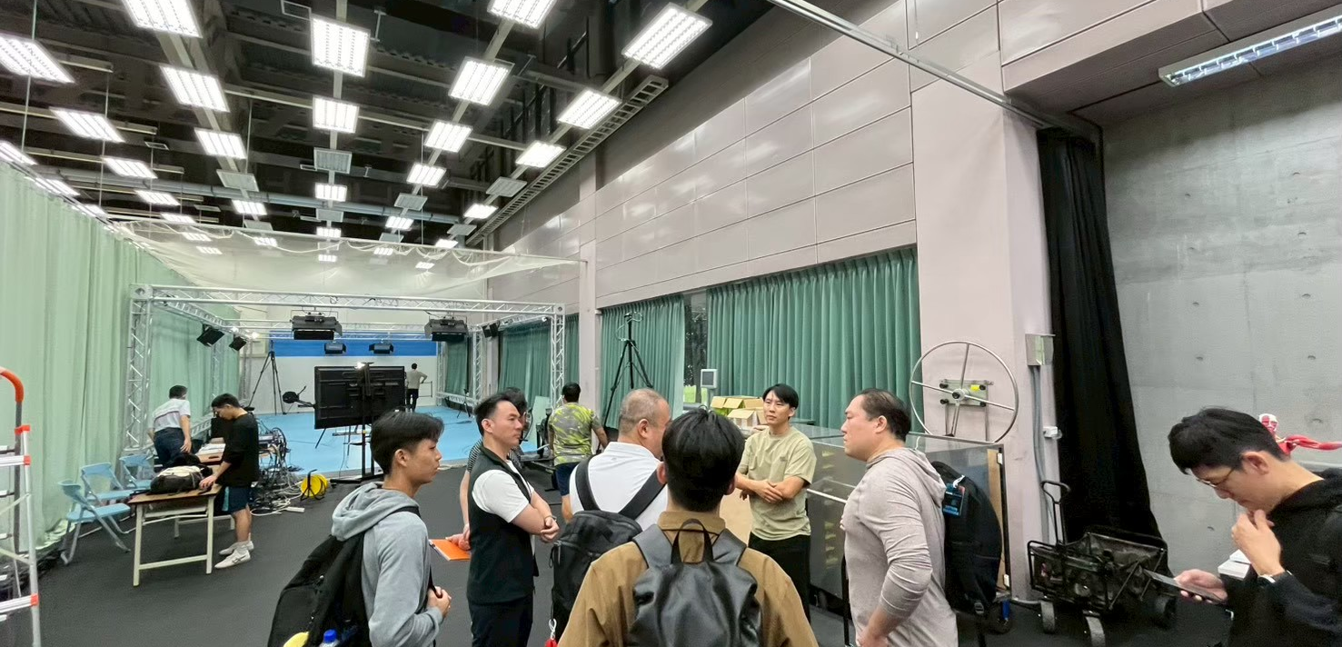


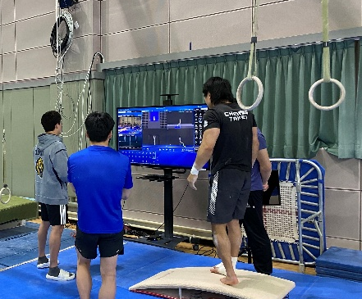
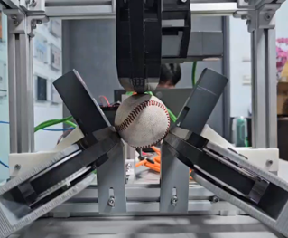

Department of Sports Technology & Information Development
Integrating Information Technology and Sports Science to Build Smart Sports Systems
We develop sports technology hardware and software, upgrade existing equipment, and build data systems that bring research results to coaches and athletes. Working with universities, research institutes and industry, we turn training needs into field-ready solutions.
Smart Imaging & Data Division
Motion capture and video analysis • Computer vision and AI pose estimation • Performance data visualization
Information Technology Development Division
Wearable sensors and smart devices • Embedded hardware and equipment upgrading • Real-time data acquisition
IOT& Embedded Systems Division
Software and systems • Sports science database • Data platform and AI applications
Notes:
‹#›

Slide 11
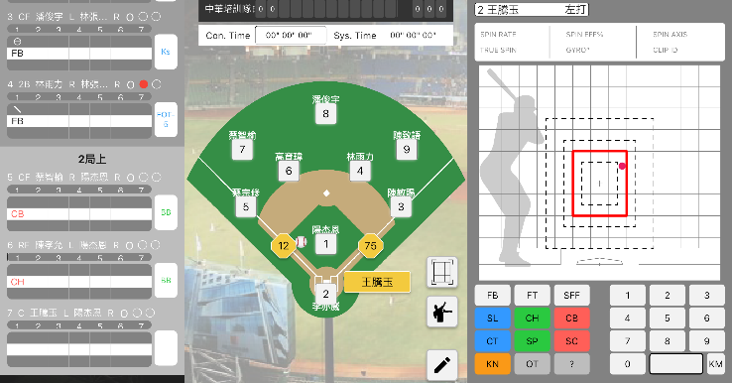




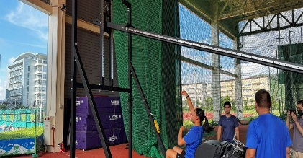


Department of Sports Technology & Information Development
Focus Areas
Technologies we develop to support coaches and athletes
Smart Training Venues
Technology-enabled baseball field and local positioning systems with live data and video feedback
AI-Assisted Training
AI gymnastics coaching, an archery robot and a smart weightlifting training system
Scouting & Competition Analysis
Game recording apps and automated match-video collection for tactical insight
Motion & Video Analysis
Video-based technique analysis and automated video tagging
Baseball game recording app
Sports Data Platform
Athlete database integrating training, testing and competition data with consent management
Smart Training Equipment
Smart pitching machine and javelin throwing platform
Javelin throwing training platform
Notes:
‹#›

Slide 12
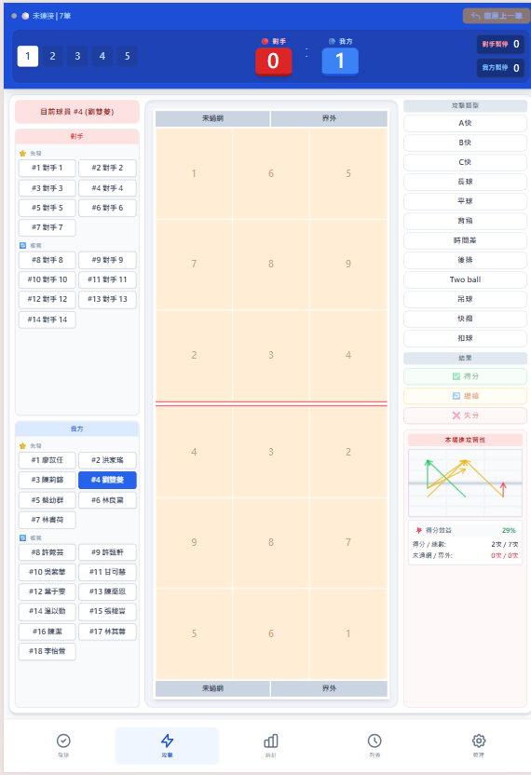
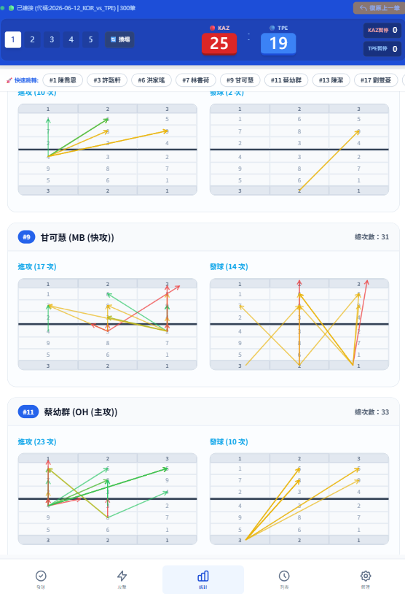
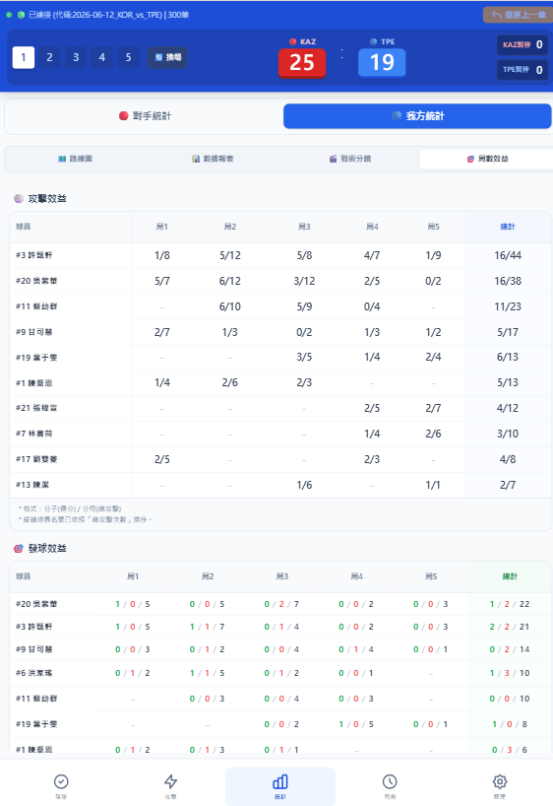

Department of Sports Technology & Information Development
Volleyball Scouting System
Live match data from the courtside to the coach’s tablet
Why We Built Our Own
Inside the System
 | Data Volley | HUDL | Our System
Live recording | ✓ | ✗ | ✓
Live push to bench | ✓ | ✗ | ✓
Learning curve | High | Low | Low
Customisation | Low | Low | High
Licence cost | High | High | In-house
Courtside input · attack routes · player efficiency
Commercial tools are either real-time but specialist-only, or video-based and post-match. Our coaches needed both: live data, simple enough for staff to run courtside.
RECORD
SYNC
DECIDE
Courtside tablet
Cloud database
Coach’s tablet
Notes:
[~1 min 40 s]
I'm Tzu-Chi Lin from the Department of Sports Technology and Information Development. I'd like to show you one system we built in-house: our volleyball scouting system.
During a match, a coach needs to know right now: where the opponent's hitters attack, how they serve, and which of our players are scoring. Commercial tools already exist. Data Volley is excellent and works live, but it needs a trained specialist to code every touch, and the licence is expensive. HUDL is great for video, but it is mainly a post-match tool, so it can't help during a timeout.
So we built our own. On the right you can see the three main screens. A staff member sits courtside with a tablet and taps each rally: who attacked, from which zone, and the result. The data goes straight to a cloud database, and the coach's tablet shows the attack routes and each player's efficiency, set by set.
Record, sync, decide. That's the whole idea, and it's simple enough that our team staff can operate it without becoming professional scouts.
（重點：教練需要即時資訊 → 商用工具的限制 → 自主開發；三個畫面；Record / Sync / Decide）

Slide 13
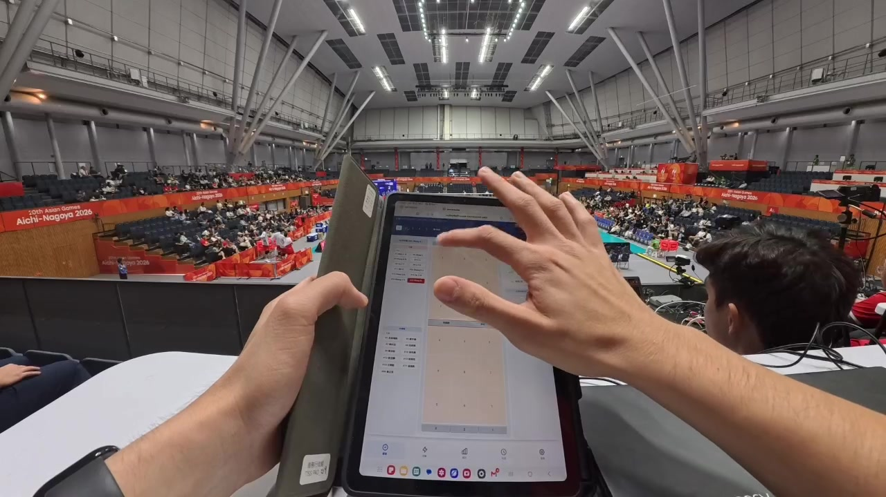
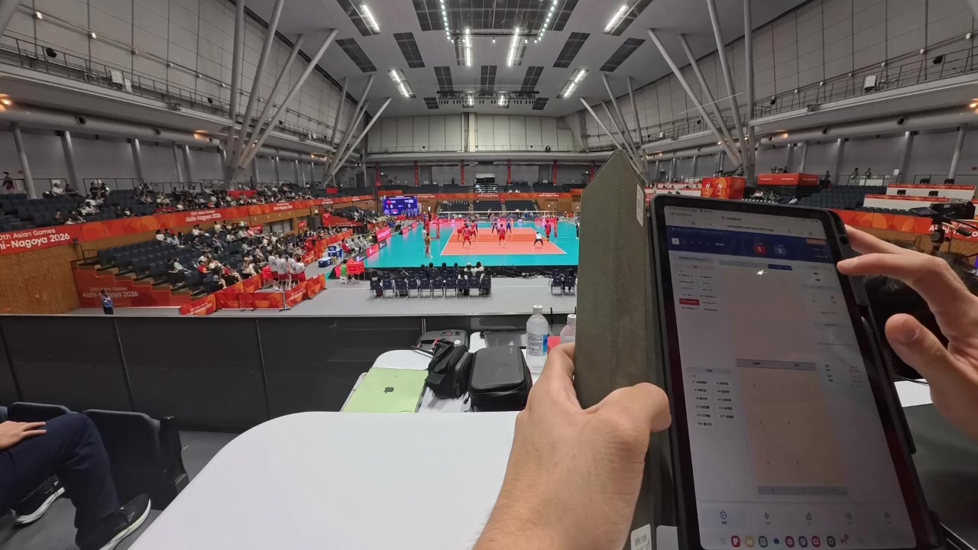
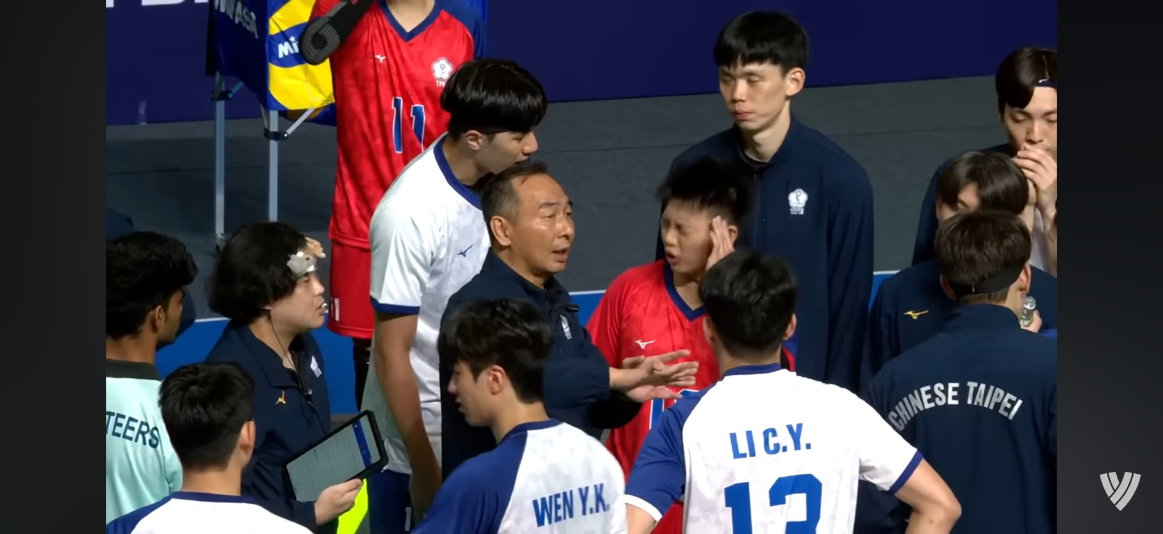



Department of Sports Technology & Information Development
Live at The Asian Games
Aichi-Nagoya 2026 — recorded courtside, read by the coaching staff in real time
Courtside Demo
In the Coaches’ Hands
Timeout: the coach reads live data on the tablet
Click to play · each rally is tapped in as it happens, from the press tribune
Opponent Tendencies
Player Efficiency
Two National Teams
Attack routes and serve patterns, updated every rally
Attack and serve results per player, set by set
Men’s and women’s squads, from the AVC Cup to the Asian Games
Notes:
[~1 min 40 s]
Here is what it looks like in real competition. These two clips were recorded at the Aichi-Nagoya Asian Games a few weeks ago. (Play the video.)
You can see the tablet in my hands, and the match on the court behind. Every rally, I tap in what happened. It takes only a few seconds per rally, so the record keeps up with the game.
On the right is what happens on the bench. During a timeout, the coach already has the tablet with the latest data: where the opponent's outside hitter likes to attack, which rotation is weak, and how our own hitters are doing in this set.
We used the system with both our men's and women's national teams, first at the AVC Cup in June, and then at the Asian Games. It was also used to scout potential opponents in other matches, so the coaching staff could prepare before facing them.
（重點：播放影片 → 我在場邊即時輸入 → 暫停時教練直接看平板 → 男女排、亞洲盃到亞運皆使用，也用於情蒐潛在對手）

Slide 14


Department of Sports Technology & Information Development
Lessons & Next Steps
From live records to video-linked, AI-assisted insight
What We Learned
Where We Are Going
Speed beats depth on the bench
01
Link Data to Video
A few key numbers in a timeout are worth more than a full report after the match
Each recorded rally jumps straight to its clip for pre-match meetings
Simple input keeps up with play
02
AI Video Analysis
A tap-based design lets non-specialist staff record every rally
In development: 2D court mapping, action classification, spike speed and jump height from match video
Scouting is a workload problem
03
Exchange with Partners
Filming, live coding and video editing compete for the same few people; most other teams we observed at Asian level had 2+ dedicated scouts
We would welcome sharing scouting workflows and data standards with Korean colleagues
Notes:
[~1 min 30 s]
Three lessons from using it in real competition.
First, on the bench, speed beats depth. In a 30-second timeout, three clear numbers are more useful than a full report the next day.
Second, simple input is what makes it work. Because recording is just a few taps, our staff could keep up with every rally without specialist training.
Third, scouting is really a workload problem. Filming, live coding and video editing all fall on the same few people. Most of the other teams we observed at the Asian level had two or more dedicated scouts.
Next, we want to link every recorded rally to its video clip, so coaches can jump straight to the moments that matter in pre-match meetings. We are also developing AI video analysis: mapping players onto a 2D court, classifying actions, and estimating spike speed and jump height directly from match video.
Finally, we'd be very happy to exchange ideas with you on scouting workflows and data standards. Thank you.
（重點：三個心得 → 影片連結、AI 影像分析（開發中）→ 邀請交流）

Slide 15
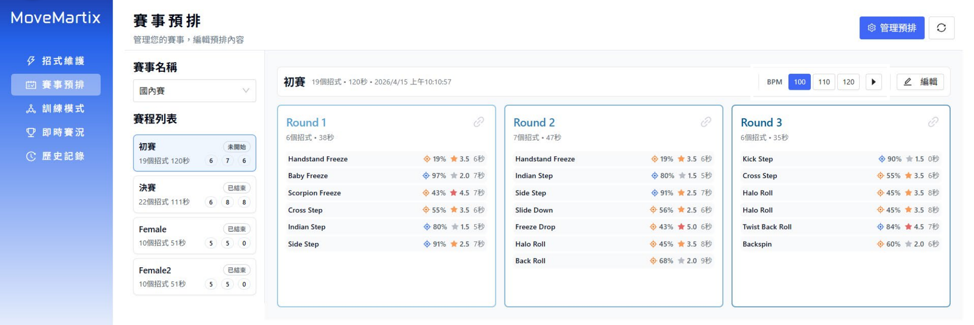



Department of Sports Technology & Information Development
Movemartix
A Breaking Move Management System — each athlete’s own “digital arsenal”
Built for Three Roles
Inside the System
Athletes
Organize their moves and plan each battle
Coaches
Pre-plan screen: moves arranged into rounds
Record performance and shape tactics
INPUT
PROCESS
OUTPUT
Define moves
Build strategy
Record on site
Notes:
[~1 min 30 s]
Three lessons from using it in real competition.
First, on the bench, speed beats depth. In a 30-second timeout, three clear numbers are more useful than a full report the next day.
Second, simple input is what makes it work. Because recording is just a few taps, our staff could keep up with every rally without specialist training.
Third, scouting is really a workload problem. Filming, live coding and video editing all fall on the same few people. Most of the other teams we observed at the Asian level had two or more dedicated scouts.
Next, we want to link every recorded rally to its video clip, so coaches can jump straight to the moments that matter in pre-match meetings. We are also developing AI video analysis: mapping players onto a 2D court, classifying actions, and estimating spike speed and jump height directly from match video.
Finally, we'd be very happy to exchange ideas with you on scouting workflows and data standards. Thank you.
（重點：三個心得 → 影片連結、AI 影像分析（開發中）→ 邀請交流）

Slide 16
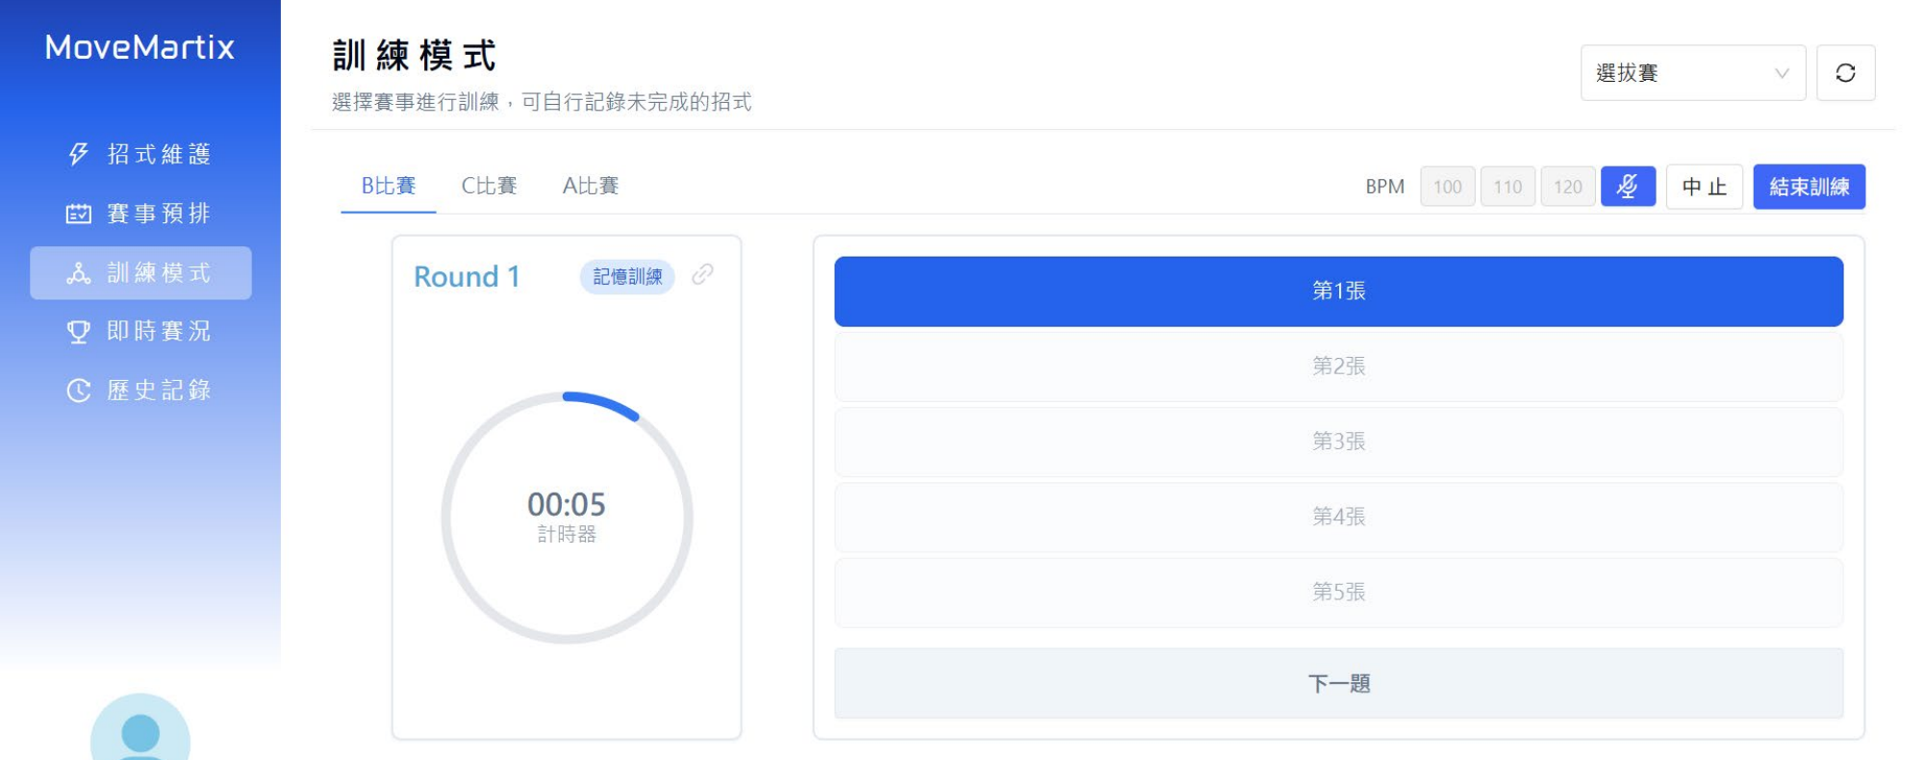







Department of Sports Technology & Information Development
From Training to Competition
One System Across the Athlete’s Season
How It Works
Training in Action
01 Build
Athletes record their moves in a personal library
02 Plan
Moves are combined into round plans for each event
03 Train
Training mode: rehearsing a round against the clock
Plans are rehearsed before competition
04 Review
Coaches record performance for post-match review
Clear Tactics
Reliable Records
Long-Term Insight
Notes:
[~1 min 30 s]
Three lessons from using it in real competition.
First, on the bench, speed beats depth. In a 30-second timeout, three clear numbers are more useful than a full report the next day.
Second, simple input is what makes it work. Because recording is just a few taps, our staff could keep up with every rally without specialist training.
Third, scouting is really a workload problem. Filming, live coding and video editing all fall on the same few people. Most of the other teams we observed at the Asian level had two or more dedicated scouts.
Next, we want to link every recorded rally to its video clip, so coaches can jump straight to the moments that matter in pre-match meetings. We are also developing AI video analysis: mapping players onto a 2D court, classifying actions, and estimating spike speed and jump height directly from match video.
Finally, we'd be very happy to exchange ideas with you on scouting workflows and data standards. Thank you.
（重點：三個心得 → 影片連結、AI 影像分析（開發中）→ 邀請交流）

Slide 17








Department of Sports Technology & Information Development
Our Approach
From Training Needs to Field-Validated Technology
How We Work
Collaboration Network
01 Identify Needs
Listen to coaches, athletes and sports scientists to define practical problems
Research Institutes
Co-development of sports technology
Universities
Joint research and student internships
02 Develop & Integrate
Combine in-house R&D with university and industry expertise
Sports Technology &
Information
Development
03 Validate in the Field
Test and refine in national training venues and competitions
04 Feed Back & Transfer
Deliver data feedback to users and transfer technology to industry
Sports Tech Industry
Field testing and technology transfer
International Partners
Academic and technical exchange
Notes:
‹#›

Slide 18
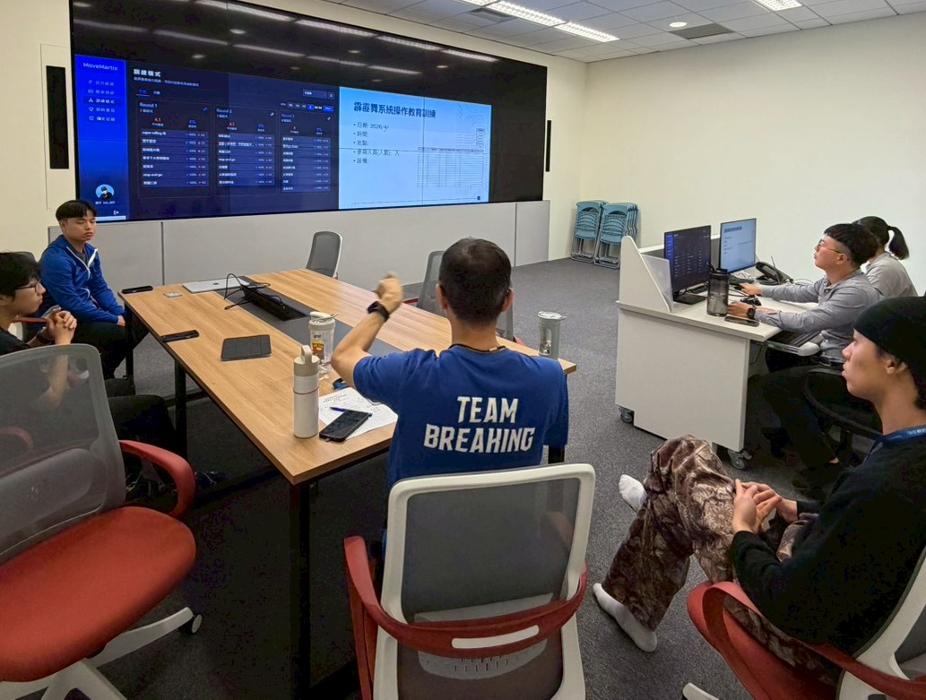
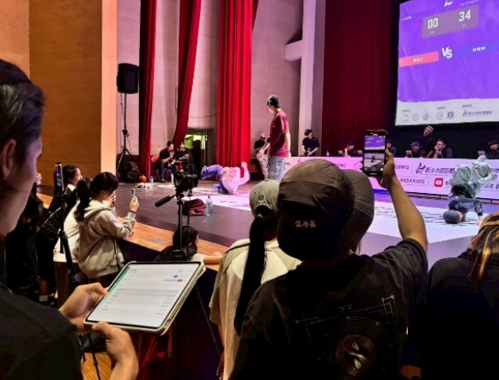
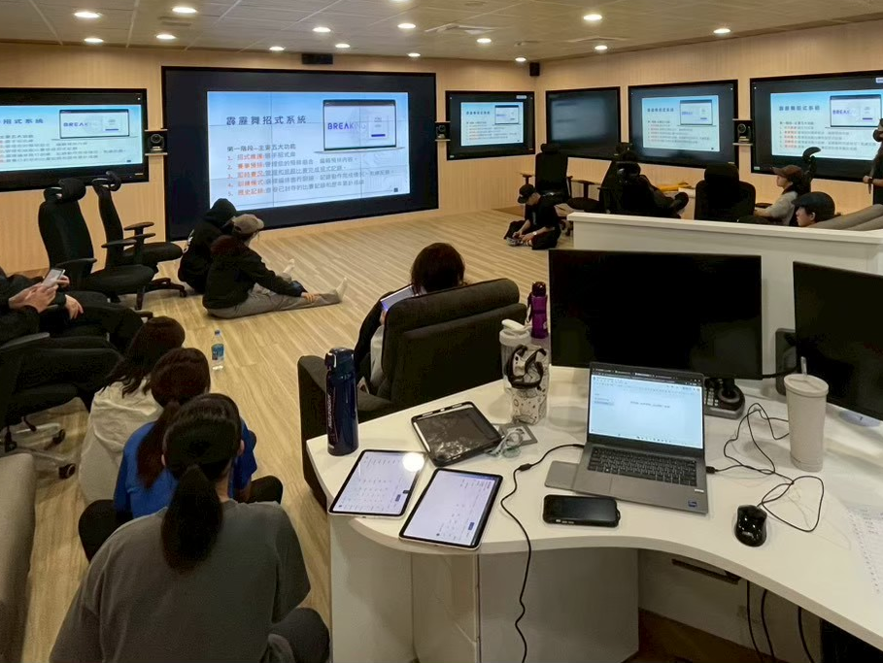
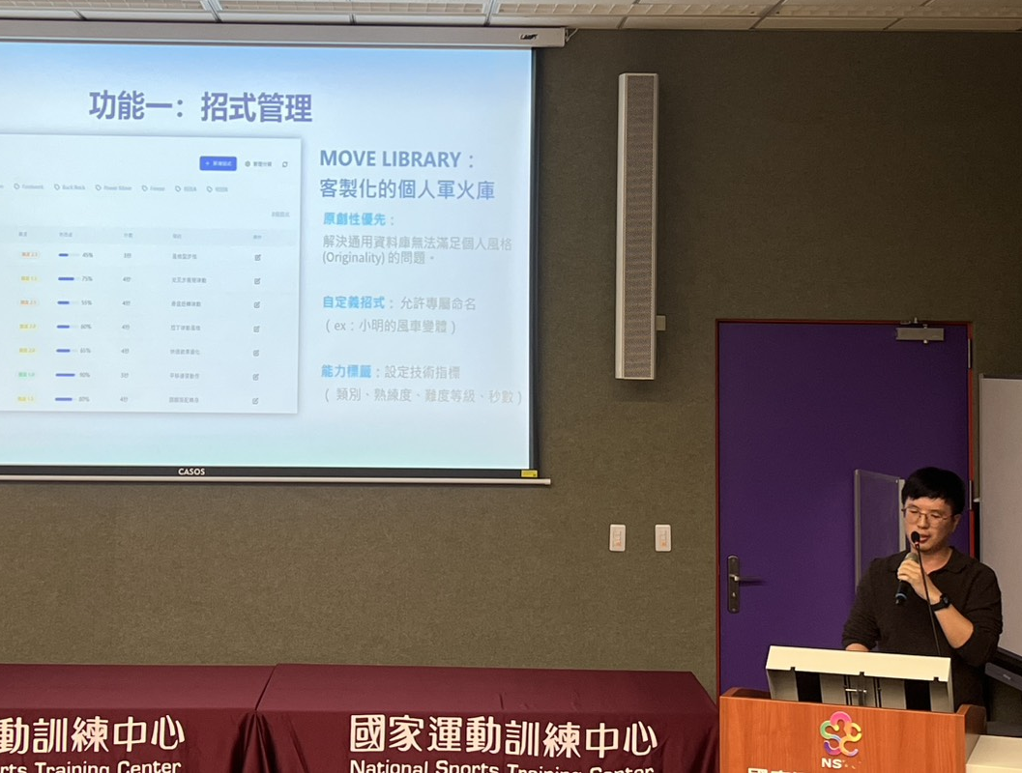
Department of Sports Technology & Information Development
From Design to The Field
Developed with coaches and athletes, validated in real competition
Our Approach in Practice
Photo 1
Photo 2
Photo 3
Photo 4
01 · DESIGN
02 · VALIDATE
03 · TRAIN
04 · SHARE
Co-Design Sessions
Live Competition Use
User Training Workshop
Internal Briefing
Long working sessions refining workflows and interface
Recording performance in real time at venues
Hands-on training for coaches and athletes
Sharing the concept and roadmap within TISS
Notes:
‹#›

Slide 19
Department of Sports Technology & Information Development
OUR APPROACH
From Training Needs to Field-Validated Technology
How We Work
Collaboration Network
01 Identify Needs
Listen to coaches, athletes and sports scientists to define practical problems
Research Institutes
Co-development of sports technology
Universities
Joint research and student internships
02 Develop & Integrate
Combine in-house R&D with university and industry expertise
Sports Technology &
Information
Development
03 Validate in the Field
Test and refine in national training venues and competitions
04 Feed Back & Transfer
Deliver data feedback to users and transfer technology to industry
Sports Tech Industry
Field testing and technology transfer
International Partners
Academic and technical exchange
Notes:
‹#›

Slide 20
Introduction of
Sports Data Platform Development Project
Taiwan Institute of Sports Science, Northern Office
October 2026

Slide 21
The Five-Layer Sports Data Ecosystem
Data Sensing
Builds scalable, reliable data-sensing capability, spanning wearables and venue-based sensors
Data Collection
Integrates sensor, competition, and historical data; establishes authorization management; ensures data quality and privacy through cleaning and de-identification
Builds a scalable data governance framework covering standard-setting, regulatory compliance, storage management, and auditing to ensure security and traceability
Data Governance
Combines data analytics and AI to develop coaching decision support, athlete performance analysis, and competition insight applications
Intelligent Applications
Drives cross-industry collaboration and data monetization through data-as-a-service, subscription models, and diverse business models
Data Economy
Notes:
‹#›

Slide 22



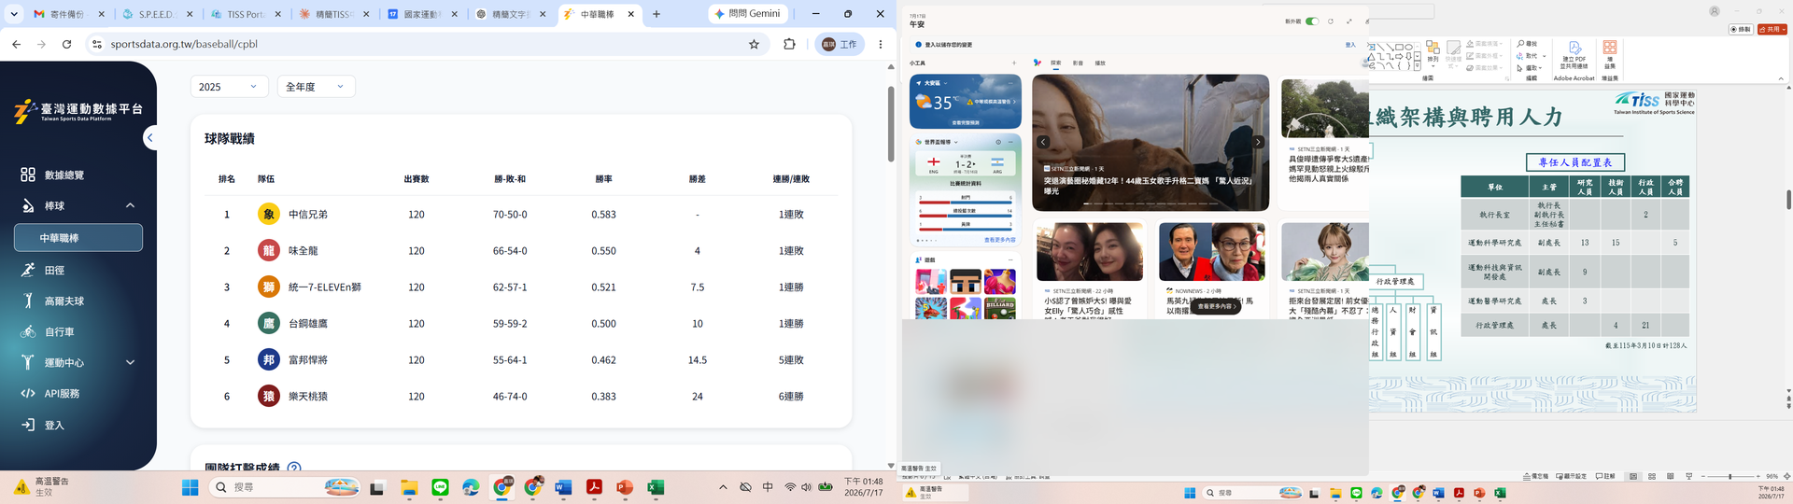
Northern Office: Three Pillars of the Sports Data Platform
  Informed Consent Platform
    Single consent, dynamic consent, and project-based consent
    The compliance foundation for sports data collection, providing authorization records and maintenance log to support the data-economy ecosystem (does not cover legal compliance determinations or dispute liability)
    High cost of linking and authenticating cyber and physical identities
  Sports Data Lake
    Sports data exchange reference standards
    Data sources and integration
    Data governance in practice, e.g. consent withdrawal, data access logs
  Data Statistics & Intelligent Applications
Authorization & Informed Consent
Data Integration Platform
Sports Services
Notes:
‹#›

Slide 23


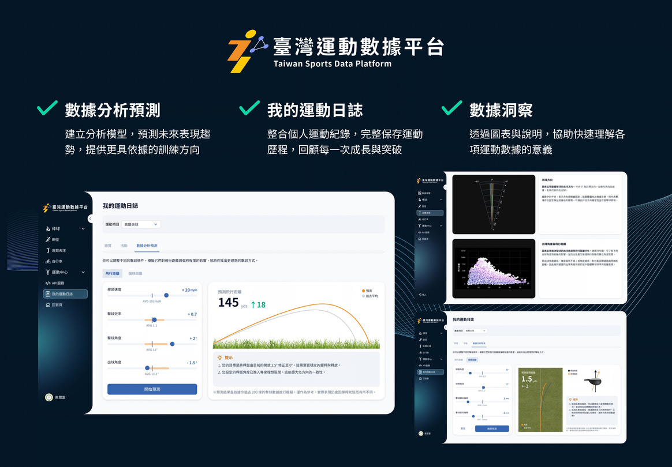
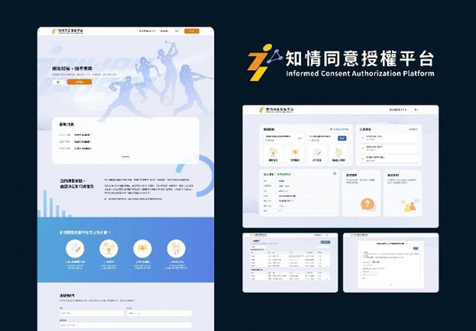





Turning Sports Data into Value
  Establish a data center for personalized sports logs,
integrating an authorization management mechanism, analyzing exercise history and fitness outcomes, and providing precise sports-health recommendations.
  Centered on the sports data platform architecture,
build a data exchange warehouse and an AI foundation, connecting cross-agency data to drive commercial validation and the digital transformation of venues.
Building business-model validation capability and data-application ecosystem potential
A comprehensive personalized sports-log
data core platform
Diverse Applications
Excellent Service
Sports Data Platform
Sports Applications
Sports Participants
Ecosystem Scale
An authoritative database consolidating key sports and cross-agency data
Notes:
運動數據平台
為什麼要有這個平台 :希望可以強化國內三大目標
1.各個地方場域的運動數據沒有明確整理歸檔並且個個場域散落在各個地
2.希望透過國內運動數據的整合促進運動產業發展以及增加民眾的參與度
3.透過各項運動數據地蒐集、分析研究，強化選手的表現
初期兩大核心
1.藉由各個智慧感測器的運動場域來蒐集運動數據
2.建立民眾使用的運動日誌

Slide 24
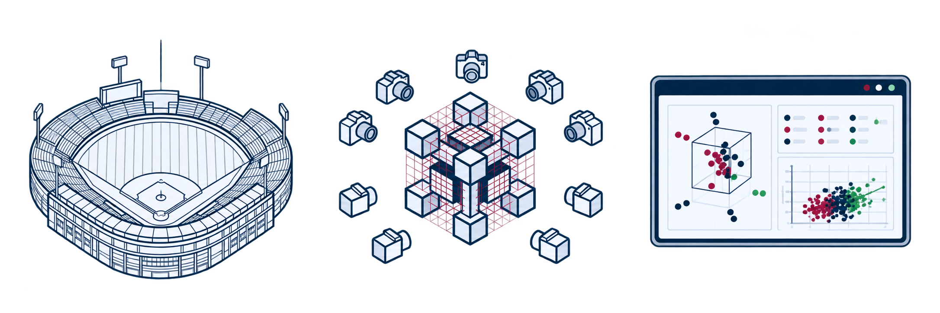
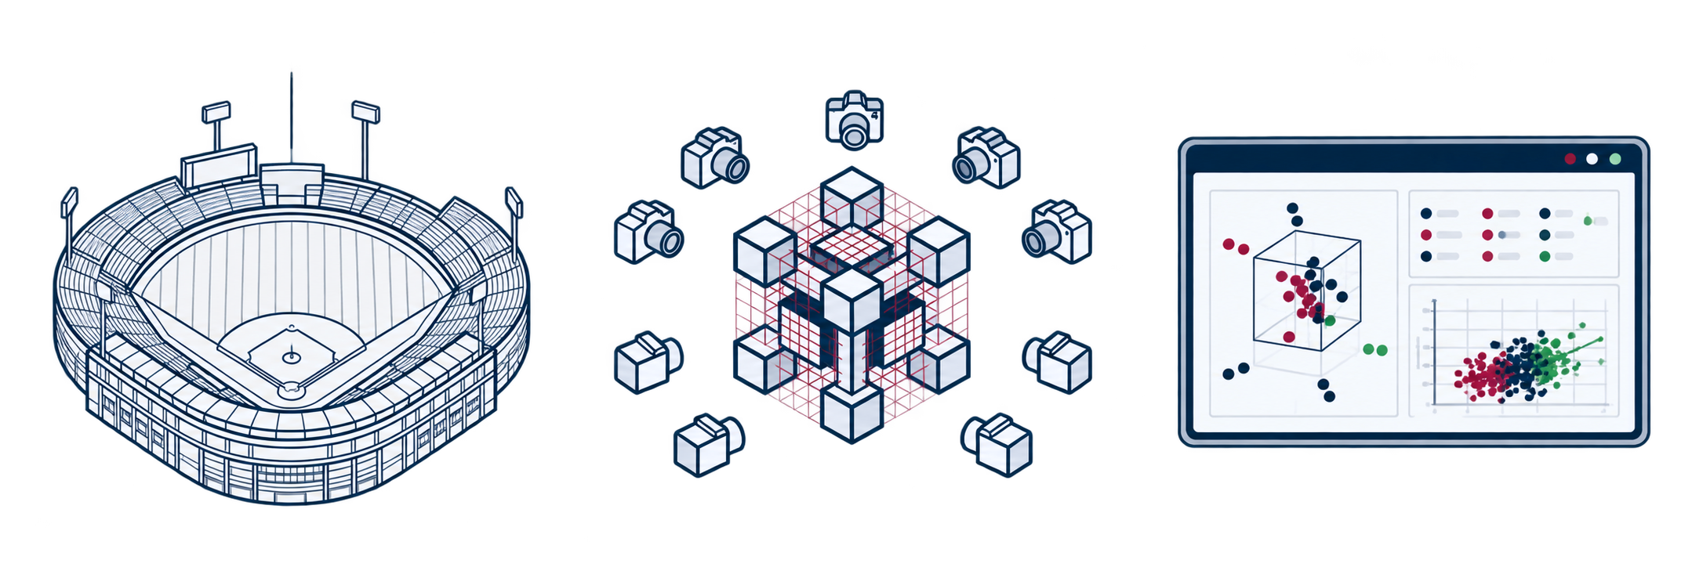
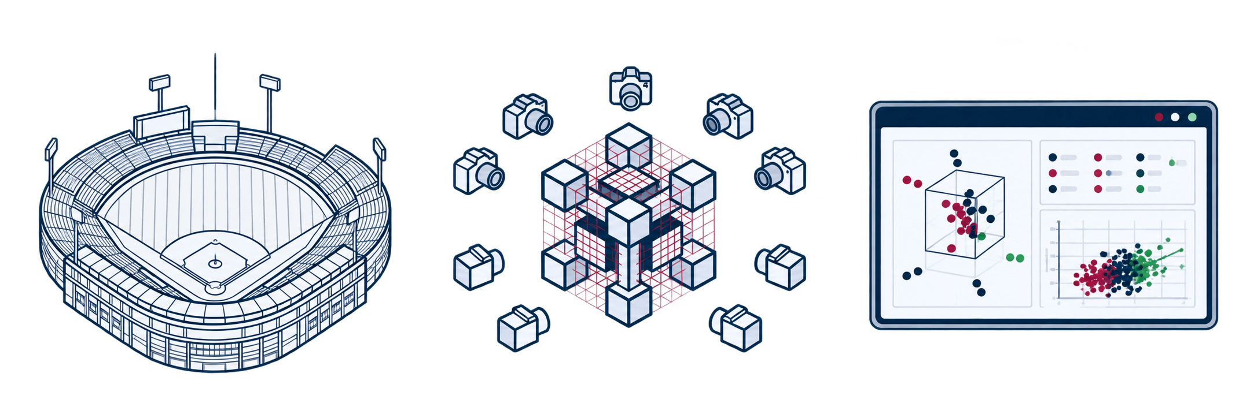
Baseball Advanced Data Platform: 野球先生 (Taiwan's Statcast)
Baseball Field
Falcon Vision System (Hawk-Eye System)
Real-time capture of high-frame-rate ball displacement and physical dynamics,
converted into data representations
Falcon Vision System Setup
Optical tracking capture and advanced computational analysis
“野球先生”
Advanced Data Public Information
High-speed cameras deployed in a 5+7 configuration,
comprehensively capturing pitching, batting, defense, and
baserunning footage
Real-time capture of high-frame-rate ball displacement and physical dynamics, converted into data representations
Providing a professional, visualized
sports-science data experience
Notes:
‹#›

Slide 25


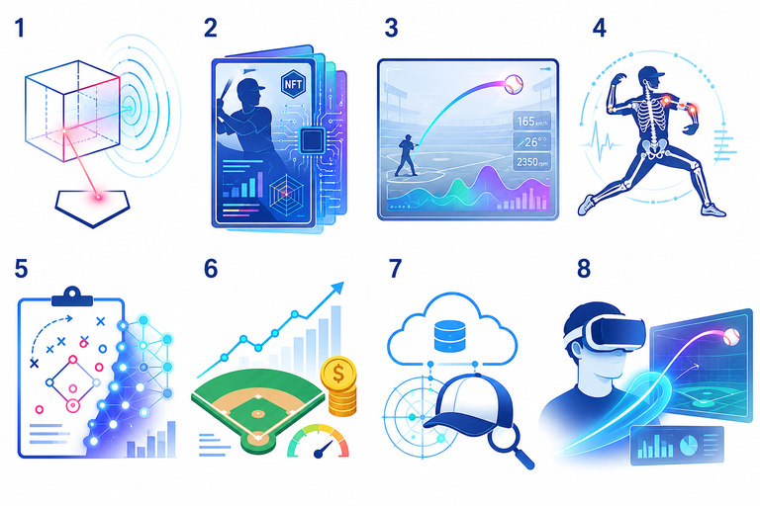


From Baseball Data to Smart Applications
Data Management & Operations
Industry Support/ Data Value Creation
(MODA + Sports Administration)
Aggregation, Cleansing & Fusion
Optical Sensor Dataset
Advanced Match Dataset
Radar Sensor Dataset
Baseball ABS System
Baseball Player Cards
Live Match Graphics
Injury Prediction Model
Match Records Dataset
Event Registration Dataset
Intelligence & Decision Platform
Sports Lottery
Athletic Talent Tracking
Baseball Gaming
Data Governance
Advanced Scientific Data Visualization
Athlete Database
a.Grassroots baseball: latest & archived footage
b.Schedule records
Informed Consent
Authorization Platform
Taiwan Sports Data
Lake
DataMosa
Taiwan Sports Data
Yakyu Sensei

Slide 26






Smart Badminton Venue Application
Design Experience Flow
Develop Application System
Validation & Data Integration
2
Integrated with LINE for real-time display
Connected to Sports Science Center
  Supports at least locations at the Normal operation of badminton venue
50+
1. Public Shuttle-Speed Leaderboard
  Hardware Requirements: Camera+ Badminton Serving Machine
Actual participant visits
2. Sports Video Clip Download
5,000+
  1 design document produced:
Reservation→ Informed Consent Onboarding→Experience
3. Serving Machine Module Upgrade
Data records integrated
Notes:
‹#›

Slide 27




Future Development of the Sports Data Platform
Diverse Business Models
Standardized Integration Framework
Data Application Optimization
Digital Governance Innovation
Design tiered plans covering licensing, subscription, and revenue-sharing models to meet the needs of different partners.
Develop standardized templates for data use and business partnership agreements to reduce communication costs and accelerate integration.
  Online Registration System: Review the current status and integrate the event registration process.
  Official Website and App Integration: Deliver a consistent, seamless cross-device user experience
  Dynamic Authorization Governance: Provide flexible, secure data authorization tailored to different application scenarios.
  Informed Consent Modular Service: Support customizable informed-consent signing processes to ensure regulatory compliance and user trust.

Slide 28
Thanks for Listening

