Slide 2
The Economic Problem: Scarcity and Choice
What gets produced?
How is it produced?
Who gets what is produced?
Limited or scarce resources force individuals and societies to choose among competing uses of resources—alternative combinations of produced goods and services—and among alternative final distributions of what is produced among households.
The production possibility frontier, a model that helps economists think about the trade-offs every economy faces.

Slide 3
The production possibility frontier (PPF)
A graphical presentation called the Production Possibility Frontier (PPF ) illustrates the principles of constrained choice, opportunity cost, and scarcity.
The production possibility frontier shows all the combinations of goods that can be produced if the means of production (resources, technology etc.) are fully employed.
The idea behind this model is to improve our understanding of trade-offs by considering a simplified economy that produces only two goods. This simplification enables us to show the trade-off graphically.

Slide 4

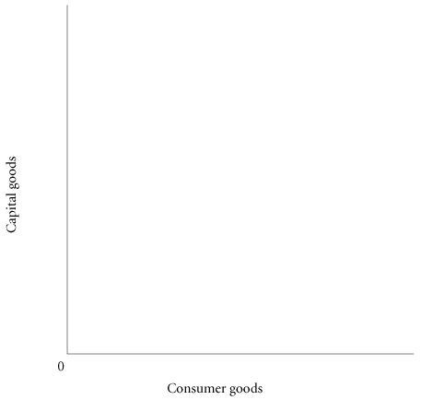


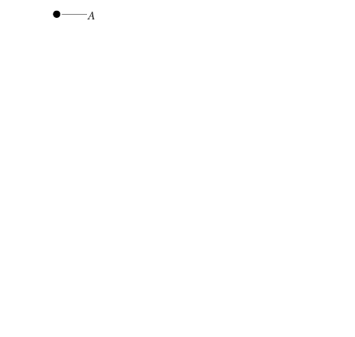
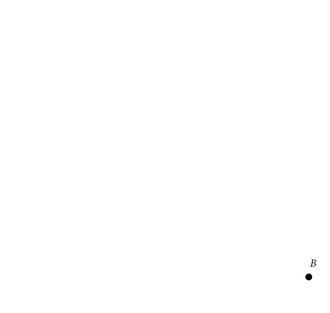
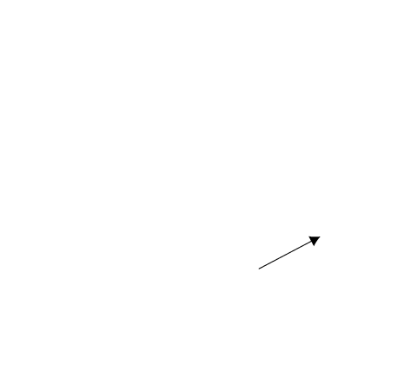
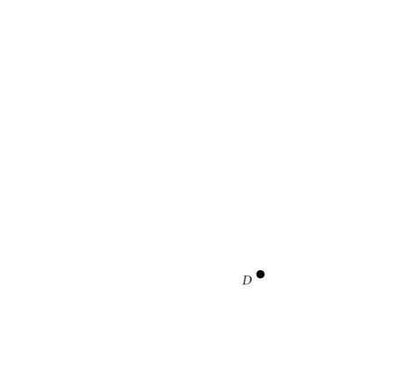
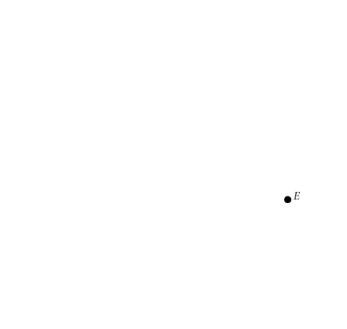
Although an economy may be operating with full employment of its land, labor, and capital resources, it may still be operating inside its PPF, at a point such as D. The economy could be using those resources inefficiently.
Periods of unemployment also correspond to points inside the PPF, such as point D.
Moving onto the frontier from a point such as D means achieving full employment of resources.

Slide 5
The PPF is a boundary. It demonstrates scarcity in that any point beyond the frontier is unattainable. Society cannot produce combinations that lie outside the PPF because there are insufficient resources to do so.
Points above and to the right of the origin are seen as better than points closer to the origin. If society produces at a point on the frontier rather than inside it, society will be better off.

Slide 6
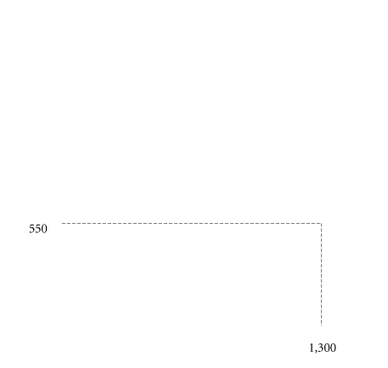
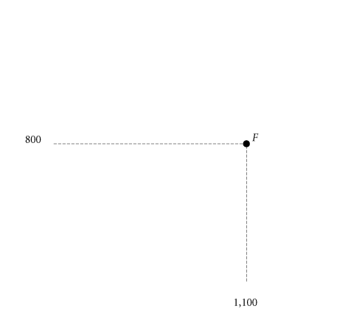
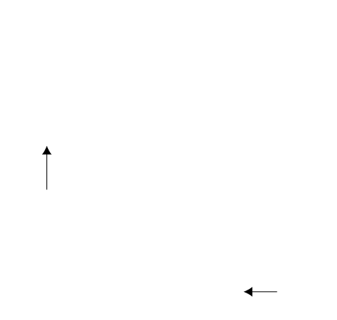
The opportunity cost of producing more capital goods is fewer consumer goods.
Moving from E to F, the number of capital goods increases from 550 to 800, but the number of consumer goods decreases from 1,300 to 1,100.

Slide 7
The PPF and efficiency
The production possibility frontier is a good way to illustrate the general economic concept of efficiency.
Economists say that an economy’s resources are used efficiently when they are used in a way that has fully exploited all opportunities to make everyone better off.
Points on the PPF are productive efficient, while points within the curve are inefficient.
An efficient allocation of means of production is one which yields a combination of outputs where it is not possible to increase the output of one good without reducing the output of the other.

Slide 8
Productive inefficiency
Empty seats on an airline flight represents productive inefficiency. Since the plane is making the trip anyway, filling the empty seat would enable the airline to serve more people with the flight without using any additional resources. Therefore, more people could fly without sacrificing any other good or service.
A firm, an industry, or an entire economy is productively inefficient if it could produce more of at least one good without pulling resources from the production of any other good.

Slide 9
Economic growth
PPF changes when we produce more of everything. Economic Growth Shifts the PPF Up and to the Right
An increase in the total output of an economy. It occurs when a society acquires new resources or when it learns to produce more using existing resources.
Two main causes of economic growth is increase in resources and technological change.
Notes:
<number>

Slide 10
The shape of the PPF and marginal analysis
‘Marginal’ simply means ‘extra’ or ‘additional’ and marginal analysis has to do with decision making at the margin.
Economists often analyse the effects of a one unit change in something
Example: how much better off will a consumer be if they can purchase one additional unit of a good? How much extra profit will a company earn by producing one additional unit of a good? How much more can a company produce if they hire one additional worker?
Asking such questions helps to find the optimal level of (for example) consumption and production,
The fact that the extra output each additional input can produce diminishes is one reason why the PPF is concave toward the origin.

Slide 11
Microeconomics
Buying decisions of the individual
Buying and selling decisions of the firm
The determination of prices and in markets
The quantity, quality and variety of products
Profits
Consumers’ satisfaction

Slide 12
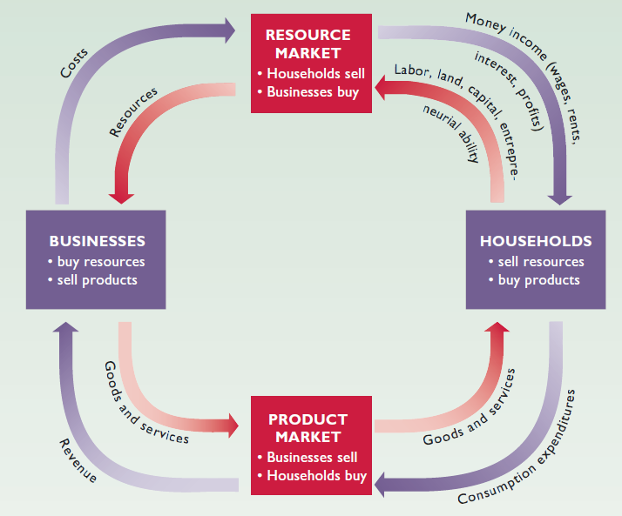
The circular flow diagram

Slide 13
There are two sides in a market for a good
Demand
Created by Consumers
Each consumer maximizes satisfaction (“utility”)
This is Consumption theory
Supply
Created by firms
Each firm maximizes its profits
This is production theory

Slide 14
Consumer Theory
Consumer Theory : Given the budget constraint, consumers choose the consumption bundle that maximizes utility. So, consumers choose the best bundle they can afford.

Slide 15
Budget Constraints
A consumption bundle containing x₁ units of commodity 1 and x₂ units of commodity 2 by the vector (x₁, x₂).
Commodity prices are p₁ and p₂.
When is a bundle (x₁, x₂) affordable at prices p₁, p₂?
A: When, p₁x₁ + p₂x₂ ≤ m where m is the consumer’s income.
Expenditure ≤ Income.

Slide 16
The bundles that are only just affordable form the consumer’s budget constraint. This is the set { (x₁,x₂) | x₁ ≥ 0, x₂ ≥ 0 and p₁x₁ + p₂x₂ = m }.

Slide 17
x₂
The consumer’s budget set is the set of all affordable bundles.
The budget constraint is the upper boundary of the budget set.
Budget constraint is
p₁x₁ + p₂x₂ = m.
m /p₂
the collection of all affordable
bundles.
Budget
Set
m /p₁
x₁

Slide 18
Budget Set and Constraint for Two Commodities
x₂
Budget constraint is
p₁x₁ + p₂x₂ = m
m /p₂
Not affordable
Just affordable
Affordable
m /p₁
x₁

Slide 19
The budget constraint’s slope is -p₁/p₂. What does it mean?
Budget Constraint can be written as
Increasing x₁ by 1 must reduce x₂ by p₁/p_{2.}

Slide 20
x₂
Opportunity cost of an extra unit of commodity 1 is p₁/p₂ units foregone of commodity 2. And the opp. cost of an extra unit of commodity 2 is p₂/p₁ units foregone of commodity 1.
+1
-p₂/p₁
x₁

Slide 21
The budget constraint and budget set depend upon prices and income. What happens as prices or income change?
Higher income gives more choice
x₂
New affordable consumption choices
Original and
new budget
constraints are
parallel (same
slope).
Original
budget set
Original
budget set
x₁

Slide 22
Budget Constraints - Income Changes
Increases in income m shift the constraint outward in a parallel manner, thereby enlarging the budget set and improving choice.
Decreases in income m shift the constraint inward in a parallel manner, thereby shrinking the budget set and reducing choice.

Slide 23
What happens if just one price decreases?
Suppose p₁ decreases.
x₂
m/p₂
New affordable choices
Budget constraint
pivots; slope flattens
from -p₁’/p₂ to
-p₁”/p₂
-p₁’/p₂
Original
budget set
-p₁”/p₂
m/p₁’
m/p₁”
x₁

Slide 24
Reducing the price of one commodity pivots the constraint outward. No old choice is lost and new choices are added, so reducing one price cannot make the consumer worse off.
Similarly, increasing one price pivots the constraint inwards, reduces choice and may make the consumer worse off.

