Slide 1
Consumer Theory

Slide 2
Preferences
A decision maker always chooses its most preferred alternative from its set of available alternatives.
So to model choice we must model decision makers’ preferences.
In economics, it is assumed that the consumer chooses her consumption bundle on the basis of her tastes and preferences over the bundles in the budget set.
Comparing two different consumption bundles, x and y:
strict preference: x is more preferred than is y.
weak preference: x is as at least as preferred as is y.
indifference: x is exactly as preferred as is y.

Slide 3
Preference relations
Strict preference, weak preference and indifference are all preference relations. Particularly, they are ordinal relations; i.e. they state only the order in which bundles are preferred.
≻denotes strict preference; x ≻ y means that bundle x is preferred strictly to bundle y. ∼ denotes indifference; x ∼ y means x and y are equally preferred. ≿ denotes weak preference; x ≿ y means x is preferred at least as much as is y.
x ≿ y and y ≿ x imply x ∼ y.
Consumer’s preferences are assumed to be such that between any two bundles (x1 , x2 ) and (y1 , y2 ), if (x1 , x2 ) has more of at least one of the goods and no less of the other good compared to (y1 , y2 ), then the consumer prefers (x1 , x2 ) to (y1 , y2 ). Preferences of this kind are called monotonic preferences.

Slide 4
Utility
Why do you buy the goods and services you do? It must be because they provide you with satisfaction—you feel better off because you have purchased them. Economists call this satisfaction utility.
It is generally assumed that the consumer has well-defined preferences over the set of all possible bundles. She can compare any two bundles. In other words, between any two bundles, she either prefers one to the other or she is indifferent between the two.

Slide 5
Indifference Curves
An indifference curve shows the various combinations of two goods that give the consumer equal level of utility or satisfaction.
Indifference curves give us a powerful framework for assessing consumer choices graphically.
Because all points along an indifference curve generate the same level of utility, economists say that a consumer is indifferent between them.

Slide 6
Indifference Curves
x₂
x’ ∼ x” ∼ x”’
x’
x”
x”’
x₁

Slide 7
Indifference Curves
I₁
x₂
All bundles in I₁ are
strictly preferred to all in I₂.
x
z
I₂
All bundles in I₂ are strictly preferred to all in I₃.
y
I₃
x₁

Slide 8
Indifference Curves Cannot Intersect
From I1, x ~ y. From I2, x ~ z.
Therefore y ~ z. But from I1 and I2 we
see y ≻ z, a contradiction.
x₂
I₂
I₁
x
y
z
x₁

Slide 9
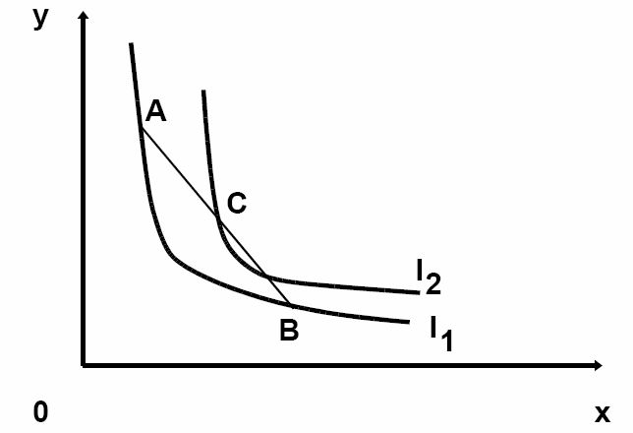
Typically indifference curves are convex. This means that starting with two bundles, A, B, which the consumer likes equally and are therefore on the same indifference curve. If preferences are monotonic, she prefers C, the average of two extreme bundles, rather than either of them. Bundle C has the average quantities of bundles A and B in X and Y

Slide 10
The indifference curves have a negative slope
As the consumer increases the consumption of X commodity, he has to give up certain units of Y commodity in order to maintain the same level of satisfaction.
Indifference curves are usually convex, or bowed inward. The term convex means that the slope of the indifference curve increases (i.e., becomes less negative) as we move down along the curve.
As more and more of one good is consumed, we can expect that a consumer will prefer to give up fewer and fewer units of a second good to get additional units of the first one.

Slide 11
Perfect Substitutes
If a consumer always regards units of commodities 1 and 2 as equivalent, then the commodities are perfect substitutes and only the total amount of the two commodities in bundles determines their preference rank-order.
If two goods are perfect substitutes then the indifference curves will have a constant slope since the consumer would be willing to switch between at a fixed ratio.
Two goods are substitutes when an increase in the price of one leads to an increase in the quantity demanded of the other.
Examples: Margarine and butter, tea and coffee. Substitute goods not only occur on the consumer side of the market but also the producer side. For example: petroleum and natural gas.

Slide 12
The two goods are perfect substitutes as you are
entirely indifferent between having of one or the other.
One 16-megabyte memory chip is equivalent to two
8-megabyte chips because both combinations have
the same memory capacity
15
I₂
8
Bundles in I₂ all have a total of 15 units and are strictly
preferred to all bundles in I₁, which have a total of only 8 units in them.
I₁
x₁
8
15

Slide 13
Perfect Substitution Indifference Curves
x₂
x₁ + x₂ = 5
13
x₁ + x₂ = 9
9
x₁ + x₂ = 13
5
V(x₁,x₂) = x₁ + x₂.
5
9
13
x₁
All are linear and parallel

Slide 14
Perfect Complements
If a consumer always consumes commodities 1 and 2 in fixed proportion (e.g. one-to-one), then the commodities are perfect complements and only the number of pairs of units of the two commodities determines the preference rank-order of bundles.
If two goods are perfect complements then the indifference curves will be L-shaped. Goods are complements when an increase in the price of one leads to a decrease in the quantity demanded of the other.
Example: Demand for cars and petrol; tea and sugar mobile phones and SIM cards

Slide 15
x₂
45º
The two goods are perfect complements because an additional X1 will not increase her satisfaction unless she can obtain the matching X2. Since each of (5,5), (5,9) and (9,5) contains 5 pairs, each is less preferred than the bundle (9,9) which contains 9 pairs.
9
I₂
5
I₁
x₁
5
9

Slide 16
Perfect Complementary Indifference Curves
x₂
45º
W(x₁,x₂) = min{x₁,x₂}
8
min{x₁,x₂} = 8
5
min{x₁,x₂} = 5
3
min{x₁,x₂} = 3
3
5
8
x₁

Slide 17
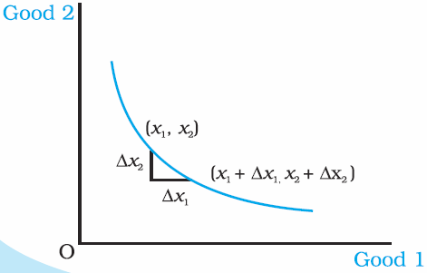
Slopes of Indifference Curves
The slope of an indifference curve is its marginal rate-of-substitution (MRS).
How can a MRS be calculated?
MRS at x’ is the slope of the indifference curve at x’. MRS= - ∆x2/ ∆x1
x₂
x’
x₁

Slide 18
Marginal rate of substitution (MRS)
The marginal rate of substitution (MRS) between two goods measures the maximum amount of a good that a consumer is willing to give up in order to obtain one additional unit of another good while maintaining the same level of satisfaction.
MRS in terms of the amount of the good on the vertical axis that the consumer is willing to give up in order to obtain 1 extra unit of the good on the horizontal axis.
The slope of a typical indifference curve gets steadily flatter as we move to the right, reflecting a diminishing marginal rate of substitution.

Slide 19
In general, the MRS varies along an indifference curve, that is, the MRS is in general different when the starting bundle of a potential trade changes.
The MRS of a consumer depends on individual preferences as expressed by the indifference curves. It does not depend on the market or the prices that may prevail in the market.

Slide 20
Utility Functions
A utility function U(x) represents a preference relation, if and only if: x’ ≻ x” U(x’) > U(x”) x’ ≺ x” U(x’) < U(x”) x’ ∼ x” U(x’) = U(x”)
Utility is an ordinal (i.e. ordering) concept.
E.g. if U(x) = 6 and U(y) = 2 then bundle x is strictly preferred to bundle y. But x is not preferred three times as much as is y.

Slide 21
Utility Functions & Indifference Curves
Consider the bundles (4,1), (2,3) and (2,2).
Suppose (2,3) ≻ (4,1) ∼ (2,2).
Assign to these bundles any numbers that preserve the preference ordering; e.g. U(2,3) = 6 > U(4,1) = U(2,2) = 4.
Call these numbers utility levels.

Slide 22
An indifference curve contains equally preferred bundles.
Equal preference ⇒ same utility level.
Therefore, all bundles in an indifference curve have the same utility level.
So the bundles (4,1) and (2,2) are in the indifference curve with utility level U ≡ 4
But the bundle (2,3) is in the indifference curve with utility level U ≡ 6.

Slide 23
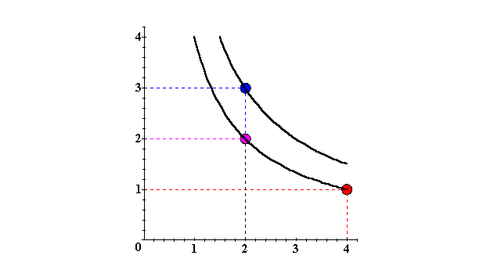
Utility Functions & Indiff. Curves
x₂
(2,3) ≻ (2,2) ∼ (4,1)
U ≡ 6
U ≡ 4
x₁

Slide 24
There is no unique utility function representation of a preference relation.
Suppose U(x₁,x₂) = x₁x₂ represents a preference relation.
Again consider the bundles (4,1), (2,3) and (2,2).
U(x₁,x₂) = x₁x₂, so U(2,3) = 6 > U(4,1) = U(2,2) = 4; that is, (2,3) ≻ (4,1) ∼ (2,2).

Slide 25
Perfect Substitution Indifference Curves
x₂
x₁ + x₂ = 5
13
x₁ + x₂ = 9
9
x₁ + x₂ = 13
5
U(x₁,x₂) = x₁ + x₂.
5
9
13
x₁
All are linear and parallel.

Slide 26
Perfect Complementary Indifference Curves
x₂
45º
U(x₁,x₂) = min{x₁,x₂}
8
min{x₁,x₂} = 8
5
min{x₁,x₂} = 5
3
min{x₁,x₂} = 3
3
5
8
x₁
All are right-angled with vertices on a ray from the origin.

Slide 27
Utility maximisation and choice
Indifference curves and the budget constraint together indicate the choice a consumer will make to maximise their satisfaction.
The point which maximises utility is the point at which the consumer reaches the highest indifference curve that the budget constraint allows.
The consumer should choose the consumption bundle where the slope of the budget line and the slope of the indifference curve coincide. In other words, it is the point at which the indifference curve is tangent to the budget constraint.

Slide 28
x₂
(x₁*,x₂*) is the most preferred affordable bundle.
x₂*
x₁*
x₁

