Slide 2
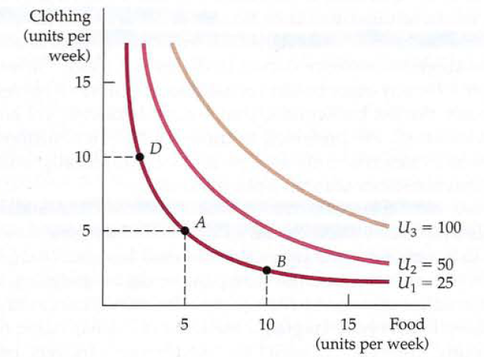
Utility Functions and Indifference Curves
A utility function can be represented by a set of indifference curves, each with a numerical indicator. This figure shows three indifference curves (with utility levels of 25,50, and 100, respectively) associated with the utility function.
Utility: Numerical score
representing the satisfaction
that a consumer gets from a
given market basket.
Utility function: Formula
that assigns a level of utility to individual market baskets.

Slide 3
Total and Marginal utility
Total utility would be the number of units of utility that a consumer gains from consuming a given quantity of a good, service, or activity during a particular time period. The higher a consumer’s total utility, the greater that consumer’s level of satisfaction.
Marginal utility is the extra satisfaction a consumer realizes from an additional unit of that product.
Marginal Utility is the change in utility associated with a small change in the amount of one of the goods consumed holding the quantity of the other good fixed. It measures the rate of change in utility when we vary the quantity of a good consumed.

Slide 4
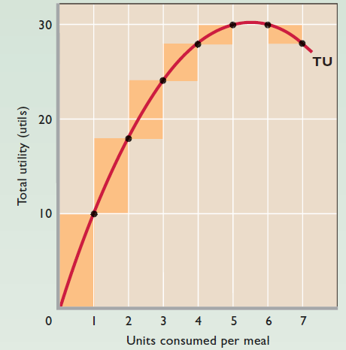
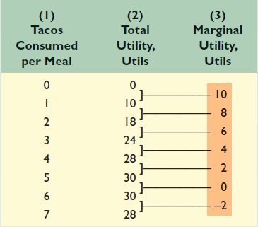
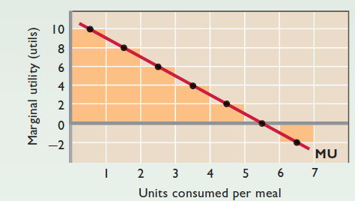

Slide 5
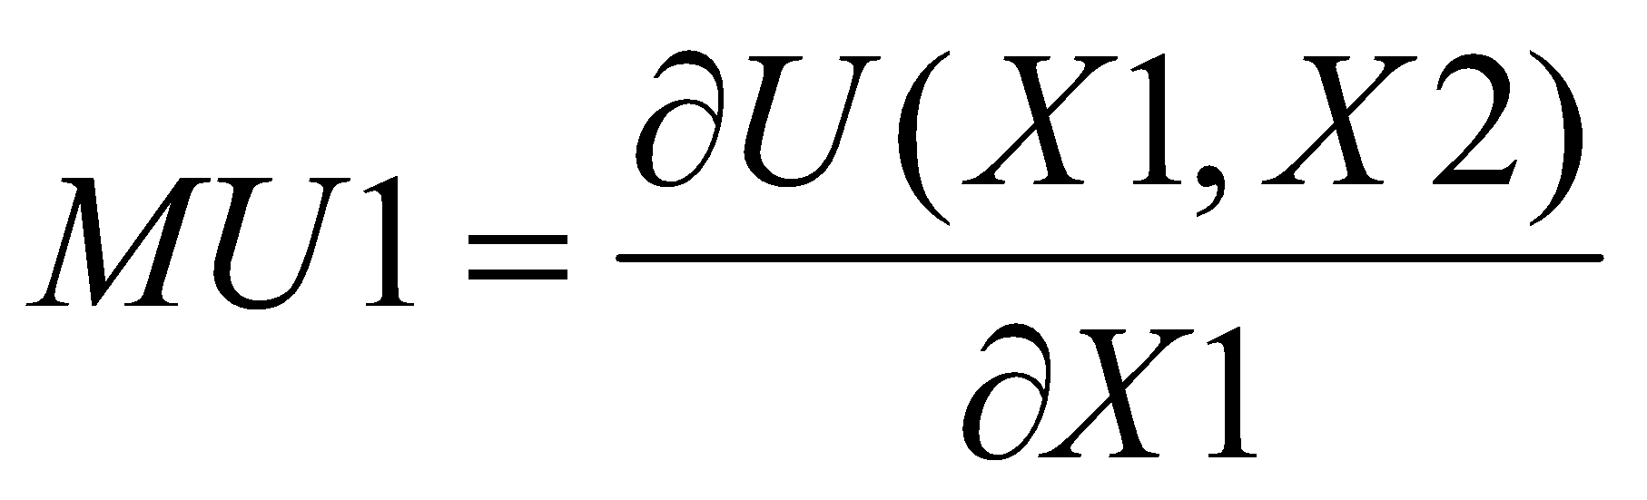

The marginal utility with respect to good 1 (MU1) as the ratio:
The marginal utility with respect to good 2 (MU2) as the ratio:
Perfect substitutes (the blue/red pencil) :
u(x1, x2) = x1 + x2
Since utility is just the total number of pencils you have, one more pencil increase your utility by exactly 1
here, MU1 = MU2 = 1

Slide 6
The law of diminishing marginal utility states that as an extra unit of the good is consumed, the marginal utility, i.e. the benefit derived from consuming the good, falls. Therefore, consumers are willing to pay less for the good.
This law implies that all goods and services eventually will have downward-sloping marginal utility curves.

Slide 7
The marginal utility diminishes with increased consumption, becomes zero when total utility is at a maximum, and is negative when total utility declines.

Slide 8
Marginal Decision Rule
Consumers wants to maximise her utility constrained by the income available to her and by the prices she must pay. If a consumer decides to spend more on one good, she must spend less on another in order to satisfy the budget constraint. She must arrange her consumption so that her total expenditures do not exceed her budget available. Hence, utility maximization is a matter of arranging that spending to achieve the highest total utility possible.
The marginal decision rule states that an activity should be expanded if its marginal benefit exceeds its marginal cost.
If the marginal benefit of an additional unit of an activity exceeds the marginal cost, the quantity of the activity should be increased. If the marginal benefit is less than the marginal cost, the quantity should be reduced. Net benefit is maximized at the point at which marginal benefit equals marginal cost.

Slide 9
The utility gained by spending an additional dollar on good X, for example, is MUx/Px . How much utility is gained by spending another $1 on a good? It is the marginal utility of the good divided by its price.
Suppose that the marginal utility of good X is 4 and that its price is $2.Then an extra $1 spent on X buys 2 additional units of utility (MUx/Px=4/2=2 ). If the marginal utility of good X is 1 and its price is $2, then an extra $1 spent on X buys 0.5 additional units of utility (MUx/Px=1/2=0.5 ).
The marginal cost is the utility lost by spending $1 less on another good. The marginal cost to the consumer of spending $1 less on a good is the loss of the additional utility that could have been gained from spending that $1 on the good.

Slide 10
Suppose a consumer has to purchase of good X and good Y
The law of diminishing marginal utility tells us that the marginal utility of good X will fall as the consumer consumes more of it; the marginal utility of good Y will rise as the consumer consumes less of it.
The marginal benefit of shifting $1 from good Y to the consumption of good X exceeds the marginal cost. In terms of utility, the gain from spending an additional $1 on good X exceeds the loss in utility from spending $1 less on good Y. The consumer can increase utility by shifting spending from Y to X.

Slide 11
In terms of the marginal decision rule, the consumer will have achieved a solution at which the marginal benefit of the activity (spending more on good X) is equal to the marginal cost.
The utility-maximizing condition: Utility is maximized when total outlays equal the budget available and when the ratios of marginal utilities to prices are equal for all goods and services.

Slide 12
Assumptions
All the units of a commodity must be same in all respects
The unit of the good must be standard
There should be no change in taste during the process of consumption
There must be continuity in consumption
There should be no change in the price of the substitute goods

Slide 13
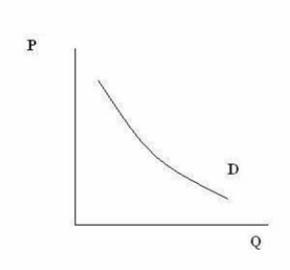
Demand curve
The relationship between price and quantity bought is called the demand curve. The demand curve shows how much of a good consumers are willing to buy as the price per unit changes.
Price higher, quantity demanded less.

Slide 14
The law of demand
When the price of a commodity is increased consumers tend to buy less of the commodity with other things are held constant. Similarly, when the price is decreased quantity demanded increases, with other things are held constant. This is called the law of demand.
Quantity demanded tends to fall as price rises for two reasons.
Substitution effect: When price rises, consumer substitute other similar goods. The substitution effect involves the substitution of good x1 for good x2 or vice versa due to a change in relative prices of the two goods.

Slide 15
Income effect: When price goes up, consumer becomes poorer than before. The income effect results from an increase or decrease in the consumer’s real income or purchasing power as a result of the price change.
The sum of these two effects is called the price effect.

Slide 16
Deriving an Individual’s Demand Curve
Suppose, Mary Andrews consumes only apples (A), and oranges(O). Apples cost $2 per pound and oranges cost $1 per pound, and her budget allows her to spend $20 per month on the two goods. We assume that Ms. Andrews will adjust her consumption so that the utility-maximizing condition holds for the two goods:
Her spending equals her budget of $20 per month; suppose she buys 5 pounds of apples and 10 of oranges.
Now suppose that an unusually large harvest of apples lowers their price to $1 per pound. The lower price of apples increases the marginal utility of each $1 Ms. Andrews spends on apples.

Slide 17
Ms. Andrews will respond by purchasing more apples. As she does so, the marginal utility she receives from apples will decline. If she regards apple and oranges as substitutes, she will also buy fewer oranges. That will cause the marginal utility of oranges to rise. She will continue to adjust he spending until the marginal utility per $1 spent is equal for both goods:
Suppose that at this new solution, she purchases 12 pounds of apples an 8 pounds of oranges. She is still spending all of her budget of $20 on the two goods [(12 x $1)+(8 x $1)=$20].

Slide 18
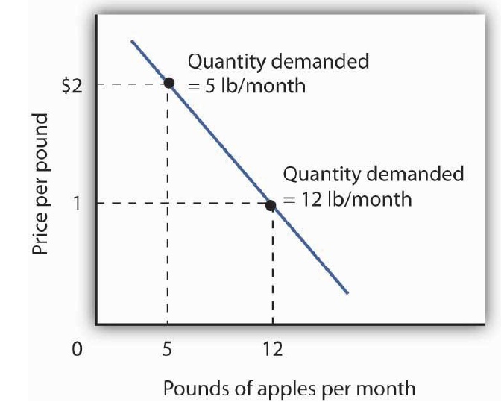
Utility Maximization and an Individual’s Demand Curve
Mary Andrews’s demand curve for apples can be derived be determining the quantities of apples she will buy at each price. Those quantities are determined by the application of the marginal decision rule to utility maximization.

Slide 19
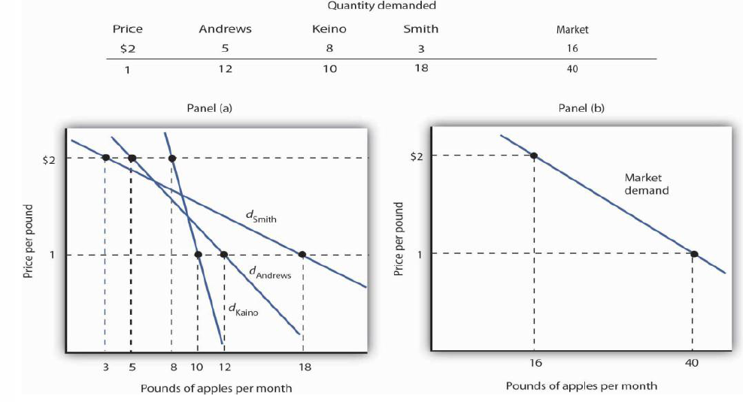
From Individual to Market Demand
Suppose that in addition to Ms. Andrews, there are two other consumers in the market for apples—Ellen Smith and Koy Keino.

Slide 20
Market demand
The market demand curve is the horizontal summation of all the individual demand curves.
The law of downward sloping is also applicable to market demand

Slide 21
The Substitution and Income Effects of a Price Change
When the price of apples fell from $2 to $1 per pound, Mary Andrews increased the quantity of apples she demanded. Behind that adjustment, however, lie two distinct effects: the substitution effect and the income effect.
Ms. Andrews was purchasing 5 pounds of apples and 10 pounds of oranges before the price change. Buying that same combination after the price change would cost $15. The extra utility per $1 she could obtain from apples now exceeds the extra utility per $1 from oranges. She will thus increase her consumption of apples. If she had only $15, any increase in her consumption of apples would require a reduction in her consumption of oranges. In effect, she responds to the income-compensated price change for apples by substituting apples for oranges. The change in a consumer’s consumption of a good in response to an income-compensated price change is called the substitution effect.

Slide 22
In other words, when the price of a good falls, people react by substituting or switching toward that good, buying more of it and less of other goods. When the price of a good goes up, people react by substituting or switching away from that good, buying less of it and instead buying more of other goods.
The price reduction essentially made consumers of apples richer. After the price reduction, it cost her just $15 to buy what cost her $20 before. She has, in effect, $5 more than she did before. In effect, the price reduction for apples was equivalent to increasing her purchasing power.
The change in consumption of a good resulting from the implicit change in income because of a price change is called the income effect of a price change.

Slide 23
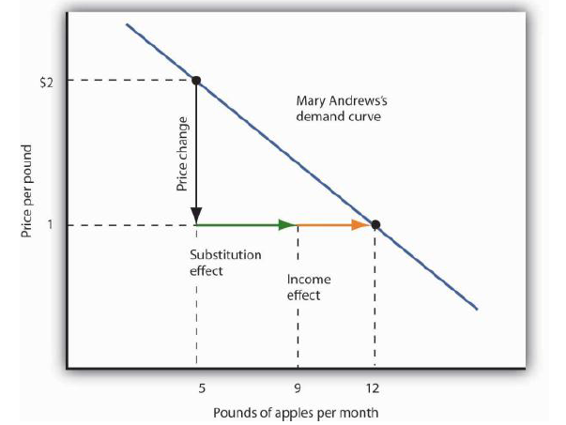

Slide 24
Normal and Inferior Goods
The nature of the income effect of a price change depends on whether the good is normal or inferior.
A normal good is one whose consumption increases with an increase in income. When the price of a normal good falls, there are two identifying effects:
1. The substitution effect contributes to an increase in the quantity demanded because consumers substitute more of the good for other goods.
2. The reduction in price increases the consumer’s ability to buy goods. Because the good is normal, this increase in purchasing power further increases the quantity of the good demanded through the income effect.
e.g., most of the products, food, furniture, and electronic equipment

Slide 25
An inferior good is one for which demand falls when income rises. It is likely to be a good that people do not really like very much.
When incomes are low, people consume the inferior good because it is what they can afford. As their incomes rise and they can afford something they like better, they consume less of the inferior good.
e.g., public transportation
The income effect of a price change works in a direction opposite to that of the substitution effect in the case of an inferior good, whereas it reinforces the substitution effect in the case of a normal good.

Slide 26
Demand Curve
A demand curve thus shows the relationship between the price and quantity demanded of a good or service during a particular period, all other things unchanged. The demand curve is the marginal utility curve. The law of diminishing marginal utility implies that demand curves have a negative slope.
This demand curve has two important properties:
1. The level of utility that can be attained changes as we move along the curve.
2. At every point on the demand curve, the consumer is maximizing utility by satisfying the condition that the marginal rate of substitution (MRS) of food for clothing.

Slide 27
Factors affecting the demand curve
While different variables play different roles in influencing the demands for different goods and services, economists pay special attention to one: the price of the good or service.
Average income: as incomes rise, individuals tend to buy more, even if prices don’t change.
Size of the market: population affects the market demand curve.
Prices of related goods: demand for good A tends to be low if the price of substitute product B is low.
Tastes or preferences: cultural and historical influences
Special influence: Seasonal effects, Buyer Expectations etc.

Slide 28
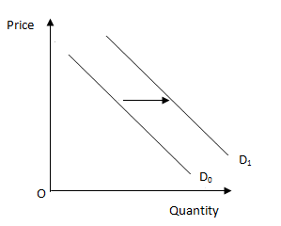
Shifts in demand
Change in price causes change in quantity demanded, hence there is movement along the demand curve accordingly.
Change in something other than price causes change in demand, hence the demand curve shifts. e.g., an increase in incomes, an increase in population, or an increase in the price of substitutes goods likely to increase the quantity of coffee demanded at each price.

Slide 29
A change in demand occurs when one of the elements underlying the demand curve shifts.
Higher incomes will increase demand and shift the demand curve for pizzas out and to the right. This is a shift in the demand for pizzas for a given pizza price.
By contrast, suppose that a new technology reduces pizza costs and prices. Consumers tend to buy more pizzas as pizza prices fall, all other things remaining constant. This change represents a movement along the demand curve, not a shift of the demand curve.

Slide 30
Supply curve
The supply curve shows the quantity of a good that producers are willing to sell at a given price, holding all other things unchanged. The supply curve is thus a relationship between the quantity supplied and the price.
With all other things unchanged, the receipt of a higher price increases profits and induces sellers to increase the quantity they supply.
Law of supply: Other things equal, the quantity supplied of a good rises when the price of the good rises and vice versa.

Slide 31
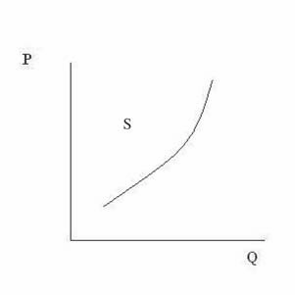
The supply curve slopes is upward. In other words, the higher the price, the more that firms are able and willing to produce and sell.
Market supply is the sum of individual supplies.

Slide 32
Factors affecting the supply curve
Price
Technology: Technological advances, lower the quantity of inputs needed to produce the same quantity of output.
Input prices: increase in the price of labor, energy, or machinery increase production costs, and lower supply.
Prices of related goods: If the price of one production substitute rises, the supply of another substitute will decrease.
Number of sellers
Government policies: subsidies, tariffs, taxes and minimum-wage laws, trade policies etc. changes production.
Expectations of sellers
Special influences: Seasonality etc.

Slide 33
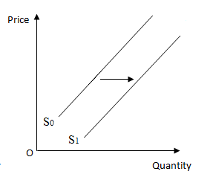
Shifts in supply curve
Change in price causes change in quantity supplied, hence there is movement along the curve accordingly.
Change in something other than price causes change in supply, hence the supply curve shifts.
e.g., production cost, returns from alternative activities, technology, natural events, seller expectations etc.

Slide 34
Equilibrium in the Market
Market equilibrium comes at that price and quantity where the forces of supply and demand are in balance.
At equilibrium price, the amount that buyers want to buy is just equal to the amount that sellers want to sell.
The market mechanism is the tendency in a free market for the price to change until the market clears-i.e., until the quantity supplied and the quantity demanded are equal. At this point, because there is neither excess demand nor excess supply, there is no pressure for the price to change further.

Slide 35
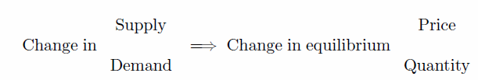
Equilibrium state:
No shortage
No surplus
Equilibrium price clears the market called market-clearing price.
Surplus: A situation in which quantity supplied is greater than quantity demanded.
Shortage: A situation in which quantity demanded is greater than quantity supplied.

Slide 36
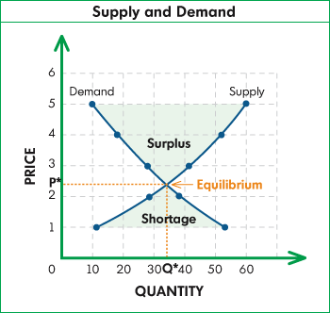
The market clears at price P* and quantity Q*. At the higher price a surplus develops. Producers would begin to lower prices. Eventually, as price fell, quantity demanded would increase, and quantity supplied would decrease until the equilibrium price P* was reached. At the lower price there is a shortage, so price is bid up.

Slide 37
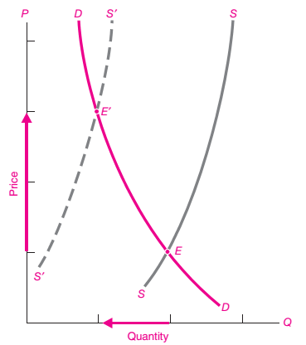
Effect on equilibrium for a shift in supply
If supply falls=>the supply curve shifts to the left and price become higher and quantity become lower.
If supply rises=>the supply curve shifts to the right and price become lower and quantity become higher.

Slide 38
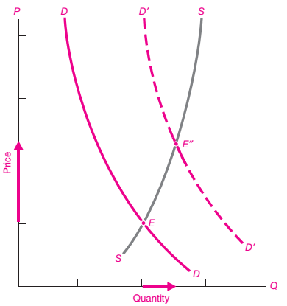
Effect on equilibrium for a shift in demand
If demand rises=>the demand curve shifts to the right and both prices and quantity become higher.
If demand falls=>the demand curve shifts to the left and both prices and quantity become lower.

Slide 39
Interpreting changes in price and quantity
When prices or quantities change in a market, does the situation reflect a change on the supply side or the demand side?
A rise in the price accompanied by a decrease in quantity suggests that the supply curve has shifted to the left (a decrease in supply).
A rise in price accompanied by an increase in quantity indicates that the demand curve has probably shifted to the right (an increase in demand)

Slide 40
To use supply-and-demand analysis correctly, we must
distinguish a change in demand or supply (which produces a shift of a curve) from a change in the quantity demanded or supplied (which represents a movement along a curve);
hold other things constant,
look always for the supply-and-demand equilibrium
When we draw and use supply and demand curves, we are assuming that at any given price, a given quantity will be produced and sold. By this we mean that both sellers and buyers should have little market power-i.e., little ability individually to affect the market price.

Slide 41
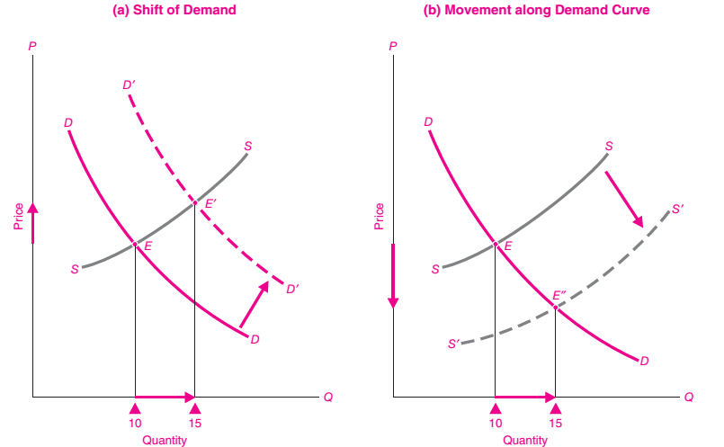

Slide 42
Change in market equilibrium
A change in market equilibrium due to a shift in demand
A change in market equilibrium due to a shift in supply
Shifts in both supply and demand
Shifts in curves versus movements along curves

Slide 43
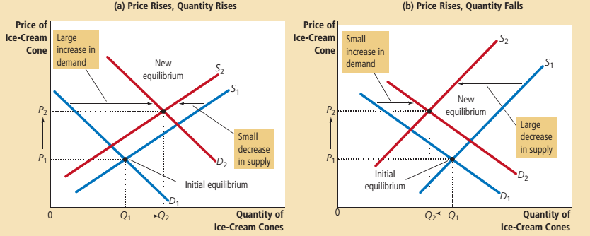
A shift in both supply and demand

Slide 44
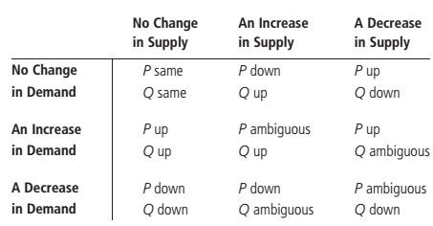
Summary table

Slide 45
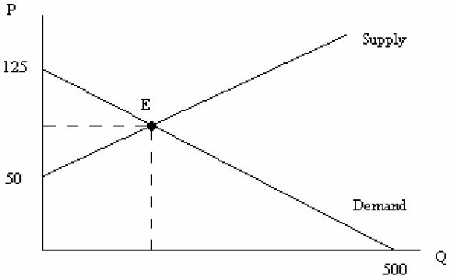
Example
Demand Curve: Qd = 500 – 4P
Supply Curve: QS = -100 + 2P
At what price and quantity do you reach equilibrium?
QS = Qd
500 – 4P = -100 + 2P
P=100
To find the equilibrium quantity
QS = 500 – 4(100) = 100
And so, equilibrium occurs at P=100 and Q=100

