Slide 2
Elasticity
Elasticity measures the “sensitivity” of one variable with respect to another.
The elasticity of variable X with respect to variable Y is
Economists use elasticity to measure the sensitivity of
quantity demanded of commodity i with respect to the price of commodity i (price elasticity of demand).
demand for commodity i with respect to the price of commodity j (cross-price elasticity of demand).
demand for commodity i with respect to the income m (income elasticity of demand)

Slide 3
Price elasticity of demand
The price elasticity of demand measures how much the quantity demanded of a good changes when its price changes.

Slide 4
Elastic and inelastic demand
Demand for a good is said to be elastic if the quantity demanded responds substantially to changes in the price.
Ex: Luxury goods, substitute goods
Demand is said to be inelastic if the quantity demanded responds only slightly to changes in the price.
Ex: food, fuel, prescription drugs

Slide 5
Arc and Point Elasticity
An “average” price elasticity of demand for commodity i over an interval of values for p_{i} is an arc-elasticity, usually computed by a mid-point formula.
Elasticity computed for a single value of p_{i} is a point elasticity.
Elasticities are written as absolute value.
Elasticity uses percentage changes in price and demand rather than absolute changes. Hence it is unit less quantity.

Slide 6
Arc Price Elasticity
p_{i}
What is the “average” price elasticity of demand for prices in an interval centered on p_{i}’?
X_{i}

Slide 7
Arc price elasticity of demand

Slide 8
Example
A quantity demanded was 240 units at a price of 90. A price increase to 110 led consumers to reduce their purchases to 160 units. What is the price-elasticity?

Slide 9
Point Price Elasticity
p_{i}
What is the price elasticity of demand in a very small interval of prices centered on p_{i}’?
p_{i}’
X_{i}

Slide 10
E.g. Suppose p_{i} = a - bX_{i}. Then X_{i} = (a-p_{i})/b and
Therefore,

Slide 11
Point Elasticity
p_{i}
p_{i} = a - bX_{i}
a
elastic
a/2
(unit elastic)
inelastic
0
a/2
a
X_{i}

Slide 12
Demand is elastic when the elasticity is greater than 1
Demand is inelastic when the elasticity is less than 1
Necessities (food) are highly price inelastic (ε < 1)
Luxuries (air travel) are highly price elastic (ε > 1)

Slide 13
Revenue and Price Elasticity of Demand
Total revenue is by definition equal to price times quantity.
Sellers’ revenue is
Hence,
For
A change to price does not alter sellers’ revenue

Slide 14
If
A price increase raises sellers’ revenue.
Hence price inelastic demand causes sellers’ revenues to rise as price rises.
If raising a commodity’s price causes little decrease in quantity demanded, then sellers’ revenues rise.

Slide 15
And, if
A price increase reduces sellers’ revenue.
Hence price elastic demand causes sellers’ revenues to fall as price rises.
If raising a commodity’s price causes a large decrease in quantity demanded, then sellers’ revenues fall.

Slide 16
Revenue and Price Elasticity of Demand
In summary:
Inelastic demand; Price rise causes rise in sellers’ revenue. In this case, the price effect is stronger than the quantity effect.
Unit elastic demand; Price rise causes no change in sellers’ revenue. In this case the two effects off-set each other.
Elastic demand; Price rise causes fall in sellers’ revenue. In this case, the price effect is weaker than the quantity effect.

Slide 17
Income Elasticity of Demand
Demand for most goods rises when aggregate income rises.
The income elasticity of demand is the percentage change in the quantity demanded(x), resulting from a 1-percent increase in income (m).

Slide 18
Normal and Inferior Goods
Normal good: Higher income raises quantity demanded.
Income elasticity positive (e.g., most of the products, food, furniture, and electronic equipment).
Inferior good: Higher income lowers the quantity demanded
Income elasticity negative (e.g., public transportation)
If income elasticity of demand of a commodity is less than 1, it is a necessity good.
Luxury good: Income elasticity greater than 1.

Slide 19
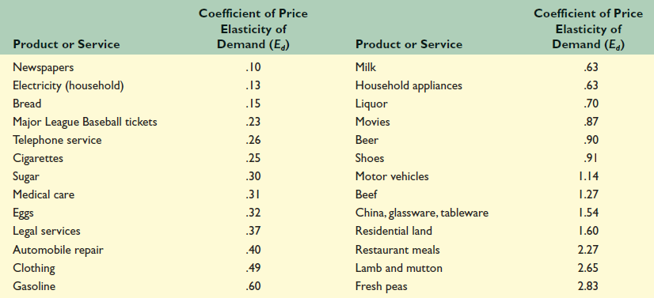
Selected Price Elasticities of Demand

Slide 20
A number of factors can thus affect the elasticity of demand for a good:
Availability of substitute goods: the more and closer the substitutes available, the higher the elasticity is likely to be, as people can easily switch from one good to another if an even minor price change is made.
Percentage of income: the higher the percentage of the consumer's income that the product's price represents, the higher the elasticity tends to be, as people will pay more attention when purchasing the good because of its cost.
Necessity: the more necessary a good is, the lower the elasticity, as people will attempt to buy it no matter the price, such as the case of insulin for those that need it.

Slide 21
Duration: the longer a price change holds, the higher the elasticity is likely to be, as more and more consumers find they have the time and inclination to search for substitutes. When fuel prices increase suddenly, for instance, consumers may still fill up their empty tanks in the short run, but when prices remain high over several years, more consumers will reduce their demand for fuel by switching to public transportation.

Slide 22
Price Elasticity of Supply
The price elasticity of supply measures how much the quantity supplied responds to changes in the price.
Supply of a good is said to be elastic if the quantity supplied responds substantially to changes in the price.
Supply is said to be inelastic if the quantity supplied responds only slightly to changes in the price.
The key determinant of the price elasticity of supply is production capacity.
Other factor influencing the price elasticity of supply is the time period under consideration.
Supply is usually more elastic in the long run than in the short run.

Slide 23
Determinants
Availability of raw materials: For example, availability may cap the amount of gold that can be produced in a country regardless of price.
Length and complexity of production: Textile production is relatively simple. The labor is largely unskilled and production facilities are little more than buildings - no special structures are needed. Thus the price elasticity of supply for textiles is elastic. On the other hand, the price elasticity of supply for specific types of motor vehicles is relatively inelastic. Auto manufacture is a multi-stage process that requires specialized equipment, skilled labor, a large suppliers network and large R&D costs.

Slide 24
Time to respond: The more time a producer has to respond to price changes the more elastic the supply. Supply is normally more elastic in the long run than in the short run for produced goods.
Inventories: A producer who has a supply of goods or available storage capacity can quickly increase supply to market.

Slide 25
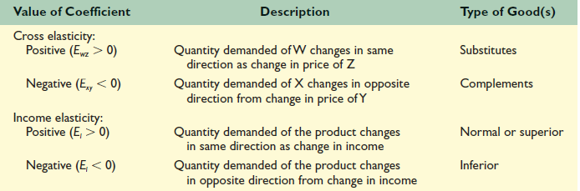

Slide 26
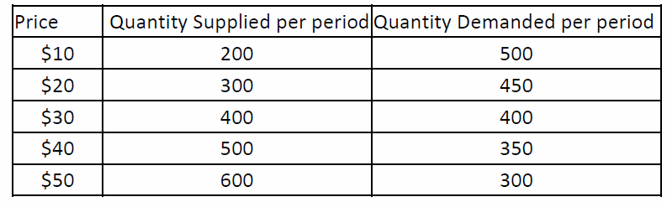
Problems
The supply and demand schedules for dozens of roses are given below:
The equilibrium price for a dozen roses is…………
Suppose the demand and supply functions for pumpkins is D(q) = 700 – 0.8q and S(q) = 100 + 0.5q. D(q) and S(q) are the prices, in dollars per ton, and q is the amount of pumpkins, in tons. Find the equilibrium point.
Recently, the price of avocados increased by 5%. As a result, 4% fewer were sold. What is the elasticity of demand? Is this elastic or inelastic?

Slide 27
Consumer surplus
In an ideal free market both consumers and producers gain by buying and selling at the equilibrium price.
Consumers’ surplus is the economic gain accruing to a consumer when they engage in trade. The gain is the difference between the price they are willing to pay and the actual price.
At the equilibrium level, the consumers’ surplus represents the total amount saved by consumers who were willing to pay more than equilibrium price per unit.

Slide 28
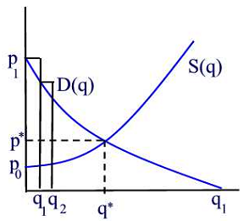

Slide 29
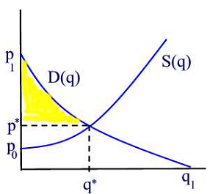
Producer surplus
The producer surplus measures the suppliers’ gain from trade.
It is the total amount gained by producers by selling at the current price, rather than at the price they would have been willing to accept.

Slide 30
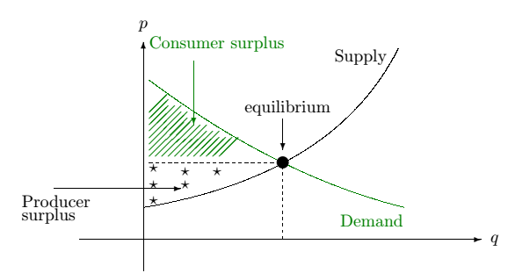
Total surplus
The sum of consumer surplus and producer surplus measures the net benefit to society of any level of economic activity.

Slide 31
The main attraction of markets in economics is that they can achieve significant net benefits through voluntary exchange between buyers and sellers, producers and consumers.
You buy a things because you expected that its benefits would exceed its opportunity cost; you expected that the purchase would make you better off. The seller sold it to you because he or she expected that the money you paid would be worth more than the value of keeping the item. The seller expected to be better off as a result of the sale.
Exchanges in the marketplace have a remarkable property: Both buyers and sellers expect to emerge from the transaction better off.

Slide 32
Efficiency and Equity
In an efficient allocation of goods, no one can be made better off without making someone else worse off. One condition that must be met if the market’s allocation is to be efficient is that the marketplace must be competitive. The equilibrium quantity and price as determined by demand and supply, is efficient.
An inequitable allocation of resources implies that the distribution of income and wealth is inequitable. Equity is very much in the mind of the observer. What may seem equitable to one person may seem inequitable to another.
The governments of all nations act in some way to redistribute income. That fact suggests that people generally have concluded that leaving the distribution of income solely to the market would not be fair and that some redistribution is desirable.

Slide 33
Deadweight loss
Markets can be a little inefficient or a lot inefficient. The markets in question are efficient before price controls are imposed. The failure of private decisions in the marketplace to achieve an efficient allocation of scarce resources is called market failure.
Government policies can create market distortions include taxes, subsidies, and quotas. We measure the level of inefficiency using the notion of deadweight loss.
The deadweight loss is an inefficiency caused by price controls. It is a loss to society—it is a reduction in total surplus, a loss in surplus that accrues to no one as a gain.
A loss that is experienced by both disappointed consumers and frustrated producers.

Slide 34
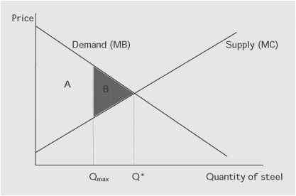
Let say government limits, the amount of steel that can be produced to Qmax. We see that this amount falls short of the amount that would be supplied at the competitive market equilibrium. At the optimum the total net benefit would equal the areas A + B, but with the supply restriction the net benefit is only equal to the area A. The deadweight loss, therefore, is equal to B, the shaded area.

Slide 35
Supply, Demand and Government policies
The interaction of demand and supply guides prices to their equilibrium levels. At equilibrium, the quantity of goods consumers are willing to buy equals the quantity of goods firms are willing to sell.
The equilibrium price does not necessarily please either buyers or sellers. Therefore, the government intervenes to regulate prices by imposing price controls, which are legal restrictions on how high or low a market price may go.
In real world, government intervenes markets by:
Price ceilings
Price floors
Taxes
Subsidies

Slide 36
When the government imposes price controls, then there will be either excess supply or excess demand, since the legal price is often very different from the market price.

Slide 37
Price Ceilings
Price ceilings specify a maximum price sellers are allowed to charge for a good or service. It is a maximum legal price which set by the government.
A price ceiling creates a shortage when the legal price is below the market equilibrium price.
A price ceiling that is below the market equilibrium causes consumers to compete for the limited supply. Suppliers can no longer charge the price the market demands but are forced to meet the maximum price set by the government’s price ceiling.
A price ceiling has no effect on the quantity supplied if the legal price is above the market equilibrium price. In this case, the market is unable to produce a price as high as the ceiling price.

Slide 38
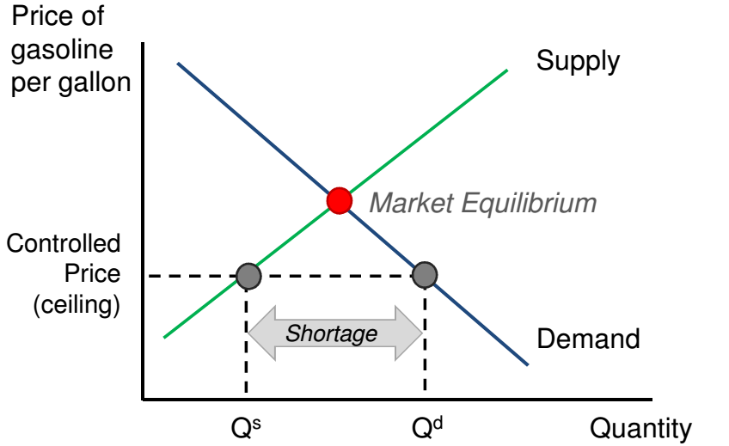

Slide 39
Price ceilings create five important effects:
Shortages
Reductions in product quality
Waste of times
A loss of gains from trade
A misallocation of resources

Slide 40
Low quality and wasted resources
Producers, unable to sell their good at the unconstrained price, are encouraged to reduce their costs by providing a lower quality good.
At the controlled price, demanders are willing to pay more. Individuals are encouraged to exchange the good outside of legal markets in order to bypass price restrictions.
The constraint causes individuals to spend time and money to acquire the scarce resource.
Misallocation of resources
Price controls eliminate incentives for producers to supply the good consumers who value it the most and are willing to offer sellers a higher price leading to a misallocation of resources.

Slide 41
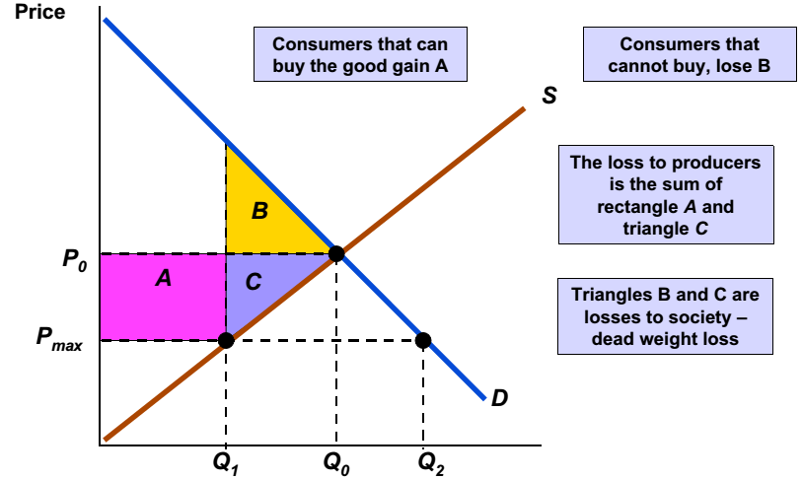
Deadweight loss
Quantity

Slide 42
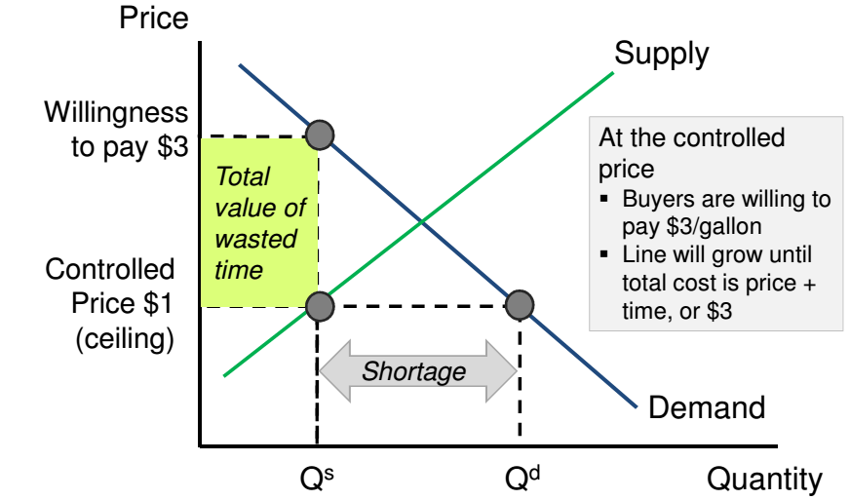
Wasted time

Slide 43
Price floors
Sometimes governments intervene to push market prices up instead of down. Price floors specify a minimum price buyers are required to pay for a good or service.
Price floors create:
Surplus
Deadweight loss from inefficiently low quantity
Wasted resources
Inefficiently high quality
Temptation to break the law by selling below the legal price

Slide 44
The government’s imposed minimum price (price floor) below the market-determined equilibrium price, has no measurable affect on the product’s price. In this case, the market is already producing a price higher than the imposed minimum.
A good example of a price floor is the minimum wage.
A minimum wage above the market price creates a surplus - the quantity of labor supplied exceeds the quantity demanded.
A surplus of labor is called unemployment.

Slide 45
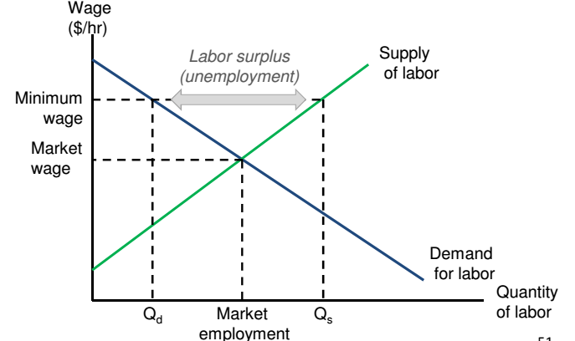
Surplus

Slide 46
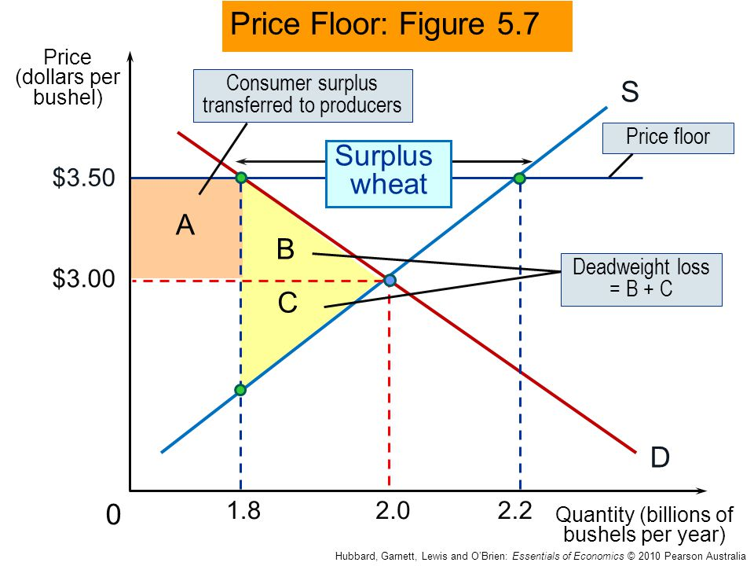
Price floors: Government policy in agricultural markets

Slide 47
Wasted Resources
Which involve government purchases of the unwanted surpluses of agricultural products caused by price floors.
Restrictions on entry misallocated resources because low-cost airlines were kept out of the industry.
Also kept out innovations, new ideas, and experiments that are part of the market process.
Inefficiently High Quality
Suppose that suppliers spend a lot to make goods of very high quality but that this quality isn’t worth much to consumers, who would rather receive the money spent on that quality in the form of a lower price. This represents a missed opportunity.

Slide 48
Tax policies
Taxes are essential for government to function. However, taxes also distort the incentives of the marketplace, creating losses in efficiency.
Government imposes taxes include on
- gasoline
- cigarette
- alcohol
- hotel rooms
As these examples suggest, one of the typical reasons for taxes is to discourage consumption of the good. However, taxes are also levied as a source of revenue.
The tax can be levied on either the buyer or the seller of the commodity.

Slide 49
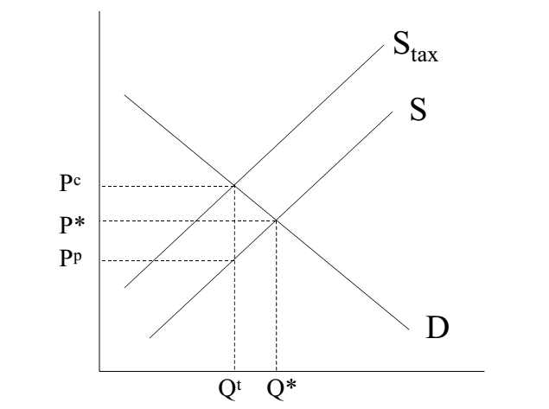
Let's suppose, that a sales tax is nominally imposed on the sellers of cigarettes. If there is a $1 tax on cigarettes, then there has to be a $1 difference between what the buyer pays and what the seller gets. The supply curve shifts vertically up by $1. This new supply curve gives a new equilibrium at (Pc,Qt)

Slide 50
Impact of tax on price and quantity
The quantity sold drops from Q* to Qt
The price suppliers gets decreases at Pp
The price consumers pay, tax included, rises from P* to Pc
It should be apparent that consumers are paying more than they were before, and producers are receiving less than they were before. The burden is distributed between the two of groups.
Notice that the tax burden is not born solely by the consumer, even though the tax is levied on the consumer. Who bears the burden of the tax is referred to as the tax incidence. The tax incidence depends on the elasticity of supply and demand.
In addition, there is also a dead-weight loss. This loss corresponds to units that should have been sold, because they would have been mutually beneficial exchanges.

