Slide 2
What is Production?
Production is the process of transforming inputs into outputs.
In the production process, firms turn inputs, which are also called factors of production, into outputs.
The inputs into the broad categories are labor, material, capital and technology.

Slide 3
Factors of production
Labor inputs include skilled workers and unskilled workers, as well as the entrepreneurial efforts of the firm's managers.
Materials include steel, plastics, electricity, water, and any other goods.
Capital includes land, buildings, machinery and other equipment, as well as inventories.
Technology

Slide 4
Production functions
The production function indicates the maximum output that a firm will produce for every specified combination of inputs.
Assuming that there are two inputs, labor L and capital K, the production function can be written as:
Q = f(K, L)
Where, L measures the number of workers, and K the amount of machinery employed by a firm.
Production functions describe what is technically feasible when the firm operates efficiently-that is, when the firm uses each combination of inputs as effectively as possible.

Slide 5
Every production function refers to a given technology. As technology advances, the production function will change to reflect the higher level of output with the same inputs.
The production function refers to a specific time horizon.
In the short run, for instance, some factors of production cannot be changed (e.g. the amount of capital/equipment): these factors are called fixed inputs. A fixed input is one whose supply is inelastic in the short run.
A variable input is one whose supply in the short run is elastic, example, labour, raw materials. Only the variable inputs appear in the production function.
In the long run all the inputs are considered variable.

Slide 6
Short run
At least one input is fixed
All changes in output achieved by changing usage of variable inputs
Long run
All inputs are variable
Output changed by varying usage of all inputs

Slide 7
Production with one variable input
Let’s consider the case in which capital is fixed, but labor is variable: Q = f(L)
When deciding how much of a particular input to buy, a firm has to compare the benefit with the cost. A firm analyses the benefit and the cost on an incremental basis or average basis.
The average product of labor is defined as the output per unit of labor input:
AP_{L} = Output/labor input = Q/L
The average product of labor measures the productivity of the firm's workforce in terms of how much output each worker produces on average.

Slide 8
Marginal product is the additional output that can be produced by adding one more unit of a specific input.
The marginal product of labor is defined as the additional output as the labor input is increased by 1 unit:
MP_{L}= Change in output/change in labor input = ΔQ/ΔL
Production with One Variable Input
Amount of Labor (L | Amount of Capital (K) | Total Output (q) | Average Product (Q/L) | Marginal Product (∆Q/∆L)
0 | 10 | 0 | — | —
1 | 10 | 10 | 10 | 10
2 | 10 | 30 | 15 | 20
3 | 10 | 60 | 20 | 30
4 | 10 | 80 | 20 | 20
5 | 10 | 95 | 19 | 15
6 | 10 | 108 | 18 | 13
7 | 10 | 112 | 16 | 4
8 | 10 | 112 | 14 | 0
9 | 10 | 108 | 12 | −4
10 | 10 | 100 | 10 | −8

Slide 9
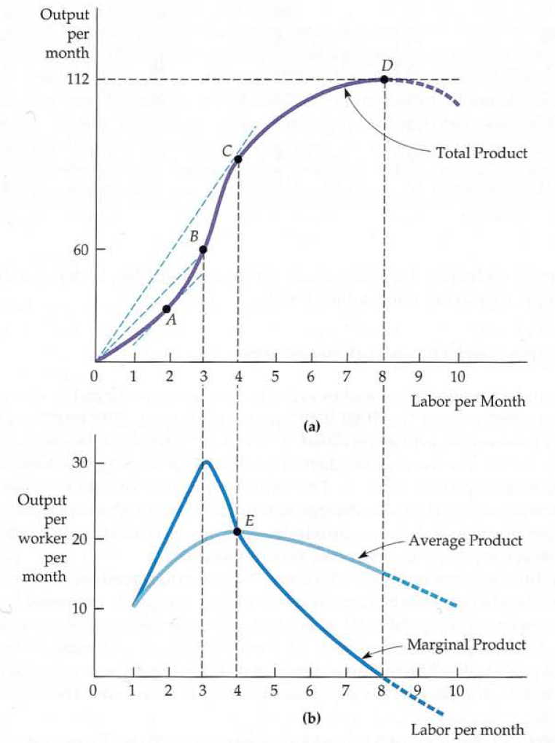

Slide 10
The portion of the total output curve that is declining denote that producing with more than eight workers is not economically rational; it can never be profitable to use additional amounts of a costly input to produce less output.
The marginal product curve crosses the horizontal axis of the graph at the point of maximum total product. This happens because adding a worker in a manner that slows production and decreases total output implies a negative marginal product for that worker.
The marginal product is above the average product when the average product is increasing and below the average product when the average product is decreasing. It follows, therefore, that the marginal product must equal the average product when the average product reaches its maximum. This happens at point E

Slide 11
Law of Diminishing Marginal Returns
Using production functions, we can understand one of the most famous laws in economics, the law of diminishing returns.
Under the law of diminishing returns, a firm will get less and less extra output when it adds additional units of an input while holding other inputs fixed. In other words, the marginal product of each unit of input will decline as the amount of that input increases, holding all other inputs fixed.
As more of an input such as labor is added to a fixed amount of land, machinery, and other inputs, the labor has less and less of the other factors to work with. The land gets more crowded, the machinery is overworked, and the marginal product of labor declines.

Slide 12
When the labor input is small (and capital is fixed), extra labor adds considerably to output, often because workers are allowed to devote themselves to specialized tasks. Eventually, however, the law of diminishing marginal returns applies: When there are too many workers, some workers become ineffective and the marginal product of labor falls.
Diminishing returns always apply in the short run. This means that every firm finds it progressively more difficult to increase its output as it approaches capacity production.

Slide 13
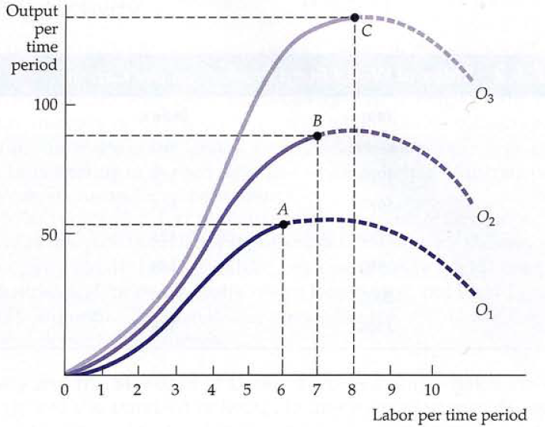
The effect of Technological improvement

Slide 14
Production with two variable inputs
Let’s go back to the general production function with two inputs, labor and capital:
Q = F(K, L)
This function can be represented graphically using isoquants.
An isoquant is a curve that shows all the possible combinations of inputs that yields the same output.

Slide 15
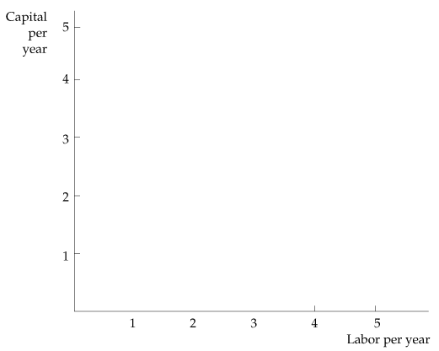
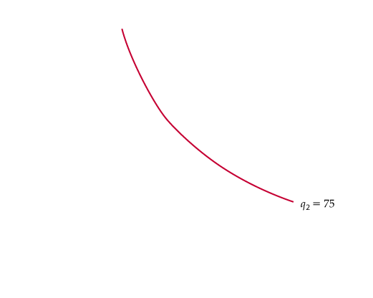
Isoquant curve
Production with Two Variable Inputs
 |  | Labor | input
Capital Input | 1 | 2 | 3 | 4 | 5
1 | 20 | 40 | 55 | 65 | 75
2 | 40 | 60 | 75 | 85 | 90
3 | 55 | 75 | 90 | 100 | 105
4 | 65 | 85 | 100 | 110 | 115
5 | 75 | 90 | 105 | 115 | 120

Slide 16
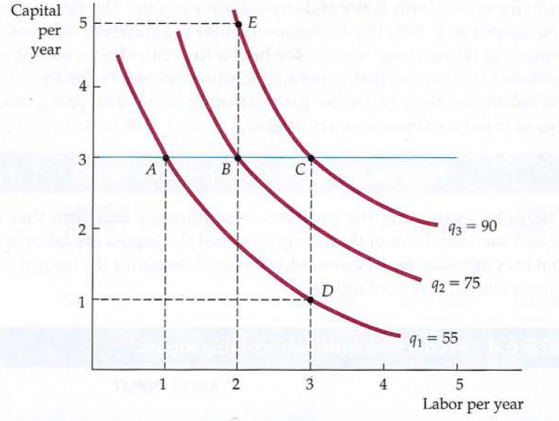
Isoquant Maps
Holding the amount of capital fixed at a particular level- we can see that each additional unit of labor generates less and less additional output.

Slide 17
Returns to scale
It is useful for a firm to choose the optimal mix of inputs and find what happens to output as each input is increased, with the other input held fixed.
One way to do so is to change the scale of the operation by increasing all of the inputs to production in proportion.
Returns to scale is the rate at which output increases as inputs are increased proportionately.

Slide 18
Increasing returns to scale (also called economies of scale ) arise when an increase in all inputs leads to a more-than-proportional increase in the level of output.
If there are increasing returns, then it is economically advantageous to have one large firm producing (at relatively low cost) rather than to have many small firms (at relatively high cost).
If output doubles when inputs are doubled, there are constant returns to scale.

Slide 19
For example, a large travel agency might provide the same service per client and use the same ratio of capital (office space) and labor (travel agents) as a small agency that services fewer clients.
Decreasing returns to scale occur when a balanced increase of all inputs leads to a less-than proportional increase in total output.
Difficulties in organizing and running a large-scale operation may lead to decreased productivity of both labor and capital. Communication between workers and managers can become difficult to monitor as the workplace becomes more impersonal.

Slide 20
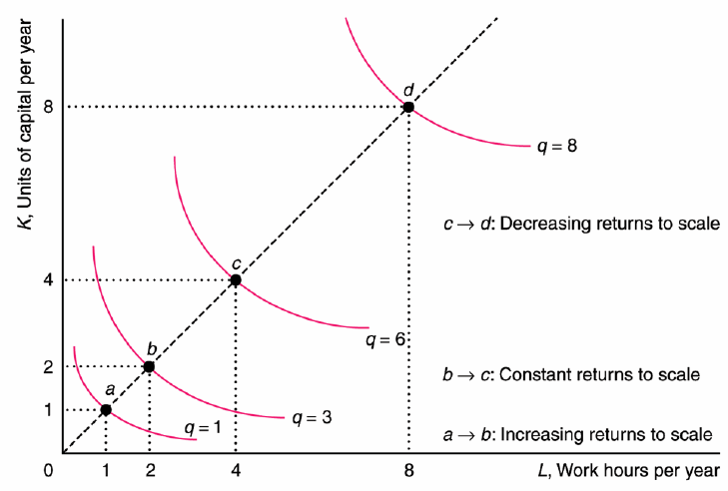
Varying Scale Economies

Slide 21
The Marginal Rate of Substitution
The marginal rate of substitution (MRS) refers to the amount of one good that an individual is willing to give up for an additional unit of another good while maintaining the same level of satisfaction.
The MRS shows the nature of the trade-off involved in adding one input and reducing the use of other input.

Slide 22
Equal marginal principle
A consumer will achieve maximum satisfaction or utility when the marginal utility of the last dollar spent on a good is exactly the same as the marginal utility of the last dollar spent on any other good.
We substitute some units of the commodity of greater utility tor some units of the commodity of less utility. The result of this substitution will be that the marginal utility of the former will fall and that of the latter will rise, till the two marginal utilities are equalized.
If good A costs twice as much as good B, then buy good A only when its marginal utility is at least twice as great as good B’s marginal utility.

