Slide 1
Analysis of Costs

Slide 2
Different types of costs in production
Fixed costs are expenses that must be paid even if the firm produces zero output. They are fixed because they do not change if output changes.
Sunk cost are an expenditure that have been incurred and cannot be recovered.
Variable cost represents expenses that vary with the level of output—such as raw materials, wages, and fuel
Total costs are total economic cost of production equal to fixed plus variable costs

Slide 3
The marginal cost of production is the additional cost incurred in producing one extra unit of output. Marginal cost is the amount by which total cost rises with an additional unit of output. It is the ratio of the change in total cost to the change in the quantity of output.
Average cost is the total cost divided by the total number of units produced
Notice that fixed costs exist only in the short run. In the long run, the quantities of all factors of production are variable, so that all long-run costs are variable.

Slide 4
Fixed, Variable & Total Cost Functions
Let, F is the cost to a firm of its short-run fixed inputs. F, the firm’s fixed cost, does not vary with the firm’s output level.
Let, c_{v}(y) is the cost to a firm of its variable inputs when producing y output units. c_{v}(y) is the firm’s variable cost function.
Let, c(y) is the total cost of all inputs, fixed and variable, when producing y output units. c(y) is the firm’s total cost function;

Slide 5
$
c(y)
c_{v}(y)
F
F
y

Slide 6
Av. Fixed, Av. Variable & Av. Total Cost
The firm’s total cost function is
For y > 0, the firm’s average total cost function is

Slide 7
Marginal Cost Function
Marginal cost is the rate-of-change of variable cost as the output level changes. That is,
The firm’s total cost function is and the fixed cost F does not change with the output level y, so
MC is the slope of both the variable cost and the total cost functions. Marginal costs reflect changes in variable costs.

Slide 8
The fixed costs are spread out more and more as output expands
Average variable cost
$/output unit
AFC(y) → 0 as y → ∞
0
y

Slide 9
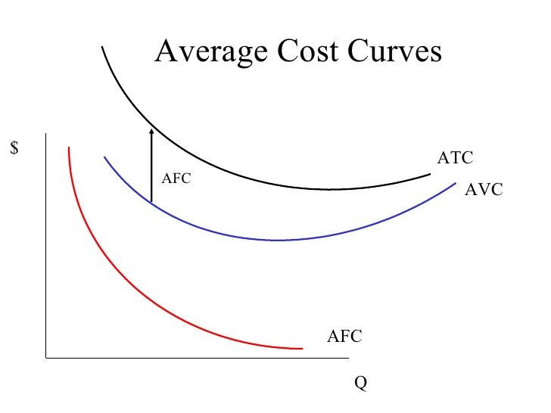

Slide 10
Cost curves
Initially a firm experience increasing marginal returns that is each additional inputs added more and more to firms output. Over the range of increasing marginal returns, each additional output requires less and less additional inputs and thus costs decreases; the total cost and total variable cost curves become flatter over the range of increasing marginal returns.
As output increases, the firm's average cost of producing that output is likely to decline, at least to a point. This can happen for the following reasons:
On a larger scale, workers can specialize in the activities at which they are most productive.
By varying the combination of inputs to produce the output, managers can organize the production process more effectively.

Slide 11
The firm may be able to acquire some production inputs at lower cost because it is buying them in large quantities and can therefore negotiate better prices.
Firm experiences diminishing marginal returns beyond a certain unit of inputs or output. In the range of diminishing marginal returns, each additional unit of a factor adds less and less to total output. The total cost and total variable cost curves become steeper and steeper beyond this level of output. That means each additional unit of output increases costs.
At some point, however, it is likely that the average cost of production will begin to increase with output. There are three reasons for this shift:

Slide 12
At least in the short run, factory space and machinery may make it more difficult for workers to do their jobs effectively.
Managing a larger firm may become more complex and inefficient as the number of tasks increases.
The advantages of buying in bulk may have disappeared once certain quantities are reached. At some point, available supplies of key inputs may be limited, pushing their costs up.

Slide 13
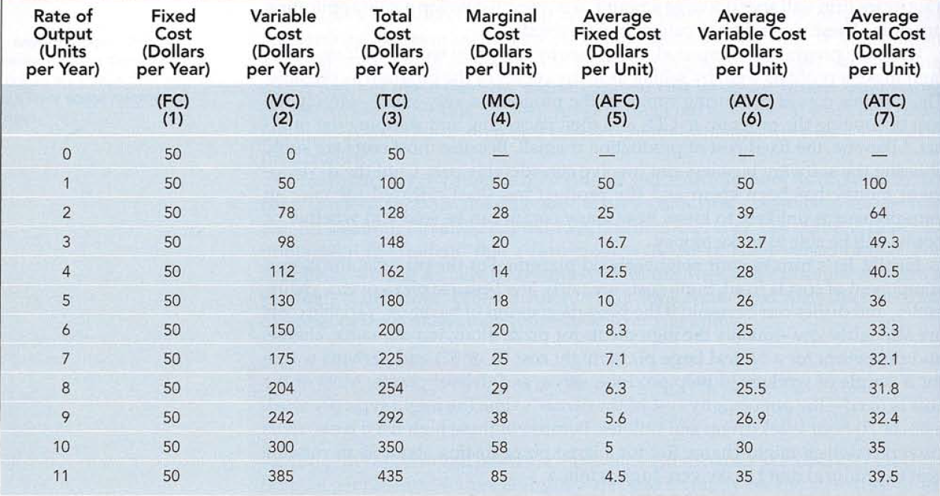

Slide 14
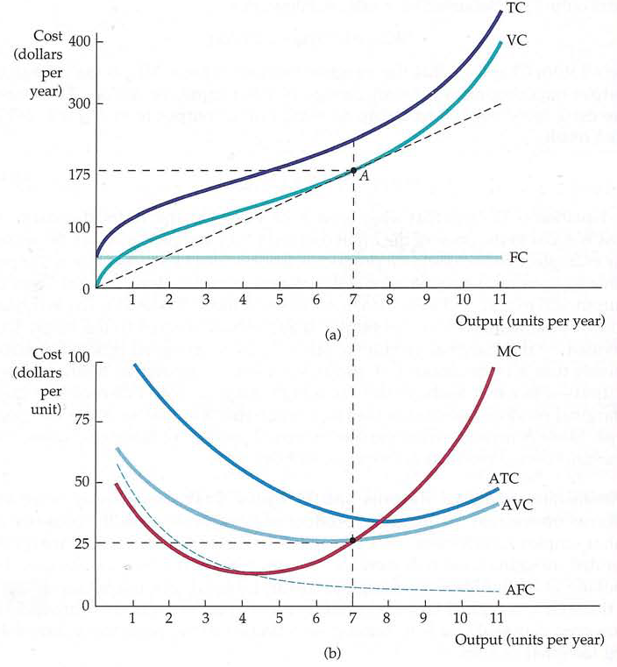

Slide 15
Marginal & Average Cost relations
Marginal cost measures the additional cost of inputs required to produce each successive unit of output. The marginal-cost curve intersects the average-total-cost curve at the ATC curve’s minimum point.
Marginal cost can be defined as the addition either to total cost or to total variable cost resulting from one more unit of output; thus this same rationale explains why the MC curve also crosses the AVC curve at the AVC curve’s minimum point.
ATC falling implies MC < ATC.
ATC rising implies MC > ATC.
At minimum ATC, ATC = MC.

Slide 16
The short-run MC curve intersects the short-run AVC curve from below at the AVC curve’s minimum.
And, similarly, the short-run MC curve intersects the short-run ATC curve from below at the ATC curve’s minimum.
MC = AVC at its minimum point and MC = ATC at its minimum point.
Costs in the long run depend on the firm’s level of output, the costs of factors, and the quantities of factors needed for each level of output. The main difference between long and short-run costs is there are no fixed factors in the long run. There are thus no fixed costs. All costs are variable, so in the long run: total cost is total variable cost.

Slide 17
The link between production and costs
What are the factors that determine the cost curves? The key elements are
factor prices
firm’s production function
Costs are derived from production data and input price
But costs also depend on the firm’s technological opportunities.

Slide 18
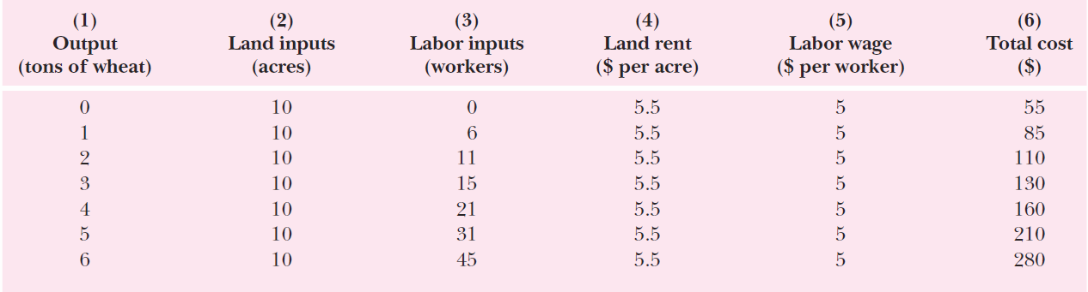
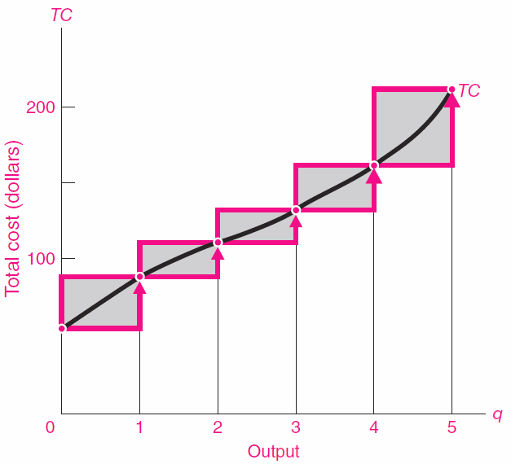
In this example, land is a fixed cost (under a 10-year lease), while labor is a variable cost

Slide 19
The optimal combination of inputs
In the long run, all factors are variable, so the firm can expand the use of all of its factors of production. The question facing the firm in the long run is: How much of an expansion or contraction in the scale of its operations should it undertake?
In its long-run planning, because all costs are variable, the structure of costs in the long run differs somewhat from what we saw in the short run.
In a long-run planning perspective, a firm can consider changing the quantities of all its factors of production. That gives the firm opportunities to select the mix of factors it wishes to use.
How shall a firm decide what mix of capital, labor, and other factors to use? We can apply the marginal decision rule to answer this question. The firm seeks the maximum output possible at every level of total cost.

Slide 20
At any level of total cost, the firm can vary its factor mix. It could, for example, substitute labor for capital in a way that leaves its total cost unchanged.
The marginal decision rule says that a firm will shift spending among factors as long as the marginal benefit of such a shift exceeds the marginal cost.
If there are more than two inputs, the firm maximises output by distributing its expenditures among various inputs in such a way that the marginal product of a dollar’s worth of any one input is equal to the marginal product of a dollar’s worth of any other input used. That is,

Slide 21
Example: The XYZ Company
A company XYZ engaged in the following engineering analysis. XYZ’s president has determined that the firm’s output per month (Q) is related in the following way to the numbers of engineers (E) and technicians used (T):
The monthly wage of an engineer is $4000 and the monthly wage of a technician is $2000. If XYZ allots $28000 per month for the total combined wages of engineers and technicians, how many engineers and technicians should it hire?
Hints: To maximize output it must choose the combination of engineers and technicians such that:

Slide 22
Cost Minimization
The fundamental assumption is that firms minimize their costs of production. Fundamental problem that all firms face: how to select inputs to produce a given output at minimum cost.
A firm is a cost-minimizer if it produces any given output level at smallest possible total cost.

Slide 23
The Cost-Minimization Problem
Consider a firm using two inputs to make one output.
The production function is y = f(x₁,x₂).
Take the output level y as given.
Given the input prices w₁ and w₂, the cost of an input bundle (x₁,x₂) is w₁x₁ + w₂x₂.
For given w₁, w₂ and y, the firm’s cost-minimization problem is to solve

Slide 24
The levels x₁*(w₁,w₂,y) and x₂*(w₁,w₂,y) in the least-costly input bundle are the firm’s conditional demands for inputs 1 and 2.
The (smallest possible) total cost for producing y output units is therefore

