Slide 2
Economic profit in the short run and long run
The firm’s profit (∏) is expressed as total revenue (TR) minus total cost (TC). That is
This is also called economic profit.
In the short run,
p > ATC: the firm makes a profit
p = ATC: the firm breaks even (total revenue=total cost)
p < ATC: the firm experiences a loss
In the long run, economic profits in a perfectly competitive markets will be driven to zero in all industries. Zero economic profit signifies not that firms are performing poorly, but rather that the industry is competitive.

Slide 3
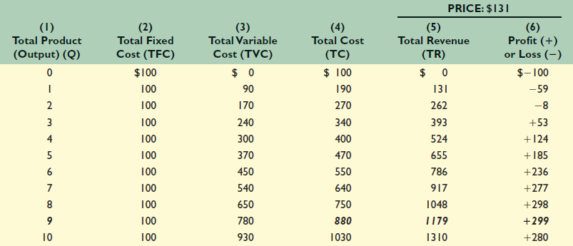
Break-even point : The break-even point is that point at which business covers its costs and thus breaks even. It tells exactly how much we must sell at the present level of costs in order to avoid making a loss.
The Profit-Maximizing Output for a Purely Competitive Firm: Total-Revenue–Total Cost Approach (Price $131)

Slide 4
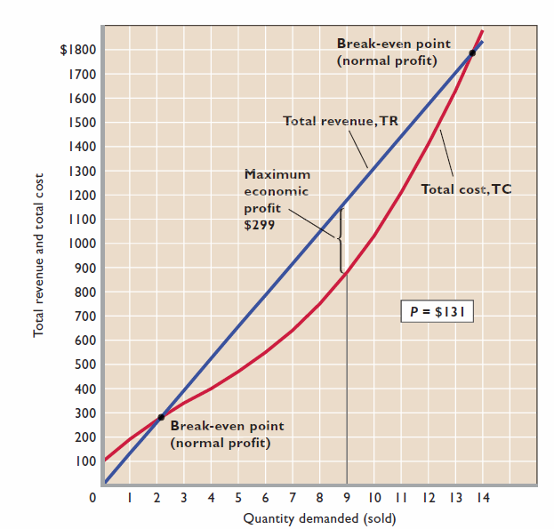

Slide 5
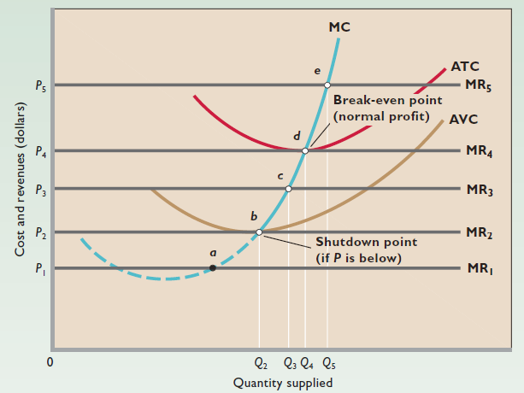
The competitive firm’s short-run supply curve

Slide 6
At price P1, p= MC at point a, but the firm will produce no output because P1 is less than minimum AVC.
At price P2 the firm will operate at point b, where it produces Q2 units and incurs a loss equal to its total fixed cost.
At price P3 it operates at point c, where output is Q3 and the loss is less than total fixed cost.
At price P4, the firm operates at point d; in this case the firm earns a normal profit because at output Q4 price equals ATC.
At price P5 the firm operates at point e and maximizes its economic profit by producing Q5 units.

Slide 7
Firm’s Long-Run Equilibrium
A competitive firm makes its long-run, profit-maximizing output at p=MC. The long-run equilibrium position of the firm is at the point where its long run average total cost equals price.
If price is in excess of the average total cost, economic profits are earned and new firms enter the industry. This increases supply, thereby driving down price and hence profit. If price is less than the average total cost, the firm will exit the industry. This decreases supply, causing price and profits to rise.
The long-run zero-economic-profit condition: P = MC =minimum long-run AC
In the long run, all costs are variable. Hence, in the long run firms will produce only when price is at or above the zero-profit condition where price equals average cost. Firms shut down when they can no longer cover their variable costs.

Slide 8
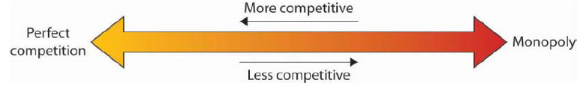
Perfect Competition and the Real World
The assumptions of identical products, a large number of buyers, easy entry and exit, and perfect information are strong assumptions. Most real firms customarily set prices. The model of perfect competition underlies the model of demand and supply.
We can understand most markets by applying the model of demand and supply. Even though those markets do not fulfil all the assumptions of the model of perfect competition, the model allows us to understand some key features of these markets.
Falling costs of transportation, together with dramatic advances in telecommunications have made many markets more competitive and have opened the possibility of entering markets to firms all over the world.

