Slide 2
Factors of production
A factor of production is any resource that is used by firms to produce goods and services.
All inputs are not factors. There are intermediate inputs which are used up in production (e.g., energy, materials etc.).
Economists usually classify factors of production into four main types:
Land
Labor
Physical capital - equipment, buildings, tools, and machines.
Human capital - improvement in labor created by education and knowledge embodied in workers.

Slide 3
The factors of production are rewarded for their contribution to the production of goods and services. The reward for land is rent, for labor it is wages, for capital it is interest and the reward for entrepreneurship is called profit.
An entrepreneur pays rent, wages, interest, and profit for availing the services of land, labor, capital, and enterprise respectively. These factors of production directly affect the production process of an organization.
Factors of production are bought and sold in factor markets.
Determination of factor prices is different from the determination of product pricing which is based on the demand and supply of products.

Slide 4
Factor markets are different from goods and service markets because:
Factor demands are derived demands: The firm’s demand for inputs is derived indirectly from the consumer demand for its final product.
The demand for particular goods or services increase the demand for the workers that produce them, so reductions in demand for particular goods or services will reduce the demand for the workers that produce them.
Suppose the land can be used only to grow corn. If the demand for corn rises, the demand curve for land will shift up and to the right, and the rent will rise. This leads to an important point about land: The price of land is high because the price of corn is high. This is an example of derived demand.

Slide 5
2. Factor demands are interdependent demands: the productivity of one factor, such as labor, depends upon the amount of other factors available to work with.
When there is demand for labor, there is a demand also for capital because labor with empty hands is unproductive. In another case, when there is demand for capital, there is demand for labor because capital can not produce anything on its own.
The interdependence of factor demand complicates the derivation of factor demand curve because
It is very difficult to measure the contribution of each factor
Change in the price of one factor changes the demand for other factor

Slide 6
There are two aspects of each factor of production, which are as follows:
Price Aspect: Refers to the aspect in which an organization pays a certain amount to avail the services of factors of production. For example, wages, rents, and interests constitute the price of factors of production.
Income Aspect: Refers to another aspect in which a certain amount is received by a factor of production. For instance, rents received by a landlord and wages received by labor constitute the income generated from the factors of production.

Slide 7
Rent
Economic rent is a payment exclusively for the use of land.
The use of land is enhanced by improvements (such as building) and payment for these improvements is made a integral part of rent. It is difficulties to measure and analyse.
Rent is entirely determined by the alternative uses which can be made of land. Land is a free gift of nature and is costless. Any subsequent payment is rent, but the original cost of land is zero.
An economic surplus is a payment made or received only because a market exists and not through any action of the individual. Thus, a land owner may receive a high rent because his/her land is in high demand without having done anything him/herself or having incurred any cost. Such payment, and rent in general, is considered an economic surplus.
Economists call all payments where an economic surplus is present, economic rent.

Slide 8
Wage
Wage: generally to include salaries and other forms of payment of labour
Payment of wages can be done in different modes such as time wages, piece wages, task wages, cash wages, and service wages.
Wage Determinants:
Labour productivity: The output of each worker varies because of worker’s ability to do the job, the use of complementary resources, and the state of technology.
Education: It has impact on labour demand and supply.

Slide 9
Human Capital: The income-earning potential of a person’s skills and knowledge
Experience: It can increase productivity, pushing up the demand for the worker’s labour and the wage rate. Higher Exp, higher wage
Seniority Right: The workplace privileges provided to workers who have the longest experience with their employer
Job conditions: For less appealing occupations, employers offer higher wages
Trade unions also influence the wage level of workers.

Slide 10
Interest
Interest is the price paid for the use of money. When people save, they expect a return. This is the interest rate or the financial return on the funds.
It is the price that borrowers need to pay lenders for transferring purchasing power from the present to the future.
Interest adjusted for that loss of purchasing power (or inflation) is known as real interest. All investment decisions are made on the basis of real interest rates, not nominal interest rates.
Demand and supply of money determine interest rates.

Slide 11
Profit
Economic, or pure, profit is what remains after all costs—both explicit and implicit costs, the latter including a normal profit—have been subtracted from a firm’s total revenue.
Normal profit, or zero economic profit, is when the firm is not making any economic profit.
Explicit costs : Payments made by the firm to outsiders.
Implicit costs: The monetary income the firm sacrifices when it uses resources that it owns, rather than supplying those resources to the market.

Slide 12
Income Distribution
Income distribution: Distribution of total income among different segments of the economy.
Economists examine two main types of income distribution:
Personal income distribution: distribution of income among different people or income groups
Factor distribution of income: distribution of income among different factors of production, like labor, land and capital

Slide 13
If we are interested in personal distribution of income we can examine factor income distribution and then examine how much of factor income goes to different people.
To know who gets how much income we can examine who owns what factors and the price of each factor.
Examples:
A disabled person who cannot work will get no labor income
A person who owns land will receive a large income if land rent is high

Slide 14
Labor market
The labor market is in equilibrium when:
At the current market wage rate, the number of workers that producers want to employ is equal to the number of workers willing to work.
All employers pay the same wage rate, and each employer, whatever he or she is producing, employs labor up to the point at which the value of the marginal product of the last workers hired is equal to the market wage rate.

Slide 15
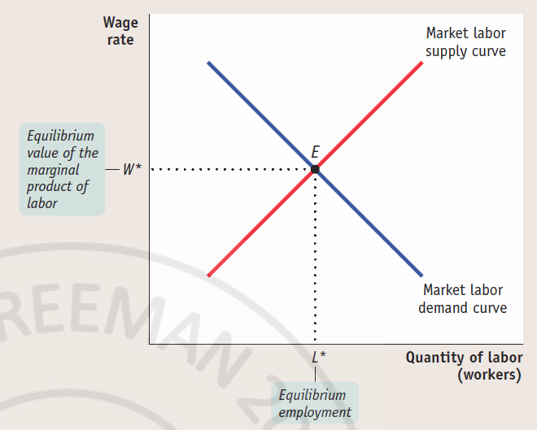
Equilibrium in the Labor Market

