Slide 1
Digital Image Processing
Hongtao Lu
Department of Computer Science
Shanghai Jiao Tong University
September, 2017

Slide 2
Textbook and Reference book
Textbook:
Digital Image Processing (Third Edition)，
Rafael C. Gonzalez, Richard E. Woods， 英文影印版，电子工业出版社，2017年出版，64.90元.
Reference book:
DIGITAL IMAGE PROCESSING, Kenneth R. Castleman, 电子工业出版社，2008出版，69.00元。

Slide 3
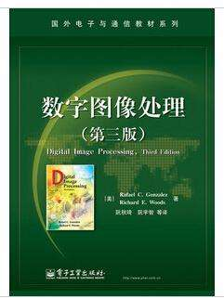
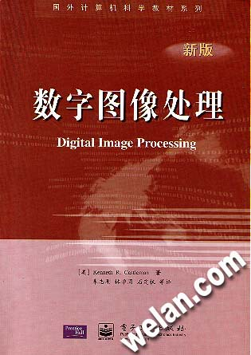

Slide 4
International Conferences
IEEE International Conference on Computer Vision and Pattern Recognition (CVPR, CCF A)
IEEE International Conference on Computer Vision (ICCV, CCF A)
ACM Multimedia Conference (MM, CCF A)
IEEE International Conference on Image Processing (ICIP)
IEEE International Conference on Pattern Recognition (ICPR)
…

Slide 5
International Journals
IEEE Transactions on Pattern Analysis and Machine Intelligence (TPAMI, CCF A)
International Journal of Computer Vision (IJCV, CCF A)
IEEE Transactions on Image Processing (TIP)
Pattern Recognition (PR)
IEEE Transactions on Circuits and Systems for Video Technology (CSVT)

Slide 6
Contact and Webpage
Hongtao Lu
Email：lu-ht@cs.sjtu.edu.cn
htlu@sjtu.edu.cn
Office：SEIEE 3-425
Tel：34204879
Webpage: http://bcmi.sjtu.edu.cn/~luhongtao/dip
Ftp address：ftp.cs.sjtu.edu.cn，prot: 990，anonymous log in. Directory: lu-ht.

Slide 7
Evaluation Policy
10 assignments.
Each is to implement one important DIP task.
Grade is based on the quality of your codes, your results and report.
Programming Language: You can use any Language, but Matlab is preferred.

Slide 8
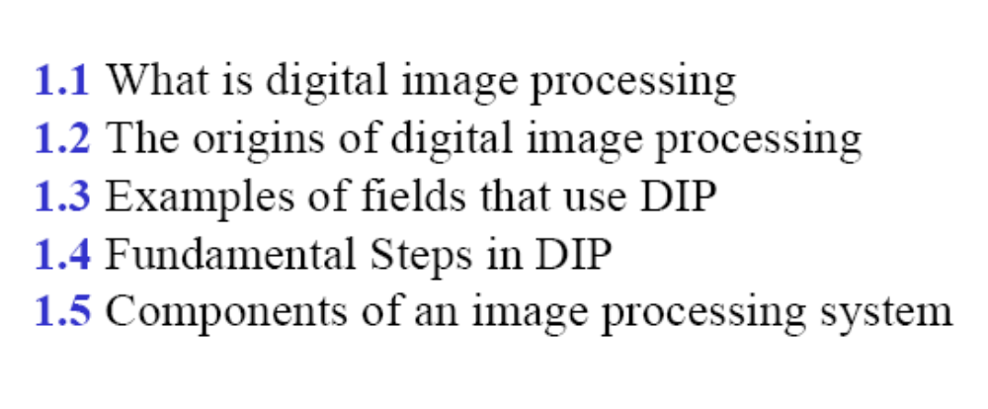
Chapter 1: Introduction

Slide 9
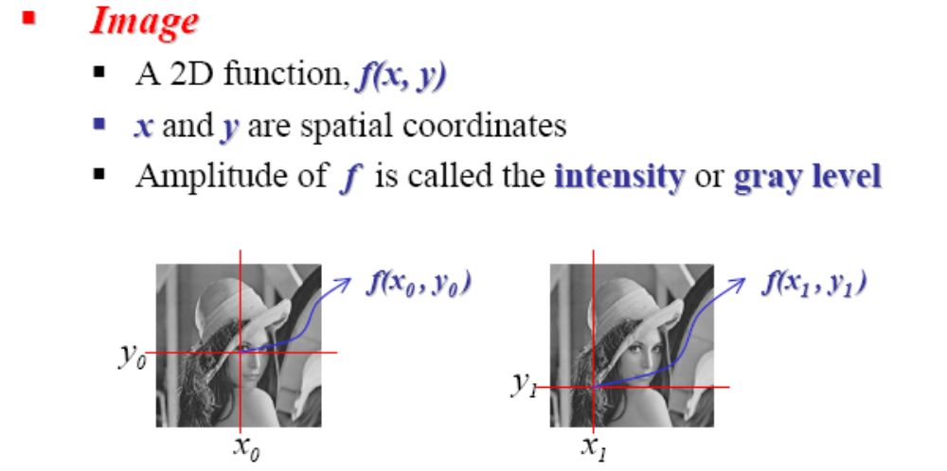
1.1 What is Digital Image Processing

Slide 10
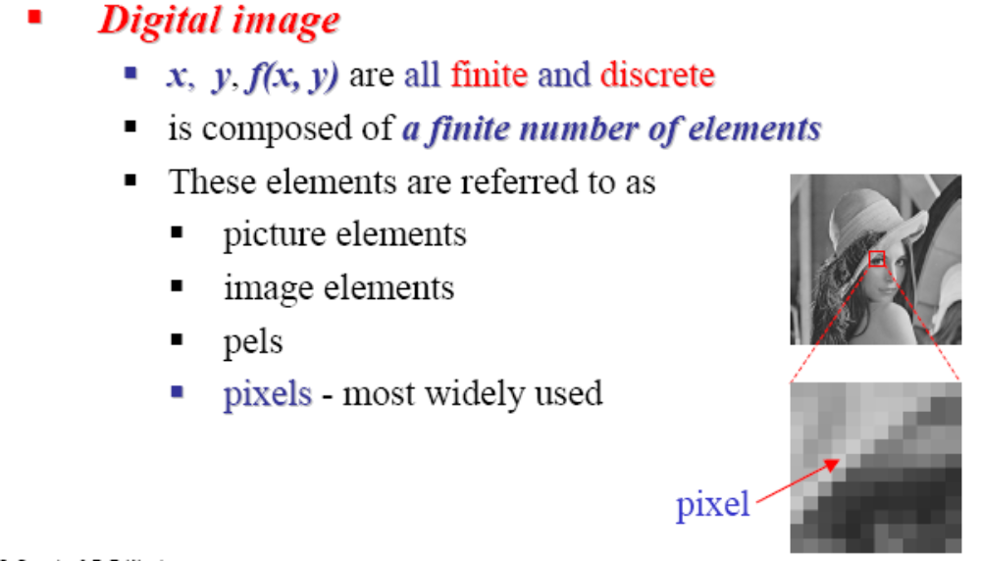
1.1 What is Digital Image Processing

Slide 11
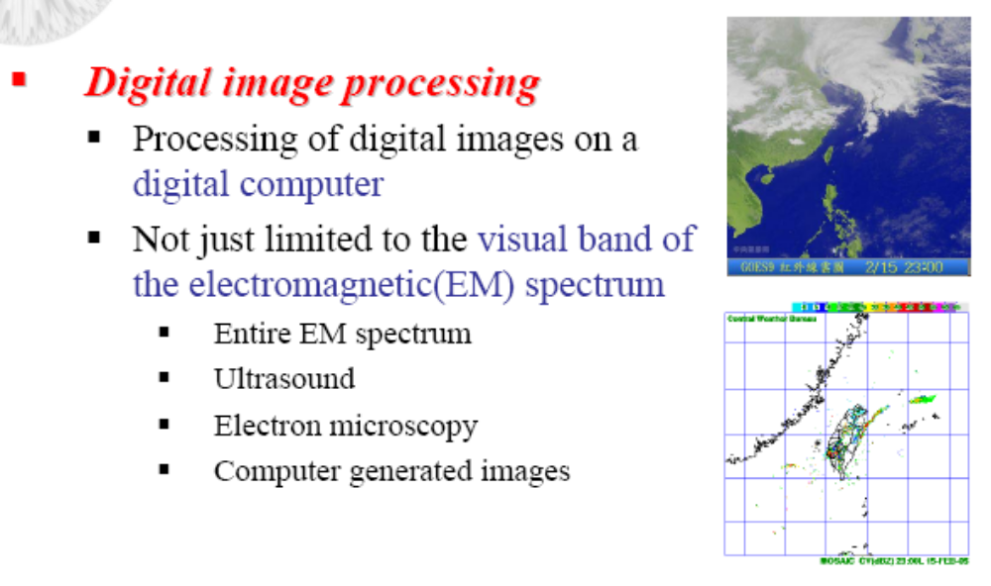
1.1 What is Digital Image Processing

Slide 12
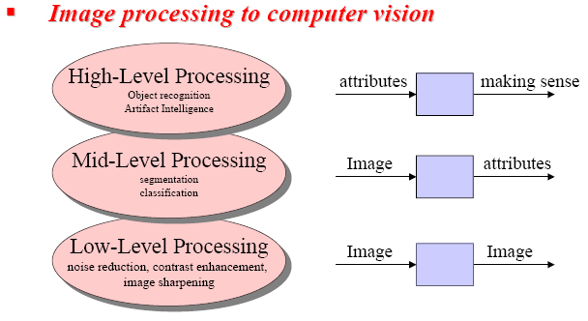
1.1 What is Digital Image Processing

Slide 13
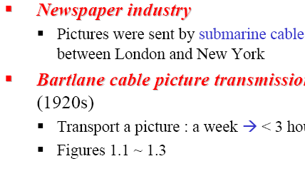
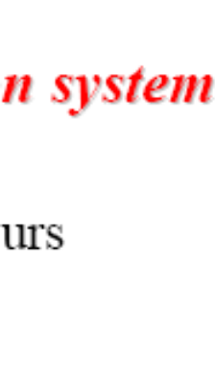
1.2 The origins of digital image processing

Slide 14
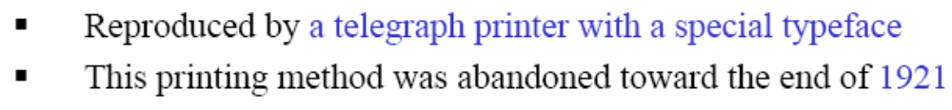
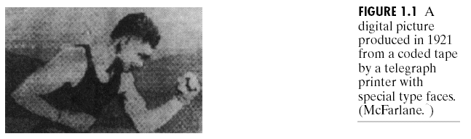
1.2 The origins of digital image processing

Slide 15
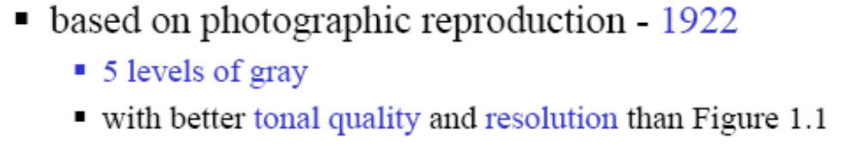
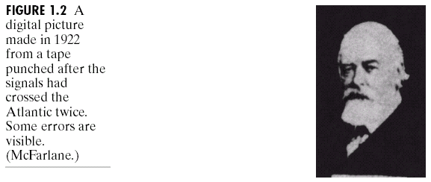
1.2 The origins of digital image processing

Slide 16
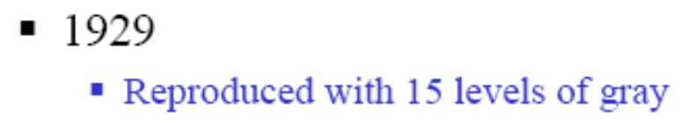
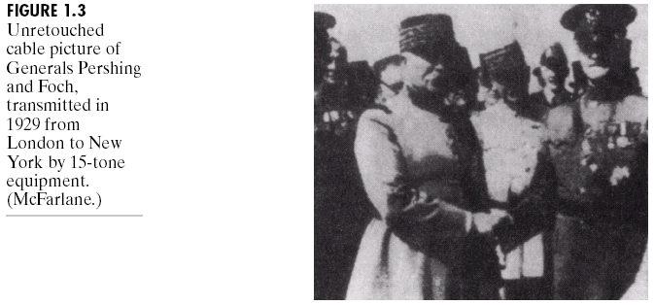
1.2 The origins of digital image processing

Slide 17
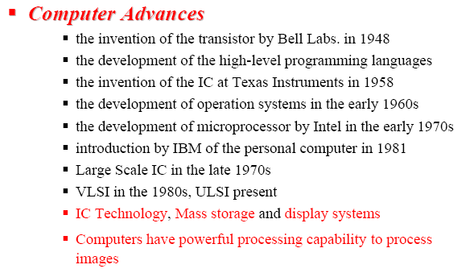
1.2 The origins of digital image processing

Slide 18
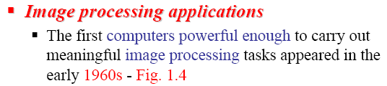
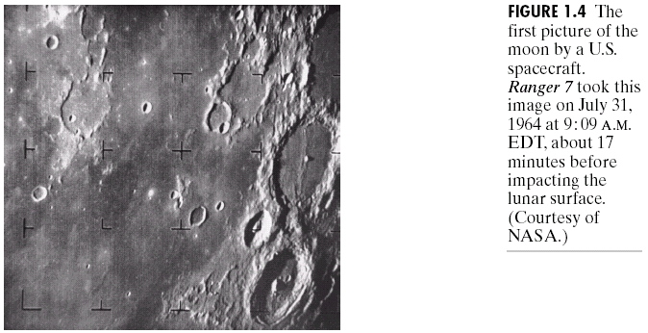

1.2 The origins of digital image processing

Slide 19
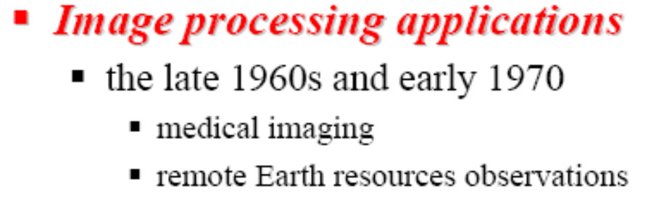

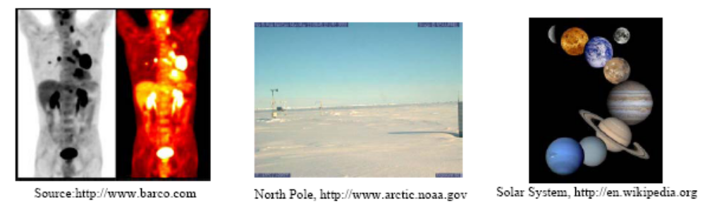
1.2 The origins of digital image processing

Slide 20
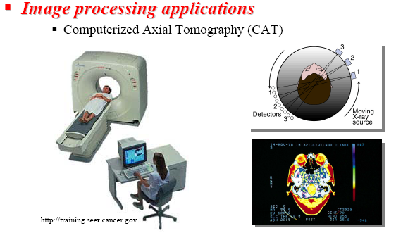
1.2 The origins of digital image processing

Slide 21
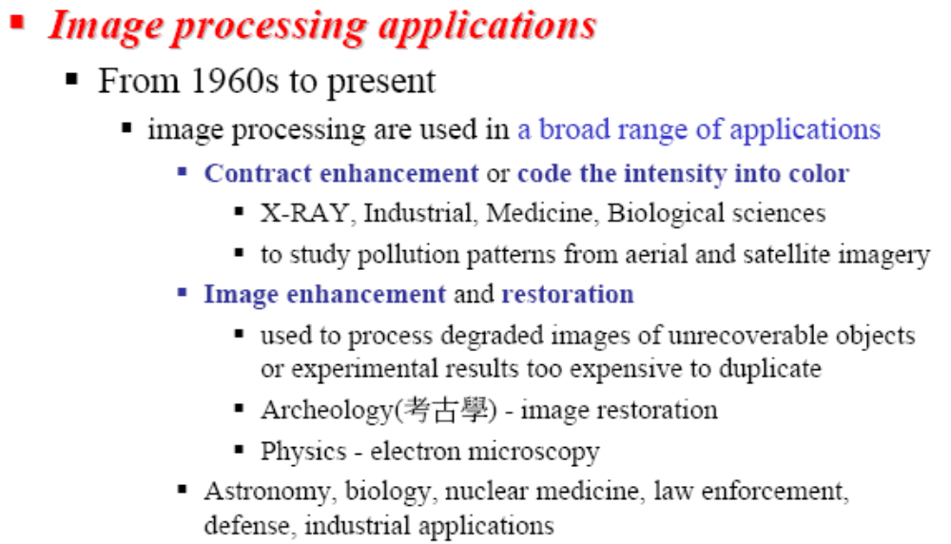
1.2 The origins of digital image processing

Slide 22
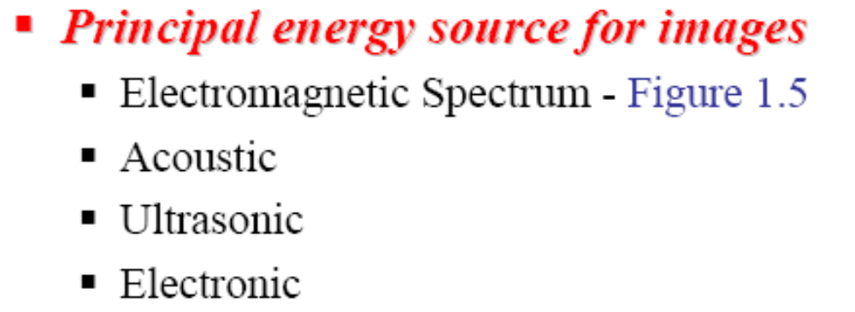
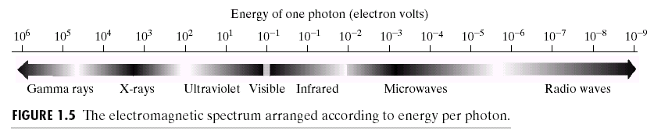
1.3 Examples of fields that use digital image processing

Slide 23
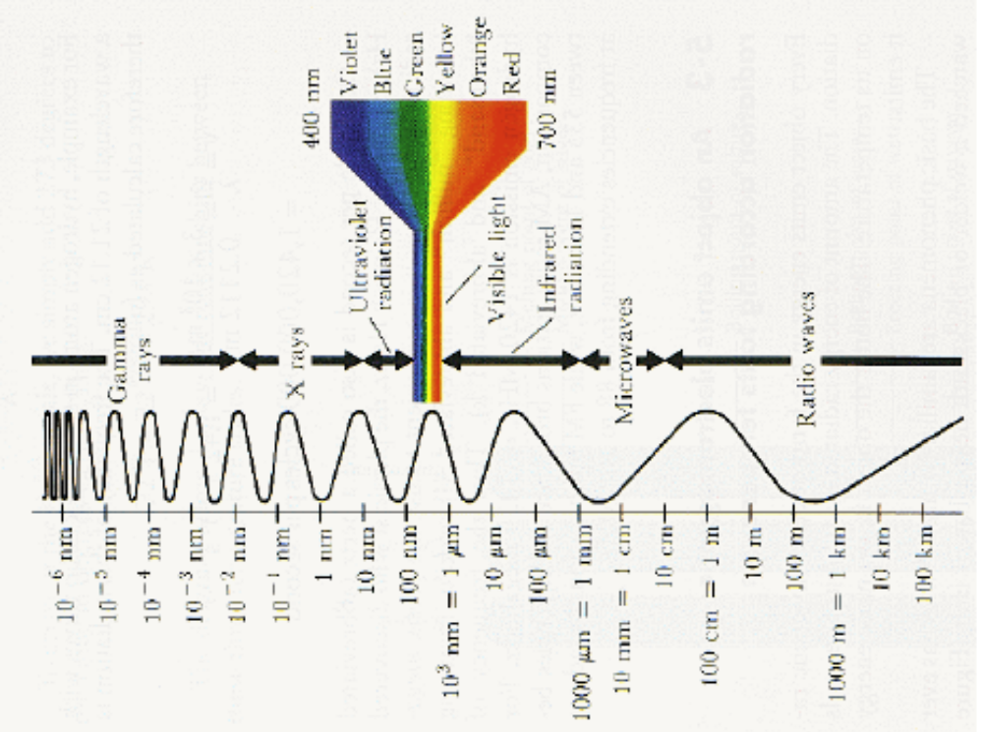
1.3 Examples of fields that use digital image processing

Slide 24
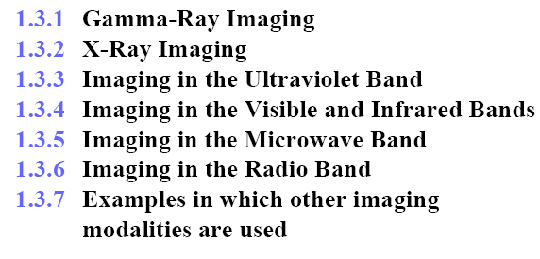
1.3 Examples of fields that use digital image processing

Slide 25
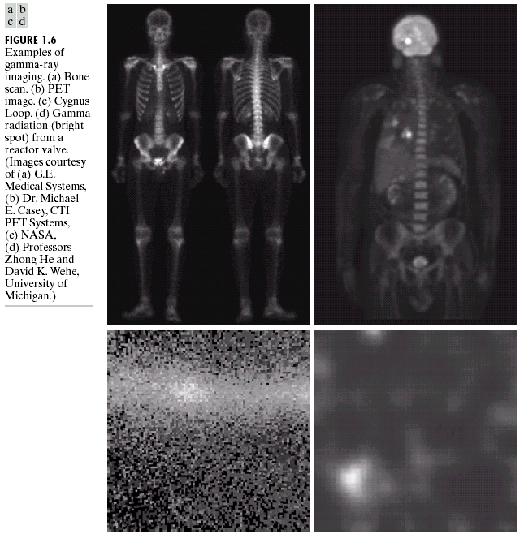
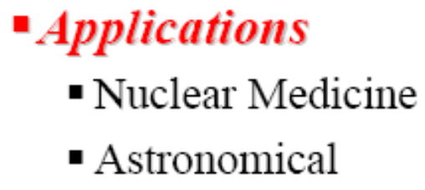
1.3.1 Gamma-Ray Imaging
PET
正电子扫描断层仪
Cygus天鹅座

Slide 26
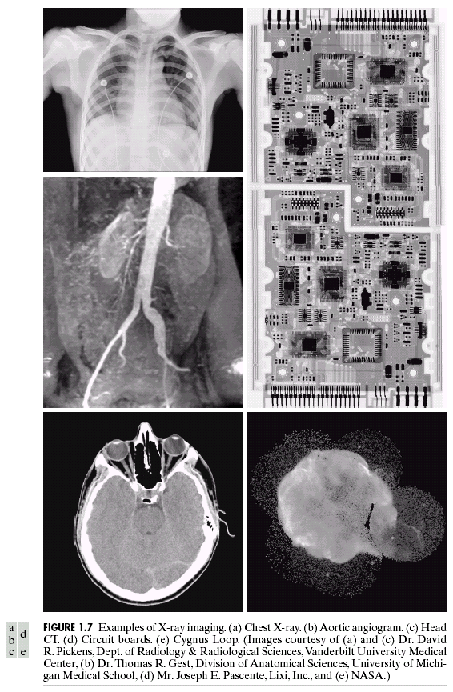

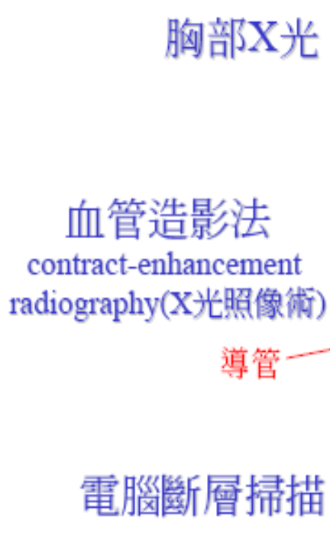
1.3.2 X-ray Imaging
Circuit Board
电路板
Cygnus天鹅座

Slide 27
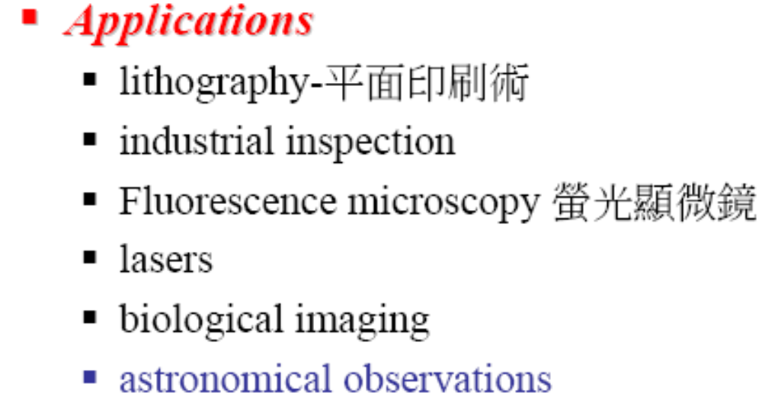
1.3.3 Imaging in the Ultraviolet band

Slide 28
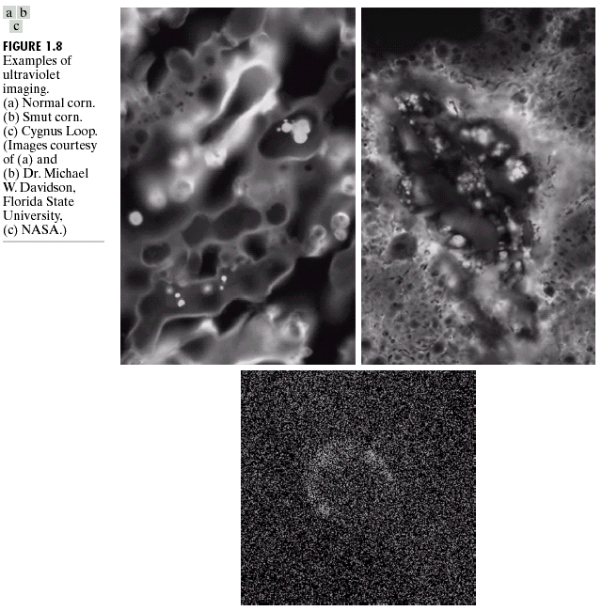
1.3.3 Imaging in the Ultraviolet band
Smut Corn
患病的玉米
Normal Corn
正常的玉米
Cygnus天鹅座

Slide 29
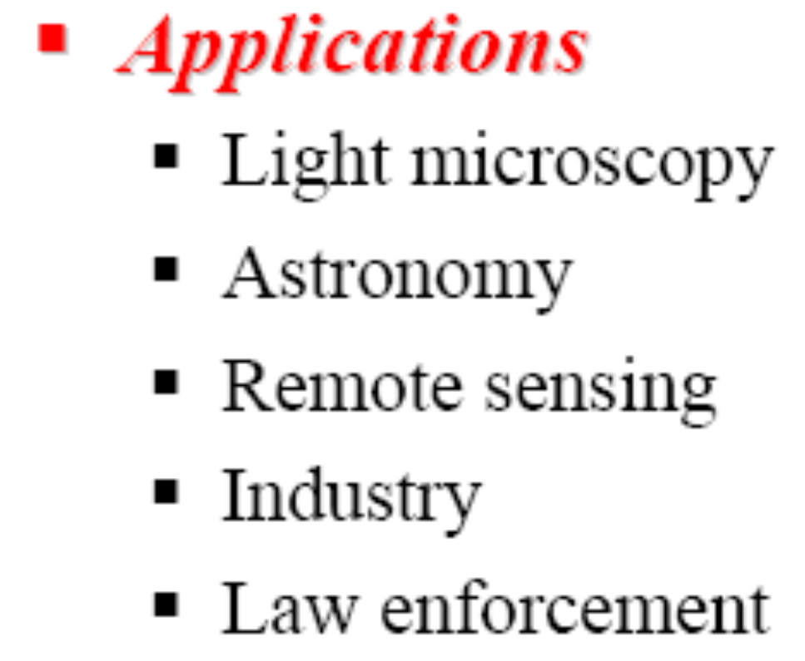
1.3.4 Imaging in the Visible and Infrared bands

Slide 30
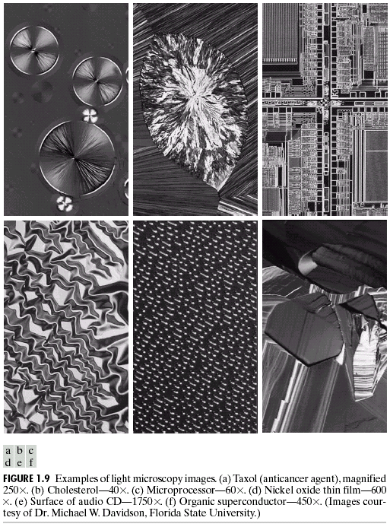
1.3.4 Imaging in the Visible and Infrared bands
Light microscopy
  抗癌药物(Taxol)
  胆固醇(Cholesterol))
  微处理器(Micro
  -processor)
  镍氧化物(Nickel
  -oxide)
  Audio CD
  Superconductor

Slide 31
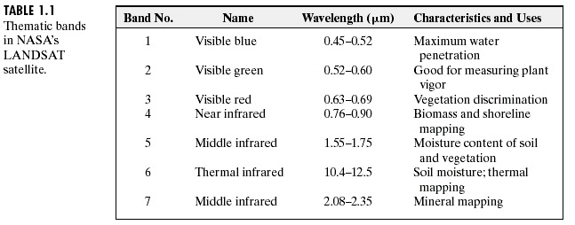
1.3.4 Imaging in the Visible and Infrared bands

Slide 32
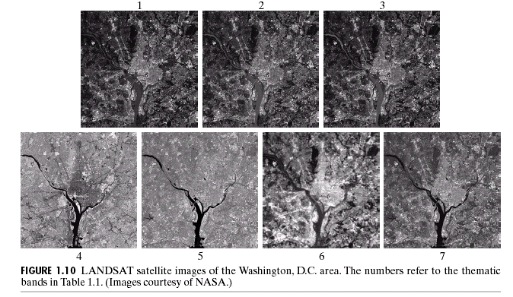
1.3.4 Imaging in the Visible and Infrared bands

Slide 33
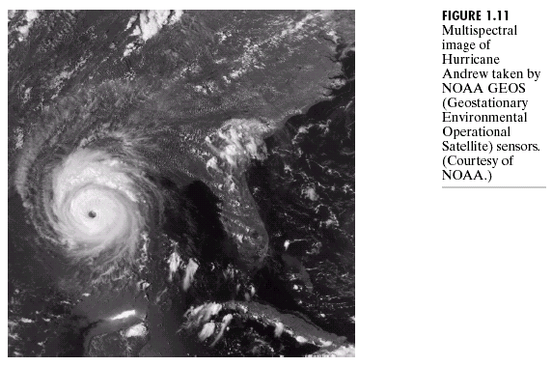
1.3.4 Imaging in the Visible and Infrared bands

Slide 34
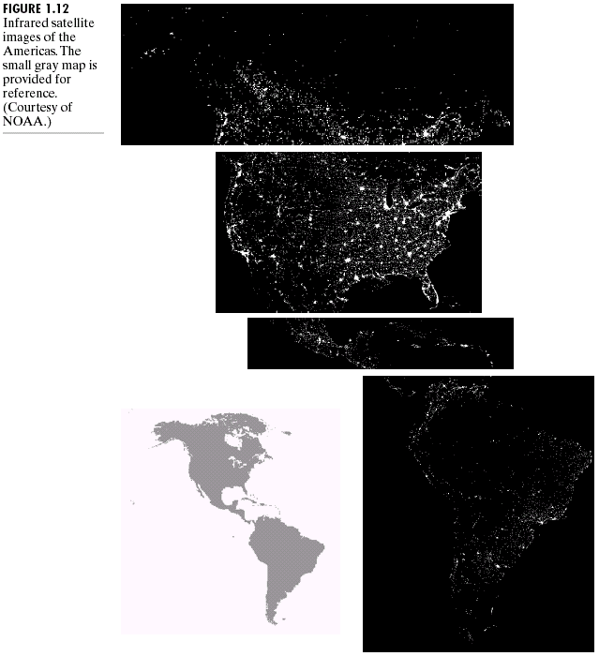

1.3.4 Imaging in the Visible and Infrared bands

Slide 35
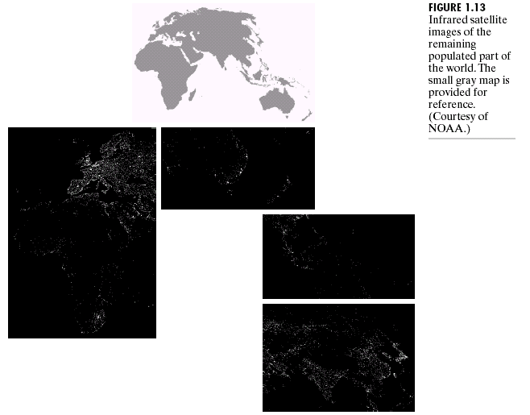
1.3.4 Imaging in the Visible and Infrared bands

Slide 36
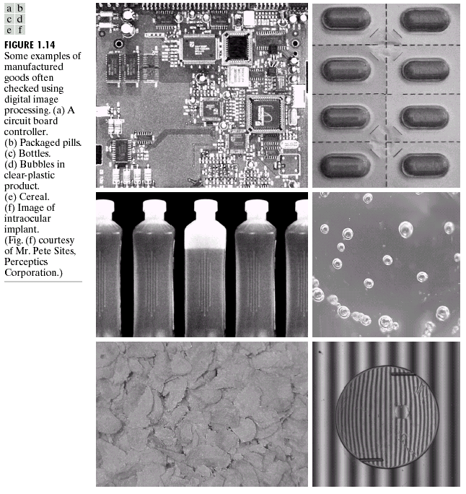
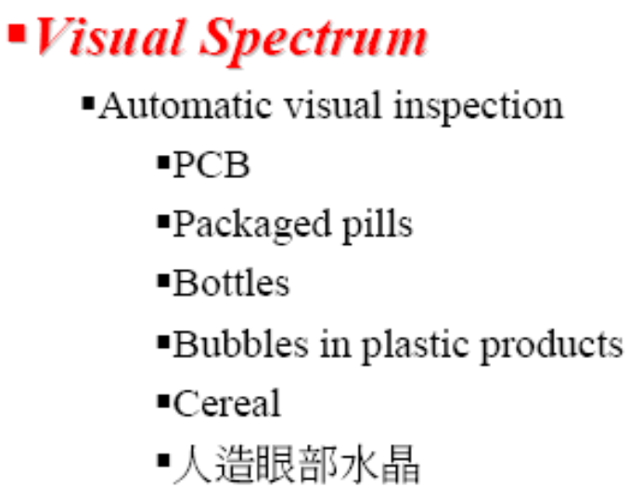
1.3.4 Imaging in the Visible and Infrared bands
Structured light
Deformations

Slide 37
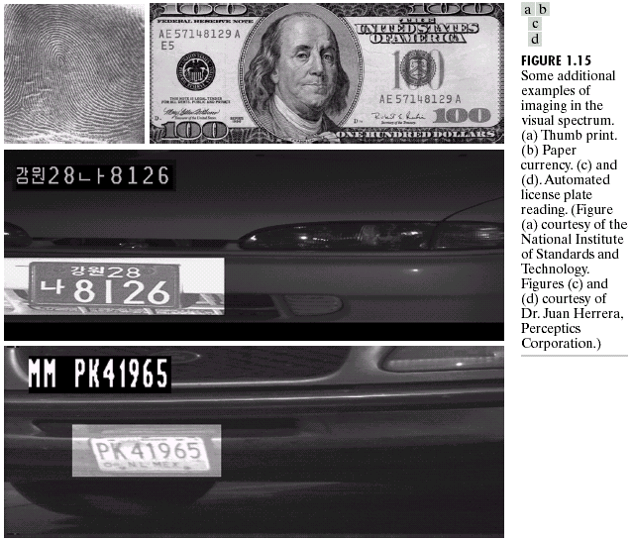
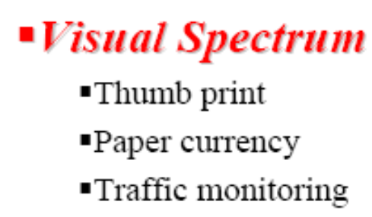
1.3.4 Imaging in the Visible and Infrared bands

Slide 38
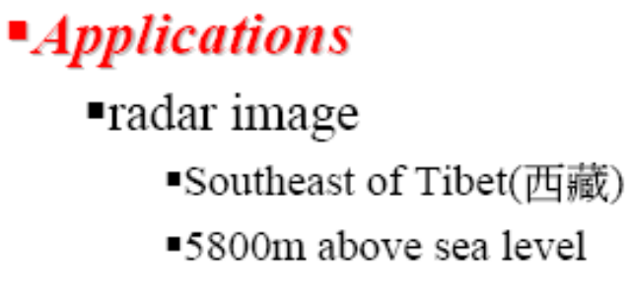
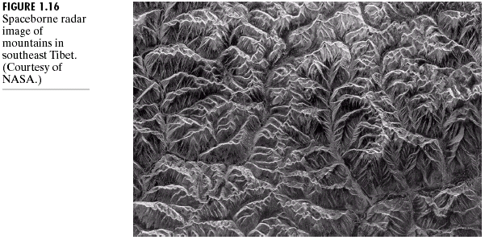
1.3.5 Imaging in the microwave band

Slide 39
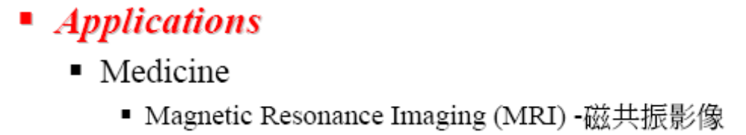
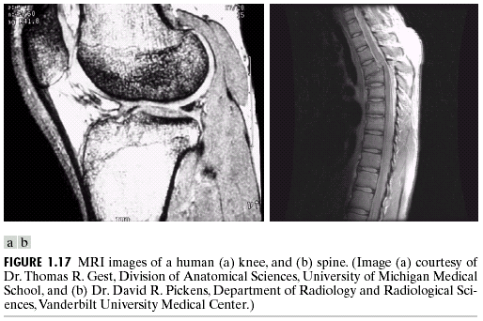
1.3.6 Imaging in the Radio band

Slide 40

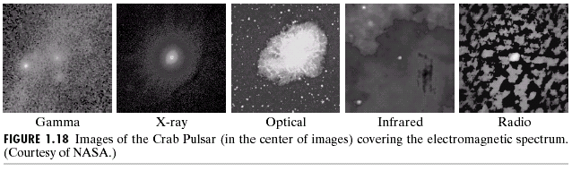
1.3.6 Imaging in the Radio band
巨蟹座脉冲星

Slide 41
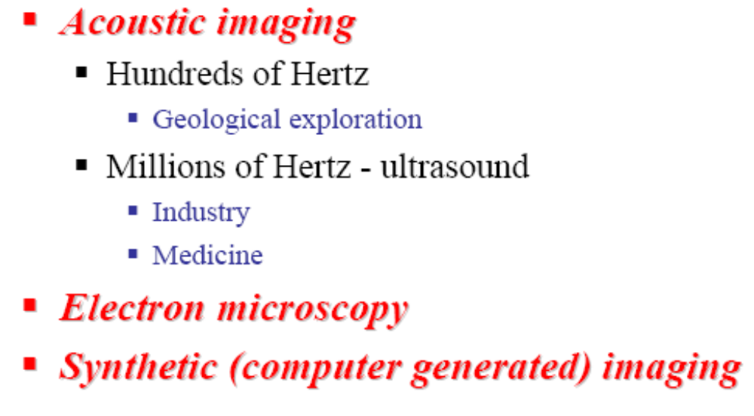
1.3.7 Examples in which other imaging modalities are used

Slide 42

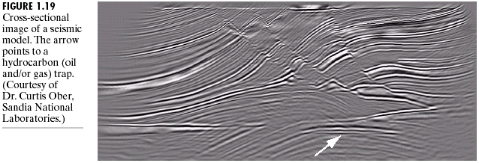
1.3.7 Examples in which other imaging modalities are used

Slide 43


1.3.7 Examples in which other imaging modalities are used
Thyroid
甲状腺

Slide 44


1.3.7 Examples in which other imaging modalities are used
Damaged IC
Tungsten
钨丝

Slide 45


1.3.7 Examples in which other imaging modalities are used
Fractal
分形

Slide 46

1.4 Fundamentals steps in DIP

Slide 47

1.5 Components of an image processing system

