Slide 1

Linear System Theory
(Chapter 9 from Castleman’s DIP)
9.1 Introduction
  9.1.1 Definitions
    One-dimensional linear systems
    Two-dimensional linear systems
Linear System
x(t)
Input
y(t)
Output
F(x,y)
Input
Linear System
G(x,y)
Output

Slide 2
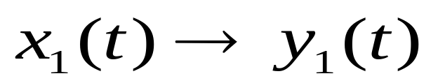
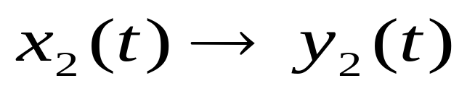
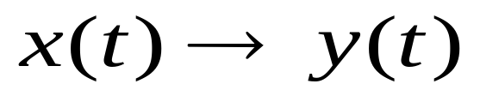

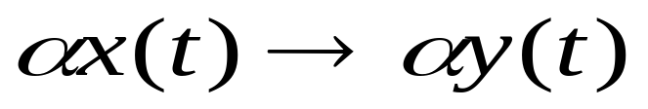
9.1 Introduction
Linearity (one dimensional)
  1. If and
  Then
  2. And if , for any real number

Slide 3
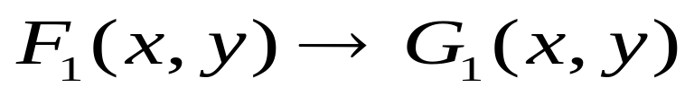
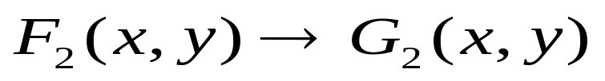


Linearity (two dimensional)
  If
  and
  Then
  2. And if , for any real number

Slide 4
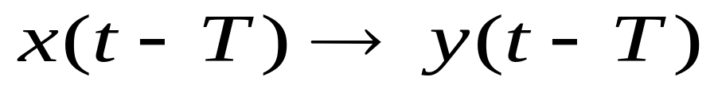
Shift Invariance
  If , then
The principal components of image-processing systems such as electrical networks, and optical systems can be modeled as shift-invariant linear systems.

Slide 5
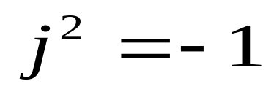
9.2 Harmonic Signals and complex signal analysis
9.2.1 Harmonic Signals (谐波信号)
  A harmonic signal is a complex-valued signal of the form
  Where is the imaginary unit.

Slide 6

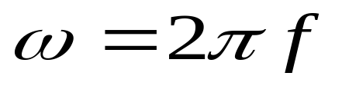

  It can be viewed as a unit length vector rotating in the complex plane with an angular velocity . The angular frequency , in radius per second, is related to the frequency f (Hertz), by

Slide 7
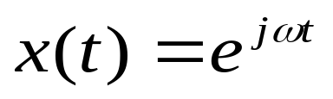
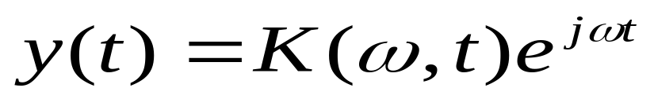
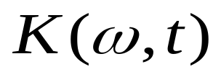
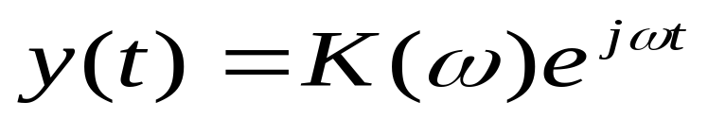
Response of a LSI system to a Harmonic Input
Suppose a harmonic signal is presented to a shift-invariant linear system, and write the response (output) of the system as
then it can be derived that is time-independent, I.e.,

Slide 8
For a LSI system, a harmonic input always produces a harmonic output at the same frequency.

Slide 9
Harmonic Signals and Sinusoids
Real-preserving property of a shift-invariant linear system means a real-valued input can produce only a real-valued output
For a physical system, its input and output are conveniently represented by real-valued functions.
The real and imaginary parts of a harmonic input go through the system independently of each other

Slide 10
The response of a shift-invariant linear system to a sinusoidal signal can be derived by: 1). Representing the sinusoidal signal as the real part of a harmonic signal; 2). Deriving the output of the linear system to the harmonic signal; 3).taking the real part of the harmonic output as the actual output.

Slide 11

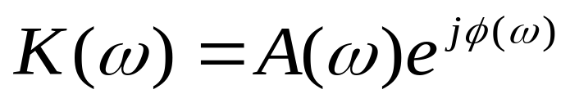
9.2.4 The Transfer Function
The function is called the Transfer Function of a linear system.
The transfer function can be written as

Slide 12
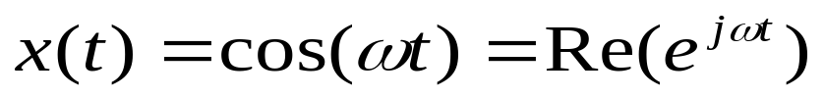
For a cosine input
The output can be calculated as

Slide 13
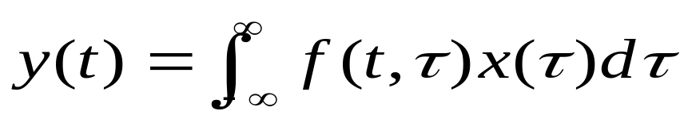
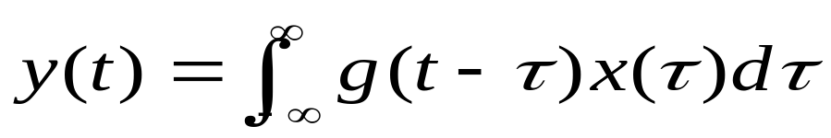
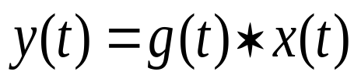
9.3 The Convolution Operation
The input-output relation of any linear system can be expressed as
For a shift-invariant linear system, it can be derived that
This is a convolution integral, and may be abbreviated by .

Slide 14
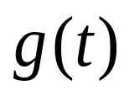
The function is called the impulse response of a shift-invariant linear system.
The output of a shift-invariant system is the convolution of the input with its impulse response
Transfer function and impulse response are two means to specify a LSI system.

Slide 15
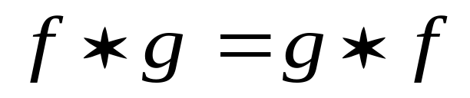
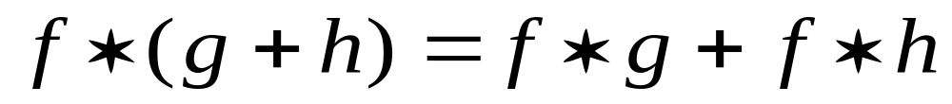
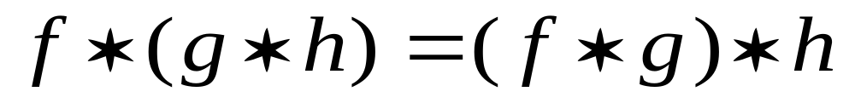
Convolution in One Dimension
Properties of convolution
  Commutative
  Distributive over addition
  Associative

Slide 16
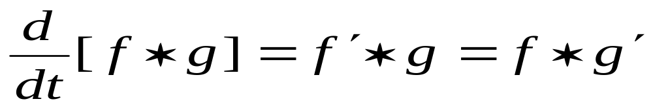
Differentiation

Slide 17
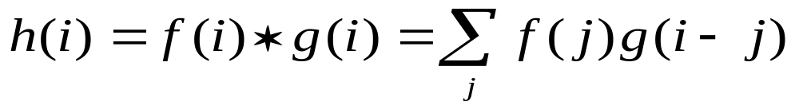
Discrete 1-D convolution
If the length of f and g is m and n respectively, then that of h is N=m+n-1

Slide 18
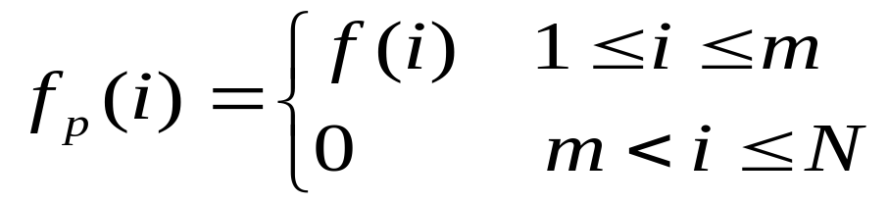
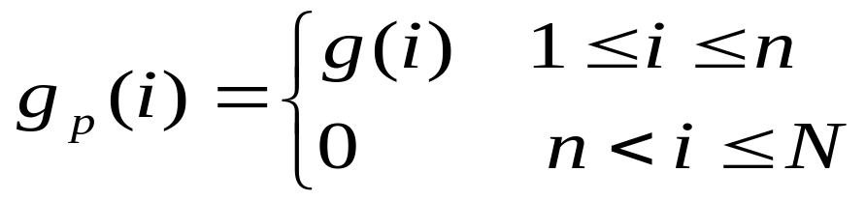
Matrix formulation of Discrete 1-D Convolution
After padding zeros to f and g to form two new sequences with length of N

Slide 19
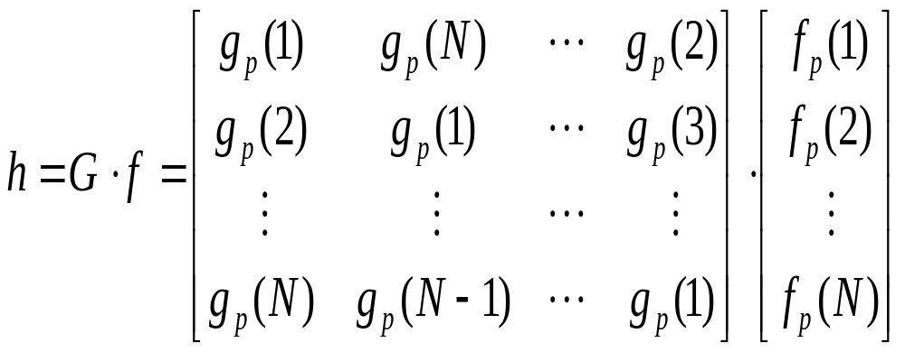
The 1-D convolution can be written as matrix form
Where G is a circulant matrix.

Slide 20
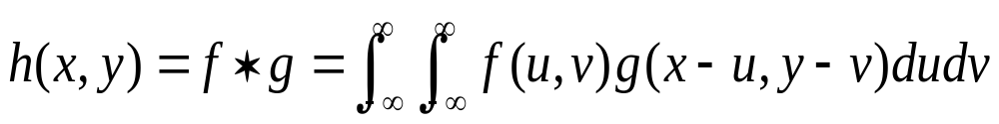
Convolution in Two Dimension
Continuous 2-D convolution
Similar properties as 1-D case can be derived
An illustration of 2-D convolution may be found at pages 153-154.

Slide 21
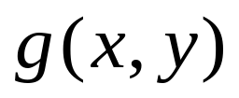
Convolution can model the effects of the sampling aperture in an image digitizer. The convolution kernel characterizes the spatial sensitive function of the sampling aperture.

Slide 22
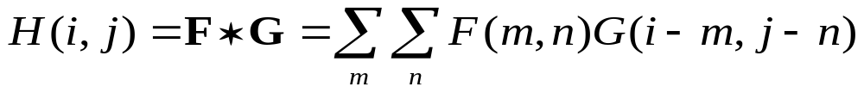
Discrete 2-D Convolution
2-D discrete convolution is defined as
Two typical method of treating edges in convolution
  Extend the input image by repeating the border rows and columns
  Fill in a constant (e.g. zeros) for output image too near the border

Slide 23

Matrix Formulation of 2-D Convolution
Two arrays F of size m₁ by n₁ and G of size m₂ by n₂ are padded with zeros to F_{p} and G_{p} of same size N by N.
Form a N²-by-1 column vector f_{p} from the matrix F_{p} by row stacking.
Form N N-by-N circulant matrices G_{i} ( ) by circular right shift from each row of G_{p}.

Slide 24
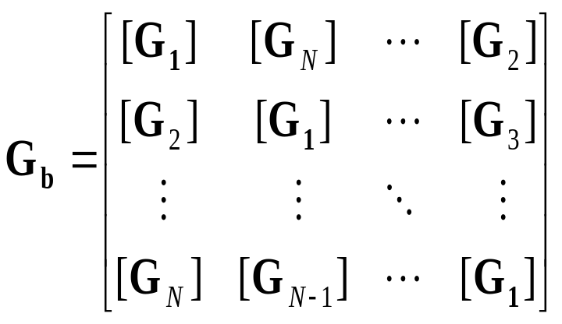
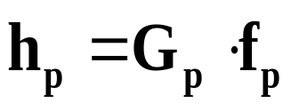
Form a N²-by-N² block circulant matrix G_{b} as
Then the output image h_{p} in padded,row-stacked,column vector form

Slide 25
Applications of Convolution
Deconvolution
  Removing the effects of unwanted but previously applied linear systems that have operated on the image.
Noise removal
  Reducing the effects of undesirable, contaminative signals that have been linearly added to the image. Typical examples are:

Slide 26
    (a) Estimating what the signal was before the noise was added.
    (b) Detecting the presence of known features embedded in a noisy background.
    (c ) Coherent (periodic) noise removal.
Feature enhancement
  Increase the contrast of specific features (edges, spots, etc. ) at the expense of other objects in the scene.

Slide 27
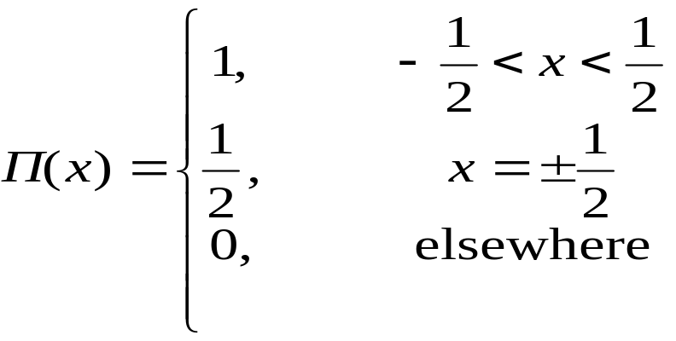

9.4 Some Useful Functions
The Rectangular Pulse
A
-a/2
a/2

Slide 28
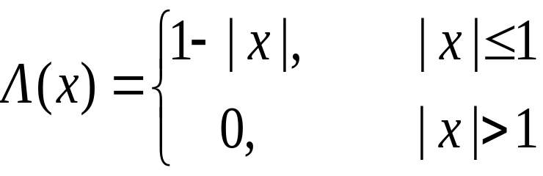

The Triangular Pulse
B
-b
b

Slide 29
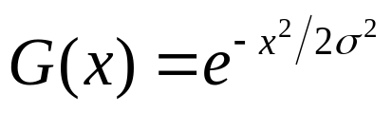
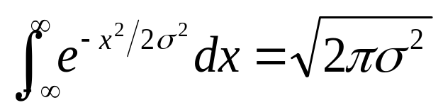
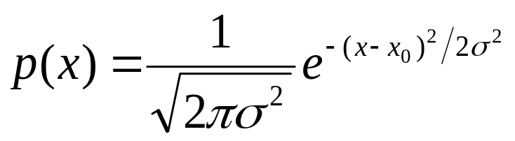


The Gaussian Function
Gaussian function is given by
The area under the Gaussian curve is
The normal distribution function is
  Where : variance, : standard deviation.

Slide 30

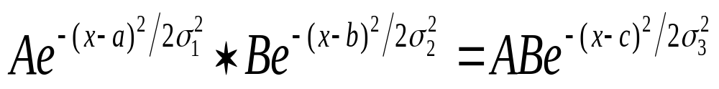

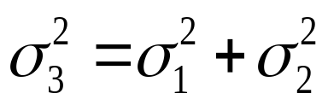
    And : mean.
Convolution of two Gaussian functions is still a Gaussian function and
  Where and

Slide 31

Values of the Gaussian function
x | G(x)
0 | 1
0.5 | 0.8825
1.0 | 0.6065
1.177 | 0.5000
1.5 | 0.3247
1.177 | 0.2500
2.0 | 0.1353
3.0 | 0.0111

Slide 32

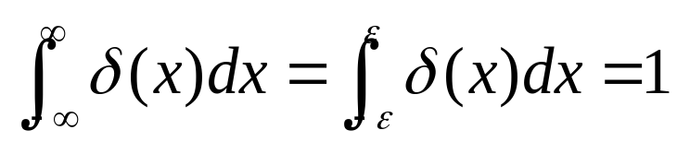



The Impulse
The impulse or Dirac delta function is defined as
  Where for and for , is undefined
The impulse can be modeled as the limit of a narrow rectangular pulse

Slide 33

The Impulse
A
1/a
-a/2
a/2
0
x₀

Slide 34
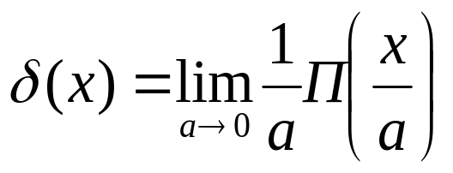
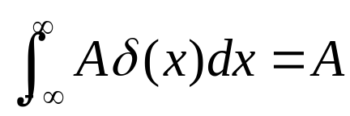
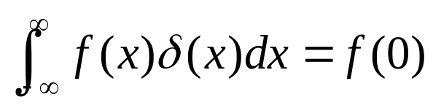
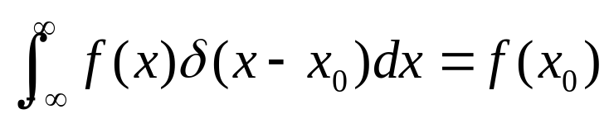
The Impulse
Properties of the Impulse
  1.
  2.
  3. Sifting property:

Slide 35
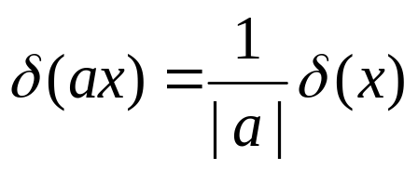
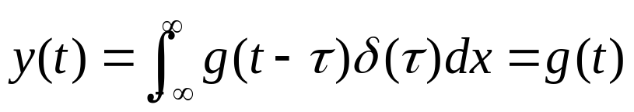
  4.Scaling property:
Impulse response of a Linear System
  Suppose a Impulse is feed to a linear system, then its output
  For this reason, is called the impulse response of a linear system.

Slide 36
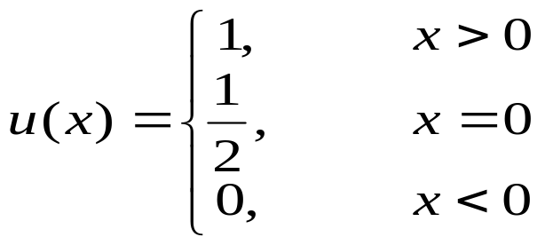

The Step Function
The step function is defined as
The shifted step function
1
0
x₀

Slide 37
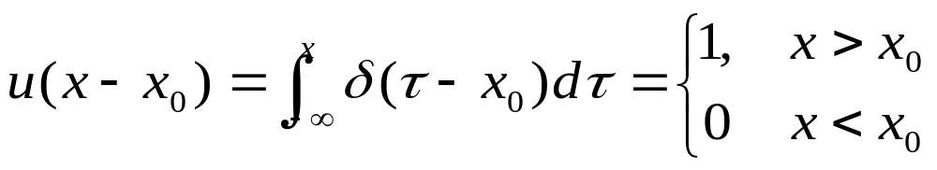
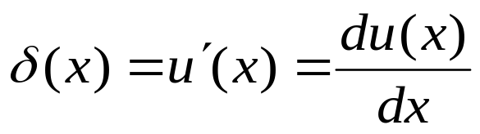
Relation between the step function and the impulse function
  1. The step function is the integral of the impulse
  2. The impulse is the derivative of the step function

Slide 38
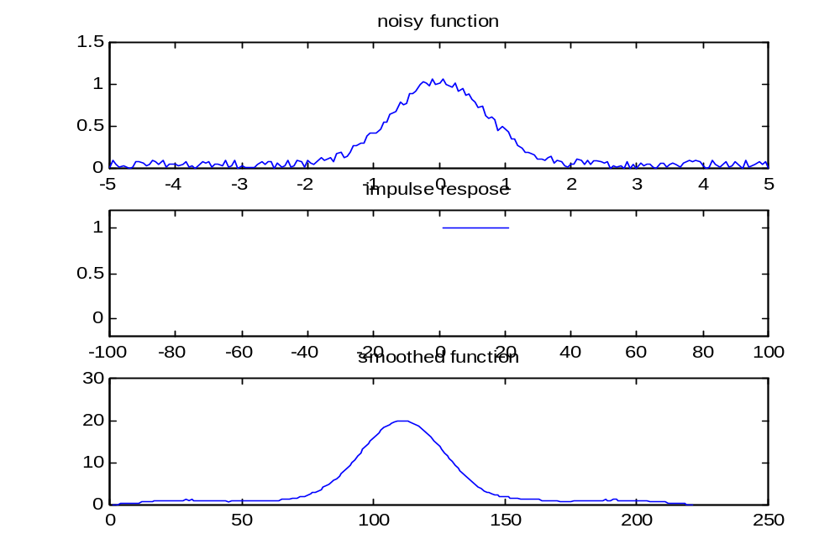
Convolution Filtering
Smoothing

Slide 39


Edge Enhancemen

Slide 40
Deconvolution

Slide 41
Summary of Important Points
When the input to a linear system is the sum of two signals, the output is the sum of the outputs produced by each of those signals acting alone
Changing the temporal (or spatial) origin of the input to a shift-invariant system merely shifts the output by the same amount.
Harmonic signals are used to represent sinusoidal signals because they simplify the analysis of linear systems.

Slide 42
4.Harmonic inputs into a shift-invariant linear system produce harmonic outputs.
5.A linear, shift-invariant system is completely specified by its transfer function.
6.The transfer function is a complex-valued function of frequency that relates the amplitude and phase of harmonic inputs and outputs.

Slide 43
7.The harmonic input multiplied by the value of the transfer function at the input frequency yields the output of a shift-invariant,linear system.
8.The convolution of two functions consists of reflecting and shifting one function and then integrating their product. The output is the value of the integral as a function of the amount of shift.

Slide 44
9. The output of a shift-invariant, linear system is given by the convolution of the input with a function called the impulse response of that system.
10.The impulse response of a particular shift-invariant,linear system is unique and completely specifies the system.
11.The convolution operation models the effect a sampling spot has on an image.

Slide 45
12.Convolution may be implemented digitally to perform linear filtering on digitized signals and images.
13. Digitally implemented linear filtering may be used for deconvolution, noise reduction, and feature enhancement.
14.Since convolution cannot proceed all the way to the border of an image, it is important to avoid having important information located there.

Slide 46
15.Convolving two Gaussian functions produces another Gaussian, broader than either of the inputs.
16.The impulse is the identity function under convolution.
17.Changes of scale in the abscissa affect the strength of the impulse.

Slide 47
18.The impulse is the derivative of the step function.
19.The impulse response of an edge enhancement filter typically has a positive peak at the origin surrounded by negative side lobes.
20.Edge enhancement filters often produce the artifact called overshoot or ringing.

Slide 48


The Fourier Transform
(Chapter 10 from Castleman’s DIP)
10.1 Introduction
  The Fourier transform is a second language of signal processing, it converts a signal from time (spatial) domain to the frequency domain.
  The Continuous Fourier Transform of a one-dimensional continuous function f(t) is defined as
  where j²=-1.
  The inverse Fourier transform

Slide 49





Fourier’s integral theorem states that
and are called a Fourier transform pair.
The Fourier transform of the Gaussian function is also a Gaussian function

Slide 50


The domain of s is called the frequency domain, while that of t is the time domain.
Writing the Fourier transform in polar form:
, Where
Is called the magnitude spectrum or spectrum of the signal f(t), and
is called the phase spectrum

Slide 51
And the power spectrum is defined as

Slide 52


Existence of the Fourier Transform
Transient functions
  If a function is either continuous or has finite discontinuities, and
  then is called a transient function.
  For a transient function, the Fourier transform always exists for values of all s.

Slide 53

The Fourier transform of Periodic and Constant Functions
For periodic and constant functions, the Fourier transform does not exist in the strict sense.
Consider the inverse transform of a pair of impulses

Slide 54




Existence of the Fourier Transform
Thus, we have
This means that the Fourier transform of a cosine of frequency is a pair of impulses located at in the frequency domain.
Similarly, it can be derived

Slide 55


Existence of the Fourier Transform
If we let , The Fourier transform of a constant function 1 is an impulse at the origin.
Since any periodic function of frequency f can be expressed as a summation of sinusoids having frequencies nf, the Fourier transform of a periodic function is a series of equally spaced impulse in the frequency domain.

Slide 56

The Fourier Transform of random functions
Random functions are nonconstant, aperiodic, infinite extent and absolute integral does not exist.
The autocorrelation function of a random function is given by

Slide 57

For a random function, the Fourier transform is defined as

Slide 58



The Fourier Series Expansion
  Suppose is a transient function that is zero outside the interval [-T/2,T/2], this also can be considered to be one cycle of a periodic function. By the preceding analysis, its Fourier transform takes values only at discrete s: , where T is the period and . By making s a discrete variable in the Fourier transform, we have

Slide 59

The inverse transform becomes
This expand a periodic function as a series of complex exponential function

Slide 60



The Fourier Series Expansion
The Fourier series expansion of a periodic function of periodic T is
where

Slide 61

An example of Fourier transform

Slide 62



The Discrete Fourier Transform
Discretizing both time and frequency, the Fourier transform becomes
Where .
The inverse transform

Slide 63




The Discrete Fourier Transform
If is a sequence of length N, then its discrete Fourier transform (DFT) is given by
And the inverse DFT is given by
Where are indices.

Slide 64
Relations between DFT and CFT
The DFT is closely related to CFT. As long as the sampling rule is satisfied, the two are essentially equivalent.
So, we can analyze a image processing problem by continuous approach, while implement the solution with the discrete approach.

Slide 65

The Fast Fourier Transform
The number of multiplication and addition required to compute DFT is on the order of N².
The fast Fourier transform (FFT) can reduce the number of operations to the order of .
FFT is implemented by rewriting DFT in matrix form as follows

Slide 66



The Fast Fourier Transform
or
where

Slide 67


The Fast Fourier Transform
When , the FFT is most efficient, and the factor of reduction in computational workload is
For N=1024, the FFT is approximately 100 times efficient as the DFT

Slide 68















Fourier Transforms of Some Useful Functions
Function f(t) | F(s)
Gaussian
Rectangular pulse
Triangular pulse
Impulse | 1
Unit step
Cosine
Sine
Complex exponential

Slide 69



Properties of the Fourier Transform
Symmetry Properties
  Any function can be written as the sum of a even function and a odd function:
  where and
  The Fourier transform can be written as

Slide 70
The symmetry Properties of the Fourier Transform
  An even component function produces an even component function in the transform.
  An odd component function produces an odd component function in the transform.
  An odd component function introduces the coefficient –j.
  An even component does not introduce a coefficient.

Slide 71
Properties of the Fourier Transform
Real and Imaginary Components
  The real even part produces a real even part.
  The real odd part produces an imaginary odd part
  The imaginary even part produces an imaginary even part
  The imaginary odd part produces a real odd part

Slide 72



Properties of the Fourier Transform
If is a real function, its Fourier transform is a Hermite function ( or conjugate symmetry), I.e.,
where * denotes the complex conjugate.
For general cases, .
See Table 10-2 for more details

Slide 73




Properties of the Fourier Transform
The Addition Theorem
  If and , then
  And take it as an axiom that for any real number c
  This implies that Fourier transform is a linear transform.

Slide 74

The Addition Theorem
Addition

Slide 75

The Shift Theorem
Time shift: shifting a function does not change the amplitude of its Fourier transform, but introduce a phase shift proportional to both frequency and the amount of shift.

Slide 76



Frequency shift of DFT
  When ,
  This shift the spectrum to the center N/2.

Slide 77


The Convolution Theorem
The Fourier transform of the convolution of two functions is the product of the Fourier transforms of these two functions
and

Slide 78

The convolution theorem shows that we can convert the convolution operation in time domain to multiplication operation in transform domain.
The convolution theorem can be used to derive the Fourier transform of the impulse

Slide 79

The Similarity Theorem
If a is greater than unity, it contracts the function horizontally, which reduces the amplitude of the Fourier transform and expends it horizontally by the factor a. If a is less than unity, it has the opposite effect.

Slide 80

An illustration of The Similarity Theorem

Slide 81




The Fourier transform of a general Gaussian
The Fourier transform of a unity-amplitude Gaussian with arbitrary standard deviation is another Gaussian with amplitude and standard deviation .
The similarity theorem can also be used to explain why

Slide 82


Rayleigh’s Theorem (Parseval’s Theorem)
For a finite support function (this means that is nonzero only over a finite portion of their domain), the energy is defined as
Rayleigh’s Theorem states that the Fourier transform has the same energy as the original function:

Slide 83







Linear Systems and the Fourier Transform
10.3.1 Linear System Terminology
    : Input signal; : Spectrum of input signal
    : Impulse response; : Transfer function
    : Output signal; : Spectrum of output signal
f(t)
F(s)
h(t)
H(s)

Slide 84


Linear System Identification
System Identification: determining the impulse response and transfer function of a system.
Can be computed by inputting a known
and measure .

Slide 85

An Example of System Identification

Slide 86

Sinusoidal Decomposition
Suppose the input and the impulse of a linear system are both real and even, the spectrum (Fourier transform) of them is also real and even. Approximate the spectrum of the input by dividing into narrow stripes (rectangular pulse pairs)

Slide 87




Sinusoidal Decomposition

Slide 88


Sinusoidal Decomposition
As , the rectangular pulse pairs approaches a impulse pair, and the inverse Fourier transform approaches
Since approaches a sum of even pulse pairs, approaches a sum of cosines of the above form. This means any real even function can be decomposed into a sum of infinitely many cosines of infinitesimal amplitude.

Slide 89



Sinusoidal Decomposition
Since the output spectrum is the product of the input spectrum and the transfer function, the output function can be expressed as a sum of cosines of the form
The action of a linear system: the input is first decomposed into a sum of cosines of all different frequencies, each cosine is multiplied by . Finally, all the cosines are summed up to form the output signal .

Slide 90
Sinusoidal Decomposition
Two properties of linear systems: 1). A sinusoidal input always produces a sinusoidal output at the same frequency; 2). The transfer function at frequency s is the factor by which the amplitude of an input sinusoidal of frequency s is multiplied.
If is real and odd, is imaginary and odd, would decompose into sine functions, and the output is a sum of sines.

Slide 91




10.4 The Fourier Transform in Two Dimensions
Definition
  2-D Fourier transform
  2-D inverse Fourier transform
  where is an image and is its spectrum. The variables u and v corresponds to frequencies along the x-axis and y-axis, respectively.

Slide 92

The domain of u, v is called the frequency domain, while that of x,y is the spatial domain. And
Is called the magnitude spectrum or spectrum of the signal f(x,y), and
is called the phase spectrum

Slide 93
And the power spectrum is defined by

Slide 94





The Two-Dimensional DFT
For a image, the 2-D DFT is defined by
For a image
or

Slide 95

For a image, the dc component of g(x,y) is

Slide 96



For a image, the inverse 2-D DFT
For a image, the inverse 2-D DFT
or

Slide 97


Separability
or

Slide 98

An example of 2-D DFT

Slide 99





Matrix Formulation of 2-D DFT
The 2-D Fourier transform can be written as
  Where , and
  are matrices.
  And F is a unitary matrix, that is

Slide 100
















Properties of 2-D Fourier Transform
Property | Spatial domain Frequency domain
Addition theorem
Similarity theorem
Shift theorem
Convolution theorem
Separable product
Differentiation
Rotation
Laplacian
Rayleigh’s theorem | =

Slide 101


Properties of 2-D Fourier Transform
Conjugate symmetry
Frequency shift
When
This shifts the center of the spectrum to (M/2,N/2).

Slide 102

An example

Slide 103



Another example

Slide 104


Properties of 2-D FT
Separability
  If a two-dimensional image factors into one-dimensional components, its spectrum does as well.
  A useful example of separable image is the elliptical two-dimensional Gaussian
  When the two deviations are equal, the function is extremely useful because it is circular symmetrical and separable.

Slide 105




Similarity
The similarity can be generalized to two-dimensional transforms as
Where

Slide 106
Properties of 2-D FT
Rotation
  Rotation is a special case of similarity by setting
  so that

Slide 107



Properties of 2-D FT
Projection
  A two-dimensional function is projected onto the x-axis to form a one-dimensional function
  The Fourier transform of is

Slide 108

Properties of 2-D FT
The one dimensional Fourier transform of a two-dimensional function projected onto a line at an angle with the x-axis is just evaluated along a line at an angle with the u-axis.

Slide 109


2-D FT of Circular Symmetry Functions
Circular symmetry
  A two-dimensional function is called circular symmetry if it can be expressed as a profile function of a single radial variable
  where

Slide 110

Circular Symmetry
If a function is circular symmetrical, its Fourier transform is a function only of a single radial variable q

Slide 111




Circular Symmetry
  Where
  And is the zero-order Bessel function of the first kind defined as

Slide 112

Bessel function of the first kind

Slide 113


The Hankel Transform (Fourier-Bessel Transform)
Direct Hankel Transform of Zero Order
The reverse Hankel Transform

Slide 114





















Hankel Transforms of Some Functions
Function
Reciprocal
Gaussian
Impulse | 1
Rectangular pulse
Triangular pulse
Shifted impulse
Exponential delay

Slide 115












Properties of Hankel Transform
Property | Spatial domain Frequency domain
Addition theorem
Similarity theorem
Convolution theorem
Laplacian
Rayleigh’s theorem
Power theorem

Slide 116



Computing the Hankel Transform
Based on the projection theorem
and so

Slide 117
Interpretation
The amplitude spectrum of an image specifies how much of each sinusoidal components is present, while the phase information specifies where each of the sinusoidal components resides with the image. As long as the components are kept in position, their amplitude appears to be less critical to the integrity of the image

Slide 118

An example

Slide 119



10.5 Correlation and the Power Spectrum
Autocorrelation
  For real functions
  For complex functions
The autocorrelation function is always even and has a maximum at .

Slide 120

The Power Spectrum: The Fourier transform of the autocorrelation function

Slide 121


Cross-correlation: indicating the relative degree to which two functions agree for various amounts of misalignment.
  For real functions
  For complex functions

Slide 122

Cross power spectrum: the Fourier transform of the cross-correlation function.

Slide 123
10.6 Summary of Important Points
  The Fourier transform is a linear integral transformation that establish a unique correspondence between a complex-valued function and a complex-valued function of frequency.
  The Fourier transform of a Gaussian function is another Gaussian.
  Evenness and oddness are preserved by the Fourier transform
  The Fourier transform of a real function is a Hermite function.

Slide 124
10.6 Summary of Important Points
  The Fourier transform of a sum of functions is the sum of their individual transform.
  Shifting the origin of a function introduces into its spectrum of a phase shift that is linear with frequency and that alters the distribution of energy between the real and imaginary parts of the spectrum without changing the total energy.
  Convolution of two functions corresponds to multiplication of their Fourier transforms.

Slide 125
10.6 Summary of Important Points
  Narrowing a function broadens its Fourier transform and vice versa.
  The energy of a function (signal) is the same as that of its Fourier transform.
  The transfer function of a linear system can be determined as the ratio of its (measured) output spectrum to its (known) input spectrum.
  The Fourier transform of a sinusoidal function is an equally spaced impulse pair.

Slide 126
10.6 Summary of Important Points
  An input signal can be decomposed into an infinite sum of infinitesimal sinusoids.
  A linear system can be thought of as operating separately on the sinusoidal components of the input signal, which are summed at the output to form the output signal.
  The Fourier transform generalizes readily to functions of two or more dimensions.

Slide 127
10.6 Summary of Important Points
  If a function of two variables can be separated into a product of two functions of a single variable, then so can its Fourier transform.
  Rotating a function of two dimensions rotates its Fourier transform by the same amount.
  Projecting a two-dimensional function onto a line at an angle to the x-axis and transforming the resulting one-dimensional function yields a profile of the two-dimensional spectrum taken along a line at an angle to the u-axis.

Slide 128
10.6 Summary of Important Points
  Circularly symmetric two-dimensional functions have circularly symmetric spectra.
  The Hankel transform relates the profile function of a circular symmetric function to that of its spectrum.
  Autocorrelation is self-convolution without reflection of either function.
  Cross-correlation is like convolution, except that neither function is reflected.
  The Fourier transform of the autocorrelation function is the power spectrum.

