Slide 1

Fruit and vegetable
recognition
presented By:
HARSHIT AGARWAL(1018493)

Slide 2
INTRODUCTION
About Project:
The motive of the project is to recognize different Fruits And Vegetables. In this model, classification machine learning algorithms are trained using a set of image data for different hand Fruits and Vegetables.
The recognition and classification of fruits play a pivotal role in various fields, including agriculture, food industry automation, and dietary analysis. This project presents a comprehensive approach to fruit recognition utilizing state-of-the-art deep learning techniques. The primary goal of this research is to develop an accurate and efficient system capable of identifying and categorizing a wide range of fruits from images, contributing to improved fruit sorting, quality control, and dietary assessment.
This project contributes to the field of fruit recognition by presenting a deep learning-based approach that has the potential to revolutionize fruit processing and dietary analysis. The developed model showcases promising results and opens up avenues for future research, such as extending the system to recognize fruit ripeness or implementing it in mobile applications for on-the-go fruit identification.

Slide 3
Languages or Frameworks Used
Language:
Python
Libraries:
NumPy
Pandas
Tensorflow
Keras
Dataset :
The dataset contains around 100 images of the following 36 different fruits and vegetables.
fruits- banana, apple, pear, grapes, orange, kiwi, watermelon, pomegranate, pineapple, mango.
vegetables- cucumber, carrot, capsicum, onion, potato, lemon, tomato, raddish, beetroot, cabbage, lettuce, spinach, soy bean, cauliflower, bell pepper, chilli pepper, turnip, corn, sweetcorn, sweet potato, paprika, jalepeño, ginger, garlic, peas, eggplant.
Dataset Link: https://www.kaggle.com/datasets/kritikseth/fruit-and-vegetable-image-recognition

Slide 4
Modules in the Project
All the work that we need to do can be split in 6 steps:
Gathering Data for Training
Preprocessing of Data
Building And Compiling the Model
Training And Validation of Model
Testing of the Model
Predicting images of different fruits and vegetables
Algorithms used:
Convolutional Neural Networks (CNN)

Slide 5
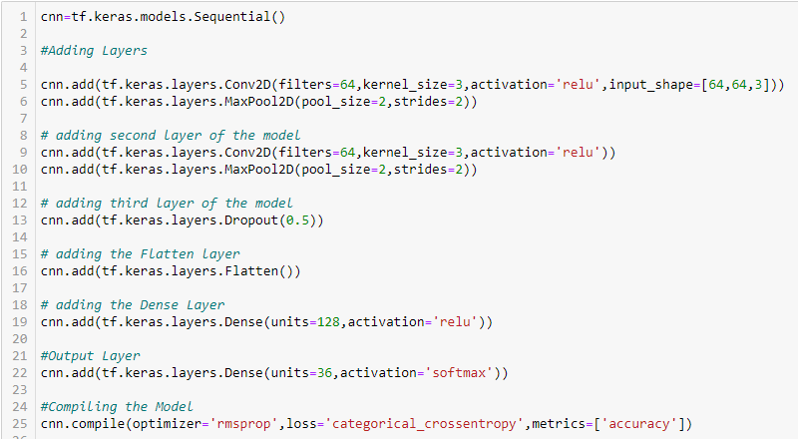
Model architecture

Slide 6
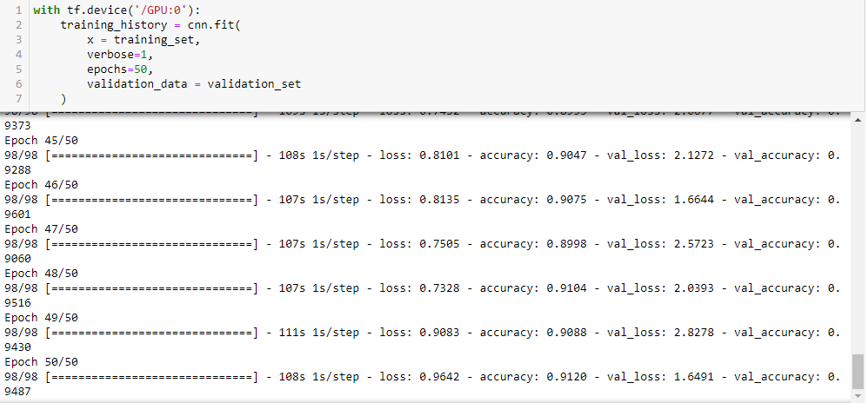
training And Validation

Slide 7
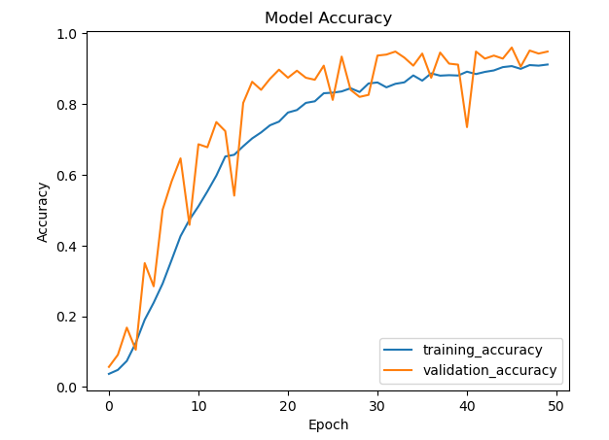
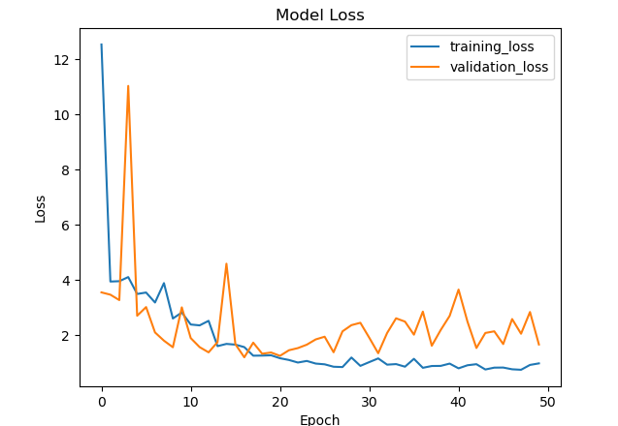
Accuracy and loss visualization

Slide 8
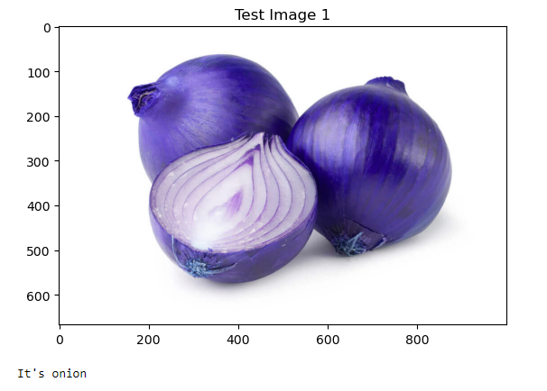
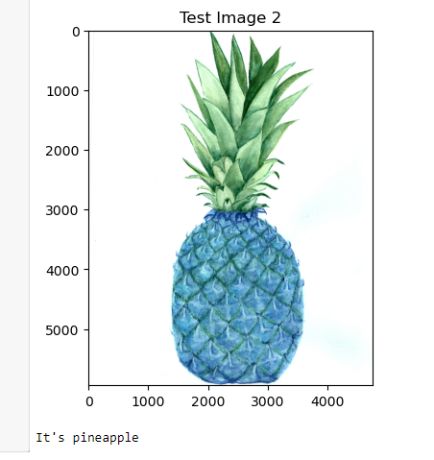
result

Slide 9
Applications of Fruit and vegetable recognition
Fruit and vegetable recognition technology has a wide range of applications across various industries and domains due to its ability to automate the identification and monitoring of produce. Here are some key applications:
Agriculture and Farming:
Crop Monitoring: Farmers can use fruit and vegetable recognition to monitor the health and growth of crops. It helps in identifying diseases, pests, and nutrient deficiencies early on, enabling timely interventions.
Yield Prediction: Predicting the yield of a crop is essential for planning harvesting and distribution. Recognition technology can estimate the quantity of produce accurately.
Food Processing and Quality Control:
Sorting and Grading: Automated recognition systems can sort and grade fruits and vegetables based on their size, shape, color, and quality. This is vital in food processing and packaging industries.
Quality Assurance: Inspection systems can identify and remove defective or contaminated produce from the production line, ensuring the quality of packaged goods.
Waste Reduction:
Reducing Food Waste: By accurately identifying the ripeness of produce, it helps reduce food waste at various stages of the supply chain.
Education and Research:
Botanical Studies: Fruit and vegetable recognition can be used in botanical research and educational programs to identify plant species and variations.

Slide 10
