Slide 1

HAND gesture recognition
IN
REAL TIME
presented By:
HARSHIT AGARWAL(1018493)

Slide 2
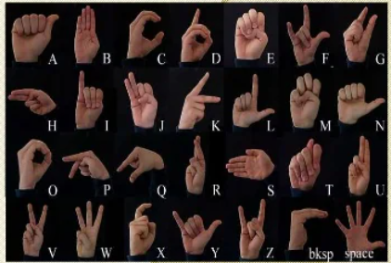
INTRODUCTION
About Project:
Objective: The motive of the project is to recogonise hand sign language in real time and convert the recognised hand sign to speech. In this model, classification machine learning algorithms are trained using a set of image data(ASL).
Sign Language:
Sign language is a visual way of communicating through hand signals, gestures, facial expressions, and body language.
Sign language is the primary form of communication for the deaf and hard of hearing community, but sign language can be useful for other groups of people as well. People with disabilities, including autism, apraxia of speech, cerebral palsy, and Down syndrome, may also find sign language beneficial for communication.

Slide 3
Languages or Frameworks Used
Language:
Python
Libraries:
NumPy
Pandas
Tensorflow
Keras
OpenCV
Dataset :
ASL Alphabet :- Image data set for alphabets in the American Sign Language
Self made dataset

Slide 4
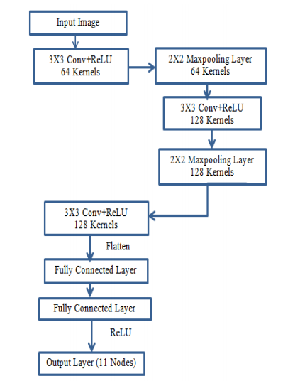
Modules in the Project
All the work that we need to do can be split in 5 steps:
Preparing the Data
Building the Model
Test of the ML Model
Predict recognized hand signs in real time
Convert recognized signs language to text
Algorithms used:
Convolutional Neural Networks (CNN)

Slide 5
Applications of Hand Sign Classification
Sign Language Recognition:
Just as speech recognition can transcribe speech to text, certain type of gesture recognition software can transcribe the symbols represented through sign language into text.
Virtual Controllers:
For system where act of finding or acquiring a physical controller could require too much time , guesture can be used a an alternative control mechanism . Controlling cars is a good example of such usage.
Remote Control:
Through the use of guesture recognition , remote control with the wave of a hand of various devices is possible.
Socially assistive robotics:
By using proper tools roboots can be made for assistance for people with verbal disability. That can convert sign language to text and speech.

Slide 6


