Slide 1
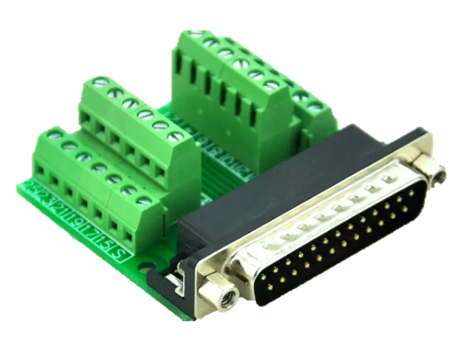
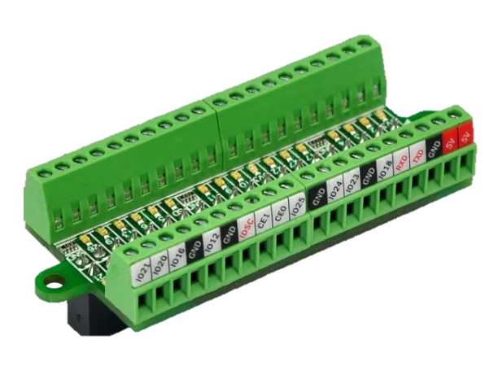
Db25 breakout to TDT
Raspberry Pi GPIO pinout
Port 1/2
Db25 Pin Jumper colour
1 White Right 27
14 Gray Left 17
2 Black Pellet 22
15 Green Right 9
3 Yellow Left 10
16 Blue Pellet 11
5 Purple Ground
Port 3/4
Db25 Pin Jumper colour
1 White Right 5
14 Gray Left 0
2 Black Pellet 6
15 Red Right 19
3 Brown Left 13
16 Orange Pellet 26
5 Purple Ground
gpio_pins_per_device = {
'Port 1': {"LeftPoke": 17, "RightPoke": 27, "Pellet": 22},
'Port 2': {"LeftPoke": 10, "RightPoke": 9, "Pellet": 11},
'Port 3': {"LeftPoke": 0, "RightPoke": 5, "Pellet": 6},
'Port 4': {"LeftPoke": 13, "RightPoke": 19, "Pellet": 26},
'Port 5': {"LeftPoke": 14, "RightPoke": 15, "Pellet": 18},
'Port 6': {"LeftPoke": 23, "RightPoke": 24, "Pellet": 25},
'Port 7': {"LeftPoke": 8, "RightPoke": 7, "Pellet": 1},
'Port 8': {"LeftPoke": 12, "RightPoke": 16, "Pellet": 20},
}

Slide 2
Db25 breakout to TDT
Raspberry Pi GPIO pinout
Port 1/2
Db25 Pin Pi pin
1 Right 27
14 Left 17
2 Pellet 22
15 Right 9
3 Left 10
16 Pellet 11
5 Ground
Port 3/4
Db25 Pin Pi pin
1 Right 5
14 Left 0
2 Pellet 6
15 Right 19
3 Left 13
16 Pellet 26
5 Ground
gpio_pins_per_device = {
'Port 1': {"LeftPoke": 17, "RightPoke": 27, "Pellet": 22},
'Port 2': {"LeftPoke": 10, "RightPoke": 9, "Pellet": 11},
'Port 3': {"LeftPoke": 0, "RightPoke": 5, "Pellet": 6},
'Port 4': {"LeftPoke": 13, "RightPoke": 19, "Pellet": 26},
'Port 5': {"LeftPoke": 14, "RightPoke": 15, "Pellet": 18},
'Port 6': {"LeftPoke": 23, "RightPoke": 24, "Pellet": 25},
'Port 7': {"LeftPoke": 8, "RightPoke": 7, "Pellet": 1},
'Port 8': {"LeftPoke": 12, "RightPoke": 16, "Pellet": 20},
}

