Slide 1
General Ward Only
Sample UI Design

Slide 2
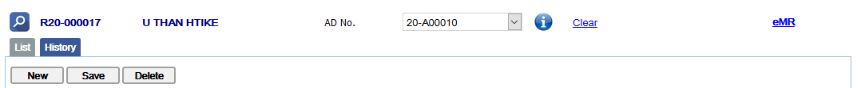

General Ward
BREATHING
Initial Date
Day Nurse
Night Nurse
Outcome Met
O2 Therapy- Nasal/ Facemask/ Trachy Mask/ Ventilator
Perform O2 Administrtion Care
Monitor O2 Saturation Level
Oral/ Laryngeal Suctioning
CIRCULATION
Circulation
Monitor Blood Pressure
Perform Neurovascular Assessment
Assess for Bleeding
Assess for Redness/ Swelling of Limbs
Observe Diabeties Right foot (last digit)

Slide 3
COMMUNICATION
Initial Date
Day Nurse
Night Nurse
Outcome Met
Communication
Monitor Conscious Level/ Mental Status
Provide Atternative Means of Communication
Update Patient/ Family on Progress
COMFORT
Confort
Pharmacological Pain Relief Provided
Non-Pharmacological Pain Relief Provided

Slide 4
General Ward
TEMPERATURE
Initial Date
Day Nurse
Night Nurse
Outcome Met
Temperature
Assess Effect of Anti-Pyretics Served
Warmer/ Cooling Mat
NUTRITION
Nutrition
Maintain NBM / IV Fluid / Tube Feeding
Check Exposed Length and Correct Tube Placement
Feeds - Sips of Water / Clear Feeds / Full Feeds
Diet Texture - Nectar / Honey / Pudding
Diet Texture - Soft / Full / Finely Minced
Assess Feeding Tolerance - Full/ Half / Quarter / Poor

Slide 5
General Ward
ELIMINATION
Initial Date
Day Nurse
Night Nurse
Outcome Met
Eliminating
Monitor Micturition -Self/ Catheter/ Lleal-Conduit
Monitor Bowel Movement
Perform Meatal / Diaper/ Stoma Care
Perform Catheter Care
RESTING AND SLEEPING
Resting & Sleeping
Asses | Ability to Sleep - Well/ Fair/ Poor/ Sedated

Slide 6
RISK FOR FALL/ INJURY
Initial Date
Day Nurse
Night Nurse
Outcome Met
Risk for Fall/ Injury
Assist in Patient's Elimination Needs
Encourange One Family / Caregiver to Stay
Explain Crib, Observe Compliance
Initiate Restraint : Bed Rails / Limb/ Body Vest
Review Restaint Used
Fail Precaution Measures
MOBILISING
Mobilising
Mobilise Patient - Sit up in Bed/ Chair/ Walking
Use
Perform
Assess

Slide 7
General Ward
PERSONAL HYGIENE AND SKIN CARE
Initial Date
Day Nurse
Night Nurse
Outcome Met
Personal Mygiene & Skin Care
Shower/ Bed Bath: Self / Assist / Total Depence
Hand Hygiene: Self / Assist / Total Dependence
Oral Care : Self / Assist / Total Dependence
Eye / Ear care
Body Care
WOUND CARE
Wound Care
Check Wound Dressing - Dry / Stained / Soaked
Wound - Clean / Sloughy / Infected / Necrotic
Dressing Performed & Documented

Slide 8
General Ward
Additional Care Activities
Initial Date
Day Nurse
Night Nurse
Outcome Met
Additional Care Activities
Care of IV Insertion Sites
No BP / Blood Taking / Venepuncture (AVF / Dripline)
Rt Arm / Lt Arm
Rt Leg / Lt Leg
Discharge Activities
Removal of IV Cannula
Removal of Wrist Tag
Medical Feedback form (Patient Satisfaction Survey)
Discharge Teaching/Instruction(HE)

Slide 9
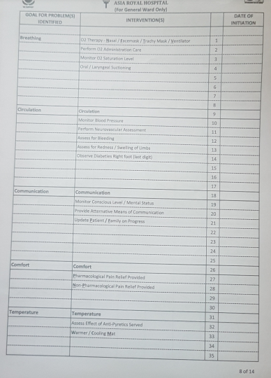
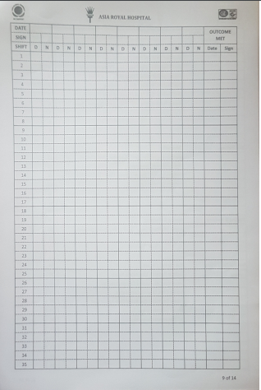
General ward List Report

Slide 10
Q & A
Nurse (day, night, outcome met) will login and data select after checking patient
Nasal / mask combo can choose one item

