Slide 1




Building a Winning Rugby Team based on the Wellness and Performance Indicators
Team Blue Jay | Westminster College
Htet Phyo Wai
Shraddha Amatya
KyungEun Kim

Slide 2
Overview
Analyzing the Individual Performance based on the GPS data
Assessing their Behavioral Answers on the Athletes’ Wellbeing

Slide 3
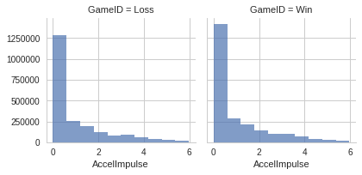
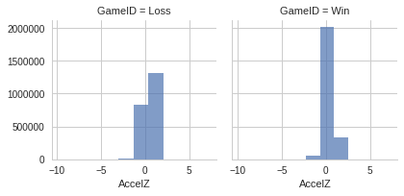
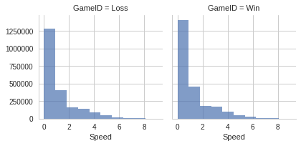
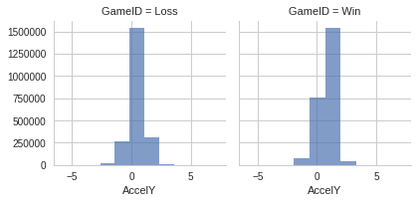
Which features determines a winning team?

Slide 4
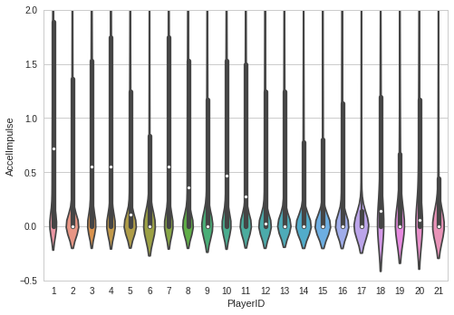
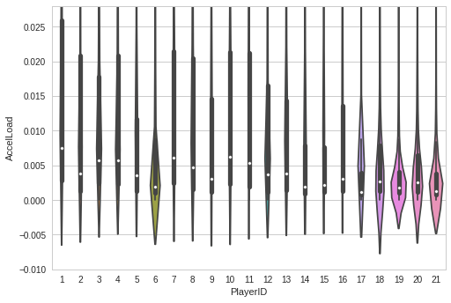
Assessing the Individual Performances
Graph - A
Graph - B
Interpretation: We compare the middle Whit Circle in each shape that indicates the mean of performance
:The Width of the Shape represent their Distributions
Graph _A: AccellImpulse ( Absolute Value of Change in Speed)
Garph_B: AccelLoad (Load detected by accelarmetor -Tackling Power*)

Slide 5
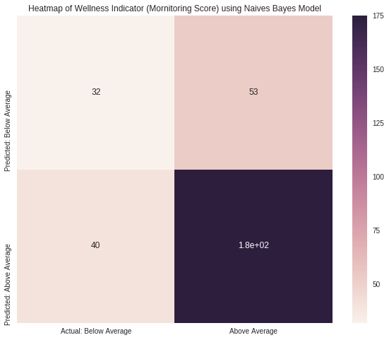
Wellness Indicators
Target: Monitoring Score (Perceptions on Sleep,Soreness, Fatigue, Desire, Irritability,)
Features: 'Pain', 'Illness', 'Menstruation', 'Nutrition','Nutrition Adjustment' (from RPE and Wellness data)
> 20 (the average of 5 indicators)
Above average: The Player is Ready!!
Use Naive Bayes Classifier
Below| Above Average
Num case 85 215
Precision 0.44 0.77
Recall 0.38 0.81
F1 0.41 0.79

Slide 6
Conclusion
Extra training for their defense team (to improve AccelZ and AccelY scores)
Keep their positivity on their wellness assessment but acknowledge other important variables such as Skills in determining the success of their team
Provide Individualized Trainings based on their Speed and Tackling skills based on the Violin Plots

